Slide 1
Enhanced EDCA for improved Collision Avoidance and Latency Improvement
Date: 1/9/2025
Authors:

Slide 2
Improved collision avoidance
In [1], a channel access mechanism with enhanced collision avoidance was proposed
  Compatible with CSMA and EDCA
  Includes an additional collision avoidance phase that reduces the number of collisions, to the point where collisions can be almost completely avoided
  Performance verified through network simulation
In [2], the same mechanism was used to achieve latency improvement for selected traffic, even in a highly congested environment

Slide 3
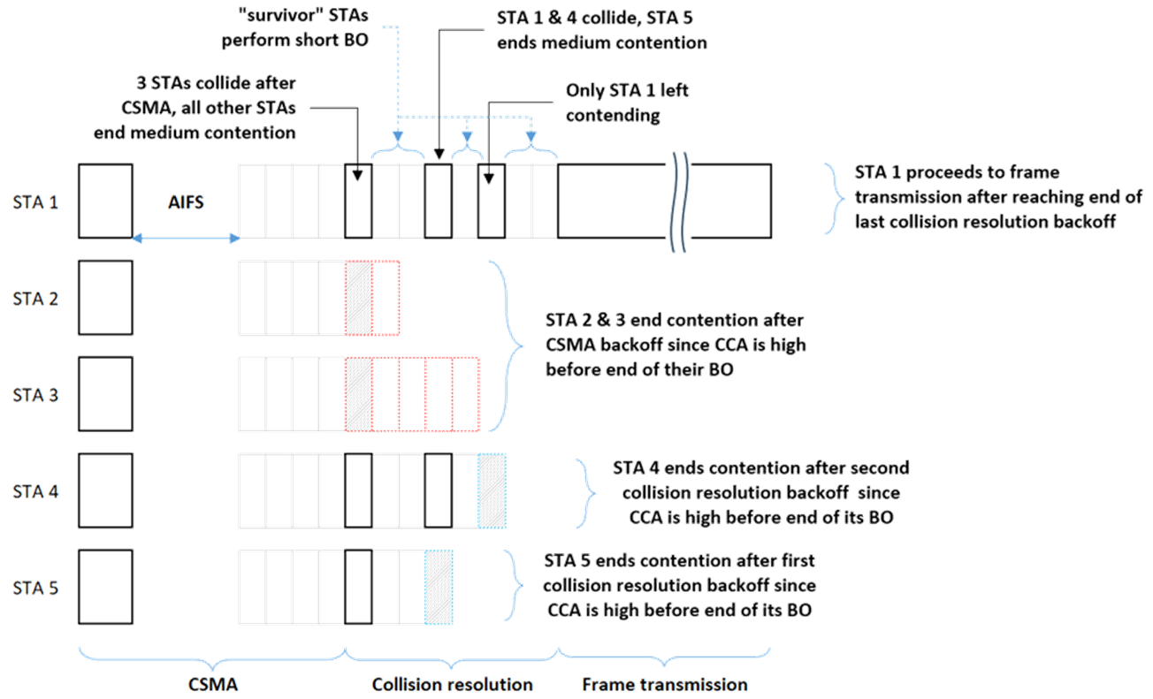
CSMA with enhanced Collision Avoidance - recap

Slide 4
Essentials of the new method
Iterative channel contention over multiple short contention periods
  Each short “round” eliminating STAs from contention
During the initial rounds of contention, a short “reservation signal” is sent
  In [1], [2] an 8 usec L-STF is assumed
Only during the last round of contention, the actual PPDU is started
STAs are not required to detect collision

Slide 5
Role of the reservation signal
It is assumed that a short transmission is sufficient for STAs to do PD and recognize the medium as busy
  Resulting in STAs ending their contention and leaving fewer STAs to contend in the next round
  802.11 CCA requires STAs to detect the presence of a preamble within aCCATime
The initial rounds of contention add overhead to the Channel Access
  Keeping the reservation signal as short as possible is important

Slide 6
Notes on reservation signal
While the CCA requirements appear clear, the kind of signal used as the reservation signal is not a regular 802.11 signal
  Response of real-world receivers is untested and may not be according to standard expectation
Making the reservation signal longer will increase overhead of Channel Access
SP requesting definition of a short common signal was not successful [3, 4]

Slide 7
New Reservation signal
Can the short reservation signal assumed in previous submissions [1, 2] be replaced with a different signal while maintaining the essential advantages?
For instance: CTS
  Shortest possible “regular” 802.11 transmission (min duration 24 usec)
  No justification for ignoring CCA based on this signal
We’ll evaluate the impact of using CTS as the reservation signal
  Note: content/payload of CTS is not used
    Doing so may allow for further enhancements

Slide 8
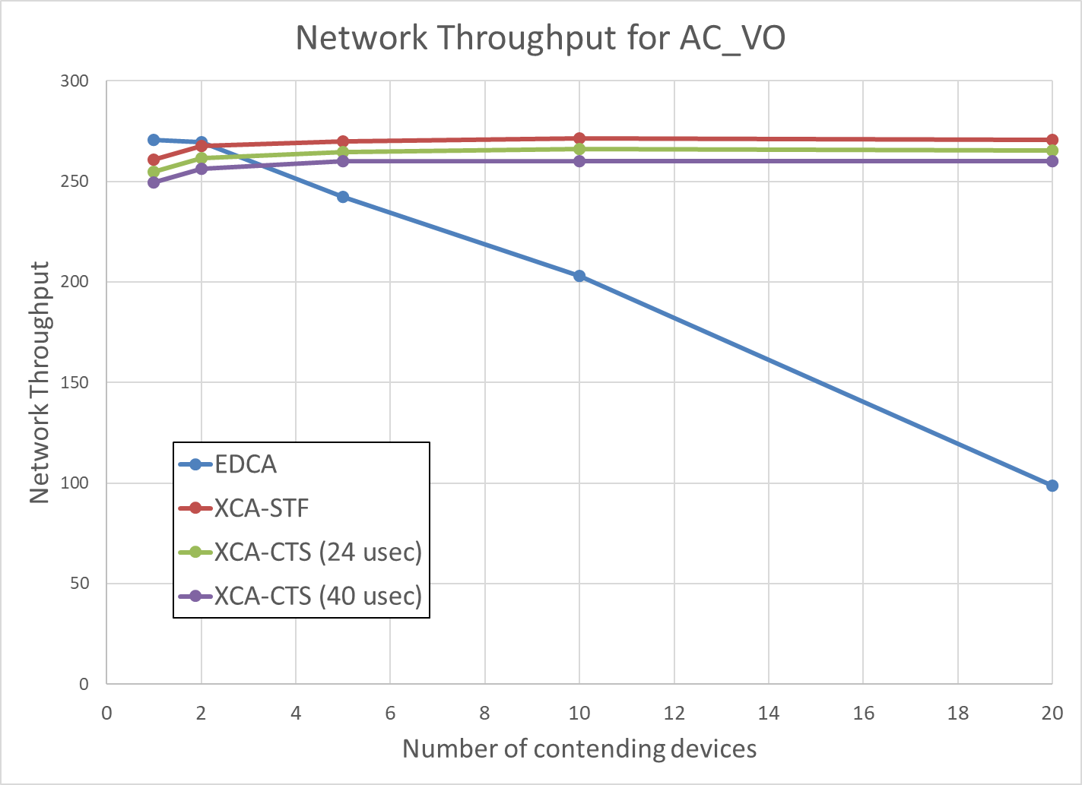
1. Collision avoidance

Slide 9
1. Collision avoidance
Evaluated network throughput as function of number of contending devices (transmitting AC_VO)
Using CTS as the reservation signal incurs minor extra overhead, but performs similarly to the original method in avoiding collisions almost entirely (See [1])
“Regular” EDCA has high residual collision rate in highly congested networks
Duration of CTS (min 24 usec, max 40 usec) has minor impact on network throughput

Slide 10
2. Latency Reduction
[2] showed how a combination of new, more “aggressive” AC and collision avoidance resulted in a AC with very favorable latency characteristics
Reservation signal can be replaced by CTS without significantly affecting these results
Enhanced EDCA significantly outperforms EDCA
Evaluated for various values of N_LL (# of LL devices needing the new latency values)

Slide 11
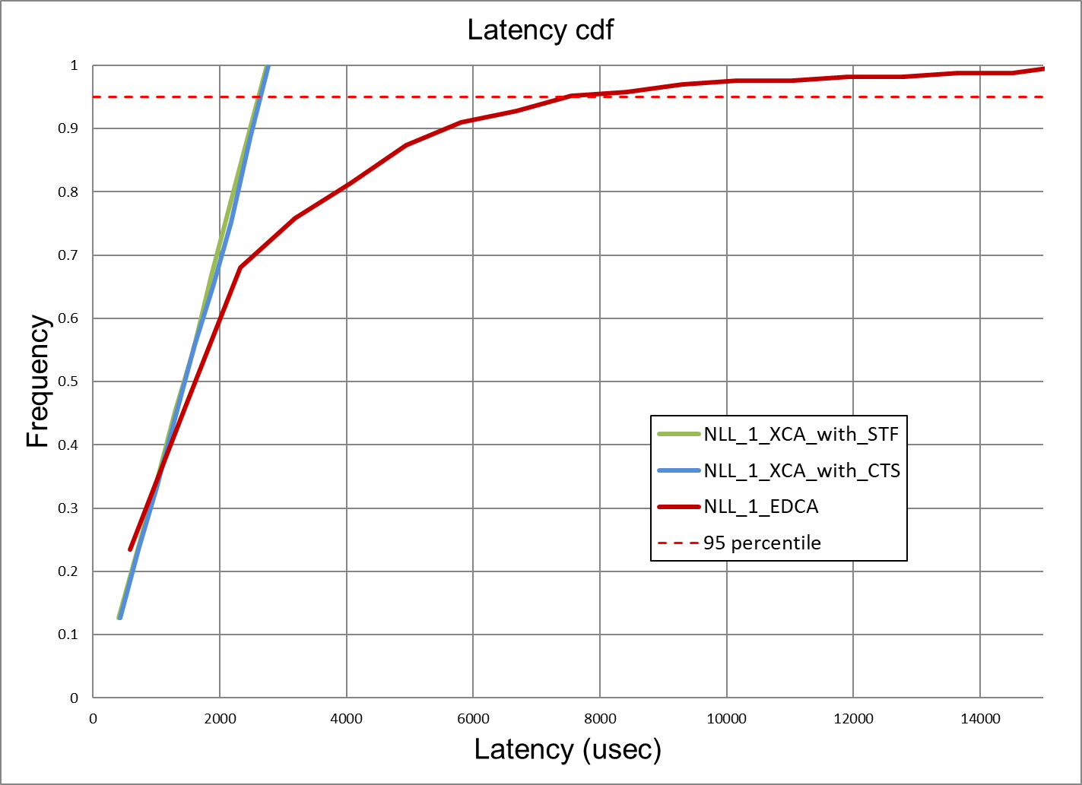
Results for N_LL=1

Slide 12
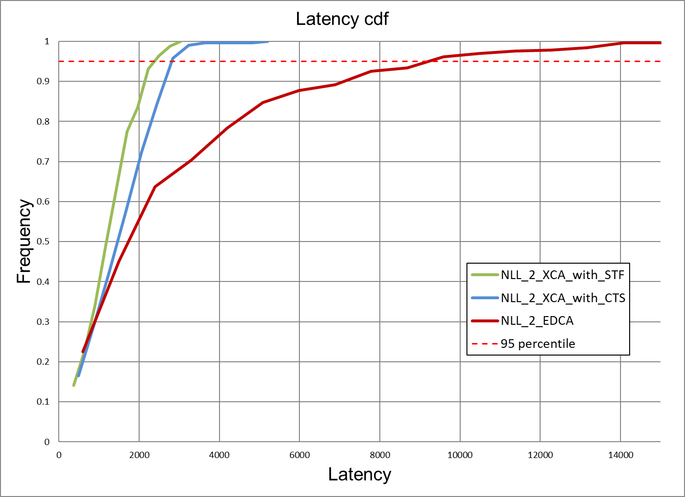
Results for N_LL=2

Slide 13
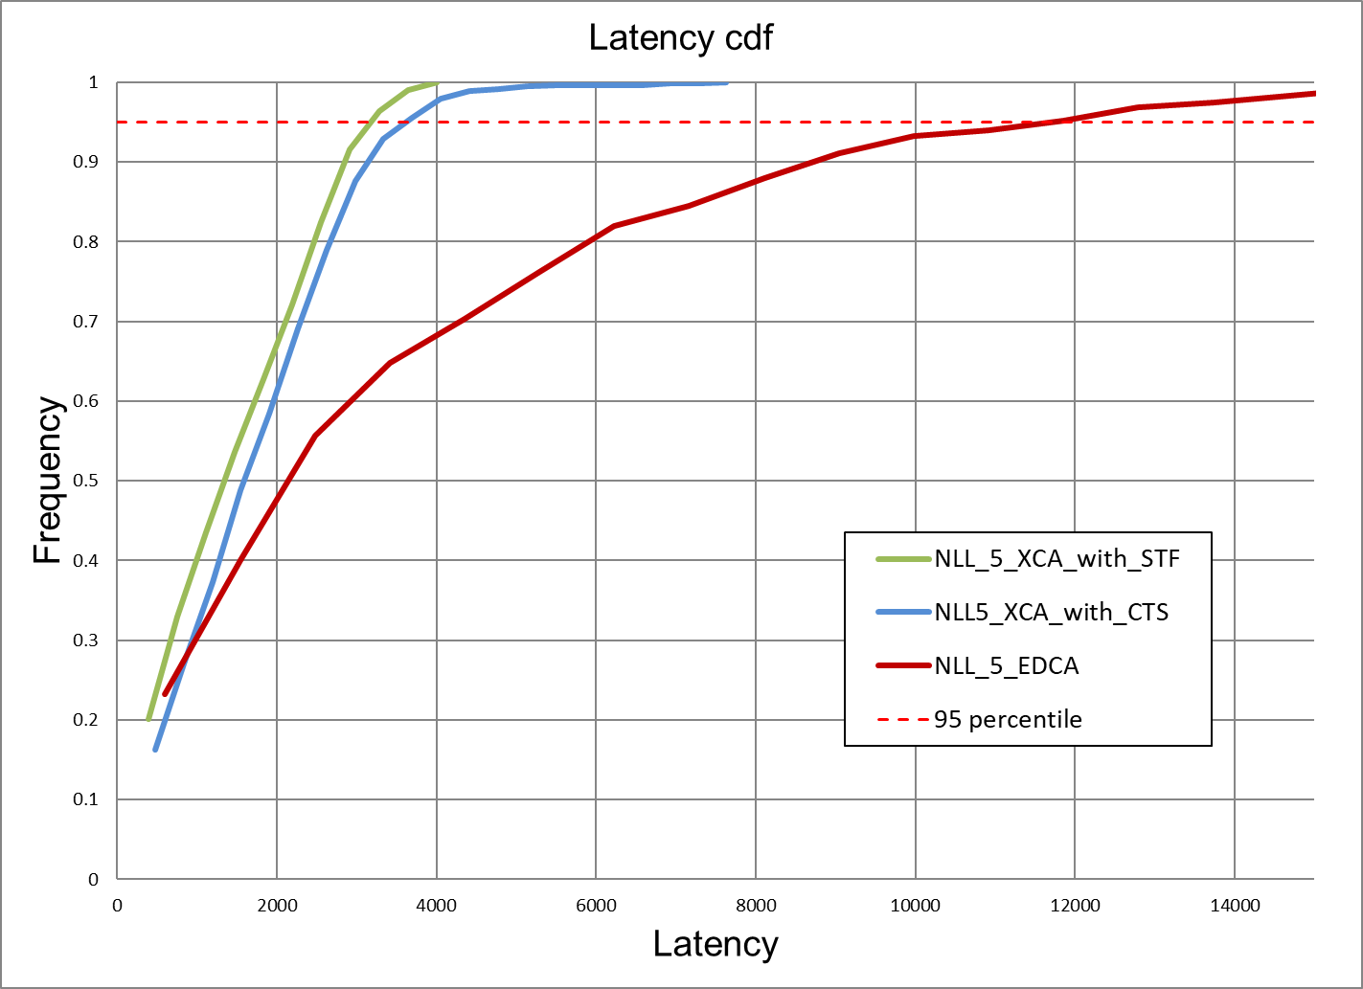
Results for N_LL=5

Slide 14
95 percentile values
N_LL | EDCA | XCA
 |  | STF | CTS
1 | 7.87 | 2.79 | 2.84
2 | 9.78 | 2.81 | 2.95
5 | 12.11 | 3.30 | 3.71

Slide 15
Conclusion
Enhanced EDCA can be achieved by a collision avoidance phase in the contention where the reservation signal is a “regular” CTS
The method achieves both collision reduction and latency improvement
The method should be considered under the “enhanced EDCA” work item in UHR

Slide 16
References
[1] CSMA with enhanced Collision Avoidance, IEEE 802.11-24/0773
[2] CSMA with enhanced Collision Avoidance for Low-Latency traffic, IEEE 802.11-24/1482
[3] Low latency, low collision, low power medium access—continued, IEEE 802.11-24/1183
[4] tgbn-sept-2024-meeting-agenda, IEEE 802.11-24/1364r14

Slide 17
Backup Slides

Slide 18
Simulation Details
1 AP, 10 STAs with full-buffer UL AC_BE traffic
N_{LL}=1, 2, 5 LL traffic streams
  2 Mbps CBR
  1500-byte packets
MCS 7, N_{SS}=1 PHY rate
EDCA, CSMA, ACK, … modeled as per 802.11

