Slide 1
UHR Receiver Minimum Input Sensitivity for ELR MCSs
Date: 2025-03-11
Authors:

Slide 2
Introduction
802.11bn has defined UHR ELR PPDU with two ELR MCSs.
The Receiver Minimum Input Sensitivity for these ELR MCSs should be defined.
In this contribution we will share some analysis results and propose the related values to be added in the 802.11bn spec. for these ELR MCSs.

Slide 3
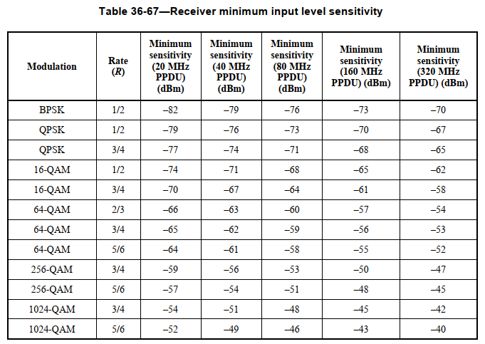
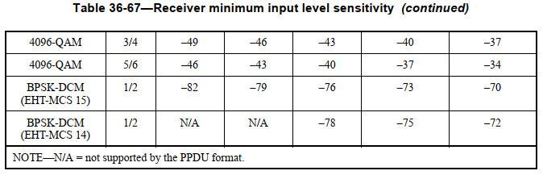
Receiver Minimum Input sensitivity for excising MCSs defined in 802.11be

Slide 4
Proposed Receiver Minimum Input sensitivity for ELR MCSs
Simulation setup
  Packet size: 2048bytes, SU, SISO, 20MHz for UHR-MCS0, MMSE receiver, ideal CSI, no impairment, AWGN and channel D
Proposed Receiver Minimum Input sensitivity for ELR MCSs
  -82 dBm for both ELR MCS1 and MCS0 with the consideration of the CCA performance
MCS | Modulation | Code rate | RU | snr gain in dB @ 10% per(AWGN) | snr gain in dB @ 10% per(Channel D) | Minimum sensitivity (20 MHz PPDU) (dBm)
UHR MCS0 | BPSK | 1/2 | 242-tone RU |  |  | -82
ELR-MCS1 | QPSK | 1/2 | 52-tone RU with four times’ duplication | -3↑ | -4.2↑ | -82
ELR-MCS0 | BPSK | 1/2 | 52-tone RU with four times’ duplication | -3↑ | -3↑ | -82

Slide 5
Proposed minimum required adjacent and nonadjacent channel rejection levels for two ELR MCSs
MCS | Modulation | Code rate | RU | Adjacent channel rejection (dB) | Nonadjacent channel rejection (dB)
 |  |  |  | 20 MHz channel | 20MHz channel
UHR MCS 0 | BPSK | 1/2 | 20MHz | 16 | 32
ELR MCS 1 | QPSK | 1/2 | 52-tone RU with 4 times’ duplication | 16 | 32
ELR MCS 0 | BPSK | 1/2 | 52-tone RU with 4 times’ duplication | 16 | 32

Slide 6
Summary
  We studied the performance of the two ELR MCSs comparing with the EHT MCS0
  Based on the simulation result, we have proposed the minimum input receiver sensitivity, minimum required adjacent and nonadjacent channel rejection levels for the two ELR MCSs added in 802.11bn

Slide 7
SP1
Do you agree to include the following to the 11bn SFD?
  The Rx minimum sensitivity and ACR/NACR specifications for the two ELR MCSs use the same value as EHT/UHR MCS0
  And do the following proposed text change to the latest TGbn draft (TGbn D0.1).
      In Section 38.3.24.2 (Receiver minimum input sensitivity), change the two “TBDs” in Table 38-47 to “-82”
      In Section 38.3.24.3 (Adjacent channel rejection), change the two “TBDs” in the column of "Adjacent channel rejection (dB)" in Table 38-49 to “16” and change the two “TBDs” in the column of " Nonadjacent channel rejection (dB)" in Table 38-49 to “32”
  Supporting doc: 11-25/98r0, 11-25/392r0

