Slide 1
Enhancing Spatial Reuse with MAP Coordination
Date: 2025-01-13
Authors:

Slide 2
Introduction
TGbn has agreed to “Define a multi-AP Coordinated Spatial Reuse at TXOP-level with power control”
The Parameterized Spatial Reuse (PSR) specified in 11ax/11be specs is actually an SR scheme at TXOP level with power control
This contribution discuss the problems in 11ax/11be PSR and how to enhance it via MAP coordination, CoSR

Slide 3
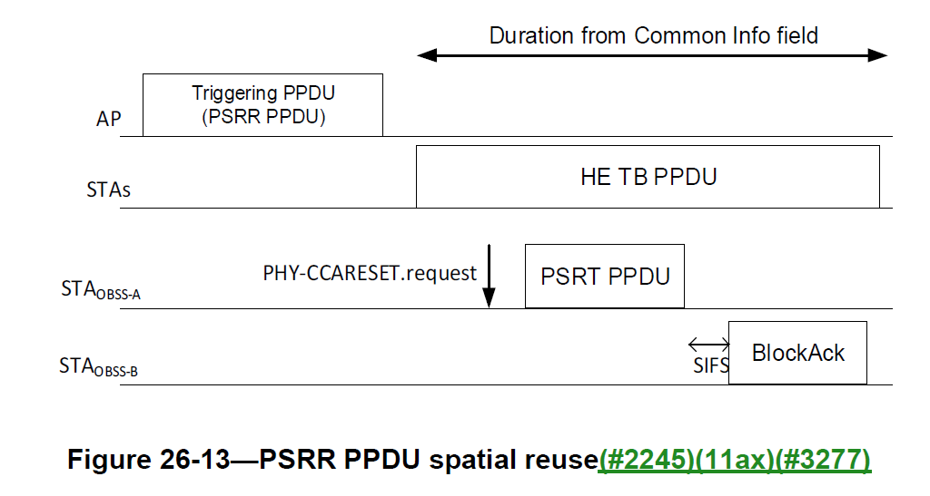
HE/EHT PSR Recap (1)

Slide 4


HE/EHT PSR Recap (2)
Initiation of EHT PSR-based Spatial Reuse:
  PHY receives a PSRR PPDU from an OBSS
    Notify MAC the reception via a PHY-RXSTART.indication primitive
  Has PSRT PPDU queued and set Tx power, $TxPower_{PSRT,total}$(dBm), of PSRT PPDU to satisfy
$$TxPower_{PSRT,total}≤10×\log_{10}{N_{PSRT,nonpunc}}+PSR_{min}−RPL_{PSRR,20MHz}$$
$N_{PSRT,nonpunc}$: the number of non-punctured 20 MHz subchannels of the PSRT PPDU
$RPL_{PSRR,20MHz}$: the normalized received signal power in units of dBm/20 MHz,
$PSR_{min}$: the smallest of PSR values within the BW of PSRT PPDU obtained from
  Received DL PSRR PPDU (Common Info field or Special User Info field), or
  The preamble of the UL TB PPDU
  The PSR value is selected by flooring
  $$PSR_{INPUT}=TX_{PWR_{AP}}+Acceptable Rx Interference Level_{AP}$$

Slide 5
HE/EHT PSR Recap (3)
Requirements for HE/EHT PSR
  PSR may be used when there is a TB based operation in OBSS
  To achieve PSR, the STA_{OBSS-A} needs to
    Identify an inter-BSS PPDU
    Decode the preamble of the PSRR PPDU, or a TB PPDU, to obtain PSR values
    Measure the received power of PSRR PPDU at STA_{OBSS-A}
    Determine the unpunctured 20 MHz channels in PSRR PPDU
To compute Tx power upper bound
HE/EHT PSR is a very simple “multiplexing” scheme – using the same resources for two Tx-Rx links
  No need of any form of orthogonality, e.g., time, frequency and space
    Therefore, no need to require synchronized transmissions
  But ensure tolerable interference to the BSS receiver via proper power control

Slide 6
Limitations and Issues with HE/EHT PSR
The 11ax/be PSR scheme doesn’t prevent multiple OBSSs to participate in SR, which could lead to significant interference to the reception of TB PPDUs at AP
Cannot be used during a non-TB based transmission in BSS
The channel for PSRT PPDU needs to be the same as, or a subchannel of, PSRR PPDU
The responding STA of the PSRT PPDU (e.g., the PPDU carrying Block Ack) in OBSS is not power controlled, so may cause interference to the ongoing reception of the TB PPDU in the BSS
If PSRR PPDU preamble is not detected, the SR opportunity may be missed

Slide 7


Enhancing PSR with Coordinated MAP (1)
Using the link between APs to inform and control the SR opportunities and convey PSR parameters at per TXOP level
For example, before TB operation, an AP announces to other APs in the MAP Set, indicating the transmission of a (PSRR) PPDU with
  The AP IDs, or BSS colors, invited to participate in CoSR
  Relative starting time and duration
  PPDU bandwidth and puncturing patten
  Tx power to use for PPDU with trigger frame, or upcoming DL PPDU
  Per 20MHz PSR values or “Acceptable Rx Interference Level” at the AP
Or, PSR(s)
PSR info
No need to decode the preamble of PSRR PPDU
TB PPDU
Rx power measurement
PSRR PPDU
(MU UL trigger)
PSRT PPDU

Slide 8
Enhancing PSR with Coordinated MAP (2)
Example:
  I-AP : To have triggering based operation
  One P-AP only
  The P-AP relays PSR info to its STA(s)
  Both P-AP and its associated STAs measure Rx power when I-AP Tx triggering PPDU and compute pathlosses from the I-AP
  P-AP and its associated STAs compute their max Tx power
  P-AP and its associated STAs may transmit at their proper power level while I-AP receives TB PPDU
Notation:
  I-AP : CoSR Initiating AP
  P-AP : CoSR Participating AP
Co-PSR Announcement
Triggering PPDU
(PSRR PPDU)
I-AP
TB PPDU
STAs(assoc. I-AP)
Decode PSR Info
Tx PSR Info
Rx Power Measure
PSRT PPDU
P-AP
Decode PSR Info
Rx Power Measure
Block Ack
STA(assoc. P-AP)
For computing Pathloss to the I-AP

Slide 9
Enhancing PSR with Coordinated MAP (3)
Another Example:
  I-AP and its associated STAs to have non-triggering based transmissions
Co-PSR Announcement
I-DL PPDU
I-AP
I-UL PPDU
STA(assoc. I-AP)
Decode PSR Info
Tx PSR Info
Rx Power Measure
P-DL PPDU
P-AP
Decode PSR Info
Rx Power Measure
P-UL PPDU
STA(assoc. P-AP)
For computing Pathloss to the I-AP

Slide 10
Observation & Conclusion
There are several problems with existing HE/EHT PSR scheme
MAP Coordination can help to overcome some of those problems
The amount of overhead introduced from coordination could harm the overall system performance
  Overhead: information exchanges and measurements among multiple APs and STAs
  Suggest limiting the number of BSSs involved in CoSR to two

Slide 11
SP
Do you agree that, in 11bn, there number of BSSs involved in CoSR should be limited to two

