Slide 1
Special STA Info Field in UHR NDPA
Date: 2025-01-08
Authors:
Name | Affiliation | Address | Phone | Email
Junghoon Suh | Huawei |  |  | junghoon.suh@huawei.com
Mahmoud Hasabelnaby
Ross Jian Yu
Yan Xin
Osama AboulMagd
Sara Norouzi

Slide 2
Background
The EHT variant type is re-used for the UHR variant NDPA [1]
For CoBF, two APs need to send the sounding frames and some sounding parameters which are common to the STAs need to be shared among the coordinated APs
Special STA Info fields are introduced to the NDPA [2-5]
It is necessary for the coordinated APs to overhear the CSI Report from the OBSS STAs
We need a guideline in the NDPA for the quality of the CSI Report frame transmitted from the OBSS STAs
We propose the common sounding parameters carried in the Special STA Info fields in the UHR NDPA to be shared between coordinated APs, and show how this guideline can be indicated

Slide 3
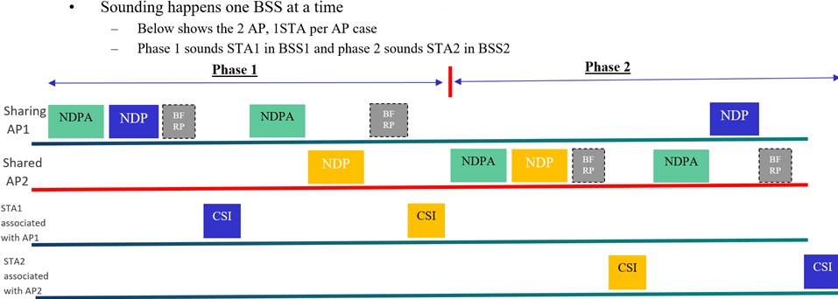
Sequential Sounding for CoBF
Cross-BSS Sounding in Phase 1:
CSI Report transmitted from the
OBSS STA is overheard in the AP2
Cross-BSS Sounding in Phase 2:
CSI Report transmitted from the
OBSS STA is overheard in the AP1
In-BSS Sounding in each Phase:
Same as the current EHT 802.11
Sounding Protocol Sequence;

Slide 4
Proposed UHR CoBF NDPA Frame Format
Frame Control | Duration | RA | TA | Sounding Dialog Token | 1st Special STA Info | ^{2nd} Special STA Info | STA Info List | FCS
2 | 2 | 6 | 6 | 1 | 0 or 4 | 0 or 4 | $n×$4 | 4
Octets
Special AID
Common sounding
parameters
NDPA Variant
Subfield = 3
Shard AP AID
Shared AP Related
sounding parameters
B0 B10 | B11 B13 | B14 B19 | B20 B26 | B27 | B28 B30 | B31
Special AID11: 2047 | NDPA Version Identifier | BSS Color | TXOP | Disambiguation | BW | Reserved
11 | 3 | 6 | 7 | 1 | 3 | 1
1st Special STA Info field
Bits
B0 B10 | B11 B15 | B16 | B17 | B18 | B19 | B20 B24 | B25 B26 | B27 | B28 B31
AID11: Responding AP ID | Punctured Channel Info | N_LTF | Starting SS | NSS | GI+ LTF | Recommended CSI MCS | Reserved | Disambiguation | Reserved
11 | 5 | 1 | 1 | 1 | 1 | 5 | 2 | 1 | 4
2nd Special STA Info field
Bits

Slide 5
The 5-bit “Recommended CSI MCS” subfield recommends the MCS of the CSI Report frame
The Recommended CSI MCS is for the OBSS AP to set the MCS in the BFRP trigger frame sent in the future Cross-BSS sounding / Joint Sounding sequence
The 5-bit MCS level includes “No Recommendation” MCS level in addition to the UHR MCS entries
Index 31 indicates “No Recommendation”
The OBSS STAs can transmit the CSI Report frame with the maximum TX Power according to the Recommended CSI MCS
When there are multiple OBSS STAs to feedback the CSI report, the Recommended CSI MCS can be set to the lowest MCS among all those OBSS STAs
The presence of Special STA Info fields are indicated and implied by the Special AID11 (2047) and 11bits of Responding AP ID
The format of STA Info fields are the same as the EHT STA Info fields

Slide 6
Summary
We proposed the common parameters necessary to be shared among the coordinated APs for the CoBF Sounding
We proposed to set the Recommended CSI MCS level in the Special STA Info field of UHR NDPA for the case of Cross-BSS Sounding in Sequential Sounding and for the Joint Sounding

Slide 7
References
[1] A. Asterjadhi, “11-24/171r26 TGbn Motions List - Part 1”
[2] S. Vermani, et. al., “11-24/1822r3 COBF Design for UHR”
[3] Q. Li, et. al., “11-24/1835r3 Backward Compatible Sounding for CoBF”
[4] Y. Chen, et. al., “11-24/1865r2 Universal Sounding and NDPA Signaling”
[5] M. Hasabelnaby, et. al., “11-24/1837r3 UHR NDPA Design”

Slide 8
SP
Do you support defining 5 bit Recommended CSI MCS subfield in the 2nd Special STA Info field of the NDPA targeted for OBSS AP in the UHR CoBF sounding?
It is set from B20 to B24 in the 2nd Special STA Info field
The 5-bit MCS level includes “No Recommendation” MCS entry in addition to the UHR MCS entries
Index 31 indicates “No Recommendation”
The Recommended CSI MCS is for the OBSS AP to set the MCS in the BFRP trigger frame sent in the future Cross-BSS sounding / Joint Sounding sequence
When there are multiple OBSS STAs to feedback the CSI report, the Recommended CSI MCS can be set to the lowest MCS among all those OBSS STAs
Y/N/A

Slide 9
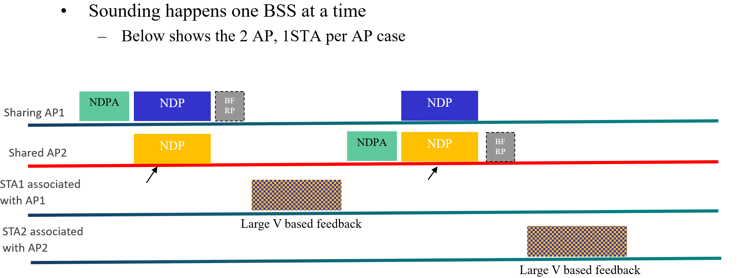
Appendix: Joint Sounding Sequence

