Slide 1
Enhanced Polling Phase for the Co-TDMA Procedure
Date: 2025-05-12
Authors:

Slide 2
Introduction
TGbn has agreed to define Co-TDMA procedure [1]
The Co-TDMA procedure includes the polling phase to allow the TXOP owner AP and the candidate AP (Polled AP) to confirm each other's intentions:
(Motion 156) The TXOP owner AP informs one or more polled APs of its intention to perform TXOP sharing
(Motion 157) The polled AP responds with a TB PPDU indicating whether it intends to participate in the TXOP sharing procedure
In this contribution, we discuss the additional information/indications that need to be exchanged between APs during the polling phase of Co-TDMA

Slide 3
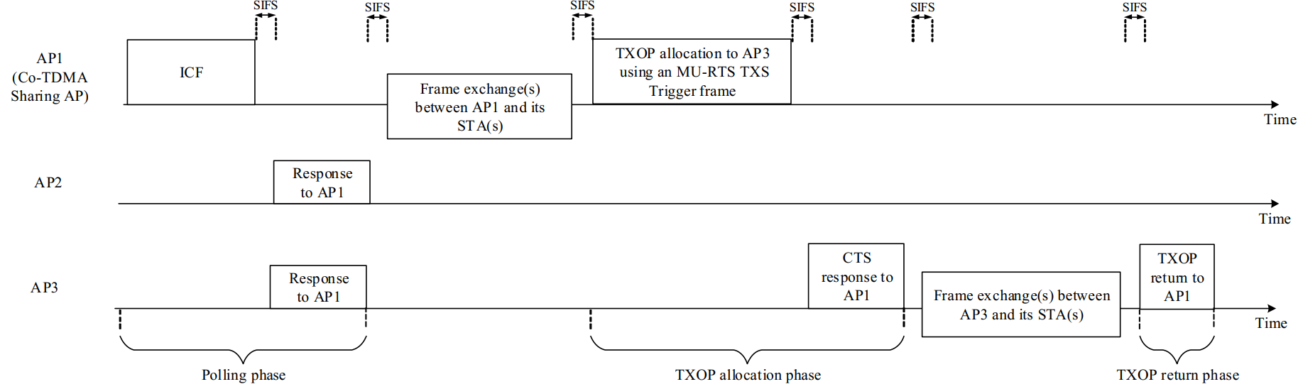
Co-TDMA procedure example (Figure 37-3 in the TGbn D0.2)
This contribution discusses the polling phase

Slide 4
Information exchange in the polling phase (1)
Polled AP needs information to determine participation in the TXOP sharing procedure
A polled AP may choose to participate in the TXOP sharing procedure if the resource provided by the sharing AP is suitable for its needs
If the shared resource is insufficient, or if the traffic types allowed for the shared TXOP do not match the polled AP's queued traffic, it may consider alternative actions, such as using Spatial Reuse or NPCA
Therefore, the TXOP owner AP should provide the polled APs with information about the amount of resources available for sharing and the types of traffic allowed to be transmitted
Related comments (CC50): 225, 624, 686, 1030, 1864, 2447, 2516, 3443, 3790, 3881

Slide 5
Information exchange in the polling phase (2)
TXOP owner AP needs information to select the shared AP among the polled APs
It would be more efficient for the TXOP owner AP to share its TXOP with a more urgent AP
Therefore, when a polled AP indicates its intent to participate in the TXOP sharing procedure, it should also provide information regarding its level of urgency
The TXOP owner AP can then select the most appropriate AP as the shared AP based on this information
Related comments (CC50): 227, 484, 624, 1543, 1865, 2214, 2215, 2446, 2515, 3581, 3789

Slide 6
Proposal 1: Information exchange in the polling phase
Step 1: AP1 informs AP2 and AP3 about the time duration of the TXOP to be shared
Step 2. AP2 and AP3 decide whether to participate in the TXOP sharing based on the indicated time duration
Step 3. AP2 and AP3 respond with TB PPDUs that include:
Intent to participate in the TXOP sharing procedure
Urgency information of the traffic (e.g., LL traffic or not)
Step 4. AP1 determines which AP to share the TXOP with
- User Info fields corresponding to the UHR AP2 and UHR AP3
- Time duration info. to be shared
Polling frame
UHR AP1
(TXOP holder)
2
1
0
ICR
(TB PPDU)
UHR AP2
No shared TXOP required
- Intention info.
- Urgency info. (e.g., LL traffic indication)
ICR
(TB PPDU)
UHR AP3

Slide 7
A frame for specifying the Shared AP
Polled AP requires certainty regarding whether TXOP sharing will be performed
In cases where multiple polled APs express their intention to participate, some may not have the opportunity to receive the shared resources
A polled AP that has indicated its willingness to participate in TXOP sharing cannot confirm whether the TXOP owner AP will share the TXOP with it
The TXOP owner AP should provide information about the selected polled AP to ensure that the other polled APs can pursue alternative actions
Without this indication, all polled APs would remain waiting for the initiation of the TXOP sharing procedure, ultimately losing the opportunity to take alternative actions
Therefore, after receiving the TB PPDUs from the polled APs, the TXOP owner AP should specify the selected polled AP (Shared AP) by transmitting the next PPDU to the Aps
Related comments (CC50): 256, 257, 1600, 1865, 2448, 2816

Slide 8
Proposal 2: A frame for specifying the Shared AP
TXOP of UHR AP1
Polling frame
TBD frame
Frame exchanges
(BSS of UHR AP1)
MU-RTS TXS
(non-HT)
UHR AP1
(TXOP holder)
2
1
0
will not be shared
ICR
(TB PPDU)
UHR AP2
Performs alternative actions
(e.g., Spatial Reuse, NPCA, Power Save, etc.)
Shared TXOP is required
ICR
(TB PPDU)
will be shared
CTS
(non-HT)
Frame exchanges
(BSS of UHR AP3)
UHR AP3
Shared TXOP is required

Slide 9
Conclusions
Enhancements to the the polling phase have been discussed:
The TXOP owner AP should provide information regarding the amount of resources available for sharing, allowing the polled APs to decide whether to participate in the TXOP sharing procedure
Polled APs should feedback the urgency of their traffic, allowing the TXOP owner AP to make more informed decisions when selecting the shared AP
To enable polled APs that do not participate in the TXOP sharing procedure to take alternative actions, a frame specifying the shared AP should be exchanged during the polling phase

Slide 10
Straw Poll 1
Do you agree to add the following text to the TGbn SFD?
As part of the Co-TDMA procedure, a TXOP owner AP indicates time duration to be shared in an Initial Control Frame sent at the beginning of the TXOP

Slide 11
Straw Poll 2
Do you agree to add the following text to the TGbn SFD?
As part of the Co-TDMA procedure, an AP responding to the Initial Control Frame received from the TXOP owner AP provides information about the traffic it intends to transmit during the shared time

Slide 12
Straw Poll 3
Do you agree to add the following text to the TGbn SFD?
As part of the Co-TDMA procedure, a TXOP owner AP should announce the designated AP after receiving TB PPDU(s) from the polled APs
The designated AP would be a target AP for the MU-RTS TXS Trigger frame to be transmitted in that TXOP

Slide 13
References
[1] 11-24/0209 Specification Framework for TGbn
[2] 11-24/1961 PDT-MAC-C-TDMA

