Slide 1
More Consideration for feedback information
Date: 2025-3-xx
Authors:
Name | Affiliation | Address | Phone | Email
Hongwon Lee | LG Electronics | 19, Yangjae-daero 11gil, Seocho-gu, Seoul 137-130, Korea |  | hongwon.lee@lge.com
Insun Jang |  |  |  | insun.jang@lge.com
Geonhwan Kim |  |  |  | geonhwan.kim@lge.com
Jinsoo Choi |  |  |  | js.choi@lge.com
Sunhee Baek |  |  |  | sunhee.baek@lge.com
Yelin Yoon |  |  |  | yl.yoon@lge.com
Dongju Cha |  |  |  | dongju.cha@lge.com
HanGyu Cho |  |  |  | hg.cho@lge.com
Sanggook Kim |  | 10680 Treena St, San Diego CA 92131 , USA |  | sanggook.kim@lge.com

Slide 2
Introduction
The Motion to allow Multi-STA BA to carry one or more types of feedback(e.g., unavailability) information was passed during the November F2F meeting
There are several options to include multiple types of feedback information
If we consider ICR and CRF, the M-BA is a good option
This contribution focuses on how to incorporate multiple types of feedback information into the M-BA

Slide 3
Feedback information in M-STA BA
Basically, it is straightforward that Multi-STA BA as CRF (rather than ICR) can carry unavailability information (if present) as well as BA information (baseline as usual)
Additionally, we can have the following potential information per our current agreements
Unavailability information [7]: Unavailability Target Start Time, Unavailability Duration
Cross-link Power Save(CLPS) information [5]: Link ID info, PM bit per link, Power Save scheduling information, etc.
Low Latency Traffic(LLT) information [4]: LLT indication(the low latency traffic indication for TXOP responder)
MAPC information: Time allocation(intention to receive/not to receive), Required TXOP Duration, LLT Traffic indication
Buffer Status Report information [1][2][3]: BSR and/or BSRE(BSR Enhancement)
This can be included in a CRF to perform unsolicited manner if necessary
This can also be included in case the BSRP solicits a non-HT (dup) PPDU
Etc.

Slide 4
M-BA with feedback information use case
AP’s TXOP
DATA
DATA
Basic TF
UHR AP
BSRP
STA1
(Legacy)
QoS Null
BA
BA
X
IDC event recognized
STA2
(UHR)
M-BA + QoS Null
BA
M-BA
Unavailable Time
DUO, LLT, CLPS, unsolicited BSR(if necessary)
Frame Control | Duration | RA | TA | BA Control | BA Information | FCS
Per AID TID Info for feedback information
Per AID TID Info (BlockAck) | AID11 | Ack Type = 0 | TID = 13 | Fragment Number | Feedback
AID – for UHR AP
12 bits + 4, 8, 16, or 32 octets

Slide 5
Multiple feedback information in the Per AID TID of M-BA
Option1 – Multiple Per AID TID info subfields for multiple types of feedback information (Preferred)
Each Per AID TID subfield has the Type field (e.g. 4 bits)
Similar method for BSRP Trigger frame – a feedback type field (4 bits) based on the motion 261
Option2 – Multiple feedback information in the Feedback subfield
BA bitmap(Feedback) size determination based on the fragment number(e.g. 4, 8, 16 or 32 octets)
Multiples types of information could be included in the BA bitmap(Feedback) subfield and should be distinguished using certain methods
Number of feedback information + T[L]V structure
Presence bitmap + fixed location for information
Both options can include with BA and feedback information in the Multi-STA BA together

Slide 6
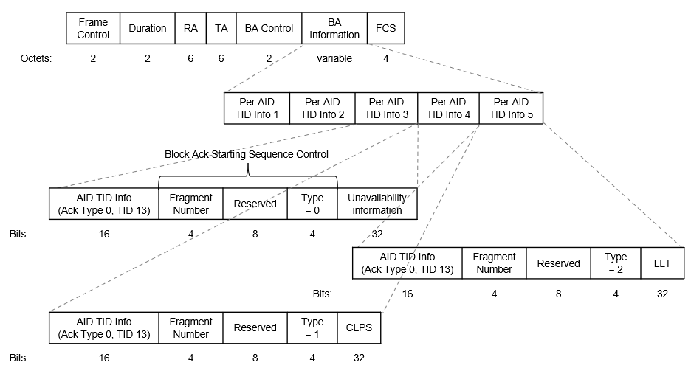
Option 1
Multiple Per AID TID info subfields for multiple types of feedback information
The Feedback subfield is indicated by setting the Ack Type to 0, and the TID to 13
The AID11 is the intended recipient AID or 2008 for All STAs
BA for TID 0
BA for TID 1

Slide 7
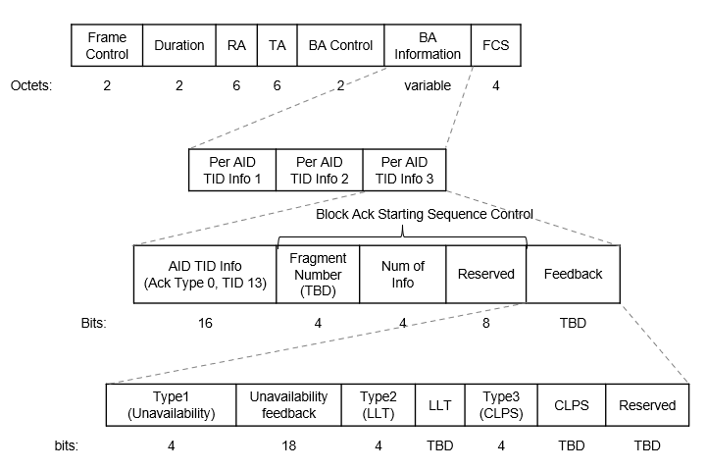
Option 2-1
Multiple types of feedback information(w/ Type) in the Feedback subfield
The Feedback subfield is indicated by setting the Ack Type to 0, and the TID to 13
The Number of Info is required to specify the actual length of feedback information in Feedback subfield. It could also be used for future extensions
The Length for each feedback type can be omitted if the feedback information has a pre-determined length
BA for TID 0
BA for TID 1

Slide 8
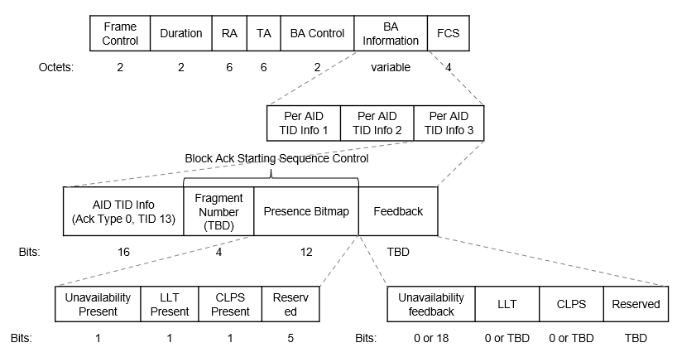
Option 2-2
Multiple types of feedback information(w/ Presence Bitmap) in the Feedback subfield
The Feedback subfield is indicated by setting the Ack Type to 0, and the TID to 13
The number of info is unnecessary, as the presence bitmap indicates the number of feedback entries
If the Presence Bitmap is included, ID(for Type) is not necessary
BA for TID 0
BA for TID 1

Slide 9
Conclusion
We discussed several options to include multiple types of feedback information in the Multi-STA BA
Option 1 : Multiple Per AID TID info subfields (w/ Type) for multiple types of feedback information (Preferred)
Option 2-1: Multiple feedback information(w/ Type) in the Feedback subfield
Option 2-2: Multiple feedback information(w/ Presence Bitmap) in the Feedback subfield
Both options can include with BA and feedback information in the Multi-STA BA together

Slide 10
Straw Poll 1
Do you agree to include the following into the 11bn SFD?
11bn allows a Multi-STA BA frame to include both Block Ack Bitmap and Feedback information if the preceding PPDU includes QoS Data frame(s) that solicit an immediate response (e.g., Ack or BlockAck context) and the non-AP STA is operating in a mode that allows inclusion of feedback information(e.g. DUO mode)

Slide 11
References
[1] 11-24/834r1, Some Details on In-Device Coexistence
[2] 11-24/1490r1, More Consideration of ICR/CRF for in-device-coexistence
[3] 11-23/2007r2, Enhancement of BSR
[4] 11-/24/0389r0, Preemption for Low Latency
[5] 11-24/0602r0, Multi Link Power Management for MLO
[6] 11-24/1221r3, ICF ICR follow up
[7] 11-24/1558r2, In-Device Coexistence – Follow Up
[8] 11-24/1887r0, BSRP TF response rules changes for M-BA

