Slide 1
AMP Mono-static Backscattering Operation
Date: 2025-01-09
Authors:

Slide 2
Introduction
[1, 2] proposed to reuse EPC Gen2 logical interface and channel access for backscattering tag
Simplify backscattering tag design
Facilitate the synergy with UHF RFID tag
In this contribution:
Discuss about EPC Gen2 logical interface
Propose the simplified protocol for AMP
Discuss about the inter-frame space definition

Slide 3
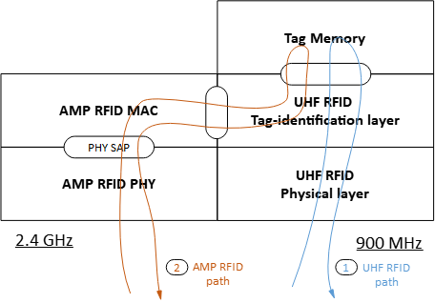
Recap: High-level Protocol Flow
AMP reuses the logical interface of EPC Gen2 protocol [2]:
Physical layer → AMP will redefine AMP PHY
Tag-identification layer → the UHF RFID commands are tunneled via the AMP MAC/PHY layer

Slide 4
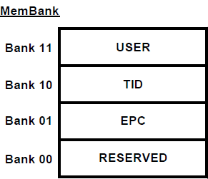
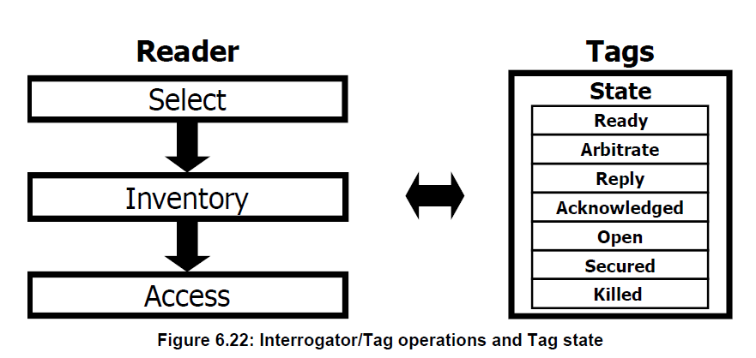
EPC Gen2 Logical Interface [3]
Tag memory definition and access commands
Inventory operation command and flags/state
Select command: choose certain tags to identify
Inventory command: identify all Tags
Sessions, A/B flag per session, Tag state
Advanced operation
Authentication
Secured communications

Slide 5
AMP Backscattering Tag
Tag memory definition and access commands
Propose no change to the interface, and selective useful commands
Inventory operation
Propose to reuse most commands
Query command to be updated based on new AMP PHY
Comply with TXOP or PPDU limit
Tag to hold status/flag among read TXOP or PPDU
Inter-frame space: “link timing”
To be updated based on AMP PHY definition
Advanced operation
Propose to support authentication only
Secured communication does not fit into WiFi: ~100ms

Slide 6
AMP Reader Commands
Minimum set
Command | Tag support | Remark
Select | mandatory | as EPC Gen2 Reader usage is optional
Query | mandatory | As EPC Gen2 Update based on AMP PHY
Query rep | mandatory | as EPC Gen2
Ack | mandatory | as EPC Gen2
NAK | mandatory | as EPC Gen2
Read | mandatory | as EPC Gen2
Write | mandatory | as EPC Gen2
Authenticate | optional | as EPC Gen2
Extend | mandatory | New command to be defined in AMP To accommodate TXOP limitation

Slide 7
“Extend” Command
AMP reader channel access needs to coex with regular WiFi and comply with TXOP
Some operation sequence may take longer time
e.g. multi-tag inventory, delayed replay
Finish the operation sequence in multiple TXOPs or PPDUs
A new “Extend” command can be defined
Reader to indicate to the tag
The next command is an extension from previous operation
Tag to maintain a persistent status and to response in next TXOP or PPDU

Slide 8
Examples
TXOP-1
CCA
TXOP-2
AMP
Reader
Tag
TXOP-1 + TXOP-2 is too long
may take milli-second processing time
e.g. Write process, Authenticate process
Tag may lose energy after TXOP-1
“Extend” command instruct tag to retain state for in persistent memory

Slide 9
Inter-Frame Space
UHF RFID link timing is very flexible due to
flexible data rate, and
diverse regulatory requirement in various geographical regions
AMP backscattering definition can be much simplified
Single DL data rate: 250kbps
Single channelization and spectrum mask definition in 2.4GHz
Backscattering sequences
Immediate reply: inventory operation
e.g. Single-Tag reply, and Multi-Tag reply
Delayed reply:
operations that tags need more time to process before response
e.g. Authentication, Write

Slide 10
Immediate Reply
Both Reader and Tag shall response within pre-defined time window during the frame exchange
T1: Tag response time
T2: Reader response time
T3: No reply time wait time
AMP
Reader
Tag
AMP
Reader
Tag
No
reply
Invalid ACK
No reply

Slide 11
Delayed Reply
Reader shall provide energy for the specified time for Tag to process and prepare response
Tag shall response within pre-defined time window
T₅: wait time for Reader
AMP
Reader
Tag
AMP
Reader
Tag

Slide 12
Examples
Reuse some of existing WiFi IFS time definition
Time | Description | AMP | Note
T1 | Tag Response time | 16us (+/-10%) | EPC Gen2: value dependent on Tari, minimum 15us
T2 | Reader Response time | 10 or 16us (+/-10%)
T3 | No replay Reader wait time | TBD | EPC Gen2: min 0us, no max
T4 | Reader minimum inter-command time | 10 or 16us (+/-10%) | EPC Gen2: min T1+T3, no max
T5 | Tag processing time for delayed reply | TBD | EPC Gen2: [250us, 20ms]

Slide 13
Summary
Discuss about EPC Gen2 logical interface
Memory and access, inventory operation, advanced operation
Propose the simplified protocol for AMP
Reuse memory definition and access command
A subset of required commands
New “Extend” command for TXOP/PPDU limit
Discuss about the inter-frame space definition
Try to reuse existing IFS values
Not to exceed the requirement of the UHF tag

Slide 14
References
[1] 11-24/0836, thoughts-on-amp-uhf-rfid-tags
[2] 11-24/1805, time-based-channel-access-discussions
[3] EPC UHF Gen2 Air Interface Protocol | GS1

Slide 15
SP
Do you agree to add the following to the TGbp SFD?
The AMP backscattering tag reuses the memory definition and access commands as in EPC Gen2 protocol.

Slide 16
SP
Do you agree to add the following to the TGbp SFD?
The AMP defines an Extend command to request the tag to extend the operation sequence in the next TXOP or PPDU.
The name and content of the command is TBD

Slide 17
SP
Do you agree to add the following to the TGbp SFD?
The nominal response time for AMP backscattering tag is 16us.

