Slide 1
ELR: Fragmentation support and Channel Access
Date: 7-Jan-25
Authors:

Slide 2
Introduction
ELR PPDU is defined in [1]
Definition has been handled mostly by the TGbn PHY ad-hoc so far
In this submission, we highlight some (more MAC-related) issues that need further discussion:
Required support of fragmentation at the transmitter
Clarification of Channel Access behavior

Slide 3
Fragmentation
Ethernet frames are 64-1500 bytes
Presented to the 802.11 layer as MSDUs of max size 1518
802.11 supports both aggregation (A-MSDU) and fragmentation
Fragmentation creates MPDUs smaller than the original MSDU
Fragmentation is a mandatory requirement at the receiver, but not at the transmitter

Slide 4
Max Payload supported by ELR PPDU
ELR supports PHY rates of 1.67 and 3.33 Mbps [2]
ELR is subject to a 5.484 msec max PPDU duration
ELR PPDU preamble + PE = 88.8 + 8 = 96.8 usec
Max # data bits in the Data Field (for 1.67 Mbps):
$\left(5484 −96.8\right)×\frac{N_{DBPS}}{T_{SYM}}≅8978 bits≅1122 bytes$
Note: Limits in TXOP duration (e.g. ETSI) could reduce this number further
ELR-MCS | Duplication | Modulation | R | Nbpscs | Nsd | Ncbps | Ndbps | Data rate (Mb/s)
 |  |  |  |  |  |  |  | 0.8us GI | 1.6us GI | 3.2us GI
0 | RRU52 4x DUP | BPSK | 1/2 | 1 | 48 | 48 | 24 | 1.76 | 1.67 | 1.50
1 | RRU52 4x DUP | QPSK | 1/2 | 2 | 48 | 96 | 48 | 3.53 | 3.33 | 3.00

Slide 5
Conclusion
ELR PPDU can not handle all MSDU sizes without support of fragmentation
Currently, fragmentation is only mandatory at receive side
Fragmentation at the transmitter should be conditionally mandatory with support of ELR

Slide 6
Channel Access
A STA may have to use a CCA Threshold below -82 dBm to receive PPDUs from remote transmitters
ELR PPDU format provides an early termination through the ELR Mark Symbols
What is the channel access behavior (specifically AIFS/BO decrement) in the following situation?
STA with pending traffic contends for the medium, performing CCA and AIFS/BO decrement
During contention, STA detects ELR frame below -82 dBm
After processing ELR Mark, STA determines that ELR frame does not match the color of its BSS

Slide 7
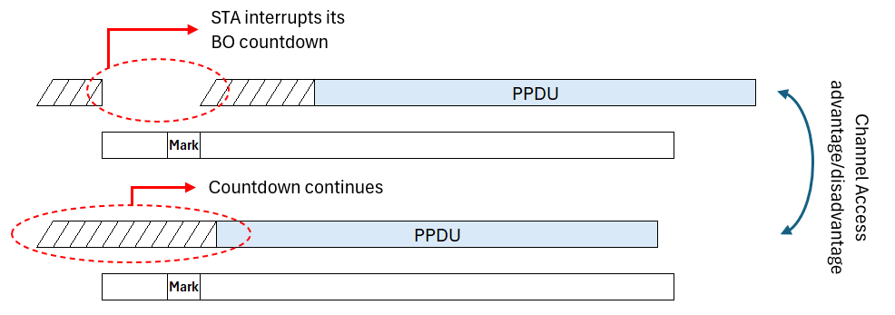
Channel Access behavior
Which is the correct behavior?
Should the STA pause its backoff during the time that it processes the ELR preamble?
Should the STA continue its initial backoff even while processing the ELR preamble and continue its contention in parallel as if the ELR frame was never there?

Slide 8
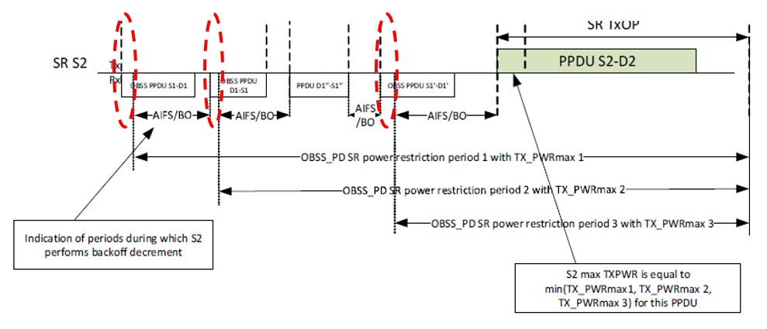
Comparison with SR
SR provides a comparable (albeit not identical) situation
In SR operation AIFS/BO is interrupted (See Figure 26-12)

Slide 9
References
[1] PDT ELR, IEEE 802.11-24/1981r3
[2] ELR PPDU Transmission Design, IEEE 802.11-24/1488r0

