Slide 1
AMP Mono-static Backscattering PHY Followup
Date: 2025-01-09
Authors:

Slide 2
Introduction
[1~2], we have evaluated the feasibility and performance of 11bp mono-static backscattering.
[3~5] proposed several frequency shifted backscattering designs
In this contribution, several aspects of mono-static backscattering are discussed
  Backscattering mode: frequency shift?
  UL BS data rate
  UL BS PPDU definition

Slide 3
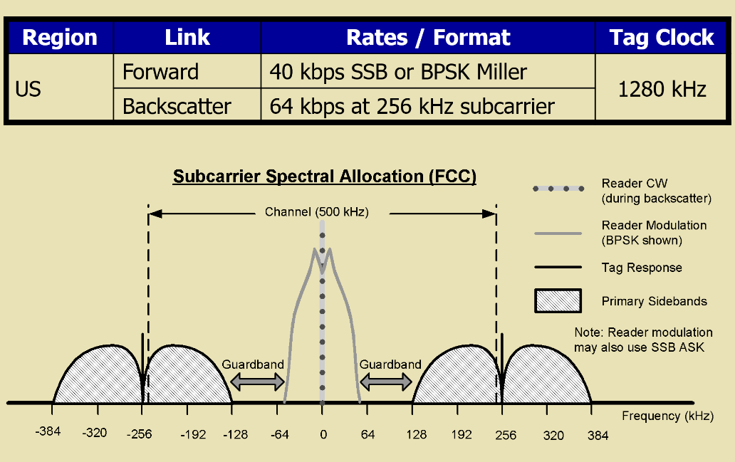
Mono-static Backscattering
Direct backscattering vs frequency shift
  UHF RFID defines Miller Code for digital frequency shift
  Tag with limited digital clock rate, ~2MHz frequency shift
  Reader sends CW tone with narrow spectrum
    Rx: RF domain DC notching can remove leakage

Slide 4
AMP Backscattering
Carrier waveform is narrow BW (e.g. >=2MHz) in 2.4GHz
With tag frequency shift capability (e.g. 2MHz)
  Can not fully separate the signal from leakage
  Larger shift (say >10MHz) will cause CCA issue
RF domain notching (e.g. circulators) is not available
  Baseband notching (analogue or digital) does not improve Rx noise floor
  Digital leakage removal is needed
2MHz
20dB
2MHz
2MHz

Slide 5
AMP Backscattering Reader
Example: Digital leakage removal
  2x2 WiFi: 1Tx →1Rx
  Achieve -35~-40dBc noise floor
Monostatic backscattering:
  Direct backscattering without frequency shift is the default operation
  AMP reader to perform time-domain leakage signal cancellation
Frequency-shifted backscattering needs further discussions

Slide 6
Backscattering Data Rate
[1] proposes two data rates: 1mbps and 250kbps
  1mbps can achieve the design target in ideal signal pathloss
  250kHz provides extra 6dB margin to accommodate different deployment environment or interferences
Airtime example
  Single tag read sequence: 1ms excitation, 16-us SYNC and 128-bit EPC code
  ~1.4ms for 1Mbps; ~1.9ms for 250kbps
Capability and operation
  Tag is mandatory to support both rates: 1mbps and 250kbps
  AMP reader can choose which rate to implement and use

Slide 7
Backscattering PPDU
[3] UL PPDU for Backscattering?
  The UL frame is always “polled” by DL frame, no SIG needed
  Overlapped with Excitation field
SYNC + Payload
  Likely need a different SYNC definition from Active Tx Tag
SYNC | Frame/payload

Slide 8
Summary
Direct backscattering should be the default mode with feasibility validated on WiFi device.
Two UL Backscattering data rate: 1Mbps and 250Kbps
  Airtime impact is limited
  1Mpbs barely meet the target of 10cm
  One lower rate can leave some margin to address practical environments
If define AMP UL PPDU, may need a different SYNC
  Will not cause any false trigger to other devices
  The PPDU overlaps with DL carrier

Slide 9
References
[1] 11-23/2038, Close Range AMP Backscattering in 2.4GHz
[2] 11-24/1798, Backscattering UL data rate and modulation
[3] 11-24/1780, further-discussion-on-amp-ppdu-design
[4] 11-24/1543, frequency-translation-backscatter
[5] 11-24/1687, frequency-shifting-in-backscatter-operations

Slide 10
SP
Do you agree to add the following to 11bp SFD?
11bp defines two data rates 1mbps and 250kbps for backscattering UL Tx?

Slide 11
Appendix
Data from Ref. [2]

Slide 12
Simulation Settings
Leakage signal: 0dBr
2x2 WiFi device in “1Tx + 1Rx” mode
  Antenna isolation is 20dB → Rx power of -20dBm
    Effective Rx noise floor of -35dBr
WiFi reader Rx BW = 40MHz, 10-bit ADC
  Fixed AGC gain to get I/Q samples
  Leakage removal using reference symbols
  Matched filter to detect modulation boundary
AMP tag:
  Backscattering data rate: 250kbps and 1Mbps
  Manchester Encoded OOK modulation: -20 dBr Tx noise
  Payload: 1000 bits
  2MHz Tag Rx nominal clock rate with high ppm
BS signal level: e.g. -30dBr
Rx noise floor: e.g. -35dBr

Slide 13
Tag Reading Performance: Distance
Coherent Detector
1mbps barely meet 10cm reading distance

Slide 14
Tag Reading Performance: Distance
Non-coherent Detector
1mbps reading distance is below 10cm

