Slide 1
Signal Design for OOK
Date: 2025-01-10
Authors:

Slide 2
Abstract
It has been shown that it is advantageous to use a large bandwidth even if the data rate is low, partly because of improved frequency diversity, partly because higher TX power can be used in PSD limited regions.
In this contribution ways to generate Manchester-coded OOK of rate 1 Mb/s and 250 kb/s to allow for a large transmission bandwidth are proposed.
The approach is based on multi-carrier OOK (MC-OOK), and key features of MC-OOK are highlighted.

Slide 3
Outline
Discussion of desired signal properties
Signal design to achieve the desired properties
Briefly about MC-OOK
Conclusions
Straw Polls

Slide 4
Discussion of desired OOK signal properties
The signal should be as wideband as possible, still within the 20 MHz spectrum mask [1] to obtain maximum frequency diversity. The same argument highlighted also for UL in [2].
The signal should be as “flat as possible” in frequency to allow for maximum TX power in PSD limited regions [3][4].
MC-OOK is a nice approch to achive this, and is therefore considered preferred compared to single-carrier OOK, which has been discussed in e.g. [5][6].

Slide 5
Briefly about MC-OOK
Waveform | PAPR (dB) | SNR (dB) @10% PER AWGN | SNR (dB) @10% PER TGnB | SNR (dB) @10% PER TGnD
Random QPSK | > 5 | -4.1 | 4.8 | 1.7
Best tradeoff [3] | 3.5 | -4.1 | 4.7 | 1.0
Proposed no DC | 0.6 | -4.7 | 4.6 | 1.3
MC-OOK is not using OFDM. OFDM means data is multiplexed on different sub-carriers and the time signal depends on the data. As a result, the PAPR is high and one has to back-off the PA.
In MC-OOK the complex input to the IFFT can be selected to achieve low PAPR, a flat spectrum, or a suitable trade-off.
In [7], a design with PAPR = 0.6 dB was proposed for both data rates.

Slide 6
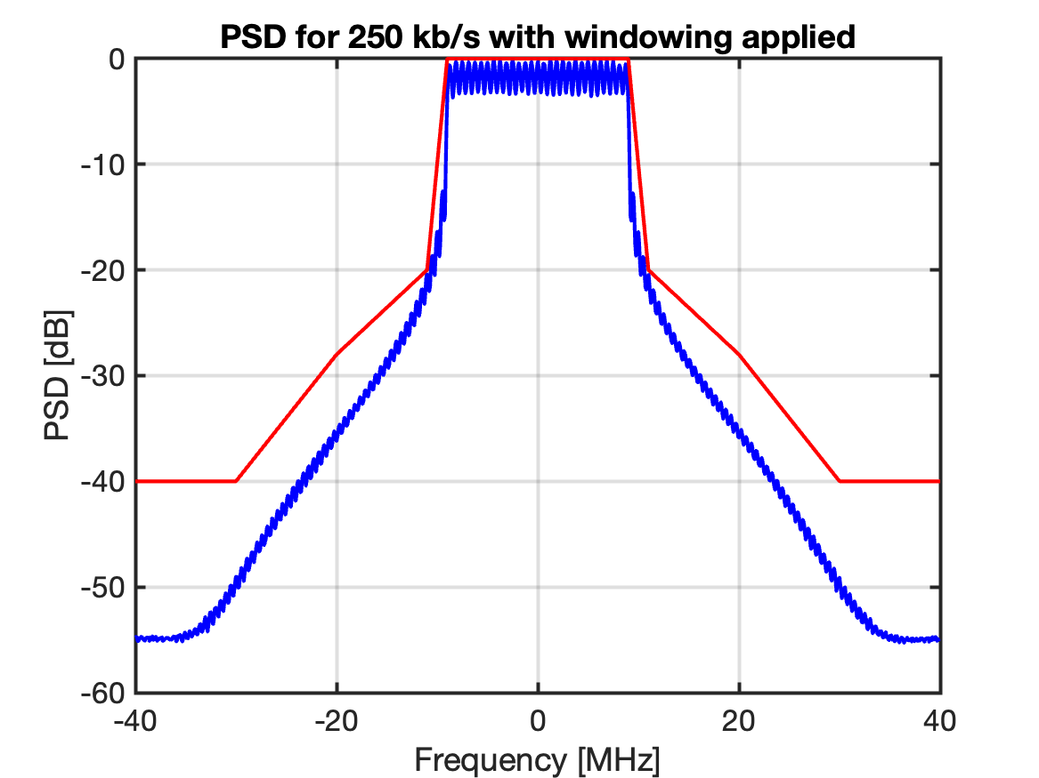
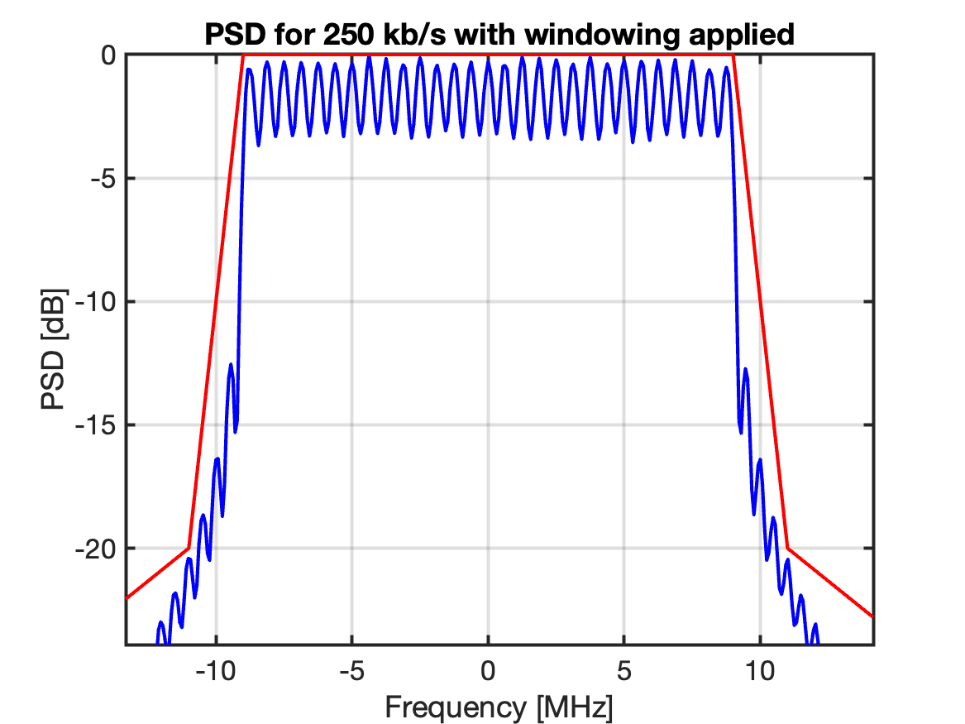
Signal design to achieve the desired properties: 250kb/s
250 kb/s fits very nicely with MC-OOK if FFT size = 32 and CP = 0.4 µs
IEEE 802.11ba used only 6 sub-carriers + DC, resulting in a 4 MHz signal
It is possible to use up to 28 sub-carriers + DC with a simple window to fulfill the TX spectrum mask

Slide 7
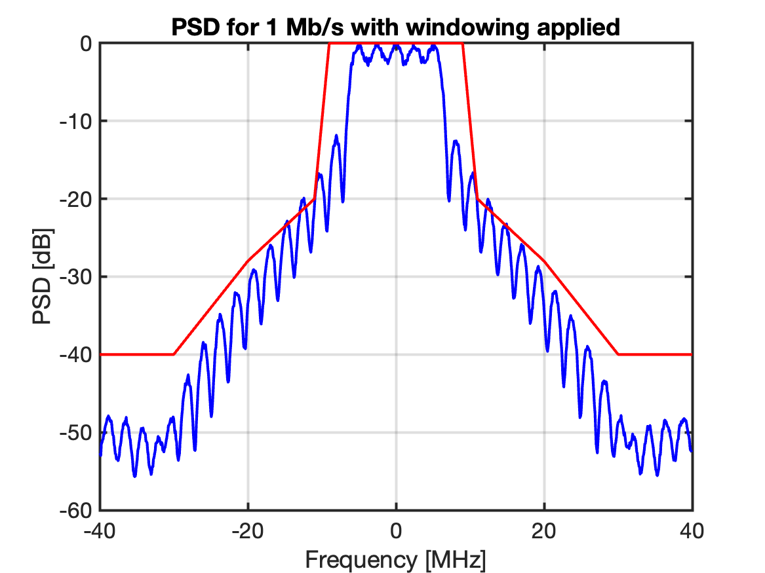
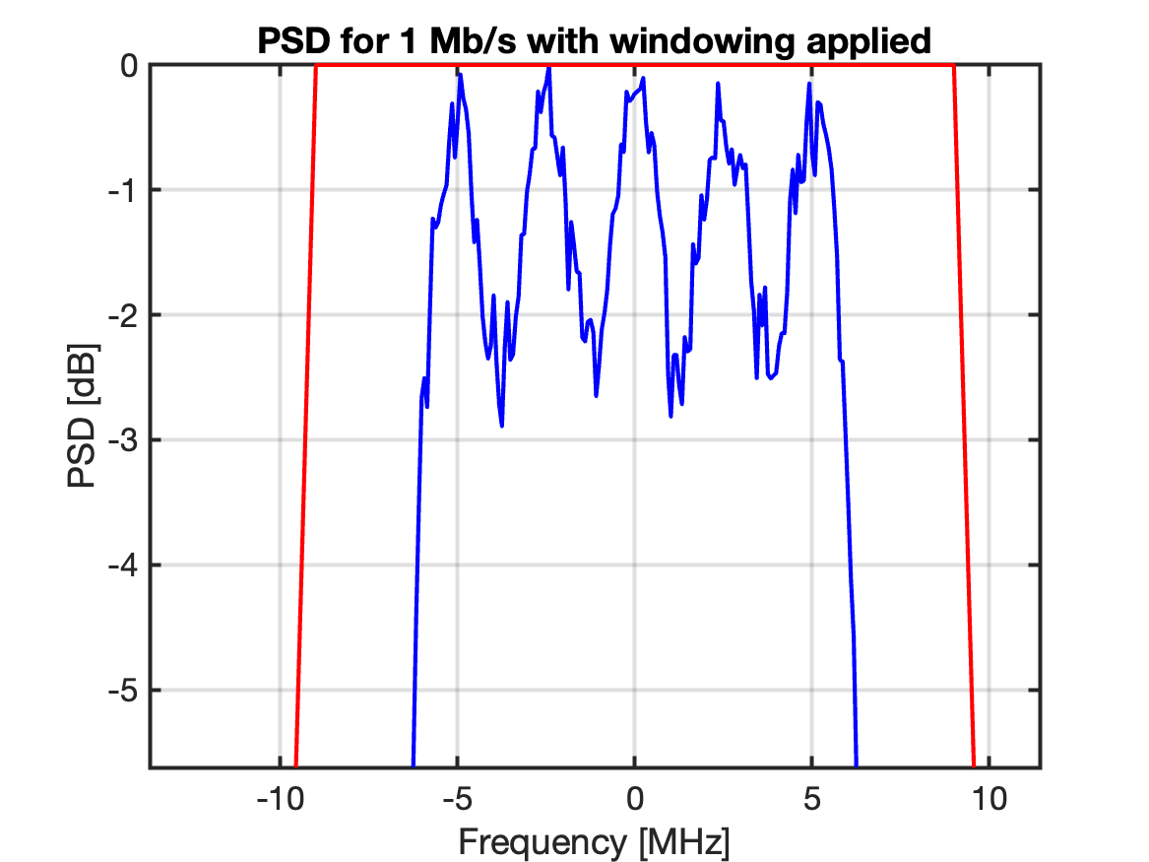
Signal design to achieve the desired properties: 1 Mb/s
To generate 1 Mb/s, one may use an 8 point FFT (or 64 point FFT with only every 8 bin populated and then truncate after ⅛ of the symbol time)
Alt 1: Use 5 sub-carriers (4 + DC) to get it symmetric

Slide 8
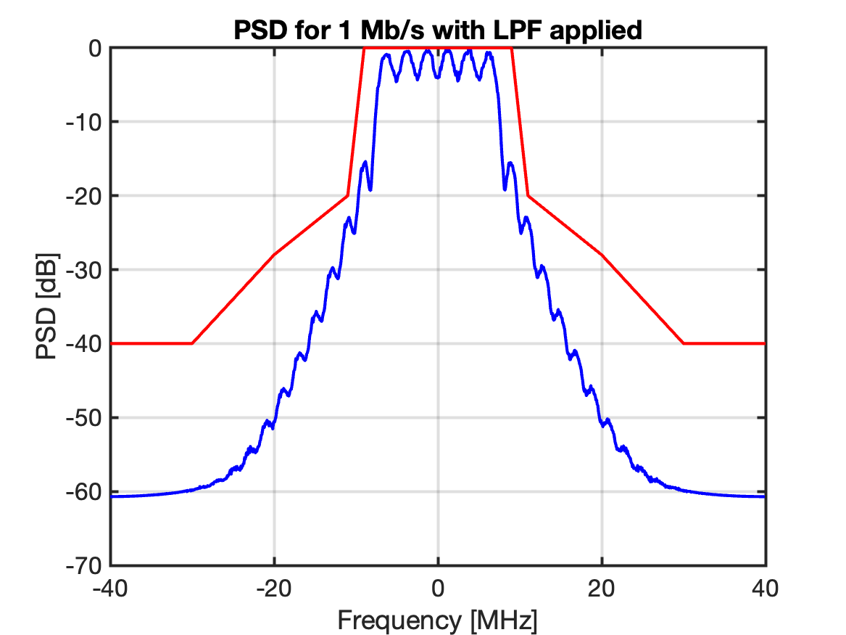
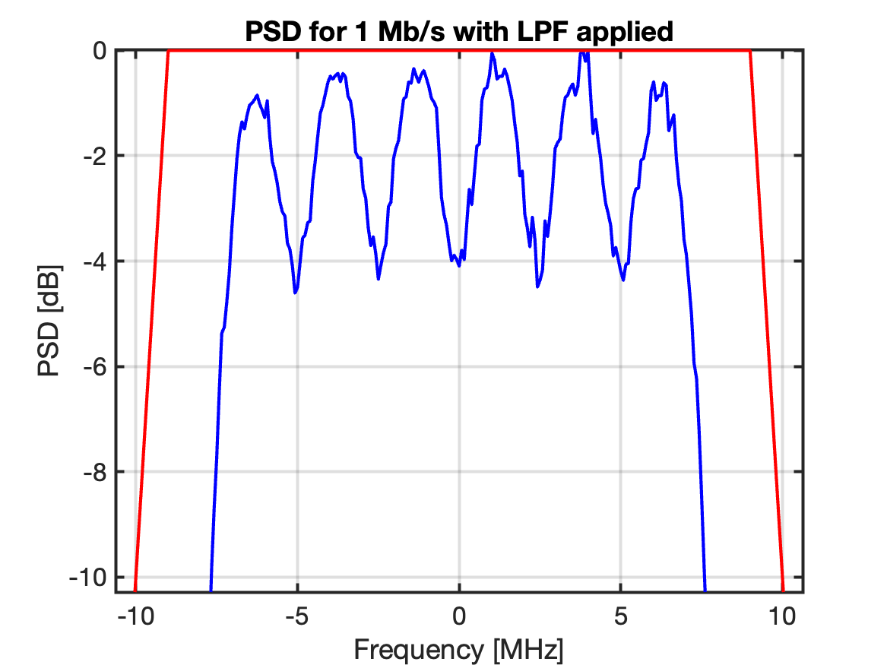
Signal design to achieve the desired properties: 1 Mb/s
Alt 2: Use 6 sub-carriers, shifted 1.25 MHz to get it symmetric. Still with an 8 point FFT.
Above a low-pass filter (LPF) is used instead of windowing to fulfill the TX mask.

Slide 9
Signal design to achieve the desired properties: 1 Mb/s
Because of the small IFFT size, the variations in PSD will reduce the total allowed power in case of PSD limited transmission, as the PSD is measured over 1 MHz.
To reduce these variations, “randomization in frequency” may be used. The sub-carriers used for generating the signal are changed from one symbol to the next. E.g. shifted by 2.5 MHz/8 = 312.5 kHz.
For the 250 kb/s mode one may also do this randomization to minimize the variations, but since the variations are within the 1 MHz measurement bandwidth the gain is negligible.

Slide 10
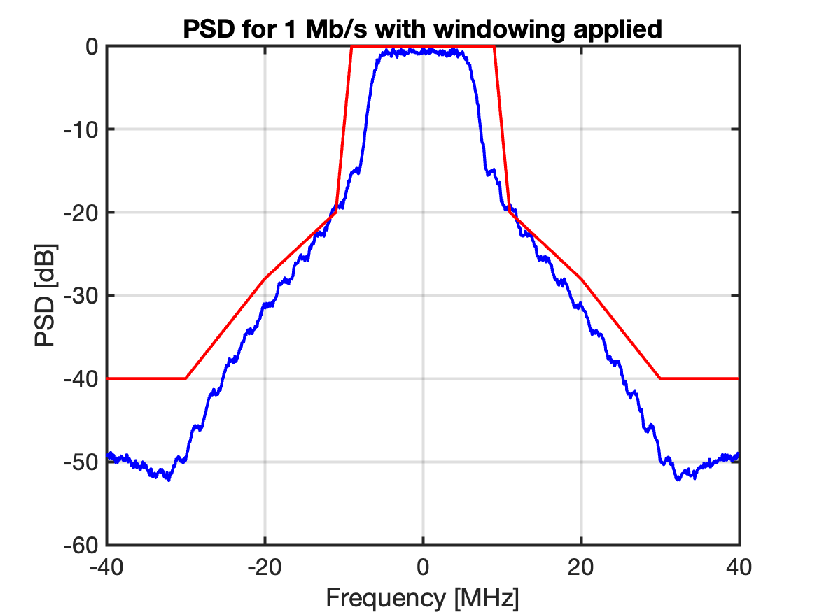
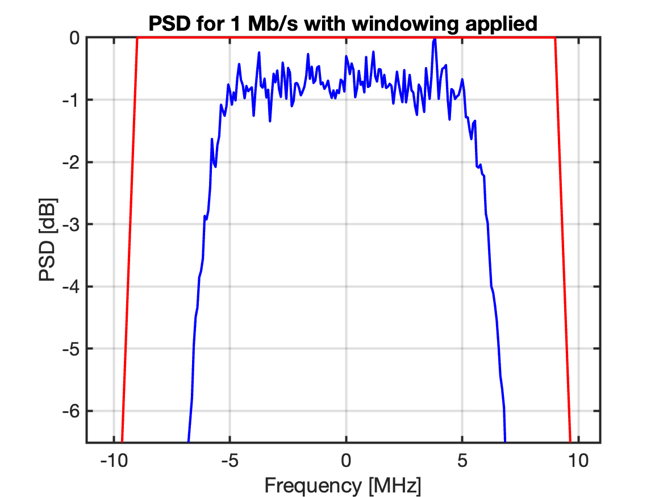
Signal design to achieve the desired properties: 1 Mb/s
With randomization
Without randomization
Because of the randomization in frequency, the PSD becomes much more flat, allowing for increased TX power in PSD limited regions.
Alt 1: Use 5 sub-carriers (4 + DC) to get it symmetric.

Slide 11
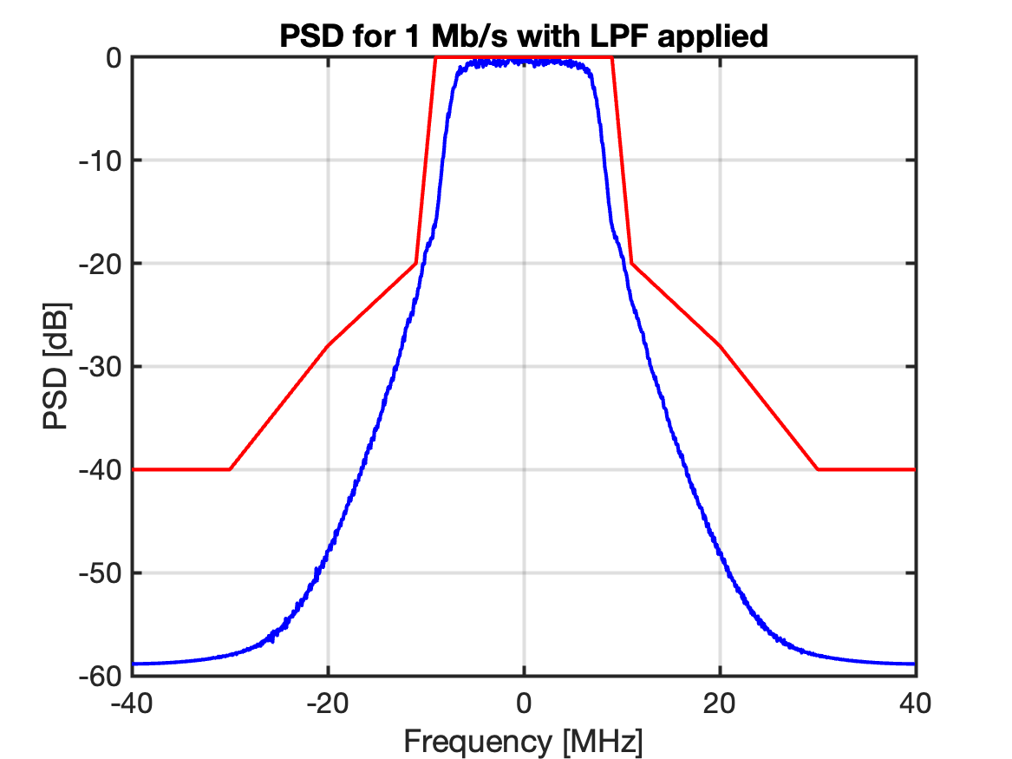
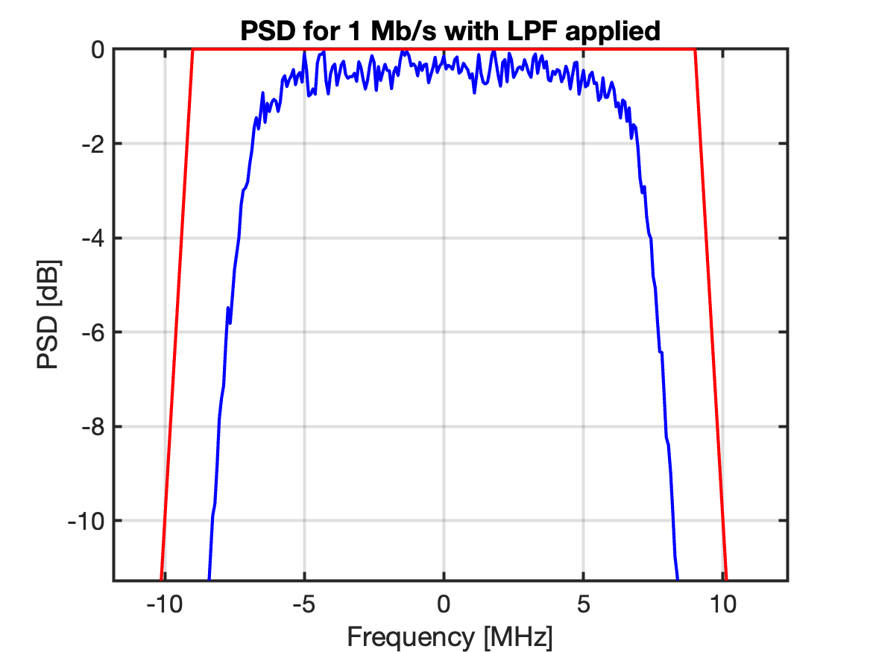
Signal design to achieve the desired properties: 1 Mb/s
With randomization
Without randomization
Alt 2: Use 6 sub-carriers, shifted 1.25 MHz to get it symmetric.

Slide 12
1 Mb/s - Discussion
Possible to fulfil the TX mask with a 15 MHz signal (6 sub-carriers and 8 point IFFT) + windowing or filtering.
Windowing mainly effective far from passband, whereas a LPF also can attenuate at the critical point ±11 MHz.
Typically, how to fulfil TX mask is implementation specific.

Slide 13
Sensitivity performance - Discussion
It was mentioned during the presentation at the November f2f, that no CSF (channel selective filter) at all is assumed.
There would be an advantage with a NB signal if a CSF is used as then the SNR at the input to the envelope detector would be increased. Without the CSF, this advantage is not present.
The two advantages with a WB signal are still present, that is
  Better frequency diversity
  Higher TX power in case of PSD limited transmission
Based on the results in [1], showing a large gain using wideband transmission, it is recommended to use as large bandwidth as seen feasilble.

Slide 14
Conclusions
Due to the large gain in performance using a wideband signal, it is suggested that the DL OOK signal should be wideband: 12 MHz - 15 MHz seems feasible.
MC-OOK was introduced in 802.11ba, and it is suggested to use the same approach in 802.11bp for generating OOK.
To achieve a flatter PSD for the 1 Mb/s mode, it is proposed that the MC-OOK signal may be generated such that the individual symbols are frequency shifted with respect to one another.

Slide 15
References
Leif Wilhelmsson et al., “Some observations related to OOK”, IEEE 802.11-24/1529r0.
Steve Shellhammer et al., “Robust Methods for AMP Active Uplink Multiple Data Rate Support”, IEEE 802.11-24/1794r0.
Steve Shellhammer et al., “Regulations and Noise Figure – Impact on SNR”, IEEE 802.11-17/0365r0 .
Leif Wilhelmsson et al, “Spec Text on Spectral Flatness”, IEEE 802.11-18/1643r1.
Weng Ke et al., “OOK generation for AMP DL”, IEEE 802.11-24/1802r0.
Steve Shellhammer et al., “AMP Downlink Data Rates”, IEEE 802.11-24/1793r1.
Miguel Lopez et al. “MC-OOK Symbol Design”, IEEE 802.11-18/0479r2.

Slide 16
Straw Poll 1
Do you agree to include the following text to the 11bp SFD:
Multicarrier on-off keying (MC-OOK ) is supported for DL AMP PHY.
Y/N/A:

Slide 17
Straw Poll 2
Do you agree that the OOK used for DL tranmission shall have a (3 dB) bandwidth of at least 10 MHz?
Y/N/A:

Slide 18
Straw Poll 3
Do you agree that for the 1 Mb/s mode, the signal for different ON symbols may have different frequency content, e.g. may be generated as described on page 8?
  Y/N/A:

