Slide 1
AMP DL Wideband OOK Generation
Date: 2025-01-10
Authors:
Name | Affiliation | Address | Email
Panpan Li | Huawei | Singapore | lipanpan25@huawei.com
Bin Qian |  | Shenzhen, China
Lei Huang |  | Singapore

Slide 2
Abstract
This contribution intends to discuss the AMP DL wideband DSSS OOK generation for backscattering communication
AMP DL benefits from wideband DSSS OOK signal
Potential bandwidth range: >=10MHz
New spreading sequences are needed

Slide 3
Recap
AMP DL bandwidth :
[1] proposed small bandwidth (4MHz) for 1Mbps, which can be implemented by a single-carrier OOK waveform with a 2 MHz symbol rate.
[2] pointed out that significant improvement can be obtained using a larger bandwidth mainly due to frequency diversity (16MHz BW roughly has 10dB gain)
[3] proposed two methods on OOK generation for AMP DL: new OFDM OOK and DSSS OOK, and pointed out DSSS based OOK has advantages including better performance, no new hardware requirement and flexibility to support different data rates.
[3] proposed to replace Barker code with another spreading code with less randomization in order to generate a narrow bandwidth DSSS signal
[1 1 1 1 -1 -1 -1 -1 -1 -1 -1], about 3 times spectrum spreading via About 4 times repetition of 1 or -1
The new DSSS OOK signal has BW 4MHz.

Slide 4
Benefits of Wideband DSSS OOK
Benefits of DSSS OOK compared with OFDM OOK
Waveform with constant energy result in better decoding performance
DSSS signal generation has lower complexity than OFDM signal
Benefits of Wideband signal compared with narrowband signal
Higher transmit power
China/ETSI regulation: 10dBm/MHz, max TX power 20dB
>=10 MHz BW can result a max TX power
Frequency diversity
More robust to narrowband fading
16MHz BW roughly has 10dB gain [2]
Potential target BW range of DSSS spreading: [10, X] MHz
>=10MHz to achieve max TX power
X TBD, X<22

Slide 5
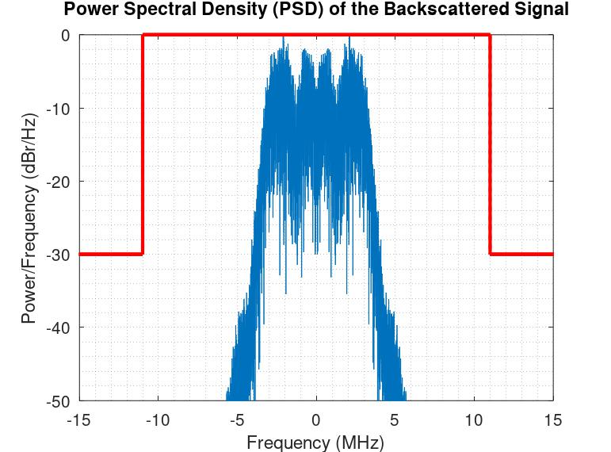
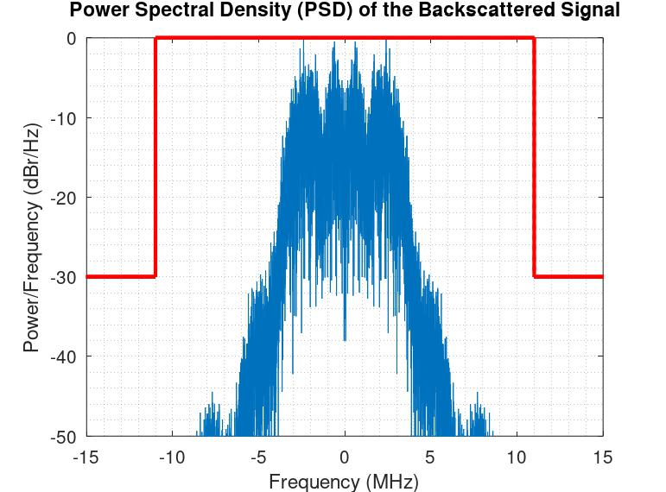
Potential Spreading Sequences
Following 11b protocol, consider a spreading sequence length 11, with chip rate being 11 MHz.
Stronger periodicity (less randomization) of the sequence, narrower of BW.
The bandwidth of DSSS signals can be changed by adjusting the spreading sequence pattern.
Example spreading sequences: [-1 -1 +1 +1 -1 -1 +1 +1 +1 +1 +1]
Data rate: 250 kbps
4-th order Butterworth filter
2-th order Butterworth filter

Slide 6
Summary
This contribution discussed the AMP DL wideband DSSS OOK generation for backscattering communication
AMP DL benefits from wideband DSSS OOK signal
Potential bandwidth range: >=10 MHz
New spreading sequences are needed

Slide 7
Reference
[1] 11-24-1793-00-00bp-amp-downlink-data-rates
[2] 11-24-1529-00-00bp-some-observations-related-to-ook
[3] 11-24-1802-00-00bp-ook-generation-for-amp-dl

Slide 8
SP 1
Do you agree to add the following text to TG bp SFD?
The bandwidth of the AMP DL PPDU is larger than 10 MHz for backscattering communication.
Yes
No
Abstain

Slide 9
SP 2
Do you agree to add the following text to TG bp SFD?
DSSS based OOK is supported for AMP DL backscatter.
Yes
No
Abstain

