Slide 1
Passive AMP STA RF Power Harvesting Sensitivity Threshold
Date: 2025-01-13
Authors:

Slide 2
Abstract
RF energy and AMP tag voltage profiles of charging and discharging durations, that represent the STA operation, were analyzed and described in [1]. The stored energy depends on the value of the STA’s capacitor and the voltage it carries. The required DL and UL PPDU durations dictate a minimum value requirement for the capacitor.
The charging and recharging durations of the STA capacitor depend on the capacitance value, the power levels incident at the antenna, the EH efficiency and the supply voltage values required for the different operation modes (Standby, RX, TX and Idle).
In [2] a direct relationship between RF AMP STA range and idle time was proposed.
Here we suggest to define EH power sensitivity levels for passive back-scattering AMP STAs that balance the intended BS ranges and use cases.

Slide 3
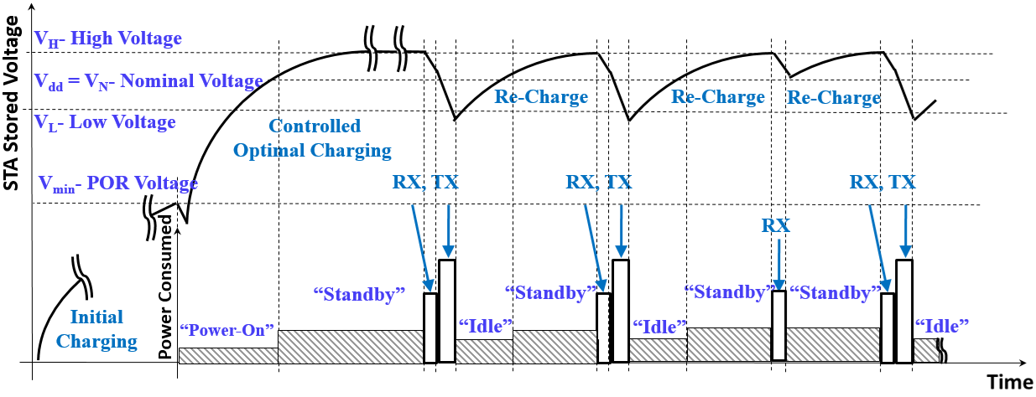
Recap [1]:STA Power Charging / Discharging Timing Profile
RF EH STAs power consumption states:
Power-On
Standby (with energy sufficient for at least one RX+TX cycle)
RX
TX
Idle ( < Standby) and (> Power-On)

Slide 4
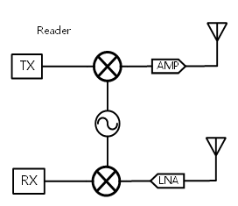
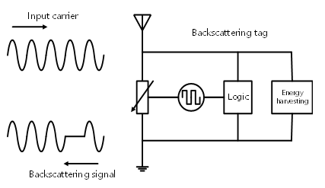
Recap [2]: 2.4 GHz Mono-Static Backscattering Example
Assumptions: AP DR= 50 dB, AMP tag BS Loss 5 dB, Freq=2.4 GHz
20 cm /-26 dB
Leakage signal: 0dBr
P_{EH} = -26 dBm
WiFi AMP reader
0 dBm
AMP tag
AP
Dynamic Range
Self Leakage 20dB
BS
Loss
BS signal:
-37dBr
P_{Lk} -20 dBm
P_{RX} -57 dBm
SNR
P_{Lk} -P_{RX} = 37 dB
SNR= 13 dB
UL range is limited by P_{EH} to ~ 20 cm between the tag and the reader
Rx noise floor: e.g. -50dBr

Slide 5
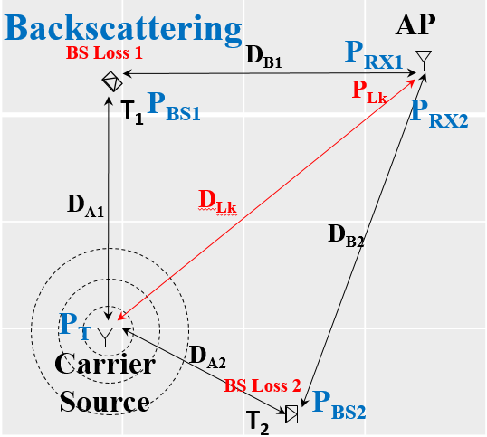
Recap [3]: 2.4 GHz Bi-Static Backscattering Example
Link Assumptions
Carrier Source EIRP | 20 dBm
Backscattering Loss | 5 dB
Reader Effective DR | 50 dB
Reader min SNR | 3 dB
* 20dBm for < 10MHz BW in the US
DR- Dynamic Range
FRIIS & SNR [dB]
D_{A}, D_{B}, D_{Lk} [m] | P_{BS} [dBm] | P_{RX} [dBm] | P_{Lk} [dBm] | P_{Lk} -P_{RX} [dB] | SNR[dB] | P_{EH} [dBm]
0.7, 0.7, 1 | -22 | -59 | -20 | 39 | 11 | -17
1, 1, 1.4 | -25 | -65 | -23 | 42 | 8 | -20
1, 5, 5 | -25 | -79 | -34 | 45 | 5 | -20
1.4, 1.4, 2 | -28 | -71 | -26 | 45 | 5 | -23
2, 2, 3.1 | -31 | -77 | -30 | 47 | 3 | -26
UL range is limited by SNR and P_{EH} to ~ 2 meters between Tag and AP

Slide 6
Discussion:
Different AMP tags will enable different range coverages
AMP BS tags attributes may be:
Lowest cost
Smallest form-factor
Shortest “Charging and Recharging” durations
Hence, AMP BS tags may support:
Lowest power consumption
Sufficiently low EH sensitivity level with adequate efficiency, which enable fast charging and recharging durations for capacitors that support the required RX+TX durations
Considering bi-static BS as range extension of mono-static operation, utilizing the same tag type, a specification of EH sensitivity power level threshold level may be required and can be identical for both use cases.
Slide 6

Slide 7
Passive BS AMP STA Operation Example (simplified) [1]
$$\text{Energy} \text{stored} \text{on} \text{a} \text{capacitor} \text{:} ES=\frac{1}{2}C∙V^{2}$$
$${\text{Energy} \text{discharge} \text{from} \text{the} \text{capacitor} \text{:} E}_{Disch}=ESH−ESL=\frac{1}{2}∙C∙\left(V_{H}^{2}−V_{L}^{2}\right)$$
Discharge interval (assumed for RX+TX) : T = 2 mSec
STA dissipated power assumed on average over RX & TX duration : P_{D}= 10 uW
Energy consumed during RX+TX : E_{Con} = E_{Disch} = T $∙$ P_{D} = 2$∙$10⁻⁸ Joule (W $∙$Sec)
$$\text{Required} \text{Tag} \text{capacitor} \text{for} \text{V}\text{H}\text{=1.1 }\text{v}\text{, }\text{VL}\text{=0.9 }\text{v}\text{ : }C=2∙\frac{E_{Disch}}{\left(V_{H}^{2}−V_{L}^{2}\right)}=100 nF$$
Initial charging - T_{Store} [1] : for DC_{Eff0} =0.1 (10%) overall efficiency and EH power P_{EH} = -26 dBm (2.5uW) = 240 mSec
Re-charging – T_{re-ch} [1] : for DC_{Eff0} =0.1 (10%) overall efficiency and EH power P_{EH} = -26 dBm (2.5uW) ~ 80 mSec
Slide 7

Slide 8
Further Discussion:
DL and UL PPDU lengths dictate a minimum capacitor discharge duration to be supported by the AMP tag
Discharge duration and operation voltage require a minimum tag capacitance
Supporting mono-static EH range of 20 cm and bi-static of 2 m @ 2.4 GHz requires initial charging and re-charging of the capacitor with minimum P_{EH} of -26 dBm
Initial tag charging and recharging durations at any P_{EH} level are inversely proportional to the overall EH efficiency at this power
Calculations from the previous slide indicate that multiple DL+UL tag operations can reach and possibly exceed 1 sec even for short BS ranges
P_{EH} sensitivity in RFID [4]: Read sensitivity: -24 dBm, Write sensitivity: -22 dBm
Slide 8

Slide 9
Summary
AMP RF EH sensitivity thresholds depend on the tag-energizer distance, deployment environment scenario and the EH frequency
RF EH sensitivity thresholds determine maximum tag operation range
EH efficiency at the threshold and above determine the tag charging and recharging durations
BS AMP tags for both mono-static and bi-static use cases share very similar EH sensitivity threshold requirements that dictate EH, RX and TX operation ranges.
Based on the analysis in previous slides we find -26 dBm to full recharge as a practical sensitivity threshold that is critical for passive AMP BS deployment.
Slide 9

Slide 10
Straw Poll #1
Do you agree that the AMP STA shall meet a minimal harvester sensitivity?
Yes
No
Abstain

Slide 11
Straw Poll #2
Do you agree that a passive BS AMP STA shall meet a minimum harvester sensitivity enabling full capacitor re-charge with a threshold of -26 dBm ?
Yes
No
Abstain

Slide 12
References
11-24-1520r0 “Charging and Discharging Intervals in Passive AMP STAs”; Dror Regev (Huawei)
11-24-0537r0 “Close-range AMP WiFi Reader Feasibility Study”; Rui Cao (NXP)
11-25-yyyyr0 “AMP UL Bi-Static Leakage and Dynamic-Range Implications”; Dror Regev (Huawei)
https://www.nxp.com/docs/en/fact-sheet/UCODE9FSA4.pdf “ACCELERATE THE IoT WITH UCODE® 9”; (NXP)
Slide 12

