Slide 1
AMP Downlink Sync Field Study
Date: 2025-01-12
Authors:
Name | Affiliations | email
Steve Shellhammer | Qualcomm | shellhammer@ieee.org
Bin Tian |  | btian@qti.qualcomm.com
Pooria Pakrooh |  | ppakrooh@qti.qualcomm.com
Manideep Dunna |  | mdunna@qti.qualcomm.com
Alice Chen |  | alicel@qti.qualcomm.com

Slide 2
Background
In [1] several Sync field designs were proposed for the 250 kb/s Downlink data rate, for the Backscatter STAs
The hardware constraints of the Backscatter STAs were considered in that presentation
Receiver sampling rate is 2 MHz
Uses analog circuitry with threshold detection
In [2] we briefly described how the Sync field design for the non-Backscatter STAs can be different than the Sync field design for the Backscatter STAs
The non-Backscatter STAs and the Backscatter STAs have different capabilities

Slide 3
Background
In [3] several requirements for a Sync field design were suggested
Detection of the receive energy (e.g., from 802.11 preamble) can be used to “wake-up” the receiver and start the Sync field detector operation
In duty cycle operation the Sync field detector can be turned on during duty cycle On periods
False alarms can be detected by checking the next field after the Sync field (either the SIG field or the beginning of the Data field)
Autocorrelation and Cross-correlation with 802.11 preamble are important
Proposed Manchester Encoded OOK

Slide 4
Introduction
Here we consider an example of a Sync field design for the 1 Mb/s Downlink Data Rate
We study how the receiver might detect the Sync field
Actual implementations are up to the Implementor
We look at the effect of clock offset at the receiver
We look at the non-Backscatter STA Sync field detectors when receiving the Backscatter STA Sync field
We look at the Backscatter STA Sync field detectors when receiving the non-Backscatter STA Sync field

Slide 5
Example Sync field for 1 Mb/s Downlink Data Rate
From the 802.11ba standard [4] we have a 32-bit sequence
Sequence = {1 0 1 0 0 1 0 0 1 0 1 1 1 0 1 1 0 0 0 1 0 1 1 1 0 0 1 1 1 0 0 0}
We will use that as our example
We use 0.5 µs OOK symbol durations
Ones in the Sequence are mapped to On symbols and Zeros are mapped to Off symbols
In this example the Sync field duration is 16 µs

Slide 6
Possible Reference Sequence at the Receiver
We can use the following sequence at the Receiver
The ones in the original sequence are mapped to ones and the zeros in the original sequence are mapped to -1s
Receiver Reference Sequence:
{1 -1 1 -1 -1 1 -1 -1 1-1 1 1 1 -1 1 1 -1 -1 -1 1 -1 1 1 1 -1 -1 1 1 1 -1 -1 -1}
Next, we will look at the correlation of the Sync field and this Receiver Reference sequence

Slide 7
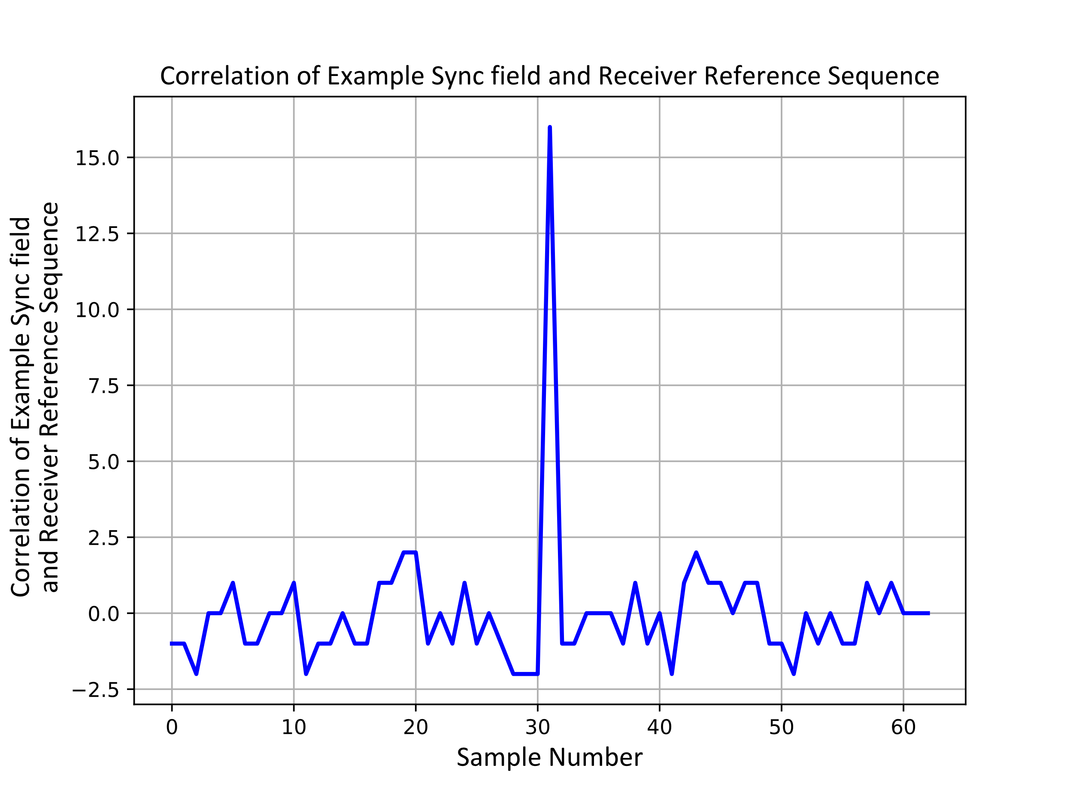
Correlation of Example Sync field and Receiver Reference Sequence
We see from the correlation of the example Sync field and the Receiver Reference Sequence that there is a very identifiable peak at the proper time
The maximum peak is 16 in this example
The next largest peak is 2

Slide 8
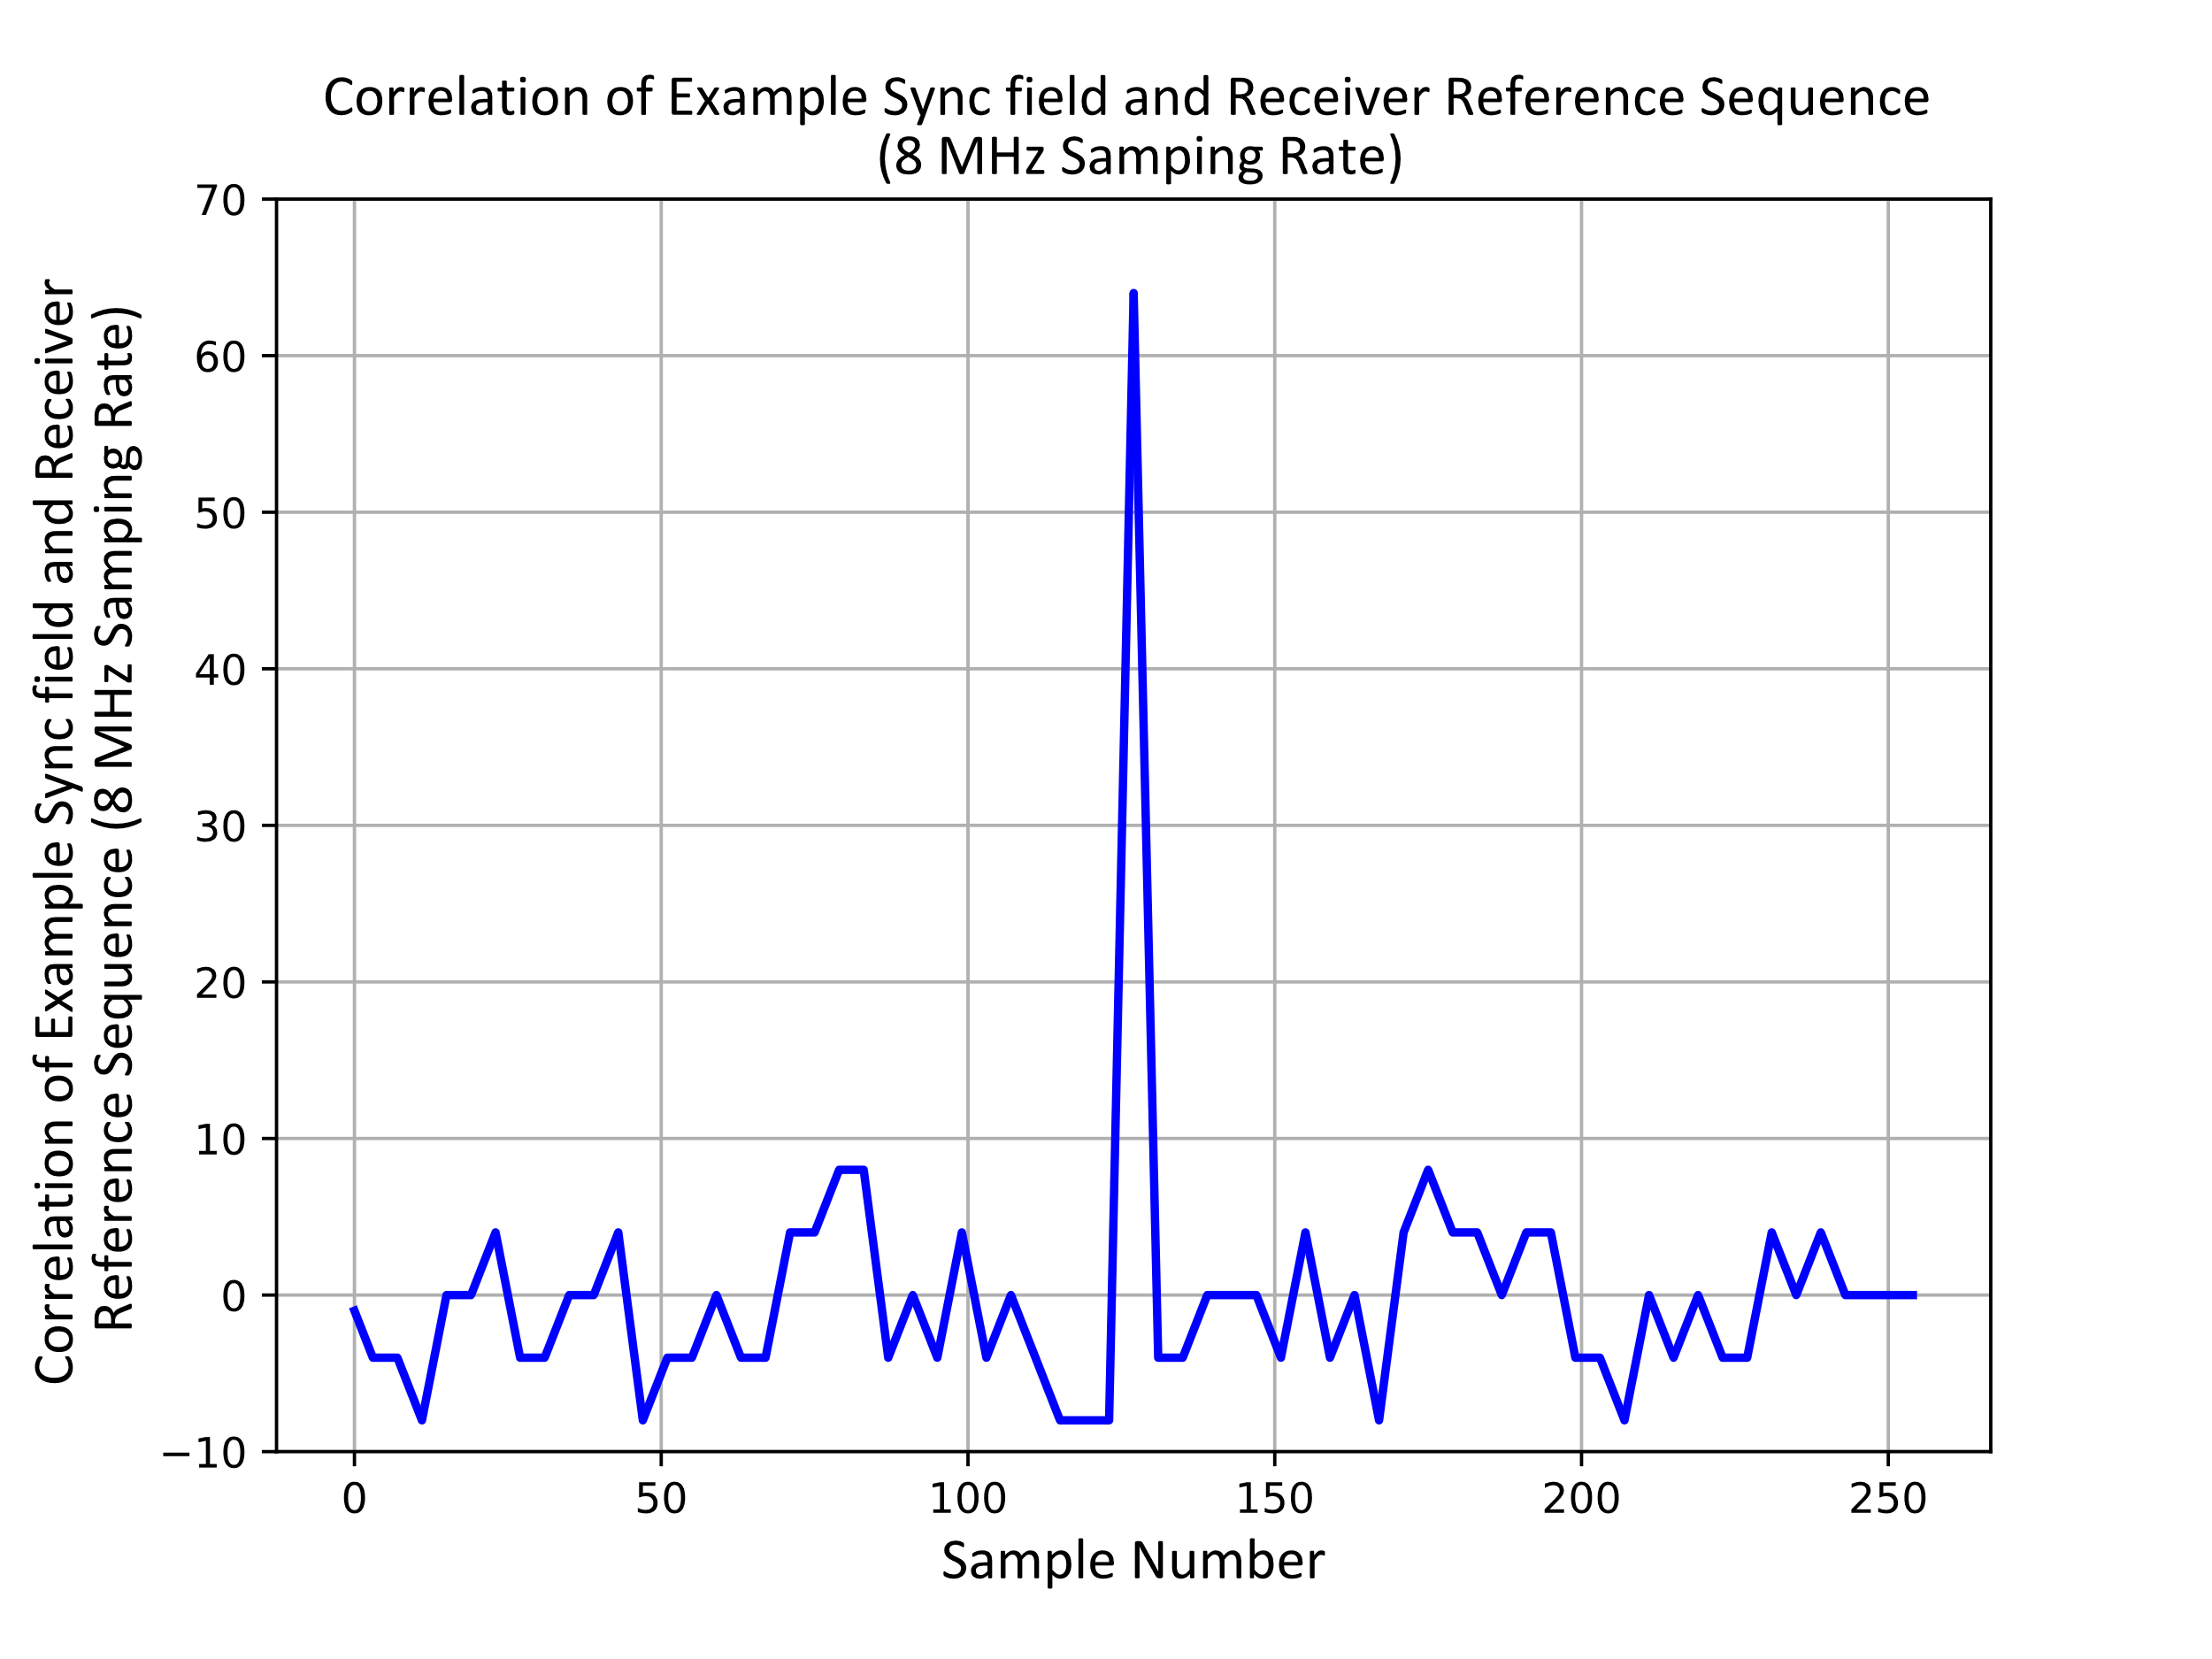
8 MHz Sampling
In practice we want to sample multiple times for each OOK symbol
It has been suggested that four samples per OOK symbol is a reasonable choice
For our example Sync field this corresponds to 8 MHz sampling rate
We see that the shape of the output of the correlator is the same, just scaled up since we have 4 samples per OOK symbol

Slide 9
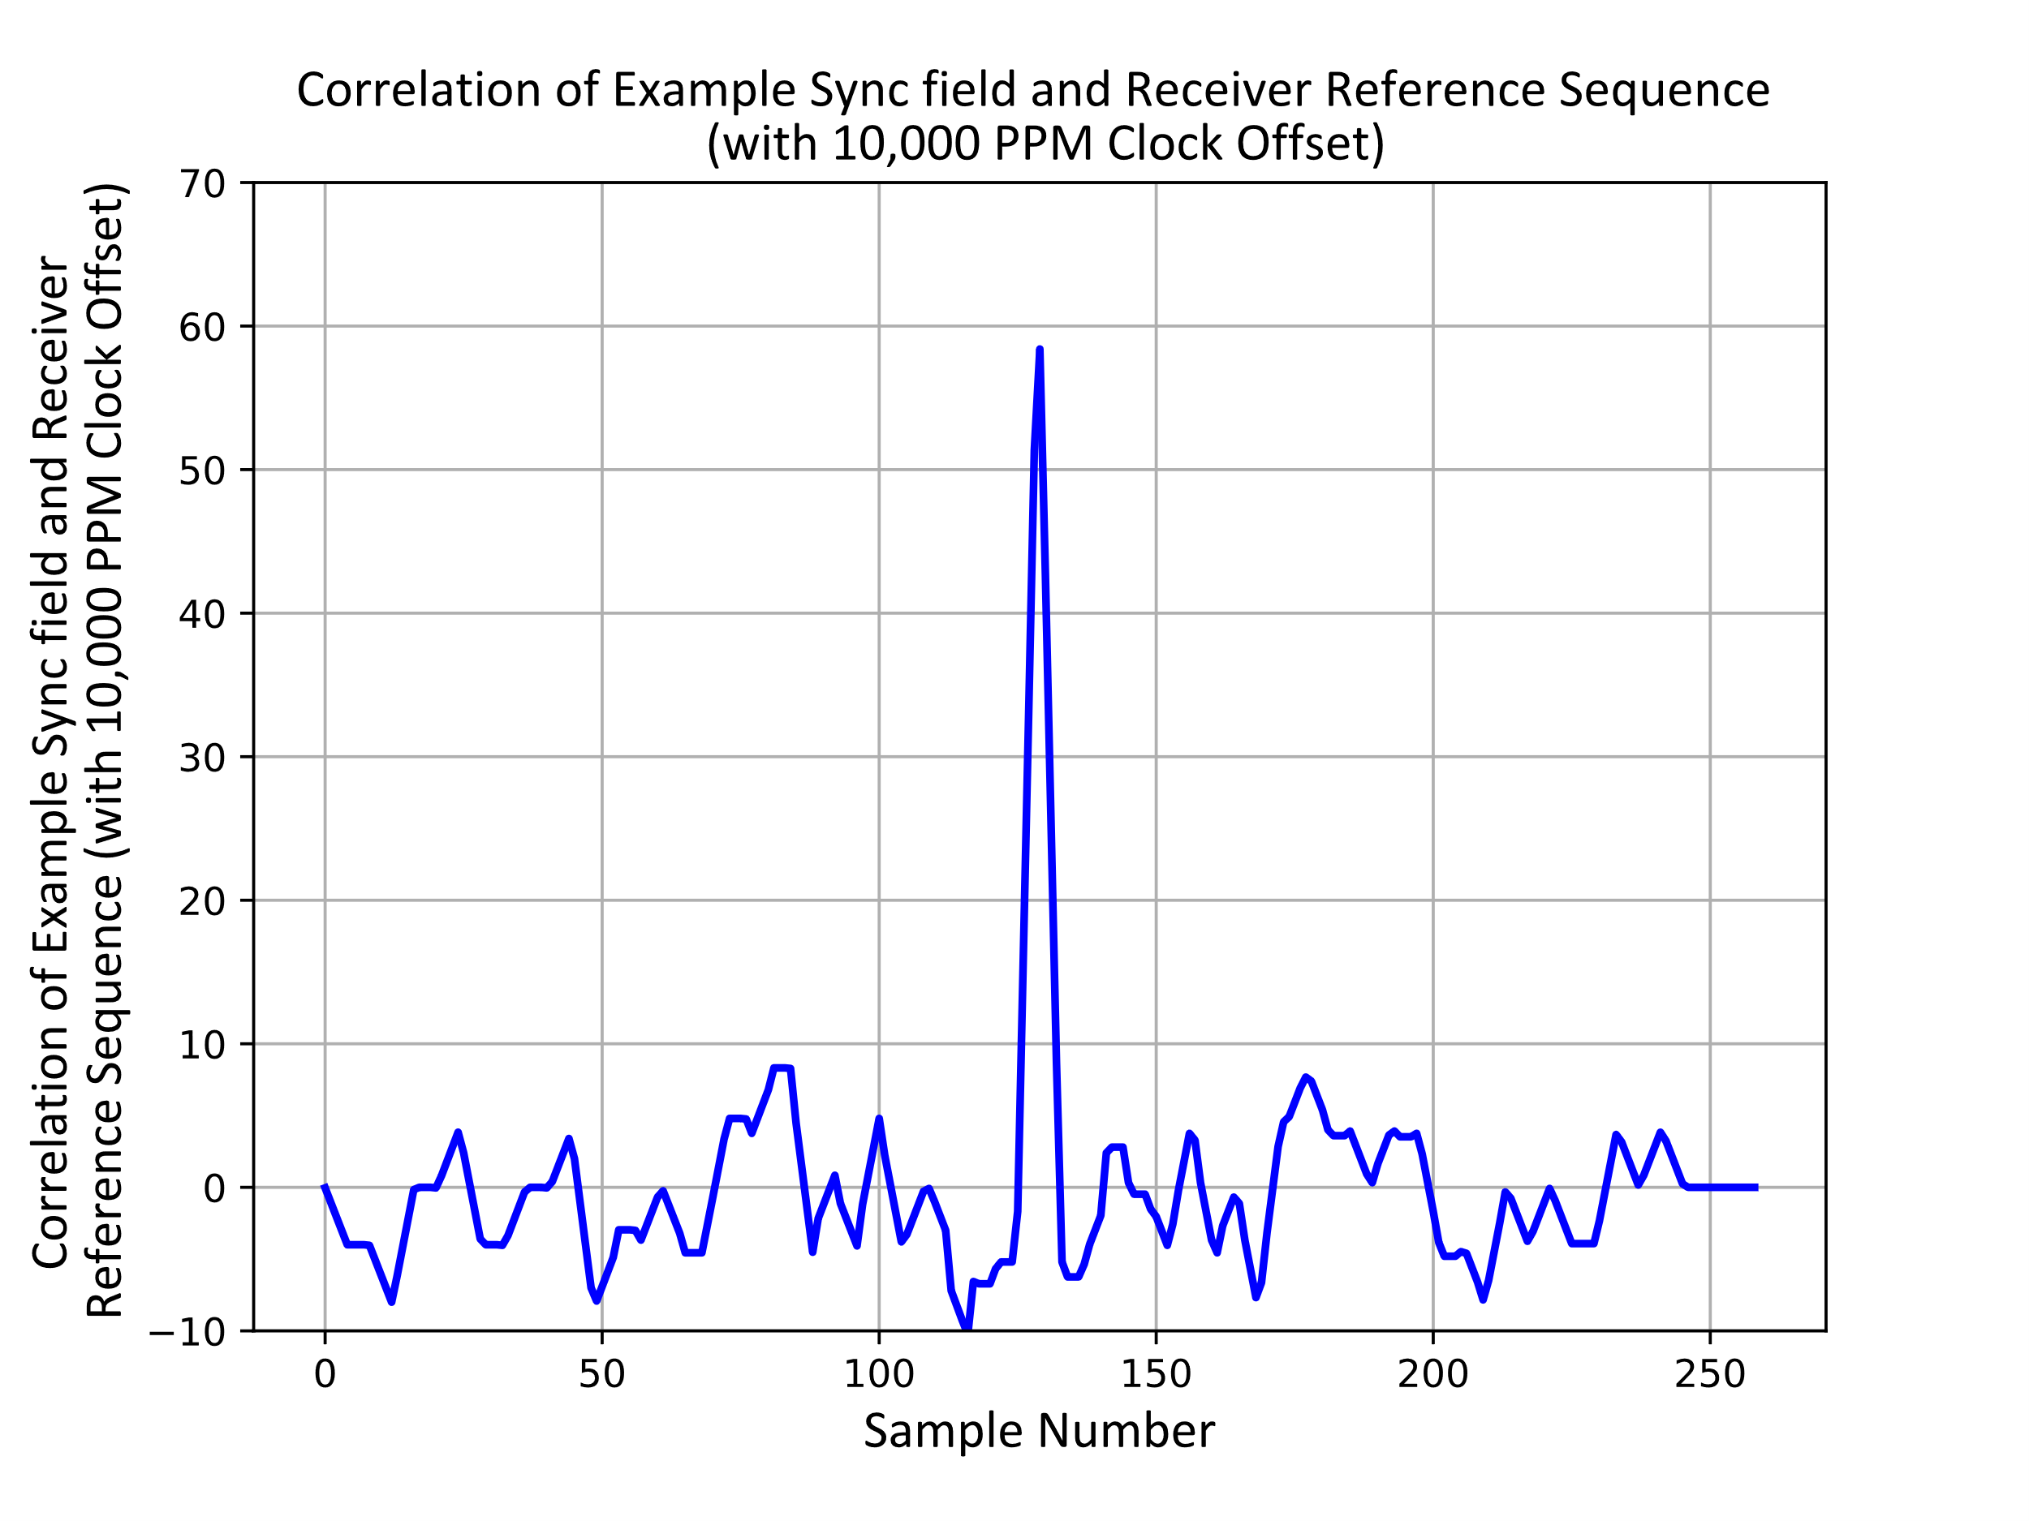
Clock Accuracy
The Task Group has not yet agreed on the required Clock Accuracy for the non-Backscatter STA receiver
There is some interest in supporting a clock accuracy of $±10,000$ PPM
Here we test the case where there is a clock offset of 10,000 PPM at the STA receiver
There is a small drop in the peak value
Over the period of the 16 µs Sync field the clock will drift 0.16 µs, which is 32% of one OOK symbol

Slide 10
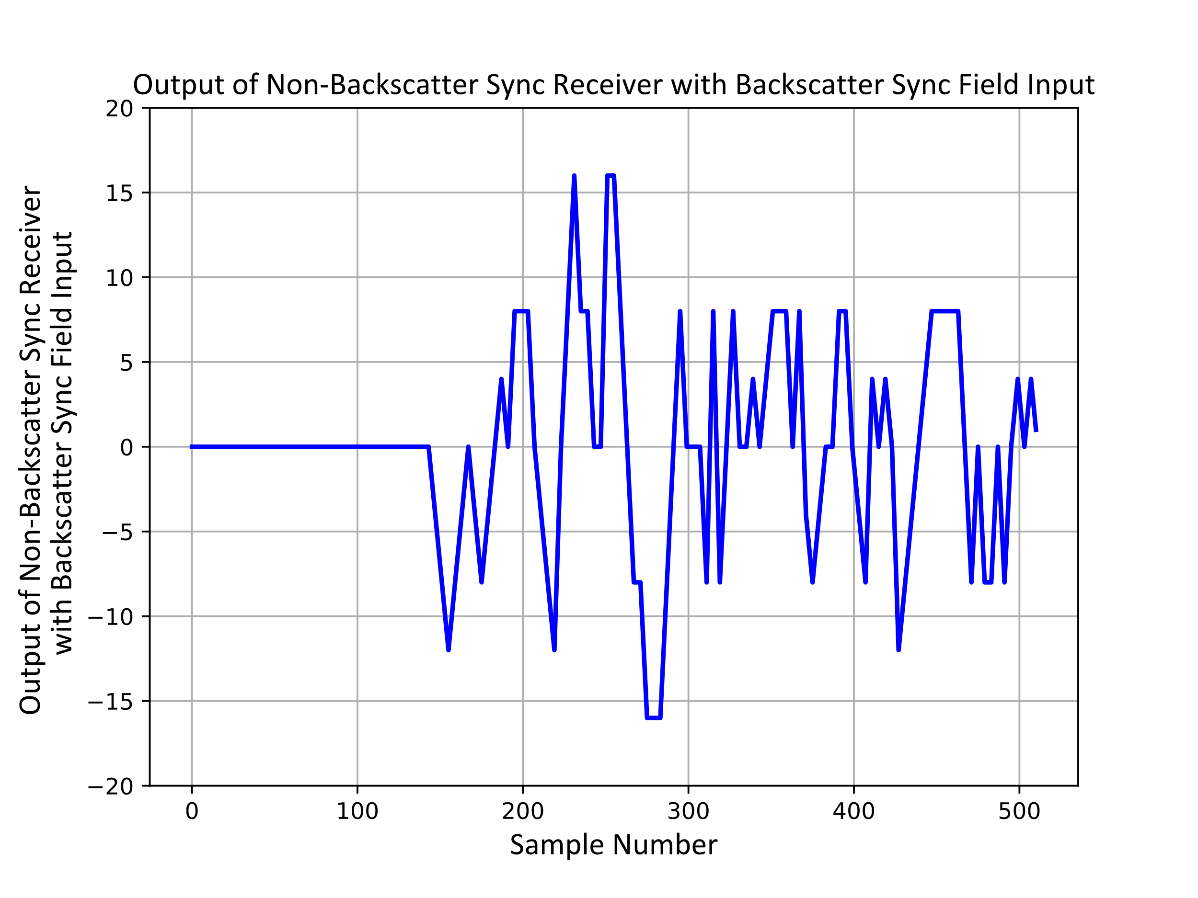
Output of non-Backscatter STA Receiver with Backscatter Sync Field Input
We will consider one of the example sequence suggested in [1]
{0 1 1 1 0 1 0 0 0 1 1 1 0 0 0 1}
Here the OOK symbols are 2 µs in duration
We consider this as an input to the non-Backscatter receiver to see if a false alarm is likely
We see this is quite distinguishable from the output from the non-Backscatter Sync field

Slide 11
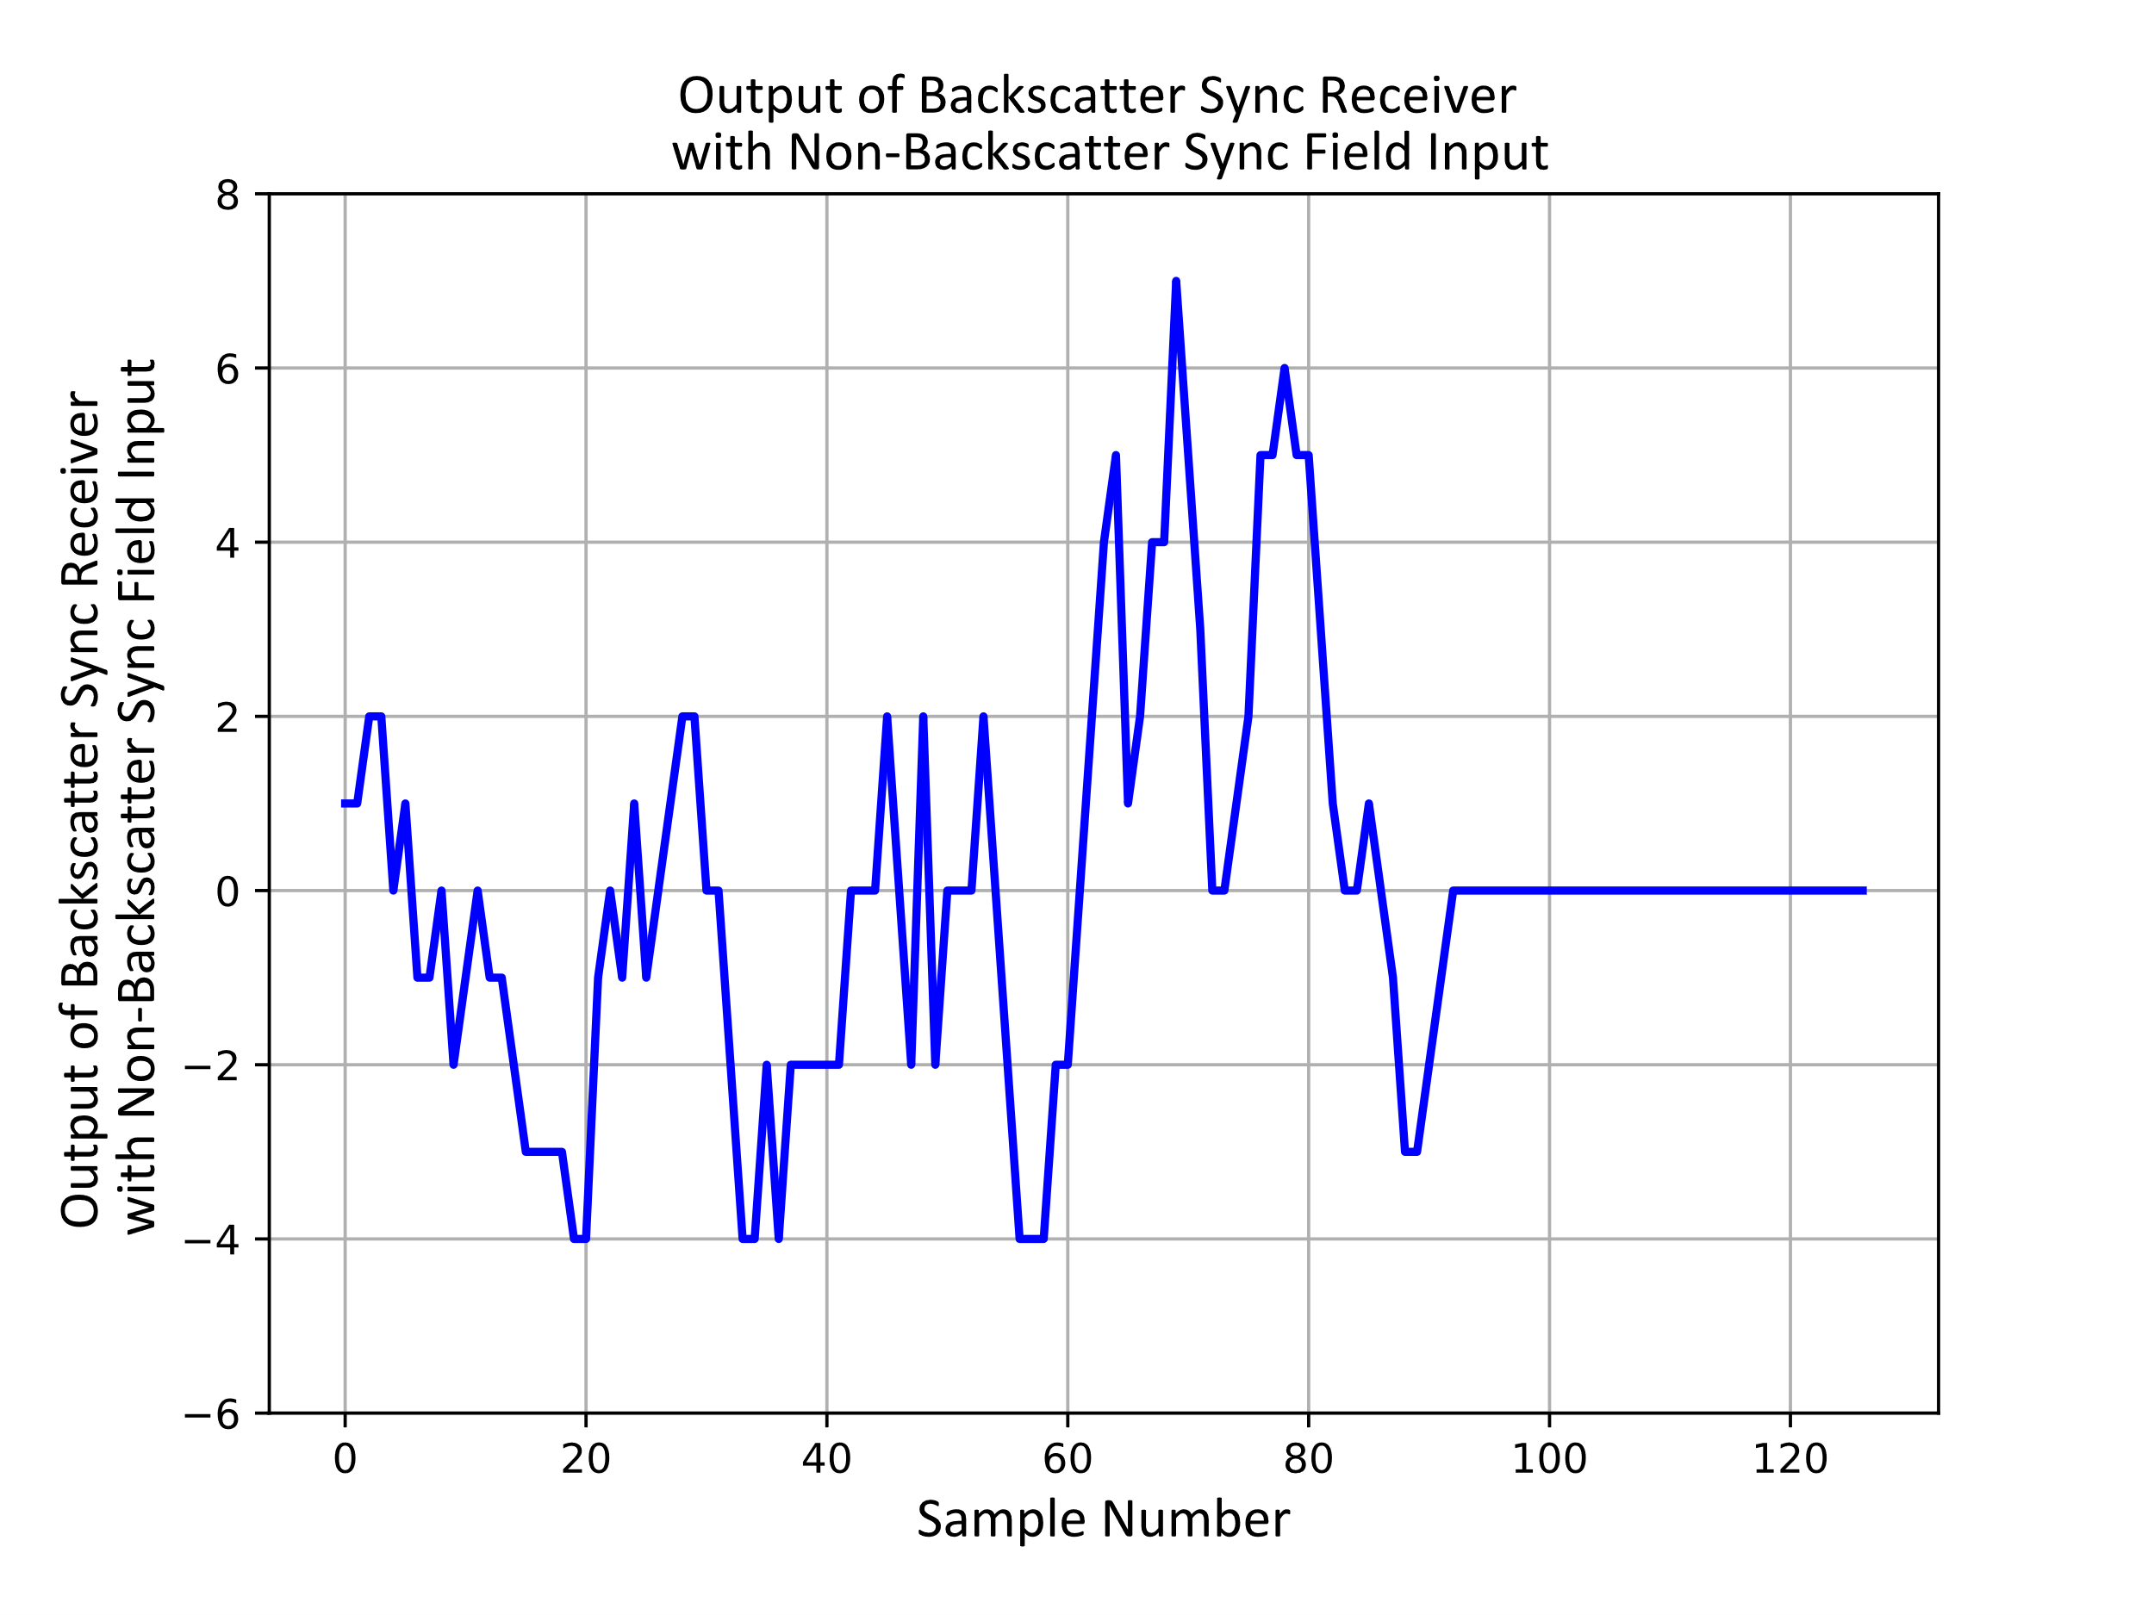
Output of Backscatter STA Receiver with non-Backscatter Sync Field Input
Now we consider the Backscatter Receiver Sync field detector with the non-Backscatter Sync field as an Input
Also, quite distinguishable from the output when a Backscatter STA receiver Sync field detector with the Backscatter STA Sync field

Slide 12
Potential Sync Detector Implementation Approaches
We consider two potential implementation approaches
One approach could be used in a high SNR case
For example, Integrated Energizer
Another approach could be used in a lower SNR case
For example, non-Integrated Energizer

Slide 13
Possible Implementation – High SNR Case
Based on reception of the 802.11 preamble the receiver can estimate the receive power and set a threshold for detection level to distinguish between On and Off power levels
The receiver samples at 8 MHz (4 samples per OOK symbol)
Some of the early samples could be from the 802.11 preamble, but the Sync detector searches for the 4x oversampled Sync field

Slide 14
Possible Implementation – High SNR Case (cont.)
Set Comparator Threshold based on 802.11 Preamble
Sample and Hold the compare to Comparator Threshold
Sample at 4x Symbol rate and store bits in a shift register
Every sample we apply the 4x Reference array (of +1 and -1 values) which involves adding and subtracting
Then we compare the output to a Detection Threshold
Likely between 8 and 58, see Slide 8

Slide 15
Possible Implementation – Lower SNR Case
Since the SNR could be lower it may be difficult to set the threshold properly based on the reception level of the 802.11 preamble
In this case we can use a small (e.g., 2-to-3-bit ADC) which would increase the power consumption level but at the benefit of Sync field detection in a lower SNR case
The receiver sets the ACG level based on the 802.11 preamble reception level
A small ADC samples the signal at 8 MHz
The Sync detector searches for the Sync field at the 4x oversampling rate

Slide 16
Possible Implementation – Lower SNR Case (cont.)
The comparator with a variable threshold has been replaced with an AGC and a small X-bit ADC
The shift register now shifts X-bit quantities
This requires some increase in power consumption and can detect at lower SNR

Slide 17
Summary
Suggested an approach to design a Sync field for the 1 Mb/s Downlink PPDU
Provided an example sequence (borrowed from 802.11ba)
Example Sync field would use thirty-two 0.5 µs OOK symbols, for a duration of 16 µs
Showed the example Sync field would work with 10,000 PPM clock offset
Showed that the example Sync field would have low correlation with an example Sync field for the 250 kb/s Downlink PPDU
Gave two examples of possible Sync field detector implementations
One uses a comparator for low power consumption at high SNR
Another uses an AGC and a small ADC requiring more power consumption and working at lower SNR

Slide 18
Next Steps
Task Group discusses and agrees on Simulation parameters
Channel Models
Adjacent Channel Interference
Receiver Models
Etc.
Build simulation for Data Field decoding assuming timing alignment is accurate
Build Sync field simulation
Evaluate several possible Sync field designs
Note, the Sync field detection should work at lower SNR than the Data field decoding
Compare simulations from different companies
Agree on Sync field design

Slide 19
References
Rui Cao, et. al., “Design Considerations of DL Data Rate and SYNC,” IEEE 802.11-24/1797r0, November 2024
Steve Shellhammer, et. al., “AMP Downlink Sync Field Options,” IEEE 802.11-24/1816r0
Amichai Sanderovich, et. al., “Considerations For Sync Sequence Selection,” IEEE 802.11-24/1982r0, December 2024
IEEE Std 802.11ba, IEEE Standard for Local and Metropolitan Area Networks: Wireless LAN Medium Access Control (MAC) and Physical Layer (PHY) Specifications. Amendment: Wake-up Radio Operation, 2021

