Slide 1
Follow-up on AMP Energizer
Date: 13 Jan 2025
Name | Affiliation | Address | Phone | Email
Ian Bajaj | Huawei | Singapore |  | ian.bajaj@huawei.com
Lei Huang
Rojan Chitrakar
Bin Qian |  | Shenzhen, China
Notes:
Jul 12, 2010
Page 1

Slide 2
Introduction
IEEE TGbp PAR [1] defines at least one mode of wireless power transfer in the sub-1 GHz band to support RF energy harvesting.
In [2], we discussed the architecture for the AMP Energizer, its function, and how it receives control information.
In this contribution, we aim to clarify the definition of the AMP Energizer, and propose an architecture that aligns with the agreed topologies for AMP Energizer [3], based on the feedback received.

Slide 3
AMP Energizer Definition
AMP Energizer is a new entity in IEEE 802.11 device architecture.
A non-collocated AMP Energizer may include a non-AMP non-AP STA (non-HT/HT/VHT/HE/EHT/UHR STA) that receives WPT control or Carrier Source control signaling from the AP.
This does not preclude AMP Energizers that receive control information through a wired connection or out-of-band (OOB) signaling.
The AMP Energizer has an Energizing Function that can transmit different signals as instructed by the control signal to provide to the AMP STAs:
WPT
Excitation signal (Carrier Signal) for Backscattering (CSB)
For a non-collocated AMP Energizer, the WPT/CSB capability information can be shared during probing or association with an AP.

Slide 4
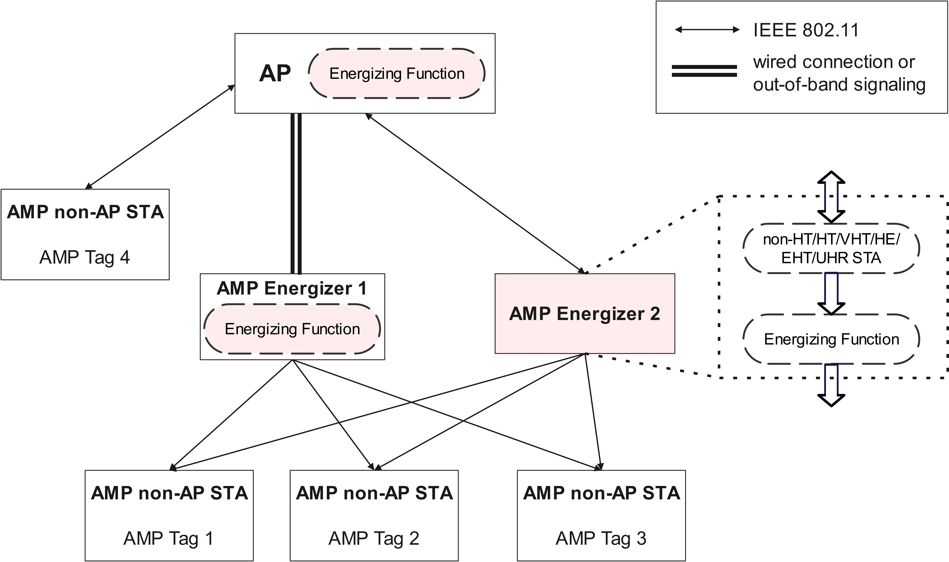
AMP Energizer Architecture
An AP can associate with multiple AMP Energizers.
The Energizer non-AP STA receives control information from an AP that is associated with to determine its Energizing Function.
This control information may also be sent via wired connection or OOB signaling
The Energizing function may be a logical entity for a integrated AP-Energizer architecture.
1
2
3
Energizer Topologies (FRD)
integrated
wired connection
wireless connection
1
2
3

Slide 5
Control Signaling
The control signaling to a non-collocated AMP Energizer can encapsulate WPT, and CSB instructions, such as:
WPT/CSB indication
Duration field indicating the duration of the charging/excitation field, and/or the duration of the control field
Interval field indicating the duration between subsequent signal transmissions
Waveform used
Transmit power indication
Start Time indication
etc…

Slide 6
Summary
The AMP Energizer entity with its corresponding architecture is defined.
The AMP Energizer determines its Energizing Function based on the control signaling received, to support WPT, and/or backscatter operation.
The information that can be carried in the control signal to the AMP Energizer is discussed.

Slide 7
SP1
Do you agree to add the following text to TGbp SFD?
IEEE 802.11bp defines an AMP Energizer that contains an Energizing Function, which is capable of transmitting WPT waveform and/or excitation waveform for backscattering operation. Additionally, the AMP Energizer may contain an IEEE 802.11 non-AMP non-AP STA.
Note: WPT waveform is transmitted over sub1-GHz. Depending on whether the backscattering operation happens in sub1-GHz or 2.4GHz, accordingly the excitation waveform will be transmitted in the same band.
[Reference: 11-24/1767r0, 11-25/0037r0]

Slide 8
SP2
Do you agree to add the following text to TGbp SFD?
IEEE 802.11bp defines a mechanism that allows control information to be sent to the AMP Energizer. The control information is TBD.
[Reference: 11-24/1208r1, 11-24/1769r0, 11-25/0037r0]

Slide 9
References
[1] 11-24/0575r1, P802.11bp PAR.
[2] 11-24/1767r0, AMP Energizer
[3] 11-24/1787r2, Further Consideration of WPT for AMP

