Slide 1
Sync field for AMP PPDU
Jan. 2025
Doc.: IEEE 802.11-25/0034r1
Date: 2025-1-10
Authors:
Name | Affiliation | Address | Phone | Email
Wang Ke | OPPO |  |  | wangke6@oppo.com
Jinyu Zhang |  |  |  | xuweijie@oppo.com
Weijie Xu |  |  |  | v-qiyinan@oppo.com
Yinan Qi
Sehngjiang Cui

Slide 2
Abstract
Doc.: IEEE 802.11-25/0034r1
In this contribution, we will firstly discuss the requirement for the Sync field and then propose candidate sync sequence.

Slide 3
High-level requirements for AMP sync(1)
Doc.: IEEE 802.11-25/0034r1
In [1]. the following requirements for AMP sync are discussed.
Different sync sequences for DL/UL for indication.
Support two different AMP DL rate
e.g. 1Mbps and 250kbps using 2 different sync
A correlator can distinguish between Sync length 16 and 32.
The Sync sequence has the same number of 1 and 0.
Good auto-correlation
The sequence have 3 consecutive 1/0, which can help distinguish synchronization field and data field with Manchester coding.

Slide 4
High-level requirements for AMP sync(2)
Doc.: IEEE 802.11-25/0034r1
During previous meeting, sync field for different receiver type have been discussed.
For some device type, e.g. close-range dual-mode RFID-like AMP STA, it may not have correlator in the its receiver
Therefore, it needs to consider both receiver types with and without correlator inside.
For the AMP device without correlator, it will use sequence matching for AMP sync field detection.
False alarm rate is the key metric, which related to the length of sync sequence
The sync sequence needs to be decode by the receiver, manchester coding is necessary to guarantee the decoding performance

Slide 5
Proposed methodology
Doc.: IEEE 802.11-25/0034r1
In order to fulfill the requirement for both receiver types, the following methodology is proposed:
Step 1: design AMP sync that fulfill the requirements for AMP receiver with correlator
Step 2: check whether sync sequence is applicable for AMP receiver without correlator

Slide 6
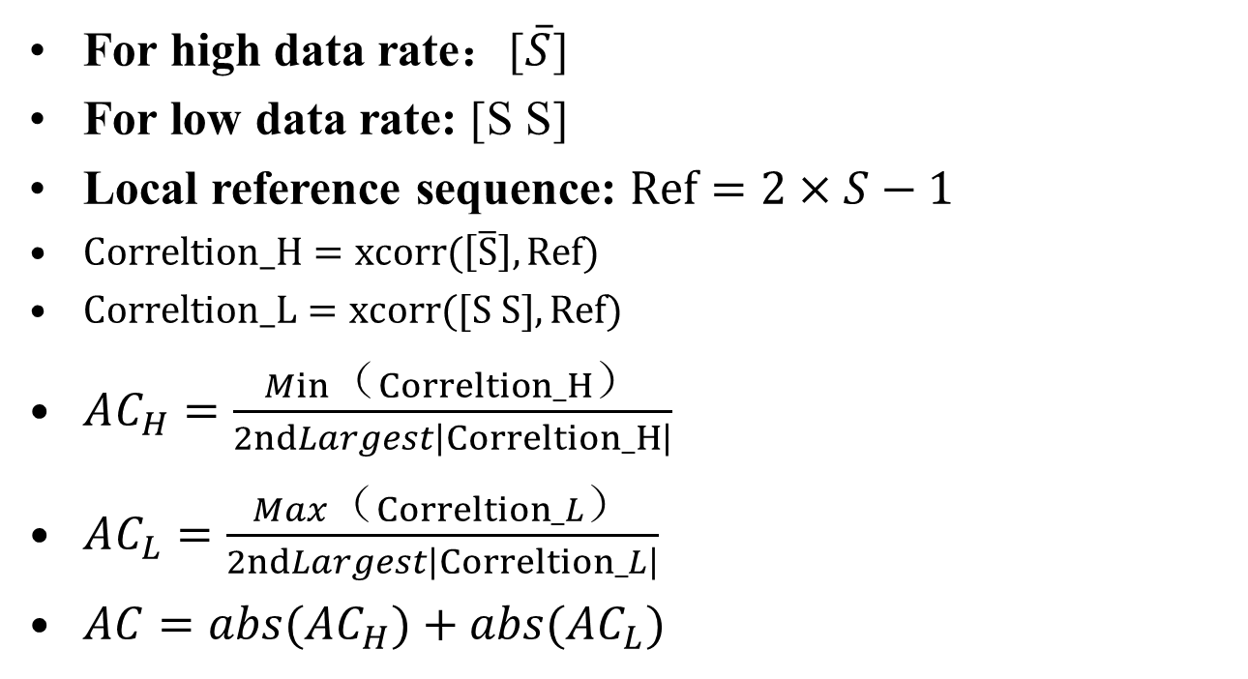
Recap: Auto-Correlation Metrics
Doc.: IEEE 802.11-25/0034r1
For high data rate：[$\overline{S}$]
For low data rate: [S S]
Local reference sequence: $Ref=2×S−1$
$Correltion_H=xcorr(\left[\overline{S}\right], Ref)$
$Correltion_L=xcorr([S S], Ref)$
$AC_{H}=\frac{Min（Correltion_H）}{2ndLargest\left|Correltion_H\right|}$
$AC_{L}=\frac{Max（Correltion_L）}{2ndLargest\left|Correltion_L\right|}$
$AC=abs(AC_{H})+abs(AC_{L})$

Slide 7
Recap: Cross-Correlation Metrics
Doc.: IEEE 802.11-25/0034r1
The Sync sequence will be correlated with other filed of the UL/DL PPDU e.g., random Manchester coding symbols to see the cross-correlation property
The sync sequence shall maintain low cross-correlation with other filed of UL/DL PPDU

Slide 8
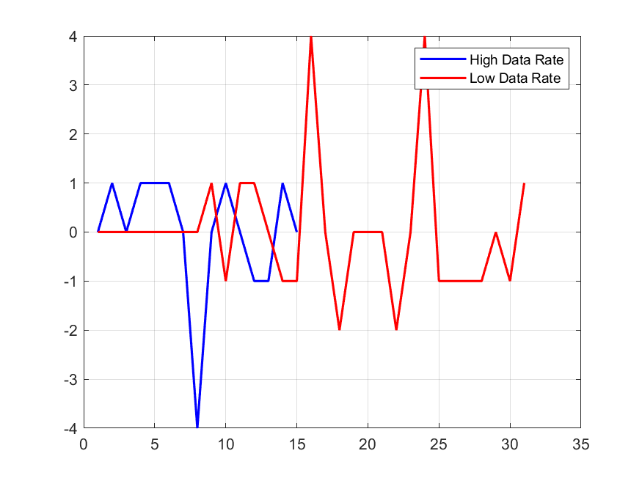
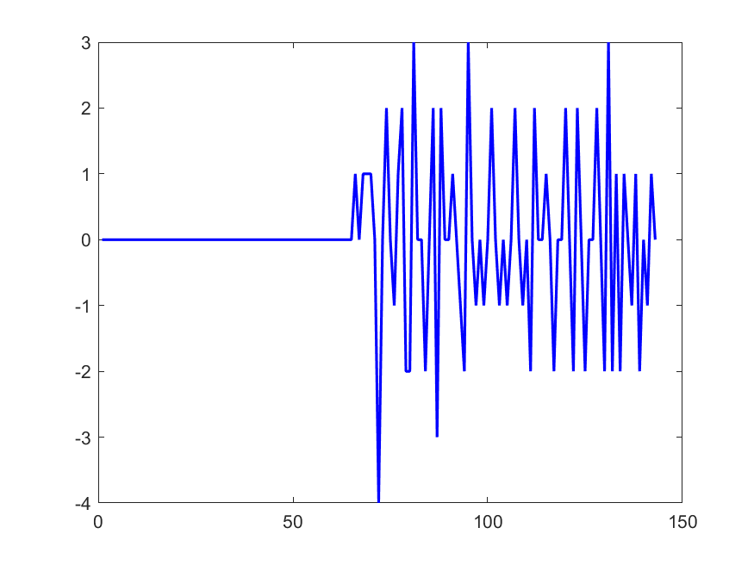
Sync sequence length(1)
Doc.: IEEE 802.11-25/0034r1
For length 8, the auto-correlation is not so good and cross-correlation with random Manchester symbols become unacceptable.
One sequence after computer searching is '10001101'
AC_H: -4 AC_L: 2
Cross-correlation with Random Manchester symbols

Slide 9
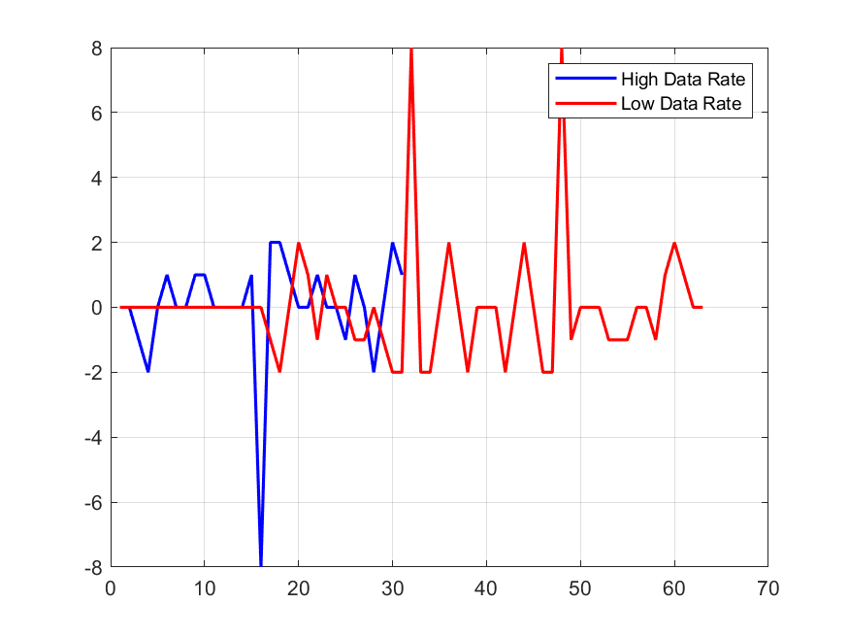
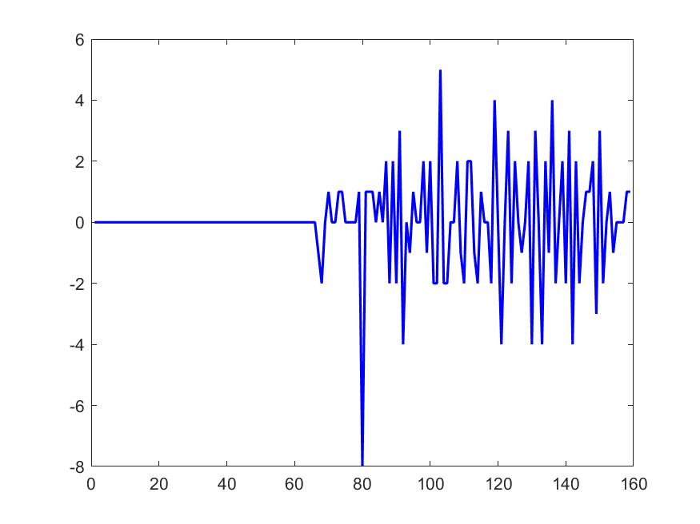
Sync sequence length(2)
Doc.: IEEE 802.11-25/0034r1
For length 16, the auto-correlation is better and cross-correlation with random Manchester symbols is good
One candidate sequence after computer searching is '1100100101011100'
AC_H: -4 AC_L: 2
Cross-correlation with Random Manchester symbols

Slide 10
Synchronization performance(1)
Doc.: IEEE 802.11-25/0034r1
The synchronization performance is evaluated with the following assumptions:
Parameters | Values
Length of AMP sync sequence | 16
Waveform | DSSS-OOK
Channel model | Channel B
Chip duration | 0.5/1/2µs
Sampling rate at AMP device | 2MHz/8MHz
Receiver type | ED receiver

Slide 11
Synchronization performance(1)
Doc.: IEEE 802.11-25/0034r1
Simulation results for 2MHz sampling rate at AMP STA. Note that the sync error is represented as the number of sampling points. The probability of different error samplings are recorded.
Table 1: Sync performance when chip duration is 0.5 µs
Table 2: Sync performance when chip duration is 1 µs
Table 3: Sync performance when chip duration is 2 µs

Slide 12
Synchronization performance(2)
Doc.: IEEE 802.11-25/0034r1
Simulation results for 8MHz sampling rate at AMP STA. Note that the sync error is represented as the number of sampling points. The probability of different error samplings are recorded.
Table 4: Sync performance when chip duration is 0.5 µs
Table 5: Sync performance when chip duration is 1 µs
Table 6: Sync performance when chip duration is 2 µs

Slide 13
Impact on decoding performance(1)
Doc.: IEEE 802.11-25/0034r1
When there is synchronization error, the impact on data decoding performance is evaluated with the following assumptions:
Parameters | Values
Date Rate | 250kpbs/1MHz
Waveform | DSSS-OOK
Channel model | Channel B
Chip duration | 2µs/0.5µs
Sampling rate at AMP device | 2MHz/8MHz
Coding | Manchester
Receiver type | ED receiver
synchronization error | 1 Sampling point

Slide 14
Impact on decoding performance(2)
Doc.: IEEE 802.11-25/0034r1
Simulation results for data rate of 250kbps in channel B
Figure 1: DL PPDU decoding performance @sampling rate of 2MHz
Figure 2: DL PPDU decoding performance @sampling rate of 8MHz

Slide 15
Impact on decoding performance(3)
Doc.: IEEE 802.11-25/0034r1
Simulation results for data rate of 1Mbps and sampling rate of 8MHz
Figure 3: DL PPDU decoding performance （Channel B）

Slide 16
Observation
Doc.: IEEE 802.11-25/0034r1
Based on the simulation above, we have the following observations
For AMP sync field, the synchronization will be affected by:
Length of sync filed
Chip duration
Sampling rate of AMP STA’s receiver
For AMP sync of length 16, the sync performance for chip duration of 1µs and 2µs is acceptable.

Slide 17
Summary
Doc.: IEEE 802.11-25/0034r1
In this submission, sync sequence for AMP is discussed. Based on the discussion, the following is proposed.
Basic sync length is 16, one proposed sequence is
S1= '1100100101011100’
Chip duration of sync field is 2 µs or 1 µs .

Slide 18
Jan. 2025
Doc.: IEEE 802.11-25/0034r1
Straw Poll #1
Do you agree with the following text:
Basic AMP sync length is 16, one proposed sequence is
S1= '1100100101011100’
Chip duration of sync field is 2 µs or 1 µs .
Yes
No
Abstain
Slide 18
Weijie Xu (OPPO)

Slide 19
Reference
Jan. 2025
Doc.: IEEE 802.11-25/0034r1
IEEE 802.11-24/1802r0 Sync field for AMP PPDU

