Slide 1
Duty-cycle AMP operation
Jan 2025
Doc.: IEEE 802.11-25/0032r0
Date: 2025-01-05
Authors:
Name | Affiliation | Address | Phone | Email
Chuanfeng He | OPPO |  |  | hechuanfeng@oppo.com
Weijie Xu |  |  |  | xuweijie@oppo.com
Yinan Qi |  |  |  | v-qiyinan@oppo.com

Slide 2
Abstract
Doc.: IEEE 802.11-25/0032r0
This submission is to discuss duty-cycle AMP operation.
  Preliminary power saving evaluation for duty-cycle AMP operation
  Some issues on the duty-cycle AMP operation

Slide 3
Jan 2025
Doc.: IEEE 802.11-25/0032r0
Background
  For AMP communication, power storage is necessary for AMP STA to supply the operation power when simultaneously harvested power only is not enough to cover the consumed power[1].
  The motion about maximum timing offset was agreed [2] [3] [4].
  MM-1: If AMP device is able to support AMP TSF, the maximum timing offset is ±10⁴ ppm.
  Power saving from duty cycle
    It is challenging for AMP STA to perform consistent monitoring for potential AMP trigger for uplink transmission due to limited power storage.
    Duty-cycle operation can reduce the time duration of AMP STAs Rx, which are the main contributors of power consumption during awake time.
Slide 3
Chuanfeng He (OPPO)

Slide 4
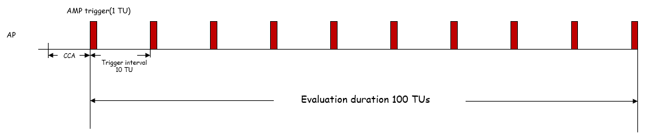
Jan 2025
Doc.: IEEE 802.11-25/0032r0
Power saving evaluation assumption
  Evaluation assumption at AP side
    AMP trigger interval: quantified to 10 time units(TUs)
    Duration of AMP trigger: quantified to 1 TU
    Duration for evaluation: 100 TUs, during which there are 10 triggers.
    For each AMP STA, there is a target trigger located randomly among the 10 triggers.
Slide 4
Chuanfeng He (OPPO)

Slide 5
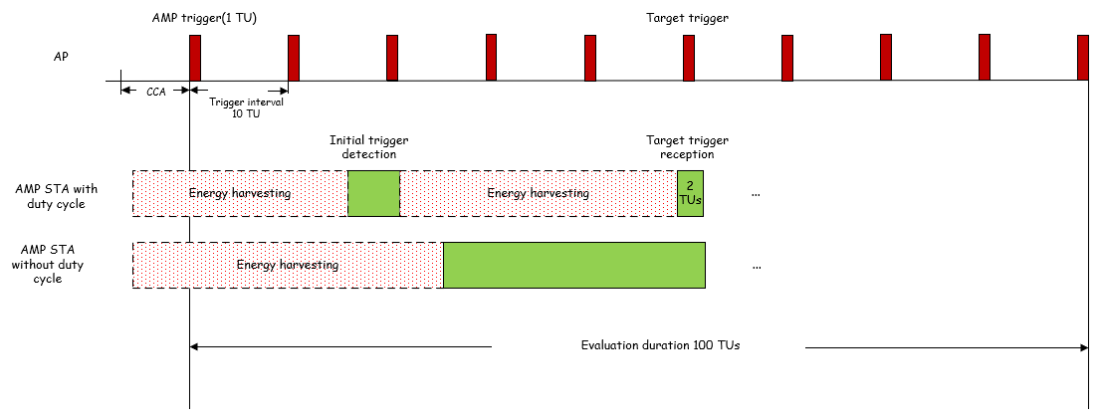
Jan 2025
Doc.: IEEE 802.11-25/0032r0
Power saving evaluation assumption
  Evaluation assumption at AMP STA side
    One AMP STA is associated with one target trigger from the 10 triggers.
    AMP STA with duty-cycle operation
      AMP STA blindly searches any trigger once it wakes up. Once any trigger is detected, AMP STA will know the transmission time of its target trigger.
      AMP STA can sleep until its target trigger arrives. The reception window for target trigger spans 2 TUs to address timing drifting.
    AMP STA without duty-cycle operation
      AMP STA continuously searches triggers once it wakes up, until the target trigger is detected.
Slide 5
Chuanfeng He (OPPO)

Slide 6
Jan 2025
Doc.: IEEE 802.11-25/0032r0
Preliminary power saving evaluation
  Power consumption evaluation
    Assume that the power consumption for reception and sleep is quantified to 1 and 0.01, respectively. The power consumption during sleep is neglectable in the following evaluation.
    AMP STA with duty-cycle operation
      The average duration for initial trigger detection is half of the trigger interval, i.e. 5 TUs
      The duration for target trigger reception is 2 TUs.
      The total power consumption is 7 TUs * 1 during 100 TUs.
    AMP STA without duty-cycle operation
      The average duration for initial trigger detection is half of 100 TUs, i.e. 50 TUs
      The total power consumption is 50 TUs * 1 during 100 TUs.
Slide 6
Chuanfeng He (OPPO)

Slide 7
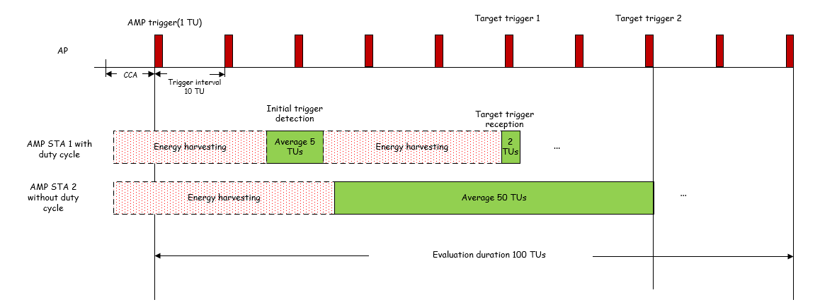
Jan 2025
Doc.: IEEE 802.11-25/0032r0
Preliminary power saving evaluation
    Power saving gain from duty cycle
      (50-7)/50 * 100%=86%
      The power saving gain from duty cycle should be larger, considering AMP STA with duty-cycle operation has more chances to perform energy harvesting or the trigger interval can be even larger than 10 TUs.
Slide 7
Chuanfeng He (OPPO)

Slide 8
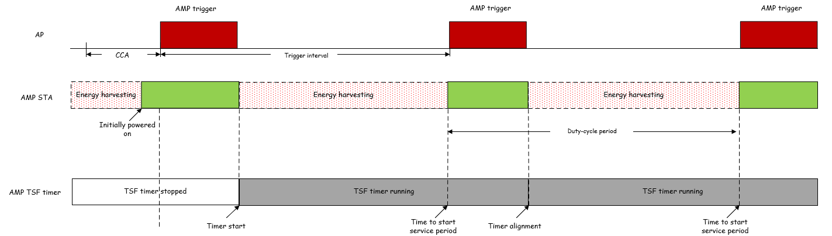
Jan 2025
Doc.: IEEE 802.11-25/0032r0
Issues on duty cycle operation
  Duty cycle configuration
    Duty cycle parameters, e.g. duty-cycle period, service period length
    Information for AMP STA to determine target trigger
    Delivery of duty cycle configuration by AMP trigger
  TSF for Duty-cycle operation
    Short timestamp
      The local TSF timer only spans short duration to support duty-cycle operation, e.g. one or several duty-cycle periods.
    Short timestamp is delivered by AMP
Slide 8
Chuanfeng He (OPPO)

Slide 9
Jan 2025
Doc.: IEEE 802.11-25/0032r0
Summary and proposals
  In this submission, the power saving gain of duty cycle operation is evaluated , and the preliminary results are shown.
  Duty-cycle AMP operation based on AMP TSF is proposed.
Slide 9
Chuanfeng He (OPPO)

Slide 10
Jan 2025
Doc.: IEEE 802.11-25/0032r0
Straw Poll #1 (For SFD)
Do you agree with the following text:
  If AMP device is able to support TSF, it can monitor AMP trigger in a duty-cycle manner.
Yes
No
Abstain
Slide 10
Chuanfeng He (OPPO)

Slide 11
Jan 2025
Doc.: IEEE 802.11-25/0032r0
Straw Poll #2 (For SFD)
Do you agree with the following text:
  Timestamp is provided in AMP trigger.
Yes
No
Abstain
Slide 11
Chuanfeng He (OPPO)

Slide 12
Jan 2025
Doc.: IEEE 802.11-25/0032r0
Straw Poll #3 (For SFD)
Do you agree with the following text:
  A short AMP timestamp is defined for AMP TSF.
  The length of the AMP timestamp is TBD.
Yes
No
Abstain
Slide 12
Chuanfeng He (OPPO)

Slide 13
Reference
Jan 2025
Doc.: IEEE 802.11-25/0032r0
IEEE 11-24/1775r1, Duty-cycle-amp-operation
IEEE 11-24/1322r5, IEEE 802.11 TGbp Motion Dock
IEEE 11-24/1475r3, Discussion on ultra-low power timing clock
IEEE 11-24/1613r3, Specification-framework-for-tgbp
IEEE 802.11-24/1774r0, Details of AMP trigger procedure

