Slide 1
Trigger based multiple access for AMP
Jan 2025
Doc.: IEEE 802.11-25/0031r1
Date: 2025-01-08
Authors:
Name | Affiliation | Address | Phone | Email
Chuanfeng He | OPPO |  |  | hechuanfeng@oppo.com
Weijie Xu |  |  |  | xuweijie@oppo.com
Yinan Qi |  |  |  | v-qiyinan@oppo.com

Slide 2
Abstract
Doc.: IEEE 802.11-25/0031r1
This submission is to discuss trigger based multiple access mechanisms for AMP.
  Trigger based TDM multiple access mechanisms
    One phase multiple access
    Two phases multiple access
    Issues for trigger based TDM multiple access mechanisms
  Trigger based FDM/CDM multiple access mechanisms

Slide 3
Jan 2025
Doc.: IEEE 802.11-25/0031r1
Recap: Trigger based AMP communications
  The motion about the requirement of an AMP-only device with active uplink communication in 2.4GHz was approved [1][2].
  PM-2: 11bp defines at least one mode of MAC/PHY that allows an AMP-only device with active uplink communication in 2.4GHz subject to the following requirements:
    clock accuracy requirement is relaxed compared to legacy 802.11 devices;
    the active uplink communication can only be sent in response to being polled by the AP.
  As discussed in [3], the AMP STA with backscatter can only be excited by excitation signal from AP or energizer, and further triggered by AP for backscatter uplink transmission.
Slide 3
Chuanfeng He (OPPO)

Slide 4
Jan 2025
Doc.: IEEE 802.11-25/0031r1
Recap: Multiple access mechanisms
  Burst uplink traffic from large number of AMP device is typical for AMP communication, e.g. in logistics and warehouse scenarios.
  Sequential polling/trigger is inefficient for the access of large number of AMP device.
    Large overhead of polling/triggering signaling
    Large average latency of uplink AMP data collection
    Large power consumption of AMP device due to long “waiting” time for target polling/triggering identification.
  Multiple access mechanism can address the burst type uplink traffic from large number of AMP device, including TDM, FDM and CDM.[4]
Slide 4
Chuanfeng He (OPPO)

Slide 5
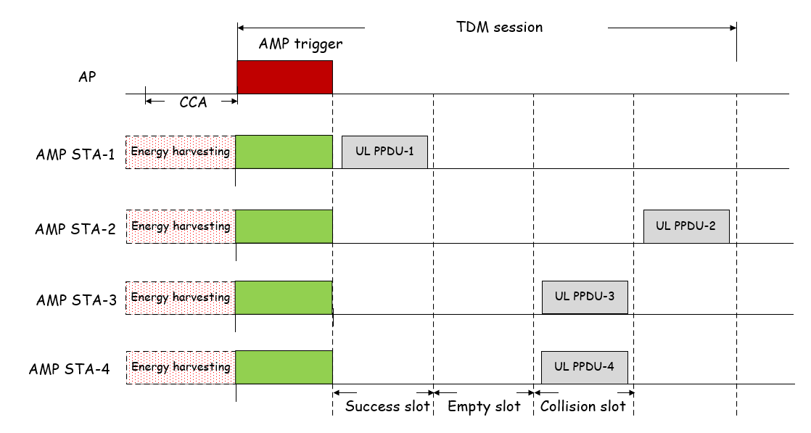
Jan 2025
Doc.: IEEE 802.11-25/0031r1
Trigger based TDM multiple access mechanism
  One AMP trigger grants multiple slots for multiple AMP STAs to access. There will be three types of TDM slots.[4]
    Success slot: AMP transmission from one AMP STA on the slot.
    Collision slot: Concurrent AMP transmission on the slot, which may lead to transmission failure.
    Empty slot: no AMP transmission on the slot, which may lead to slot waste and idle channel assessed by other devices.
  The first slot is success slot since only one AMP STA selects this slot for AMP transmission.
  The second slot is empty slot since no AMP STAs select this slot for AMP transmission.
  The third slot is collision slot because AMP STA 3 and 4 both select this slot for AMP transmission.
Slide 5
Chuanfeng He (OPPO)

Slide 6
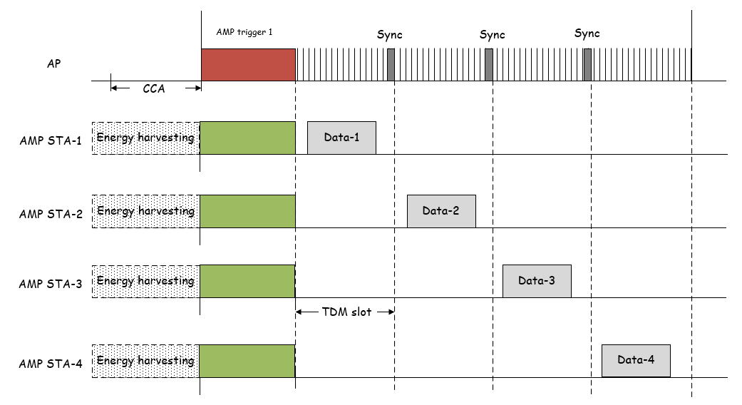
Jan 2025
Doc.: IEEE 802.11-25/0031r1
Potential TDM multiple access mechanisms (1)
  One phase multiple access
    AMP trigger schedules multiple slots for AMP STAs to perform direct data transmission
    AMP STAs choose one slot for data transmission.
    For backscatter or active transmitter
  Ideally, slots of AMP STA 1-4 are distributed evenly without collision.
Slide 6
Chuanfeng He (OPPO)

Slide 7
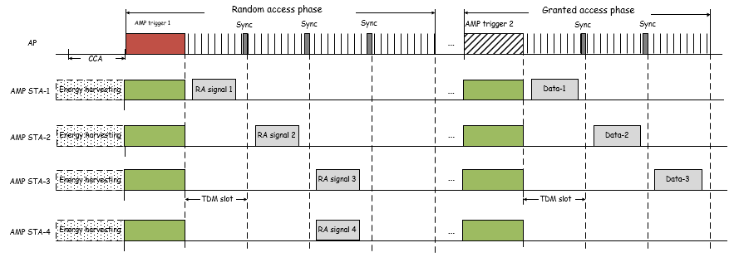
Jan 2025
Doc.: IEEE 802.11-25/0031r1
Potential TDM multiple access mechanisms (2)
  Two phases multiple access
    Random access phase: AMP STAs choose one slot scheduled by AMP trigger for random access (RA) signal transmission.
    Granted access phase: AP performs contention resolution based on the RA signals, and schedules slots for AMP STAs to perform data transmission.
    For backscatter or active transmitter
  Collison happens between AMP STA 3 and 4 during random access phase.
  Contention resolution by AP during granted access phase.
Slide 7
Chuanfeng He (OPPO)

Slide 8
Jan 2025
Doc.: IEEE 802.11-25/0031r1
Issue 1: Collision slots reduction
  For one phase multiple access
    Mechanism of slot distribution among AMP STAs should avoid collision slots as much as possible, e.g.
      Random distribution among slots
      Based on some distribution rules
  For two phases multiple access
    For random access phase, mechanism of slot distribution among AMP STAs should avoid collision slots.
    For granted access phase, collision slots can be avoided by contention resolution based on the RA signals.
Slide 8
Chuanfeng He (OPPO)

Slide 9
Jan 2025
Doc.: IEEE 802.11-25/0031r1
Issue 2: Empty slots avoidance
  One phase multiple access
    Empty slots can also be avoided by mechanism of slot distribution among AMP STAs as much as possible.
    It is still difficult to avoid empty slots since the potential UL transmission is unknown to AP.
  Two phases multiple access
    Similar to one phase multiple access, it is difficult to avoid empty slots during random access phase.
    Empty slots are avoided during granted access phase, since slots are scheduled for the AMP STAs whose RA signals are received by AP.
  Empty slots avoidance
    Empty slots can be avoided to improve resource utilization efficiency.
    Empty slots should be avoided for active transmitter case, which may lead to idle channel assessed by other devices.
      It can be realized by the assist of AP. For example, AP could send dummy signal once it detects empty slot.
Slide 9
Chuanfeng He (OPPO)

Slide 10
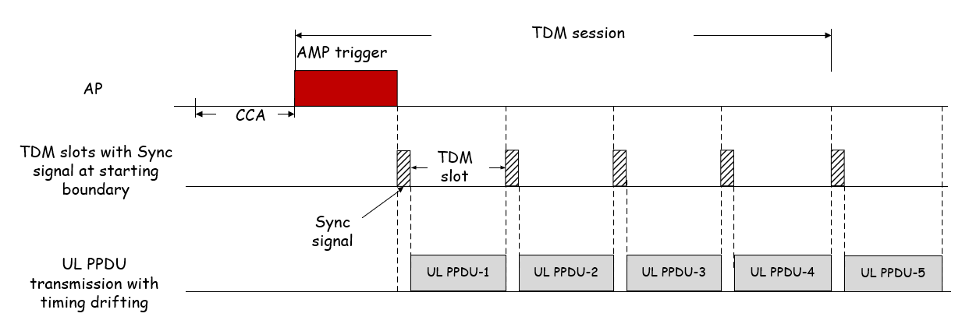
Jan 2025
Doc.: IEEE 802.11-25/0031r1
Issue 3: Time synchronization during TDM operation
  AMP STA is able to support AMP TSF, which means it can support TDM multiple access based on its local TSF time.[4]
  To address the timing drifting during TDM operation
    Option 1: Guard intervals are introduced between adjacent slots to minimize the potential collision due to timing drifting.
    Option 2: Sync signal at the TDM slot boundaries to align the AMP transmission on the TDM slots.
      The Sync signal is used to eliminate timing misalignment due to timing drifting. AMP STAs monitors sync signal of the target TDM slot before UL PPDU transmission.
Slide 10
Chuanfeng He (OPPO)

Slide 11
Jan 2025
Doc.: IEEE 802.11-25/0031r1
Issue 4: AMP trigger design (1)
  Terminology[3]
    Preferred to unify AMP terminology about trigger to ease further discussion.
    Proposed AMP terminology
      AMP trigger: A frame to trigger AMP transmission from AMP STAs.
  Signaling from AMP trigger[3]
    Resource grants
      Multiple access resources, e.g. TDM,FDM or CDM resources
    AMP transmission mode
      Resources for backscatter or active transmitter
    Power control for active transmitter
      To reduce the interference to the legacy WiFi devices, reduce power consumption, and optimize link adaptation.
Slide 11
Chuanfeng He (OPPO)

Slide 12
Jan 2025
Doc.: IEEE 802.11-25/0031r1
Issue 4: AMP trigger design (2)
    Timestamp for AMP TSF
      AMP transmission is triggered by AMP trigger. It should be easier to obtain timestamp from AMP trigger.
      Short timestamp to support multiple access operation
        The operation time duration for successful UL transmission may be short, e.g. in logistics and warehouse scenarios.
        The local TSF timer only need to span a short time period to support the transmission during at least one AMP trigger session.
        The timestamp in AMP trigger can be used to support TDM multiple access and duty-cycle operation.[3][4]
    Duty cycle configuration
      AMP trigger interval for AMP STA to detect AMP trigger.
      Duration of service period for AMP STA to detect AMP trigger.
Slide 12
Chuanfeng He (OPPO)

Slide 13
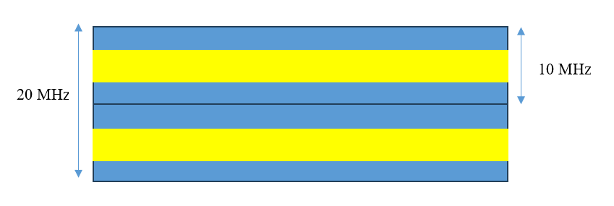
Jan 2025
Doc.: IEEE 802.11-25/0031r1
Trigger based FDM/CDM multiple access mechanism
  FDM
    As discussed in [4], it is feasible to use FDM for AMP device supporting active transmission. For AMP device with clock accuracy of ± 1000ppm, there can be several FDMed uplink channels.
    FDM can boost the access capacity at least for active transmission device. Therefore, it can reduce collision and improve the system efficiency.
    Whether it is possible to support FDM for backscattering needs further study, especially considering wideband carrier for backscattering is needed in 2.4GHz.
  CDM is discussed detailly in [5].
Slide 13
Chuanfeng He (OPPO)

Slide 14
Jan 2025
Doc.: IEEE 802.11-25/0031r1
Summary and proposals
  In this submission, triggered based multiple access for AMP was discussed.
  We propose to support at least TDM and FDM as triggered based multiple access mechanisms for AMP.
Slide 14
Chuanfeng He (OPPO)

Slide 15
Jan 2025
Doc.: IEEE 802.11-25/0031r1
Straw Poll #1
Do you agree with the following text:
  At least TDM and FDM are supported as trigger based multiple access mechanisms for AMP.
Yes
No
Abstain
Slide 15
Chuanfeng He (OPPO)

Slide 16
Jan 2025
Doc.: IEEE 802.11-25/0031r1
Straw Poll #2
Do you agree with the following text:
  AMP terminology about trigger is defined as “AMP trigger”.
Yes
No
Abstain
Slide 16
Weijie Xu (OPPO)

Slide 17
Jan 2025
Doc.: IEEE 802.11-25/0031r1
Straw Poll #3
Do you agree with the following text:
  The following signaling are delivered by AMP trigger:
      Resource grant
      AMP transmission mode
      Power control
      Timestamp
      Duty cycle configuration
Yes
No
Abstain
Slide 17
Weijie Xu (OPPO)

Slide 18
Reference
Jan 2025
Doc.: IEEE 802.11-25/0031r1
IEEE 802.11-24/1322r4, IEEE 802.11 TGbp Motion Dock
IEEE 11-24/1613r3, Specification framework for tgbp
IEEE 11-24/1774r1, details of amp trigger procedure
IEEE 11-24/1776r1, multiple access mechanisms for amp
IEEE 11-25/0035r0, CDM access for amp

