Slide 1
AMP UL Bi-Static Leakage and Dynamic-Range Implications
Date: 2025-01-13
Authors:

Slide 2
Abstract
Backscattering Uplink AMP performance in a Bi-Static scenario is analyzed and the direct carrier leakage effects on instantaneous dynamic range are considered, showing the limitations imposed on UL range.
Here we show that whereas leakage mitigation may be used in some scenarios (e.g. [4] and [5]), there are many other scenarios and use cases where leakage mitigation is not required.

Slide 3
Background: AMP Bi-Static Backscattering
P_{T} – Carrier power transmitted
P_{BS}- Power Backscattered
P_{RX} - Power received at the reader
P_{Lk} - Power leaked at the reader
T_{n} – Tag n
Uplink transmitted power by backscatter STAs (P_{BS}), depends on the EIRP of the carrier source, the path loss from it to the tag and the backscattering loss.
The desired AMP STA UL power P_{RX} arriving at the AP (reader) antenna, depends on the path loss from the tag to the AP.
An undesired direct leakage of the carrier signal of a magnitude P_{Lk} appears simultaneously at the AP with desired signal P_{RX} and acts as a blocker.
Backscattering
AP
BS Loss 1
D_{B1}
P_{RX1}
P_{BS1}
P_{Lk}
T₁
P_{RX2}
D_{A1}
D_{Lk}
D_{B2}
BS Loss Factors:
Modulation
Design
Frequency
Tag orientation
Object Absorption
P_{T}
Carrier Source
D_{A2}
BS Loss 2
P_{BS2}
T₂

Slide 4
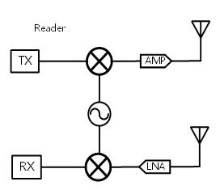
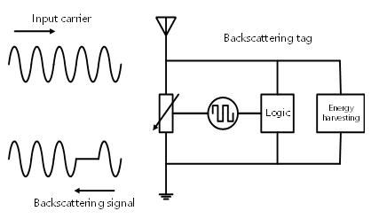
2.4 GHz Mono-Static Backscattering [1], [2]
[1]
[2]
Leakage signal: 0dBr
WiFi AMP reader
AMP tag
BS signal level: e.g. -30dBr
Can we follow a similar approach with Bi-Static BS?
Rx noise floor: e.g. -45dBr

Slide 5
Background: 2.4 GHz Uplink Backscattering [3]
In [3], the UL SNRs with no carrier direct leakage were treated.
Link Assumptions
P_{T} – Carrier power transmitted
P_{BS}- Power Backscattered
P_{RX} - Power received at the reader
Carrier Source EIRP | 20 dBm
Backscattering Loss | 5 dB
Reader NF | 9 dB
Reader minimum SNR | 3 dB
* 20dBm for < 10MHz BW in the US
AP
D_{B2}
P_{RX1}
BS Loss - without a mixer for frequency shifting
D_{B1}
FRIIS & SNR_{UL} [dB]
D_{B3}
D_{A2}
Backscattering Loss
BW |  |  | 1 MHz | 2 MHz | P_{EH} [dBm]
D_{A}, D_{B} [m] | P_{BS} [dBm] | P_{RX} [dBm] | SNR | SNR | for Harvesting
4, 8 | -37 | -95 | 10 | 7 | -32
10, 10 | -45 | -105 | 0 | -3 | -40
8, 4 | -43 | -95 | 10 | 7 | -38
P_{BS1}
D_{A3}
D_{A1}
BS Loss Factors:
Modulation
Design
Frequency
Tag orientation
Object Absorption
P_{T}
Carrier
With no direct leakage, the UL range exceeds 5 meter and is limited by the EH range (assuming -34 dBm EH sensitivity threshold)

Slide 6
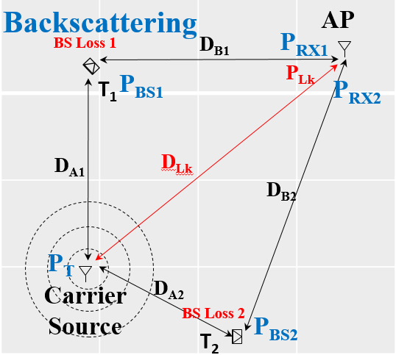
2.4 GHz Bistatic Uplink Accounting for Direct Leakage
Link Assumptions
Carrier Source EIRP | 20 dBm
Backscattering Loss | 5 dB
Reader Effective DR | 50 dB
Reader min SNR | 3 dB
DR- Dynamic Range
DR in practical AMP BS with a direct leakage is not limited by the noise floor
FRIIS & SNR [dB]
D_{A}, D_{B}, D_{Lk} [m] | P_{BS} [dBm] | P_{RX} [dBm] | P_{Lk} [dBm] | P_{Lk} -P_{RX} [dB] | SNR[dB] | P_{EH} [dBm]
0.7, 0.7, 1 | -22 | -59 | -20 | 39 | 11 | -17
1, 1, 1.4 | -25 | -65 | -23 | 42 | 8 | -20
1, 5, 5 | -25 | -79 | -34 | 45 | 5 | -20
1.4, 5, 5 | -28 | -82 | -34 | 48 | 2 | -23
1.4, 1.4, 2 | -28 | -71 | -26 | 45 | 5 | -23
2, 2, 3.1 | -31 | -77 | -30 | 47 | 3 | -26
4, 4, 4 | -37 | -89 | -32 | 57 | -7 | -32
Uplink range is degraded significantly by the direct leakage

Slide 7
Revisit 2.4 GHz Mono-Static Backscattering
Leakage signal: 0dBr
Example : AP DR= 50 dB, AMP tag BS Loss 5 dB
20 cm /-26 dB
P_{EH} = -26 dBm
AP
Dynamic Range
WiFi AMP reader
0 dBm
AMP tag
Self Leakage 20dB
BS
Loss
BS signal:
-37dBr
SNR
P_{Lk} -20 dBm
Rx noise floor: e.g. -50dBr
P_{RX} -57 dBm
P_{Lk} -P_{RX} = 37 dB
Uplink range is limited by P_{EH}
SNR= 13 dB

Slide 8
Discussion:
The direct leakage blocker in bi-static backscattering, imposes a DR limitation similar to the self leakage in mono-static backscattering
The bi-static blocker degrades passive BS range to about 2 meters, or more if the tag is within 1 meter from the carrier source
Bi-static BS can be treated as an extension of the EH and UL ranges of mono-static BS.
A simple use case example, maybe a smart shopping cart that enables both mono-static and bi-static BS
Slide 8

Slide 9
Summary
In principle we can adopt the BS mono-static UL analysis for bi-static operation. The BS range is limited by the direct carrier leakage/blocker and dictated by the AP DR performance
UL range of about 2 meter, may still be achieved when direct leakage is present for an DR of 50 dB with EH power levels that are relatively sufficient
Hence such simple fully passive backscattering devices will be able to charge/recharge and communicate relatively frequently and efficiently to short ranges as compared with semi-active BS tags [4], or active tags with extended ranges that dissipate more power while harvesting at much lower levels
Slide 9

Slide 10
References
11-24-0798r0 “Close-range AMP WiFi Reader Feasibility Study
Follow up”; Rui Cao (NXP)
11-24-0537r0 “Close-range AMP WiFi Reader Feasibility Study”; Rui Cao (NXP)
11-24-1786r0 “Tradeoffs - Active and Backscattering AMP Tags ”; Dror Regev (Huawei)
11-24-1687r0 “Frequency Shifting in Backscatter Operations”; Nelson Costa (Haila)
11-24-1543r0 “Frequency translation backscatter”; Manideep Dunna (Qualcomm)
Slide 10

