Slide 1
Channel access and trigger design for active STAs
Date: 2025-01-13
Authors:
Name | Affiliations | Address | Phone | Email
You-Wei Chen | Mediatek | 2840 Junction Ave. San Jose, CA, 95134 |  | You-Wei.Chen@mediatek.com
Jianhan Liu
Thomas Pare

Slide 2
Introduction
Passed motion [1]:
  11bp defines at least one mode of MAC/PHY that allows an AMP-only device with active uplink communication in 2.4GHz subject to the following requirements:
      clock accuracy requirement is relaxed compared to legacy 802.11 devices;
      the active uplink communication can only be sent in response to being polled by the AP
There is an AMP trigger frame before an active AMP UL transmission.
In this presentation, we will review some contributions related to channel access and discuss out thought for low-power legacy STA or AMP-only active UL STA on this topic.

Slide 3
Contributions related to channel access
In [2, 3], multiple access mechanisms were discussed, e.g., TDM, FDM, CDM. Guard intervals and TDM sync frame were proposed for TDM.
In [4], multiple phases were discussed. For channel access, a scheduled mode was proposed, i.e., AP sends a trigger frame to an associated AMP non-AP STA with respective STA ID.
In [5] time-slot based channel access was discussed. TXOP for AC_BK was reviewed (2.528ms) and the avaiable time slot can be used is limited. Later, [6] suggested that two different channel access mechanisms for Active AMP tags and Backscatter AMP tags.
Without loss the generality, we simply focus on a scheduled UL for active STAs as a starting point.

Slide 4
Proposed frame exchange for active UL
Since RTS/CTS protocol is not applicable for AMP non-AP STA, CTS-to-self becomes an alternative mechanism to set NAV
After transmitting CTS-to-Self, if no AMP UL PPDU be received in an TBD estimated duration, TXOP holder should truncate or terminate the TXOP, e.g., send a CF-End frame for NAV reset. So, third-party STAs can content the channel early.
Protected duration: TXOP
if no AMP PPDU be received in an estimated duration
AMP AP STA
CTS-to-Self
AMP Trigger
Ack
CF-end
TB UL PPDU: OOK format
AMP non-AP STA

Slide 5
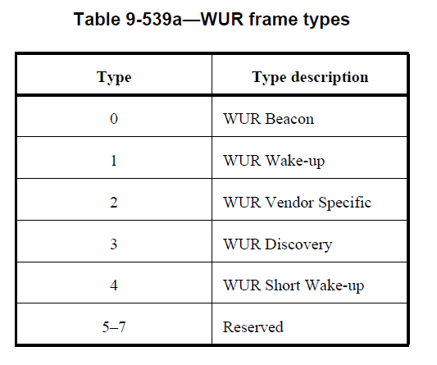
Proposed trigger frame indication
For low-power legacy STAs or active AMP-only STAs, reusing WUR MAC frame structure seems a good option to save time of standard development.
The trigger frame can be indicated in the MAC header, e.g., reusing WUR structure and using the reserved entries of the Type subfield in the Frame control field.
Client identifier can be carried in MAC header, e.g., STA ID.
AMP Trigger
PHY header
MAC header
Frame body
FCS
Frame control
…
…
ID

Slide 6
SP1
Do you agree to include the following to the 11bp SFD?
    AMP AP STA transmits CTS-to-self before transmitting an AMP trigger frame

Slide 7
SP2
Do you agree to include the following to the 11bp FRD?
    For low-power legacy STAs or active AMP-only STAs, WUR MAC frame structure should be used as a starting point.

Slide 8
SP3
Do you agree to include the following to the 11bp SFD?
    Trigger frame indicator uses the reserved entries of the Type subfield in the Frame control field

Slide 9
References
[1] 11-24/1322, IEEE 802.11 TGbp Motion Dock
[2] 11-24/1776, Multiple access mechanisms for AMP, Chuanfeng He et al., OPPO.
[3] 11-24/1804, CDM access for AMP, Weijie Xu and Ke Wang, OPPO
[4] 11-24/1839, Considerations for AMP STA Access, Sanket Kalamkar et al., Qualcomm.
[5] 11-24/1212, Discussions on AMP Channel access, Rojan Chitrakar et al., Huawei
[6] 11-24/1806, AMP time-based channel access for Active tags, Rojan Chitrakar et al., Huawei

