Slide 1
Discussion on AMP Energizer: Function and Operation Frequency
January 2025
Doc.: IEEE 802.11-25/0010r0
Date: 2025-01-07
Authors:
Name | Affiliation | Address | Phone | Email
Yinan Qi | OPPO |  |  | v-qiyinan@oppo.com
Weijie Xu
Chuanfeng He

Slide 2
Abstract
Doc.: IEEE 802.11-25/0010r0
In this contribution, we discuss the function and operation frequencies of AMP energizers.

Slide 3
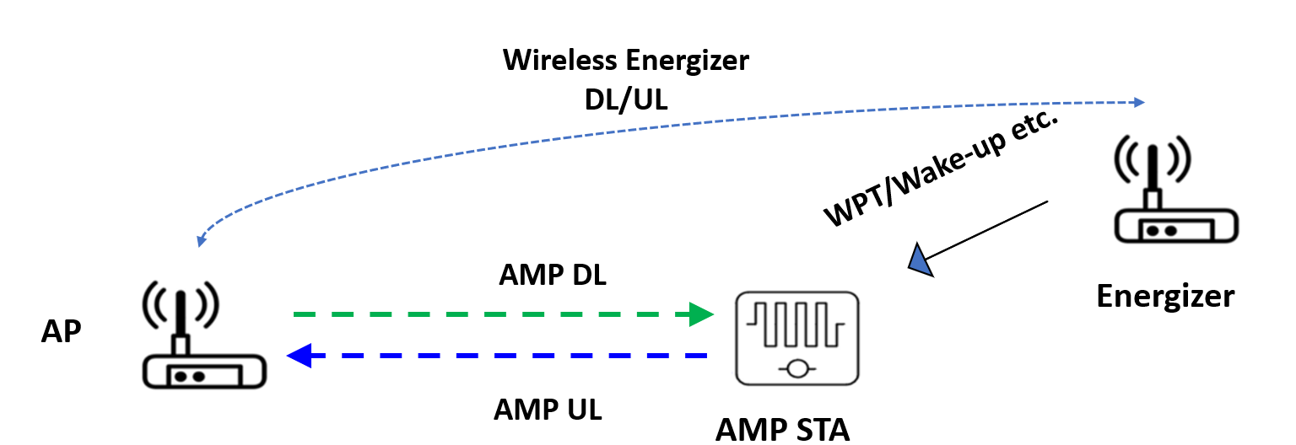
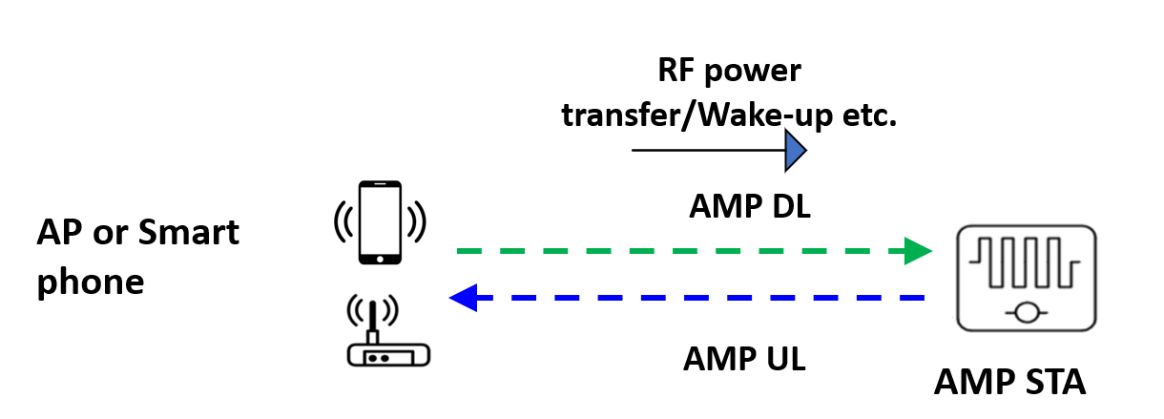
January 2025
Doc.: IEEE 802.11-25/0010r0
Recap of Energizer Definition [1]
Integrated Type A: AP and energizer are integrated
AP can operate in both 2.4G and S1G frequency bands
No signalling exchange between AP and energizer
Independent Type B: energizer is an independent device
Wired/wireless connection between AP and energizer
Signalling between AP and energizer
Energizer functions: at least excitation, WPT and wakeup [1]-[2]
Slide 3
Yinan Qi (OPPO)

Slide 4
January 2025
Doc.: IEEE 802.11-25/0010r0
AP and Energizer Type
AP
Type-A, Single frequency: 2.4GHz
Type-B, Dual frequency: 2.4GHz and S1G
Type-C, Single frequency: S1G
Energizer
Type-1, Dual frequencies: 2.4G for communication and excitation, S1G for communication and WPT
Type-2, Single frequency: S1G for WPT only (must be wired connected with AP)
Type-3, Single frequency: S1G for communication and WPT
Type-4, Single frequency: 2.4GHz for communication and excitation
Type-5, Dual frequency: 2.4G for communication and excitation and S1G for WPT only
Slide 4
Yinan Qi (OPPO)

Slide 5
January 2025
Doc.: IEEE 802.11-25/0010r0
AP and Energizer Type
Three main functions for energizer
Communication
Between energizer and AMP non-AP STAs, e.g., wakeup signal
Between AP and energizer via legacy interface
Excitation: activation and backscattering
WPT
Type 1 energizer is the most complicated
Type 2 to 5 energizers’ functions sets are subsets of type 1 energizer with reduced complexity and cost
Two operation frequencies including 2.4GHz and S1G
2.4GHz for communication and excitation
S1G for WPT and communication
Different AP type and energizer type can be paired
Slide 5
Yinan Qi (OPPO)

Slide 6
January 2025
Doc.: IEEE 802.11-25/0010r0
AP and Energizer Pair 1
Pair 1: Type-A AP + Type-5 energizer
Communication at 2.4GHz
WPT protocol
AP and energizer: AP controlling energizer signalling
AP and AMP non-AP STAs: e.g., EH capability feedback
Configuration of Energizer Tx
Excitation signal: energizer excites AMP devices
Wakeup signal: energizer wakes up AMP devices
Excitation at 2.4GHz
Energizer sending excitation signals to AMP devices
WPT at S1G
Energizer wireless charging signal to AMP devices
Slide 6
Yinan Qi (OPPO)

Slide 7
January 2025
Doc.: IEEE 802.11-25/0010r0
AP and Energizer Pair 2
Pair 2: Type-A AP + Type-4 energizer
Communication at 2.4GHz
WPT protocol
AP and energizer: AP controlling energizer signalling
AP and AMP non-AP STAs: e.g., EH capability feedback
Configuration of Energizer Tx
Excitation signal: energizer excites AMP devices
Wakeup signal: energizer wakes up AMP devices
Excitation at 2.4GHz
Energizer sending excitation signals to AMP devices
WPT at S1G
Energizer wireless charging signal to AMP devices
No S1G thus no WPT protocol or WPT signal
Reduced complexity and cost for 2.4GHz deployment only
Slide 7
Yinan Qi (OPPO)

Slide 8
January 2025
Doc.: IEEE 802.11-25/0010r0
AP and Energizer Pair 3
Pair 3: Type-B AP + Type-3 energizer
Communication at S1G, e.g., 802.11ah
WPT protocol
AP and energizer: AP controlling energizer signalling
AP and AMP non-AP STAs: e.g., EH capability feedback
Configuration of Energizer Tx
Excitation signal: energizer excites AMP devices
Wakeup signal: energizer wakes up AMP devices
Excitation at S1G
Energizer sending excitation signals to AMP devices
WPT at S1G
Energizer wireless charging signal to AMP devices
Co-existence of WPT signal and 802.11ah signal in S1G needs to be considered
Slide 8
Yinan Qi (OPPO)

Slide 9
January 2025
Doc.: IEEE 802.11-25/0010r0
AP and Energizer
Prioritize pair 1 and 2 considering different energizer capability, e.g., some of them may only work in 2.4GHz due to simplicity and cost.
Pair 3 can be further studied for future S1G
Backscattering mode
Coordinated DL PPDU transmission by AP and energizer may not be feasible
Very different Rx power from AP and energizer due to different Tx power, distance, etc., may be challenging for very simple Rx circuit of AMP devices.
AP may not know the exact excitation field length, e.g., AP has no information of UL payload size.
Energizer is expected to be relatively complicated, thus able to transmit entire DL PPDU
Need to clarify what energizers can do.
Preamble
Excitation
SYNC
SIG
Data
Excitation
Slide 9
Yinan Qi (OPPO)

Slide 10
Reference
January 2025
Doc.: IEEE 802.11-25/0010r0
[1] “Further Consideration of WPT for AMP,” IEEE 802.11-24/1781r2, Nov. 2024
[2] “Further Discussion on the AMP WPT Protocol,” IEEE 802.11-24/1769r0, Nov. 2024

Slide 11
SP 1
January 2025
Doc.: IEEE 802.11-25/0010r0
Energizer should be allowed to transmit the entire DL PPDU when configured by the AP.

