Slide 1
AP ID in NDPA signaling

Slide 2
Introduction
In Co-BF,11bn agreed on two new sounding sequences: Joint sounding and sequential sounding.
  In Joint/(cross-BSS)Sequential sounding, the NDPA solicits the NDP from the responder AP , and solicits the associated STA receiving the NDP.
  In In-BSS Sequential sounding, the NDPA only solicits the associated STA receiving the NDP.
Conclusion: The NDPA may contain both AP identifier(like AP ID) and STA identifier(like AID)
In this contribution, we would like to discuss the AP ID design in NDPA

Slide 3
AP ID and AID collision issue in NDPA
Need to well design the new signaling on NDPA to backward compatible with EHT STA.
  The NPDA may silicate either EHT STA or UHR STA,but the new signaling design in NPCA is not visible to EHT STA.
  If AP ID is in AID11 and has the same value with one assigned AID of a EHT STA, EHT STA may decode the AP ID as AID and make the wrong decoding in the sequential subfield.
  If we define the rule to disallow AP ID and AID to be same on one link, the adding link operation via ML reconfiguration may be failure.

Slide 4
The following figure depicts the adding link failure issue if only consider the different AP ID and AID value on one link
AP1
STA1
AP1
AP ID=10
AP22
Non-AP MLD can’t add link on link1 via ML reconfiguration, as the value of 10 is a AP ID on link1, can’t be used as AID any more.
AID=10
AP2
STA2
AID=10
AP2
STA2
AID=10
AP3
STA3
AID=10
AP3
STA3
AP MLD
non-AP MLD
AP MLD
non-AP MLD
T1
T2
T3

Slide 5
More thought on the AP ID assignment
AP ID is assigned by a peer AP, while AID may be assigned by the AP MLD.
  11be baseline is quoted as bellow:
    An AP MLD shall assign a single AID to a non-AP MLD upon successful ML setup.
    All the non-AP STAs affiliated with the non-AP MLD shall have the same AID as the one assigned to the non-AP MLD during ML setup.
      AP ID is per link level identifier, while AID may be MLD level identifier, putting AP ID and AID in the same allocation space make the implementation more complicated.
      Further, AP ID belongs to one of the AP’s attributions, while AID is the property of STAs, AP ID and AID sharing the same allocation space will cause more confusion in the SPEC.
    Propose the AP ID and AID to have the different allocation spaces. The allocation of AP ID and AID shall be decoupled.
      The value of AP ID and AID can be same on one link.
      If AP ID and AID in the same frame, use two IDs approach to differentiate AP ID from AID.

Slide 6
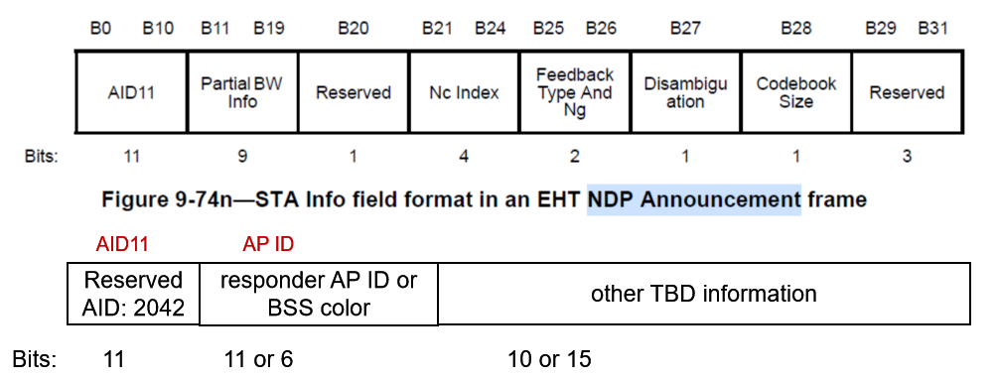
The proposal of AP ID design in NDPA
In one STA Info field, one Reserved AID(like AID 2042) is filled in AID11 and AP ID or responder AP’s BSS color is filled in AP ID field if the responder AP’s information is included.
e.g. 0b0010

Slide 7
The proposal of AP ID design in Trigger frame
In M-AP Trigger frame, the AID12 field used to identify each shared AP.
  Quoted the passed motion as bellow:
    The sharing AP, that transmits a Trigger frame as part of a transmission sequence in a Multi-AP coordinated transmission scheme, identifies the shared AP via an AP ID carried in the AID12 field of the User Info field of the frame
    Note: the name of "sharing AP" and "shared AP" are TBD
    Note: Multi-AP coordinated transmission schemes are Co-SR, Co-BF and Co-TDMA
    [Motion #135]]
If a M-AP Trigger frame solicits the response from both AP and STA, the MSB of AID12 subfield can differentiate AP ID from AID.
  The MSB of the AID12 subfield is set to 1 to indicate the AP ID
  The MSB of the AID12 subfield is set to 0 to indicate the AID（baseline）
e.g. 0b10....010

Slide 8
Summary
Analysis the potential AP ID and AID collision issue in NDPA
Analysis the potential non-AP MLD adding link failure issue due to the AP ID and AID collision issue.
Propose AP ID and AID to have different allocation spaces.
  AP ID and AID can be same on one link
  Using two IDs approach to differentiate AP ID from AID if AP ID and AID appear in the same frame

Slide 9
THANK YOU ☺

Slide 10
Reference
24/209r6 TGbn Specification Framework for TGbn
24/2028r1 PDT-Joint-Sounding procedure

Slide 11
SP1
For AP ID assignment, what’s option do you prefer?
  Opt1: (Link level AP ID)The value of AP ID and AID shall be different on one link, disable the function of adding link operation via ML reconfiguration in UHR.
  Opt2: Define MLD level AP ID.
  Opt3: (Link level AP ID) The value of AP ID can be same to the AID on one link, use two IDs approach to differentiate AP ID from AID if AP ID and AID appear in one frame(like NDPA).
  Note: Such SP won’t be into 11bn SFD.

Slide 12
SP2
Do you agree the following red field design when the responder AP’s information is included in NDPA?
  AID11 field is filled with a Reserved AID. the value of Reserved AID is TBD.
  AP ID field is filled with the responder’s AP ID, the length is TBD.
AID11 AP ID
Reserved AID: 2042
responder AP ID or BSS color
other TBD information
Bits: 11 11 or 6 10 or 15
STA Info field

