Slide 1
Sounding procedure following up

Slide 2
Introduction
In Co-BF,11bn agreed on two new sounding sequences: Joint sounding and sequential sounding.
In Joint sounding procedure, the NDPA solicits the NDP from both initiator AP and responder AP , and solicits the associated STA to receive the NDP.
In Cross-BSS Sequential sounding, the NDPA solicits the NDP from responder AP , and solicits the associated to STA receive the NDP.
The problem is: the responder AP may not send the NDP due to some reasons, which causes the sounding procedure failure.
In this contribution, we would like to discuss the sounding protection and recovery approach

Slide 3
Recap: Sequential sounding in motion[#100]

Slide 4
Recap: Joint sounding sequence in motion[#101]

Slide 5
Problem : NDP from OBSS AP missing issue
OBSS AP may not send NDP after NDPA+SIFS
The CCA is shown as medium busy due to the interference from some hidden nodes.
The OBSS AP may not receive the NDPA or error parse the received NDPA
The initiator AP may detect the NDP missing issue from OBSS AP in sequential sounding procedure.
After SIFS, if the initiator AP doesn’t detect the NDP frame, the initiator AP will determine the NDP is missing from the OBSS AP.
The initiator AP may retransmit the NDPA frame to fast recovery the sounding procedure.
The initiator AP can’t detect the NDP missing issue from OBSS AP in Joint sounding procedure.
The initiator AP will stay in TX state(to transmit NDP in parallel)

Slide 6
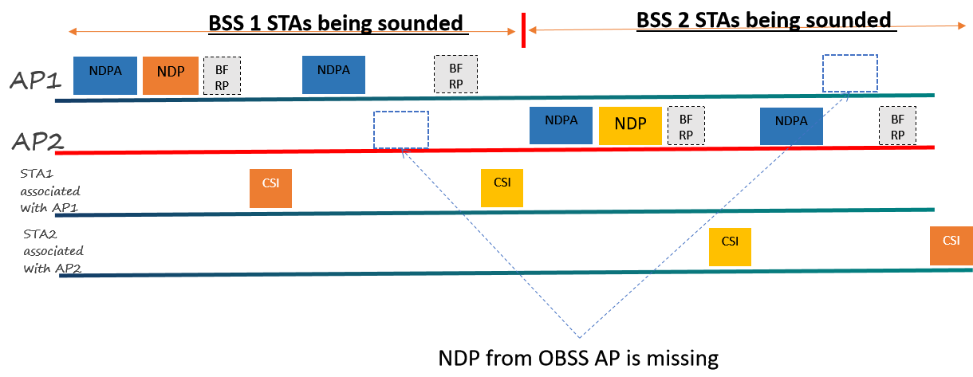
The following figure depicts the NDP from OBSS AP missing issue in sequence sounding procedure

Slide 7
The following figure depicts the NDP from OBSS AP missing issue in Joint sounding procedure

Slide 8
Proposal: Add ICF/ICR to address the hidden node issue
ICF/ICR exchange in cross-BSS sequential sounding and Joint sounding
BSRP/M-BA(multi-STA BA) already used in other features, we propose to reused BSRP/M-BA as ICF/ICR
The Duration of ICF/ICR should cover the whole sounding procedure, or at least cover the NDP transmission time from OBSS AP(long protection)
The hidden node issue may happen on the associated STA side as well, it will be more efficient if the initiator AP to solicit the target STA to response via ICF.
It’s still not efficient if the responder AP doesn’t make the response when ICF solicits single responder AP. One approach is to add double ICF/ICR exchange
The first ICF/ICR（Query）: solicit multiple responder APs and associated STAs with short protection.
The second ICF/ICR(Selection): solicit single responder AP with long protection.

Slide 9
The following figure depicts the double ICF/ICR exchange in Joint sounding procedure
Query
Selection

Slide 10
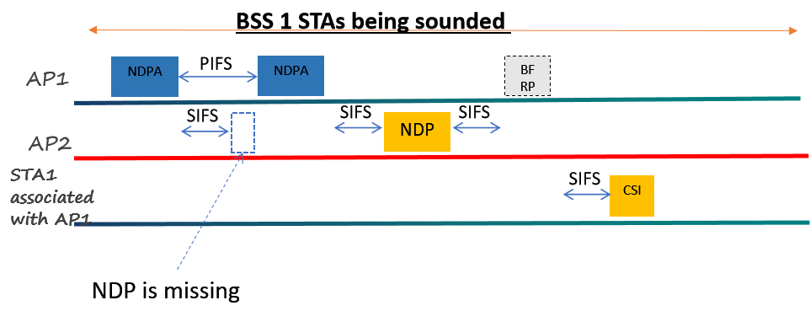
Proposal2:NDPA retransmission in sequential sounding procedure
The initiator AP retransmit NDPA if NDP from responder AP is not detected
The initiator AP may retransmit NDPA after PIFS (as shown in the Figure)
The initiator AP may terminate the cross-BSS sounding procedure after retry several times.

Slide 11
Summary
Analyze the NDP from OBSS AP missing issue
Propose to use ICF/ICR for sounding procedure protection
Single ICF/ICR approach
Double ICF/ICR approach
Propose to retransmit NDPA if the solicited NDP from OBSS AP is missing in sequential sounding procedure

Slide 12
THANK YOU ☺

Slide 13
Reference
24/209r6 TGbn Specification Framework for TGbn

Slide 14
SP1
Do you agree to add the ICF/ICR frame exchange to protect the Co-BF sounding procedure?
The duration in ICF/ICR should at least cover the transmission time of NDP

Slide 15
SP2
Do you agree to add the double ICF/ICR frame exchange to protect the sounding procedure?
The duration in the first ICF/ICR only cover the transmission of ICR1
ICF1 may solicit multiple APs to make the response.
The duration in the second ICF/ICR should at least cover the transmission time of NDP
ICF2 at most solicit one of the APs that responded with ICR1 to ICF1 to make the response.

Slide 16
SP3
Do you agree the initiator AP may retransmit the NDPA frame after PIFS interval if the NDP from the responder AP is missing in sequential sounding procedure.

