Slide 1
MAPC discovery follow up

Slide 2
Introduction
11bn group agreed on the action frame for MAPC Discovery and the UHR AP is capable of transmitting a TB PPDU with the following motion:
  A UHR AP shall indicate to another AP its capability to respond in a TB PPDU or not[M #120]
  When an AP use Management frames to discover the capabilities and/or parameters of individual M-AP coordination schemes, the AP shall use the defined MAPC Public Action frame with the following setting:[M#359]
  • The action field is set to MAPC Discovery
In this contribution, we propose to define a TB MAPC Discovery procedure

Slide 3
The overhead issue in M-AP discovery procedure
In MAPC, one AP may discover another AP via the MAPC discovery action frame exchange.
  In active scan, one AP may send broadcast discovery request frame, and receives the discovery response frame one by one in different TXOPs, in which a serious overhead issue may happen

Slide 4
The following figure depicts the overhead issue in actively discovery procedure
TXOP1
TXOP2
TXOP3
TXOP4
TXOP5
discovery
request
discovery
response
discovery
response
discovery
response
discovery
response
AP1 AP2 AP3 AP4 AP5
T

Slide 5
Propose to define Trigger-based MAPC discovery procedure
To mitigate the overhead issue, we propose to define a Trigger-based MAPC discovery procedure.
Leverage the gain of RA-RU, the initiating AP may transmit a TB frame including multiple RA-RU for the responding AP without AP ID.
Other aspects for TB MAPC discovery
  The responding APs that don’t support the transmission of TB PPDU won’t make the response.
  Also, AID12 field can be set to the AP ID if the target responding AP obtained an AP ID from the initiating AP before.
  MAPC discovery request and TB frame can be merged to one frame(like reusing TRS control field or define a new MAPC discovery request polling frame(DRP)).

Slide 6
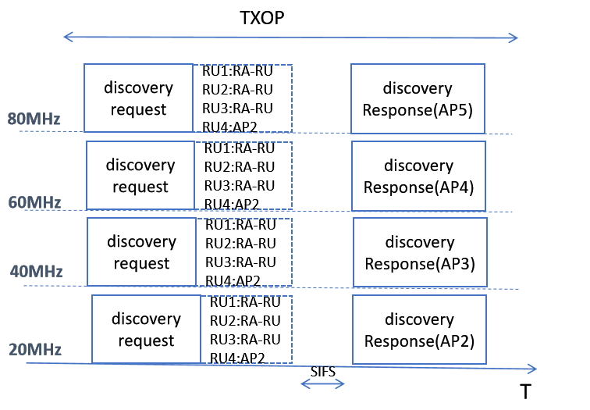
The following figure depicts one approach of Trigger Based MPAC discovery request/response procedure(RU size=242-tone)
Note: RU size in DRP may smaller or larger than 242-tone

Slide 7
Additional thought on the capability of sharing/shared AP
In general, each AP is capable to become a sharing or a shared AP during MAPC transmission.
  E.g. each AP can allocate an AP ID to its peer AP during MPAC negotiation phase. And each AP can share a portion of the TXOP to its peer AP in Co-TDMA scheme.
But in some special use case, like MAPC between a master AP and a slave AP in a centralized network.
  The master AP with higher capability may always be a sharing AP(TXOP owner during MAPC transmission), and the slave APs with lower capability may always be a shared AP.
In another cases, MAPC may be between the regular AP and the mobile AP.
  The regular AP may always being a sharing AP,especially for these APs lack of supporting the transmission of TB PPDU.
  The mobile AP may always being a shared AP due to low capability, but it can transmit TB PPDU as it’s the basic requirement for the STA in 11ax.

Slide 8
The proposal of sharing/shared AP capability in MAPC discovery procedure
To meet different requirements, we propose to add the sharing/shared AP capability indication for Co-TDMA,Co-SR and Co-BF in MAPC discovery action frame.
  Using totally 6 bits to indicate the sharing/shared AP capability for Co-TDMA, Co-SR and Co-BF.
  In MAPC agreement negotiation, the MAPC requesting AP and the responding AP decide whether to allocate an AP ID based on the sharing/shared AP capability of the three schemes.

Slide 9
Summary
Analysis some special use cases for the requirement of sharing/shared AP capability
Propose to define a TB discovery request/response frame exchange to avoid overhead issue.
  Only the responding APs that are capable of transmitting TB PPDU can make the response.
  AID12 field in the Trigger frame can set to RA-RU or set to the responding AP’s AP ID
Propose to define the sharing/shared AP capability indication for Co-TDMA,Co-SR and Co-BF.
  Such capability indication is included in MAPC discovery action frame.
  Totally 6 bits for now.

Slide 10
THANK YOU ☺

Slide 11
Reference
24/209r6 TGbn Specification Framework for TGbn
24/1762r13 PDT-MAC-NPCA

Slide 12
SP1
Do you agree to define Trigger based MAPC discovery procedure?

Slide 13
SP2
Do you agree to define the capability indication of sharing/shared AP in Co-TDMA,Co-SR and Co-BF scheme in MAPC discovery frame?

