Slide 1
Advantages of 802.11b DSSS in Long-Range Backscatter
Date: 2025-01-13
Authors:

Slide 2
Abstract
Here, we present some advantages of using the 802.11b DSSS waveform in long-range backscatter communications.

Slide 3
Background
In [1], we presented some advantages of using a 1 Mb DSSS waveform in the excitation field to facilitate backscatter modulation.
  Selectively flipping bits in a BPSK sequence can be done with a simple energy-efficient backscatter transceiver.
  This technique allows legacy STAs to receive and decode the backscattered frame.
  This technique avoids the use of purpose-built exciters.
  Takes advantage of an asymmetrical link: Much of the complexity of forming the PPDU lies with the infrastructure, not the AMP STA.
  Longer range: 1 Mb DSSS offers the best link budget.
  2 Mb DSSS (DQPSK) with shorter preambles is also possible using this architecture.

Slide 4
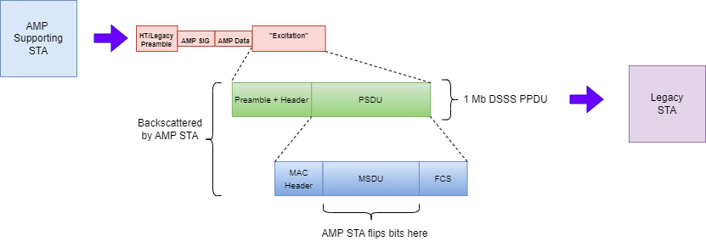
Review: DSSS Waveform for Backscatter Operations
[2] Take the example where we’d like to backscatter a 1 or 2 Mb DSSS frame embedded in the Excitation field of an AMP PPDU.

Slide 5
Long Range Backscatter: DSSS advantages Over OFDM
There are well known advantages of 802.11b 1 Mb, 2 Mb DSSS versus OFDM waveforms, especially in the context of long-range.
  Typical 3 dB SNR advantage in receiver sensitivity (mostly due to lower rates)
  Typical 3 – 4 dB lower PA backoff due to OFDM linearity requirements. (Also implies decreased PA efficiency).
    More transmit power on the air also equates to more power backscattered.
A good 802.11b implementation should have roughly 6-7 dB link margin advantage over OFDM.
Results in approximately 40 – 50% more range in very high pathloss environments.

Slide 6
11b DSSS Versus OFDM: Practical Example
Reference [5] is the data sheet for the Silicon Labs WF200 “Network Co-Processor”. This is an example of an ultra low power 802.11 b/g/n Wi-Fi transceiver that might be used in IoT applications.
With respect to link margin KPIs, the advantages of DSSS over OFDM become especially clear when reviewing these specs.

Slide 7
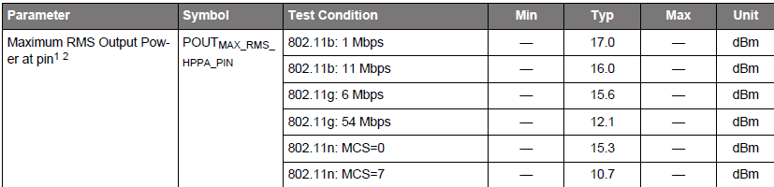
11b DSSS Versus OFDM: Practical Example [5]
Transmit power for 1 Mb DSSS shows 1.7 dB advantage over 11n (MCS 0).

Slide 8
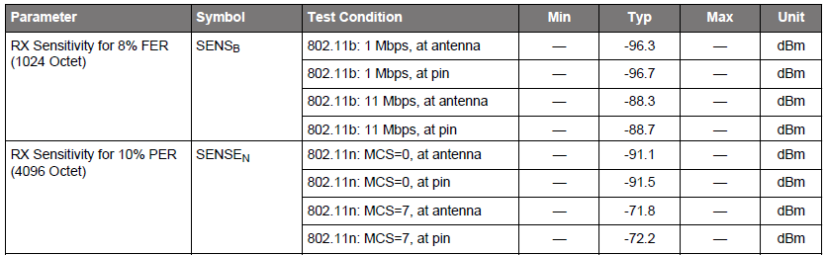
11b DSSS Versus OFDM: Practical Example [5]
Receive sensitivity for 1 Mb DSSS shows 5.6 dB advantage over 11n (MCS 0).
Total link margin advantage DSSS over OFDM: 1.7 + 5.6 = 7.3 dB

Slide 9
11b DSSS Versus OFDM: Use Case Study
In [3], the WFA liaison presented several use case in which non-OFDM (11b) waveforms were advantageous when compared to OFDM waveforms. The use cases of interest to 11bp were
  Smart home
  Smart metering
  Home security
In these use cases, the advantages of DSSS over OFDM were found to be
  Longer ranges, which equates to increased reliability across a wider variety of applications.
  Lower power consumption.
  The lower data rates (1 Mb, 2 Mb) were often more than adequate for the applications.
    This is especially true in many IoT-related applications.

Slide 10
Conclusion
802.11b DSSS waveforms provide several significant advantages in the context of long-range backscatter.
  6 – 7 dB advantage in link margin (versus OFDM)
  Simple backscatter architecture
    lower complexity leads to lower power consumption at the AMP STA
  Backward compatibility with legacy STAs
802.11b-compatible STAs and APs are widely deployed.
1, 2 Mb DSSS were found by the WFA to be advantageous in IoT applications.

Slide 11
Straw Polls
SP1:
Do you agree that to add the following content to TGbp SFD?
11bp defines at least one backscattering mode that supports using 1 Mb and 2 Mb DSSS PPDUs within the Excitation field of an AMP PPDU.

Slide 12
References
[1] Kezys et al., Low Complexity Backscatter AMP STA, 11-24/2002, November 2024.
[2] Costa et al., Frequency Shifting in Backscatter Operations, 11-24/1687, November 2024.
[3] Stephens, Liaison statement from Wi-Fi Alliance on Non-OFDM Use Cases, 11-14/0905, July 2014
[4] D. Ehichioya, G. Arya, “Performance Comparison of OFDM and DSSS on Aeronautical Channels,” in International Telemetering Conference Proceedings, Sept. 2009. [Online]. Available: https://repository.arizona.edu/handle/10150/606137
[5] Silicon Labs, “WF200 Data Sheet: Wi-Fi Network Co-Processor”, December 2018 [Revision 1.1, September 2020]. Available: https://www.silabs.com/documents/public/data-sheets/wf200-datasheet.pdf

