Slide 1
Multi-AP Sounding Analysis
Date: 09-Jan-25

Slide 2
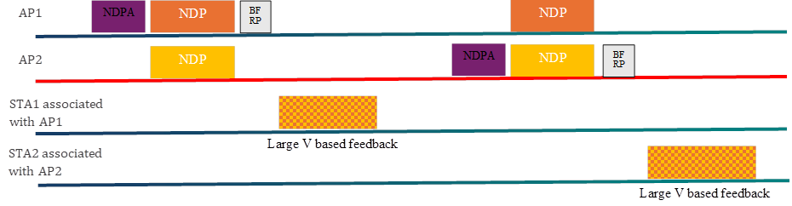
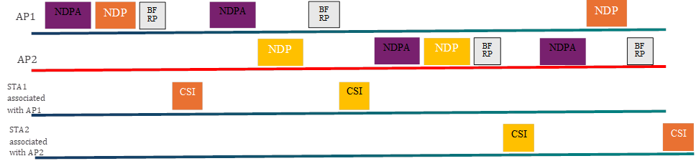
Introduction
Multi-AP Sounding protocols have been proposed in [1, 2]
  Joint Sounding
  Sequential Sounding

Slide 3
Problem Statement
Sounding overhead needs to be considered
Clock synchronization between joint sounding APs is a non-trivial requirement
COBF performance depends on sounding and precoding algorithm
  Joint sounding allows partial rank nulling, but without joint optimization doesn’t perform well
  Sequential sounding without partial rank nulling is limited to 1-antenna STAs and 2-spatial stream transmissions
In this contribution:
  We assess overhead impact of the current sounding proposals
  We analyze (timing) impairments for joint sounding
  We analyze joint optimization of precoding matrices

Slide 4
Issue 1: Sounding Overhead – Joint Sounding
(single instance)
2 APs (4 ant.) , 4 STAs (2 ant.), 1 or 2 spatial streams, 160MHz
  NDPA1 64µs+16µs
  NDP1 2x LTF, 8 streams ➔ 108µs
  BFRP1 64µs+16µs
  Feedback 1 @ MCS 0: 100/54 symbols =>1644µs/908µs+16µs
  NDPA2 64µs+16µs
  NDP2 2x LTF, 8 streams ➔ 108µs
  BFRP2 64µs+16µs
  Feedback 2 @ MCS 0: 100/54 symbols => 1644µs/908µs +16µs
Sounding feedback overhead of joint sounding is prohibitive: up to 4ms, if all STAs transmit feedback at different times and minimum rate
More aggressive rates are problematic because feedback must be received by both APs
(8x2=>26 angles, 8x1=>14 angles 7/9 bits, grouping 4=>468 carriers) 97344 bit or 52416 bit, with 980 bit per data symbol

Slide 5
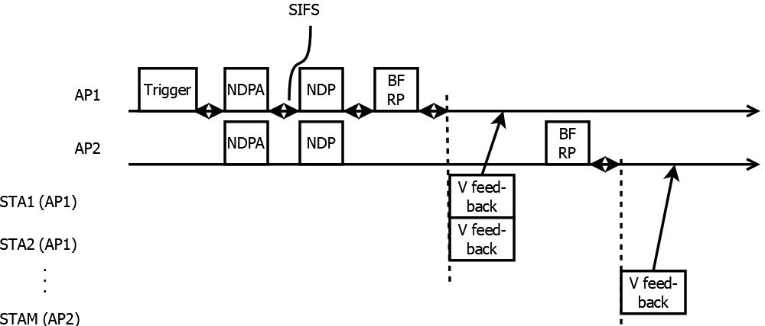
Possible Improvements
Single NDP transmission (trigger + NDPA1/2 + NDP)
  Trigger+NDPA1 2 x (64µs+16µs)
  NDP1 2x LTF, 8 streams ➔ 108µs
Dedicated feedback to associated AP and feedback exchange on DS
  BFRP1 64µs+16µs
  Feedback 1 mcs5: 13/7 symbols =>256µs/160µs+16µs
  BFRP2 64µs+16µs
  Feedback 2 mcs5: 13/7 symbols => 256µs/160µs +16µs
Sounding overhead time around 0.8 msec

Slide 6
Sounding Overhead – Sequential Sounding
2 APs, 4 STAs, with 4/2 antennas, 1 or 2 spatial streams, 160MHz
  NDPA1-1 64µs+16µs NDPA1-2 64µs+16µs
  NDP1-1 76µs+16µs NDP1-2 76µs+16µs
  BFRP1-1 64µs+16µs BFRP1-2 64µs+16µs
  Feedback1-1 mcs5: 96µs+16µs Feedback1-2 mcs1: 240µs+16µs
  NDPA2-2 64µs+16µs NDPA2-1 64µs+16µs
  NDP2-2 76µs+16µs NDP2-1 76µs+16µs
  BFRP2-2 64µs+16µs BFRP2-1 64µs+16µs
  Feedback 2-2 mcs5: 96µs +16µs Feedback 2-2 mcs1: 240µs+16µs
➔Lower overhead time (1.8ms), but feedback to un-associated APs (intra-OBSS) is not efficient (per-antenna feedback needed, conservative mcs, because channel is not known)
(4x2=>10 angles, 4x1=>6 angles 4/6 bits, grouping 4=>468 carriers) 37440 bit or 22464 bit, with 980 bit per data symbol
Mcs1 is used for feedback, because there is a single dedicated receipient

Slide 7

Possible Improvements for sequential sounding intra-OBSS feedback
Sequential sounding according to [1, 2] doesn‘t allow for partial rank nulling.
This can be resolved by defining a new feedback report for intra-OBSS feedback [5, 6].
Associated STA channel: $H_{s1a1}=U_{s1a1}S_{s1a1}V_{s1a1}^{H}$
Intra-OBSS feedback $H_{s1a2}:$ ${S_{s1a1}^{−1}U}_{s1a1}^{H}H_{s1a2}$
Channel: $\left[\begin{matrix}H_{s1a1} & H_{s1a2} \\ H_{s2a1} & H_{s2a2}\end{matrix}\right]$

Slide 8
Sounding Interval
Performance degrades over time
Different precoding methods were considered:
  Zero-forcing (perfect nulls)
  Partial nulling (regularized inversion)
  IPO (iterative phase optimization) ➔ joint optimization
Sounding Interval
  About 20ms sounding interval is needed to maintain consistent performance
  With 4ms per sounding, this amounts to 20% total overhead, with 0.8ms, overhead reduces to 4%
2 STAs per AP
1 STA per AP
Simulation: Joint sounding, 2 APs,
D NLOS channel with 1.2km/h movement

Slide 9
Issue 2: Joint Sounding Impairments
Joint Sounding and CFO
In joint sounding, a clock offset between the two APs causes a channel estimation error, because the STA can lock to only one of the APs
Due to the duration of the joint sounding LTFs, the frequency drift within the LTFs can cause a performance impact
  Not an issue for sequential sounding
Performance penalty of CFO during transmisson of 8 LTFs
Simulation: 4x LTFs, 4-antenna AP, 2-antennas STAs (joint, sequential non-standard), 1-antenna STA (sequential), CFO as in trigger-based

Slide 10
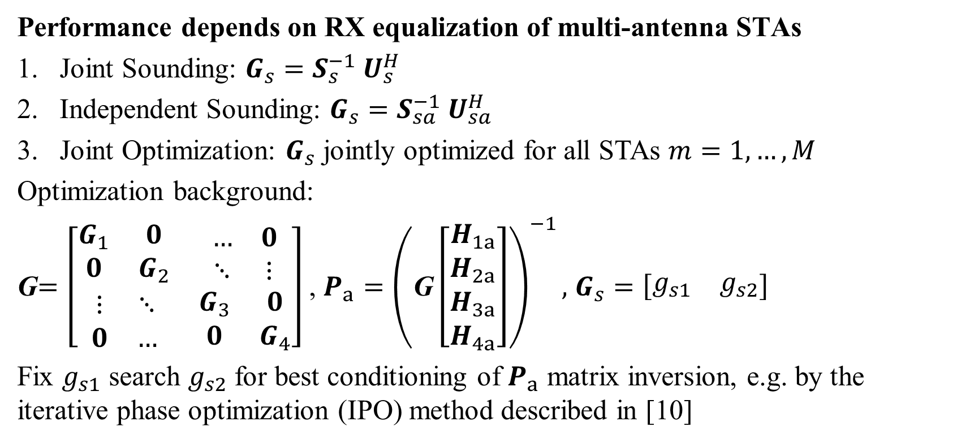
Issue 3: COBF Performance
Performance depends on RX equalization of multi-antenna STAs
Joint Sounding: ${G_{s}=S}_{s}^{−1} U_{s}^{H}$
Independent Sounding: ${G_{s}=S}_{sa}^{−1} U_{sa}^{H}$
Joint Optimization: $G_{s}$ jointly optimized for all STAs $m=1,…,M$
Optimization background:
G$=\left[\begin{matrix}\begin{matrix}G_{1} & 0 \\ 0 & G_{2}\end{matrix} & \begin{matrix}… & 0 \\ ⋱ & ⋮\end{matrix} \\ \begin{matrix}⋮ & ⋱ \\ 0 & …\end{matrix} & \begin{matrix}G_{3} & 0 \\ 0 & G_{4}\end{matrix}\end{matrix}\right]$ , $P_{a}={\left(\text{G}\left[\begin{matrix}\begin{matrix}H_{1a} \\ H_{2a}\end{matrix} \\ \begin{matrix}H_{3a} \\ H_{4a}\end{matrix}\end{matrix}\right]\right)}^{−1},$ $G_{s}=\left[\begin{matrix}g_{s1} & g_{s2}\end{matrix}\right]$
Fix $g_{s1}$ search $g_{s2}$ for best conditioning of $P_{a}$ matrix inversion, e.g. by the iterative phase optimization (IPO) method described in [10]

Slide 11
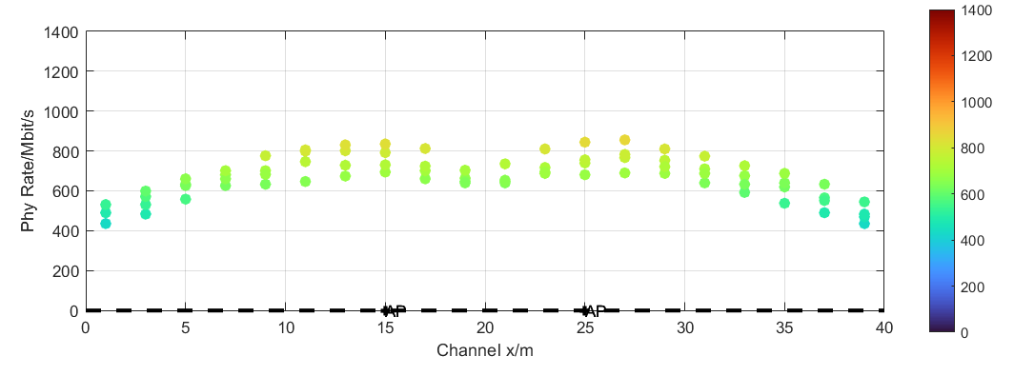
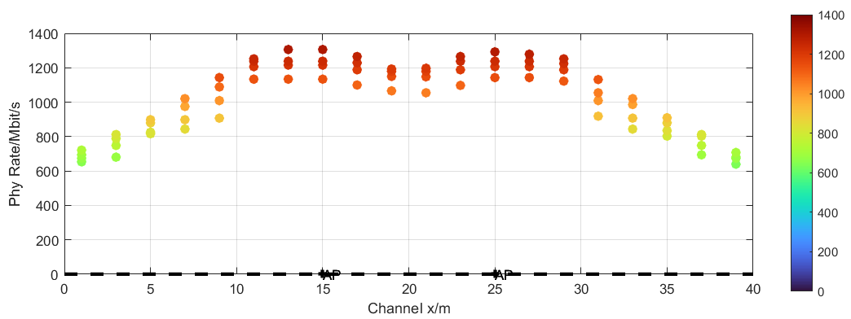
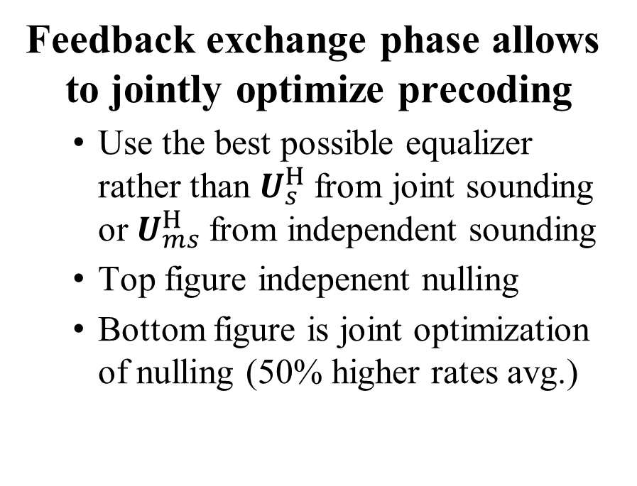
Joint Optimization
Feedback exchange phase allows to jointly optimize precoding
  Use the best possible equalizer rather than $U_{s}^{H}$from joint sounding or $U_{ms}^{H}$from independent sounding
  Top figure indepenent nulling
  Bottom figure is joint optimization of nulling (50% higher rates avg.)
STAs associated
STAs associated
with AP1
with AP2
AP1
AP2
STAs associated
STAs associated
with AP1
with AP2
AP1
AP2

Slide 12
Conclusions
Sounding Overhead
  20ms sounding interval seems acceptable for good spatial nulling performance.
  Without improvements, joint sounding overhead is problematic (up to 20% overhead for 2 STAs per AP)
Joint sounding issues
  CFO in joint sounding results in a channel estimation error (even with aggressive assumption on precompensation), which is not the case for sequential sounding
Independent sounding has advantages
  Dedicated feedback for data and nulling, which can be optimized for the needs (e.g., do sounding for nulling less frequently).
  Feedback packets have a specific recipient, which allows higher rates

Slide 13
References
[1] Sameer Vermani et.al., “Sounding Schemes for Coordinated Beamforming”, IEEE 802.11-24/1542 September 2024
[2] Ron Porat et.al., “Sounding Design for C-BF”, IEEE 802.11-24/1568 September 2024
[3] Insing Jung et.al., “Coordinated Beamforming for 11bn – Follow Up”, IEEE 802.11-24/1515r2 September 2024
[3] Aiguo Yan et.al., “Unified CoBF/MUMIMO Schemes with Zero-MUI”, IEEE 802.11-24/1432r2 August 2024
[4] Shimi Shilo et.al., „Coordinated BF: Figures of Merit”, IEEE 802.11-24/1484r0 September 2024
[5] Shimi Shilo et.al., „Zero MUI Coordinated BF”, IEEE 802.11-23/1998r0 November 2023
[6] Rainer Strobel et.al, “Coordinated Spatial Nulling (C-SN) Concept”, , IEEE 802.11-24/0011r0 January 2024
[7] Rainer Strobel et.al, “Coordinated Spatial Nulling (C-SN) Simulations”, , IEEE 802.11-24/0012r0 January 2024
[8] Rainer Strobel et.al, “Coordinated Spatial Re-Use and Coordinated Spatial Nulling Follow-Up”, , IEEE 802.11-2
4/0635r0 March 2024
[9] Alfred Asterjadhi, “TGbn Motions List – Part 1”, , IEEE 802.11-24/171r19 January 2024
[10] Strobel, Rainer, Avi Mansour, and Ziv Avital. "Uplink and Downlink Precoding for Ultra High Reliability WLAN." ICC 2024-IEEE International Conference on Communications. IEEE, 2024.

Slide 14
APPENDIX

Slide 15
Simulation parameters
Parameter | Value
TX/RX Antennas | 4/2
APs/STAs | 2/4
Spatial streams | 1
Bandwidth | 160 MHz
AP TX Power | 21 dBm
Channel model | D NLOS [8]
MCS | 0-13 (optimized)
Frequency | 5 GHz
GI | 1.6µs
TX/RX SNR | As on 42/40dB
Channel aging/Doppler | 1.2km/h, 6Hz
BF quantization | ideal
Precoder type | Zero-forcing, joint or independent
Overhead | Sounding and MAC overhead not considered

