Slide 1
Follow-up on Channel Shifting in Backscatter Operations
Date: 2025-01-13
Authors:

Slide 2
Abstract
Follow up to our presentation 11-24/1687 Frequency Shifting in Backscatter Operations.
Questions raised since the presentation,
How do we reserve medium use on two channels?
Double sideband (DSB) versus single sideband (SSB) operation when mixing the backscattered signal with the channel clock.
Power consumption estimates with a channel clock.
Consider 50 MHz clock and its power consumption.

Slide 3
Review: Frequency Shifting in Backscatter Operations [1]
Presentation discussed the concept of frequency shifting as an effective method to reducing self-jamming in long range backscatter operations.
With this method, the link margin was related directly to
The receiver’s ability to reject adjacent channel interference.
The receiver’s ability to decode signals in the presence of in-band interferers.
The transmitter’s emissions mask.
Generally, the larger the frequency difference between the transmitter and receiver, the more link margin we get.
This technique enables long-range backscatter.
This technique forms an uplink PPDU that is compatible with legacy STAs.

Slide 4
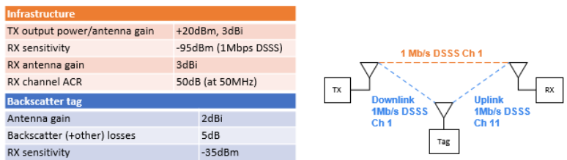
Review: Frequency Shifting in Backscatter Operations [1]
Link margin example.
Note 50 dB introduced by receiver Adjacent Channel Rejection (ACR) at 50 MHz separation.

Slide 5
Medium Usage on Multiple Channels
Requirements
The transmission needs to protect a TXOP on multiple channels. (the excitation signal and the backscattered signal).
It would be preferable for the excitation and backscattered signal to be transmitted on non-adjacent channels (e.g channel 1 and 11 in the 2.4 GHz spectrum).
The TXOP protection mechanism needs to work for legacy 802.11 STAs.

Slide 6
Medium Usage on Multiple Channels: Existing Mechanisms
In the following, we review several mechanisms in 802.11 that reserve medium in multiple channels.
This review is to set precedence; there have been methods in the past to reserve medium on two channels.
These methods may not be directly applicable to AMP backscatter.
Many of these methods are designed to be backward compatible.

Slide 7
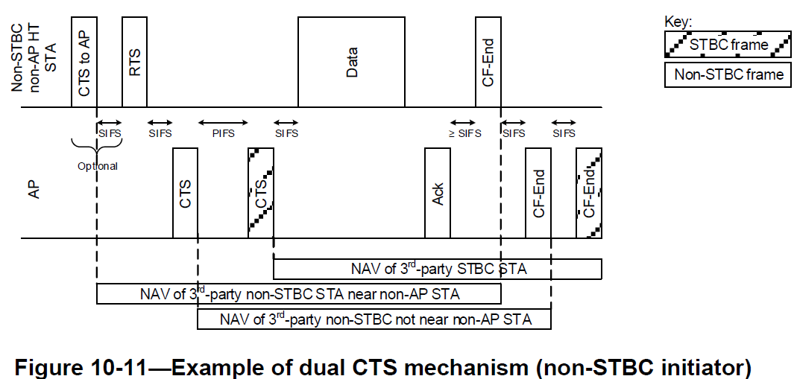
Medium Usage on Multiple Channels: Dual-CTS (By Initiator STA)
Note that this feature is marked obsolete in IEEE 802.11-2024.
It’s used to protect 11n transmissions from 11b/g devices.
10.3.2.10 of the IEEE 802.11-2024 Standard describes the following example exchange.
A STA initiates the exchange by sending a CTS to the AP (to protect the TXOP) followed by a RTS to the AP (to initiate the TXOP).
This approach does not look applicable as a mechanism to protect AMP backscatter.
It’s marked obsolete.
It’s more complicated than required for long-range AMP backscatter.

Slide 8
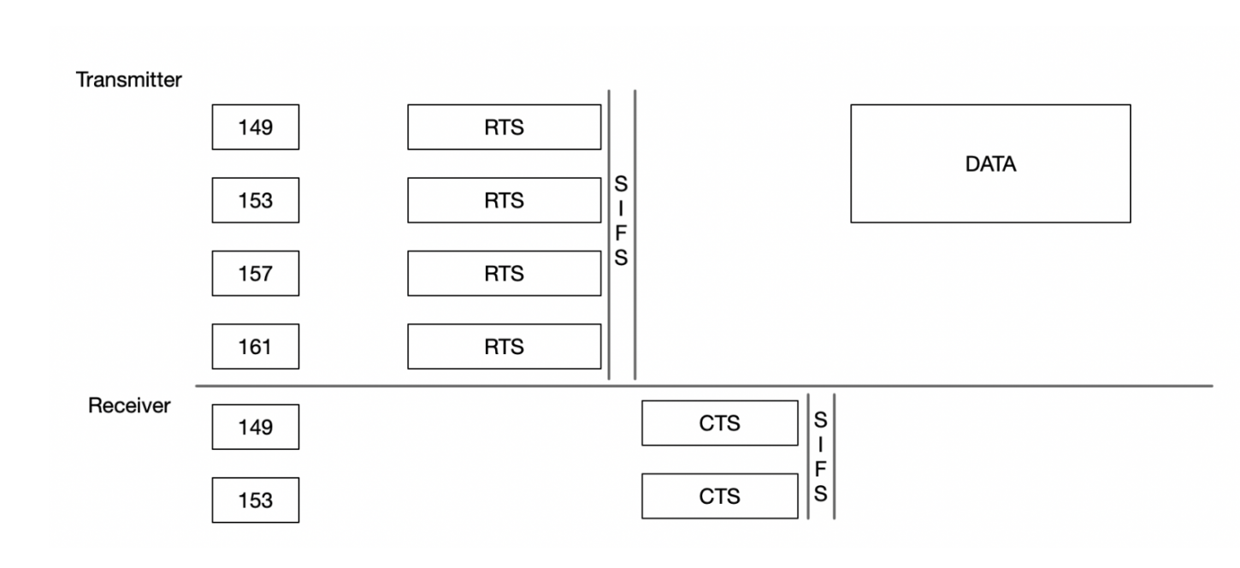
Medium Usage on Multiple Channels: Bandwidth Signaling TA in RTS
A technique introduced in 11ac uses RTS frames with a bandwidth signaling TA (formatted as the address of the transmitter with the Group-Addressed bit in the MAC address set) to indicate a request to reserve a series of channels for a TXOP.
In this example [3], a transmitter is requesting an AP to reserve an 80 MHz channel. The AP is responding with a CTS indicating the reservation of a 40 MHz channel.
In this case, the frames are transmitted in non-HT duplicate PPDU format (which requires OFDM modulation).
Disadvantages:
While a mechanism based on this technique could be used, its unlikely an AP would perform such a medium reservation in the 2.4 GHz band.
There’s no guarantee the receiver would respond with CTS on the two required channels for backscatter.
We may receive CTS on one (not both) required channels, which may lead us to reserving medium without actually using it.

Slide 9
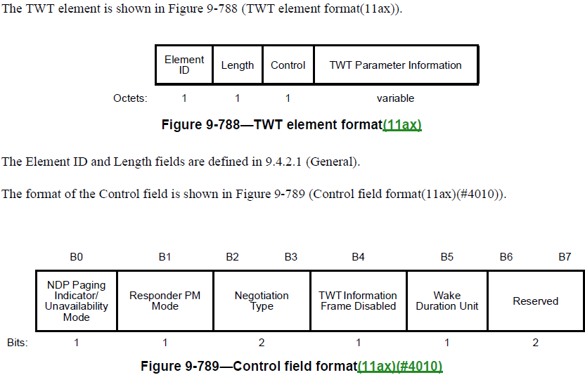
Medium Usage on Multiple Channels: (R)TWT (through AP)
Target Wait Time (TWT) was introduced in 11ax.
The requesting STA requests the specific times and periods it will be awake and the responding STA evaluates and grants the request.
The TWT period can be used for unicast or broadcast communications.
An AP (the responding STA) generally manages TWT periods.
11be extended the feature to cover Restricted TWT by allowing an AP to advertise TWT periods and requiring EHT STAs to not transmit during those periods.
A TWT period, even with multi-link operations (11be), can only be reserved on a single channel.

Slide 10
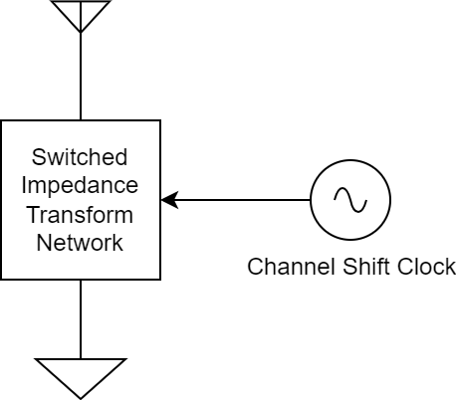
Single Sideband (SSB) Modulation with Backscatter
SSB modulation with a channel shifting clock during backscatter operations is similar to an SSB mixer.
There are publicly-available implementations that implement SSB in backscatter.
They combine the energy in both sidebands to one.
This has the added benefit of increasing backscatter efficiency.
One possible architecture requires three backscatter switches versus one for the Double Sideband (DSB) case.
Each additional switch requires very little power to operate.
The actual architecture is implementation-specific.

Slide 11
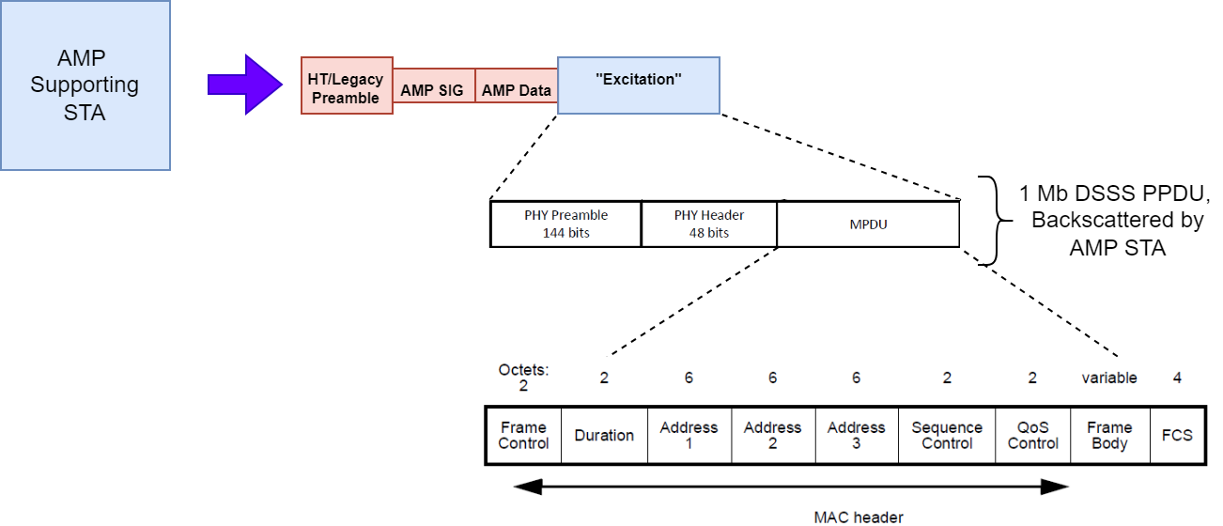
50 MHz Power Consumption Example
Consider the example where we’d like to backscatter a 1 Mb DSSS frame embedded in the Excitation field of an AMP PPDU.

Slide 12
50 MHz Power Consumption Example
The infrastructure (AP or AMP Supporting STA) transmits the entire AMP PPDU, including the 1Mb DSSS PPDU.
The AMP STA is only responsible for channel shifting during the excitation period (in this case, during the 1 Mb DSSS PPDU.)
Let’s say we want to backscatter 80 bytes of data, encapsulated in an unencrypted frame of type Data, subtype QoS Data.

Slide 13
50 MHz Power Consumption Example
50 MHz Clock Specs
Operating Voltage | 0.8 V
Active current | 120 µA
Idle current | 1 pA
Ramp up time | 150 µs
Ramp up current | 1 mA
Clock accuracy | 20 ppm
Data Requirements
Packet duration | 1072 µs
Backscatter period | 2 s
Power Specs
Battery capacity (CR2032) | 2400 J
LDO Efficiency | 30%
Consider the case where we have a 50 MHz clock with the following specifications.
We’d like to backscatter 80 bytes once every 2 s, where 2 s is the backscatter period.
Further consider the case where the AMP STA is equipped with a lifetime battery CR2032 with about 2400 J of useful energy.
At a polling period of 2 s, this translates into a lifetime of about 203 years (just for the 50 MHz clock circuitry + LDO).
Note, practically speaking, batteries don’t last 200 years.
This power consumption is compatible both with lifetime battery and ambient powered applications.
Resulting Power Consumption
Energy consumed per BS period | 225 nJ
Number of BS periods on one battery | 3.2e9 periods
Battery life | 203 years

Slide 14
Straw Polls
SP1:
Do you agree to add the following content to TGbp SFD?
11bp defines an optional backscattering mode that supports channel shifting.

Slide 15
References
[1] Costa et al., Frequency Shifting in Backscatter Operations, 11-24/1687, November 2024.
[2] IEEE Std 802.11-2024.
[3] Rowell, “Dynamic Bandwidth Operation.” Accessed: 6 Jan 2024. [Online] Available: https://www.cleartosend.net/dynamic-bandwidth-operation/

