Slide 1
Fast RSSI Measurement Follow-Up
July 2024
Date: 2024-12-09
Authors:
Notes:
September 2012

Slide 2
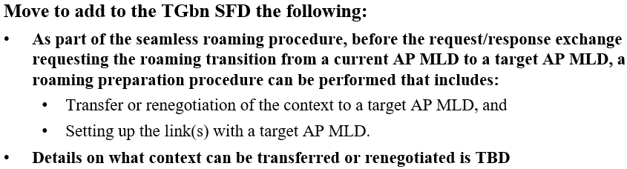
Introduction
Considering the following Motion which had been approved in the IEEE Nov. F2F meeting, a natural improvement is to further allow the non-AP MLD to probe neighboring AP MLDs through the current AP MLD (i.e. over-the-DS probe) to avoid the off-channel scanning.
Thus the non-AP MLD can initiate the over-the-DS link setup with one or more neighboring AP MLDs after the above over-the-DS probe operation.

Slide 3
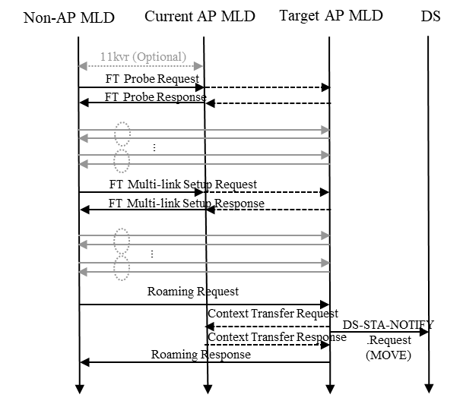
Motivation
However, the client still needs to measure the RSSI measurement of neighboring APs over the air, which cannot be accomplished by the over-the-DS probe.
A fast RSSI measurement has been proposed in [1-3], and it can be used in the following roaming stages :
  (Before roaming preparation) After the over-the-DS probe, the non-AP MLD may measure the link quality with one or more candidate AP MLDs and select one or more AP MLDs to initiate the link setup with the target AP.
  (After roaming preparation) After the over-the-DS link setup with the target AP MLD, the non-AP MLD needs to monitor the RSSI of the target AP MLD and decides when to trigger the DS mapping change.
  (After association) The associated AP recommends one or more candidate AP MLDs for roaming based on the RSSI info reported by the non-AP MLD. Specifically, define a new measurement mode for the Beacon Request. (See Appendix A)
Figure Procedure of over-the-DS seamless roaming

Slide 4
Motivation (Cont.)
Currently, there are two options for the fast RSSI measurement.
  Option 1. NDPR/NDPA/NDP
  Option 2. RTS/CTS
In this contribution, we will give some comparisons between these two options.

Slide 5
Comparison
Advantages of Option 1 over Option 2 are listed as follows:
  It is possible to include the timestamp within the NDPA frame. Thus the client can synchronize with the target AP MLD and measure the DL RSSI.
    Otherwise, the client shall still listen to the Beacon frame or exchange Probe Request/Response to synchronize with the target AP MLD.
    Based on the current Spec., the non-AP MLD shall accomplish the time synchronization with the target AP before initiating the (Re)association process. (See Appendix B)
      Time synchronization is essential for power management, e.g. TBTT and DTIM.
      In addition, some context with the timing info (e.g. the Target Wake Time of the individual TWT element, the Service Start Time of the QoS Characteristics element of the SCS) may be renegotiated during the roaming preparation phase.
  Note. The time synchronization with the target AP MLD also cannot be accomplished through the over-the-DS probe. Because the over-the-DS probe will introduce a random delay and cause the timestamp value is not correct any more.

Slide 6
Comparison (Cont.)
Advantages of Option 1 over Option 2 are listed as follows
  It can include more than one LTF to improve the measurement precision
    During the roaming period, the measured RSSI value normally fluctuates in a relatively large range due to the channel fading and obstacles. There is a need to improve the measurement precision of the RSSI.
    It’s very useful to avoid the ping-pong roaming.
  It matches the original usage of NDPA/NDP, i.e. channel measurement/sounding.
    Note that in order to reduce the energy consumption during the scanning procedure, a NDP Probing mechanism had been defined for the S1G STA (See 11.1.4.3.6 NDP Probing).
Propose to define NDPR/NDPA/NDP to obtain the timestamp info and measure the RSSI.

Slide 7
Additional Proposal
Currently, AP MLDs have the same TSF value if a wired time synchronization protocol (e.g. 802.1AS Precision Time Protocol) is implemented within the DS.
So propose to use one bit to indicate whether the reported AP and the reporting AP are synchronized (i.e. have the same timestamp value).
  e.g. RNR element, Neighbor Report element
If the target AP MLD and the current AP MLD are synchronized, then the non-AP MLD may skip the synchronization procedure before initiating the link setup or the DS mapping change.
  The synchronization procedure. The non-AP MLD need to receive the Beacon frame or initiate Probe Request/Response frame exchange with the target AP MLD and use MLME-JOIN.request and MLME-JOIN.confirm to start synchronization.
This indication is helpful for the non-AP MLD to precisely understand the timing info (e.g. the Target Wake Time of the TWT element) carried within the over-the-DS Probe Response frame and select a good roaming time point to initiate the DS mapping change.

Slide 8
Summary
In this contribution, we have discussed the necessity to define a fast RSSI measurement and time synchronization procedure, which is used together with the over-the-DS probe to reduce the energy and time consumption during the scanning procedure.
Compared with the RTS/CTS frame exchange which is used for initiating the data transmission, we prefer to define a new short frame exchange instead, i.e. NDPR/NDPA/NDP.
We also propose to use one bit to indicate whether the reported AP and the reporting AP are synchronized.

Slide 9
References
[1] 11-23-1897-00-00bn-thoughts-on-improving-roaming-under-existing-architecture
[2] 11-24-1414-02-00bn-channel-measurement-based-on-control-frame-exchange
[3] 11-24-1879-00-00bn-proposals-for-expeditious-discovery-of-aps-for-initial-association-and-roaming

Slide 10
SP 1
Do you agree to define a new measurement mode for the Beacon Request?
  The measurement is based on a Control frame exchange initiated by a non-AP STA
  Details of the above frame exchange are TBD.

Slide 11
SP 2
Do you support to add one bit to indicate whether the reported AP and the reporting AP are synchronized?
  Note. TBD on where this bit is carried.

Slide 12
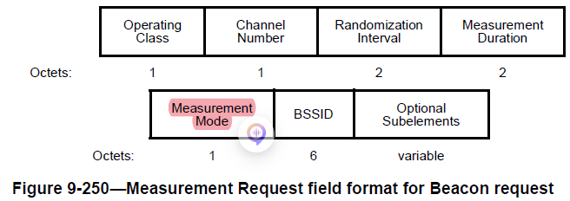
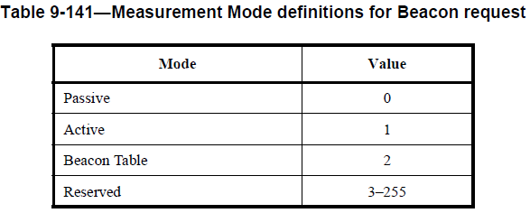
Appendix A

Slide 13
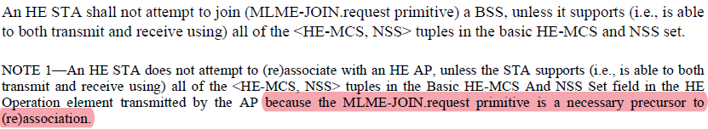
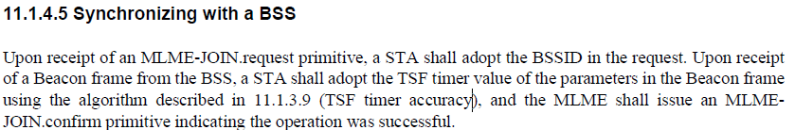
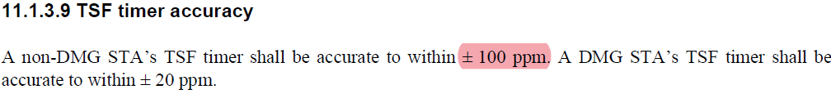
Appendix B

