Slide 1
Long-Range Backscatter Use Case
Date: 2024-01-07
Authors:

Slide 2
Abstract
Make the case to create and include a subset of features that enable long-range backscatter in the SFD.

Slide 3
Background: Backscatter in Current SFD Draft
Current SFD has some provisions for backscatter communications. Under 4.1 General,
  PM-3: 11bp defines at least one mode of MAC/PHY that supports close-range mono-static backscattering communication in 2.4 GHz.
  PM-4: 11bp defines at least one mode of MAC/PHY that supports bi-static backscattering communication in 2.4 GHz.
The SFD is largely mute on a long-range backscatter use case.
We believe the requirements for long-range backscatter are significantly different from “close-range mono-static backscattering”.
We believe “bi-static backscattering” may not cover the requirements for long-range backscatter.
We also believe that implementation considerations for “bi-static” versus “mono-static” may be separate from “long-range” versus “short-range”,

Slide 4
Background: Prior Submissions
DCN | Author | Title | Notes
11-22/0963 | Zhisong Zuo et al. | Use Cases for AMP IoT Devices | Advocates for battery-free Wi-Fi devices. Coverage up to 30 m indoor, 100 m outdoor. Some requirements (Smart Home application): Service life > 10 years
11-23/2038 | Rui Cao et al. | Close-range AMP Backscattering in 2.4GHz | Introduces new category, "close-range (~10 cm)" backscattering. This is primarily for Consumer applications. Applications page for "AMP Backscattering Applications", in a caption, mentions "Read range requirement: several meters" Future application (11bp?) states read range of 5 - 10 cm with a phone. Tags in these cases are powered by the reader, 0 dBm "sufficient to energize the tag" Dynamic range assumes 20 dB isolation from antennas alone. States 30-50 dB dynamic range total.
11-23/2203 | everyone | Technical Report on support of AMP IoT devices in WLAN | Everything's in here.
11-24/0075 | Wei Lin et al. | Follow Up on AMP Link Budgets | Quoting 23/2203, three backscattering device classes considered: 1) without power storage, 2) with power storage, 3) with power storage and "tx LNA" Quoting [7] (BackCom), they consider two backscatter topologies 1) monostatic (MoBC), 2) bistatic (BiBC). Monostatic backscatter assumes 30 - 50 dB Tx/Rx isolation Asserts that bistatic backscatter won't need to consider Tx/Rx isolation. This is only true of an unmodulated carrier. MoBC: 2 - 2.8 m, BiBC: 0.8 - 1.3 m (downlink), 13.8 - 31.5 m (uplink)
11-24/537 | Rui Cao et al. | Close-range AMP WiFi Reader Feasibility Study | Tx waveform was indeterminate: stated 11b or OFDM could be used. Rx path involved: "Fixed" AGC Matched filter for increased SNR Differential decoding for interference mitigation Repetition combining OOK based detection Suggested 2x2 Wi-Fi devices already have a 1Tx + 1Rx mode, implying that regular Wi-Fi devices can do duplex comms.
11-24/798 | Rui Cao et al. | Close-range AMP WiFi Reader Feasibility Study Follow up | Largely a rehash of 11-24/537, but introduces effects of sloppy clocks on backscatter. Cite example from UHF RFID tags, FM0, and Miller Coding for timing recovery. Coex mechanism only via "Legacy preamble"; nothing else in the PPDU is decodable by legacy receivers. Claim 22 - 26 cm range, clock accuracy penalty of 6 - 15 cm for 100k PPM clock.
11-24/0853 | W. Xu et al. | Design target and device capabilities for AMP IoT | For AMP IoT talks about 10 - 30 m ("RF Power") and up to 200 m "other ambient power". <1 mW consumption. Three scenarios, 1) short/med range (10-100 m), 2) "close" range (20 - 50 cm), 3) "Compatible Ambient IoT" (10 - 100 m). Backscatter with/without a reflection amplifier. Amp provides up to 15 dB gain @ 100 µW. Backscatter without amp = approx. 2 m, with amp approx. 11 m. States "short/medium range" AMP device are required to have energy storage mechanism as can rely on WPT alone. Advocates for clock accuracy of 10k PPM at tag.
11-24/1215 | Wei Lin et al. | Feasibility study on long range backscatter operation | Covers both "close range" and "long range" backscattering cases. Long range backscatter case shown as bi-static topology. "Close range" backscatter is from 11-23/2038 model. Long range "several meters", "Close range" 20 cm. Presented link margins for long range backscatter use case. The link margins don't appear to consider "self-jamming"

Slide 5
Background: Some take-aways
Service ranges for backscatter-specific applications are divided between
  “close range” 10 – 50 cm, and
  “long-range” 2 – 32 m.
Clock accuracy greatly affects range (no matter the application.)
There are applications that consider a battery
  here, we consider a “lifetime” battery; a battery that does not require replacement over the lifetime of the product.
  Lifetime battery applications ease market adoption.
Most backscatter applications did not consider “self-jamming” in their link budgets.
  With modulated carriers, self-jamming is the limiting factor in link budgets [2].

Slide 6
Backscatter Trade-off Space
We believe the parameters defining use case should be
  Mono- versus bi-static
  Short- versus long-range.
Range is one of the biggest factors in determining application space.

Slide 7
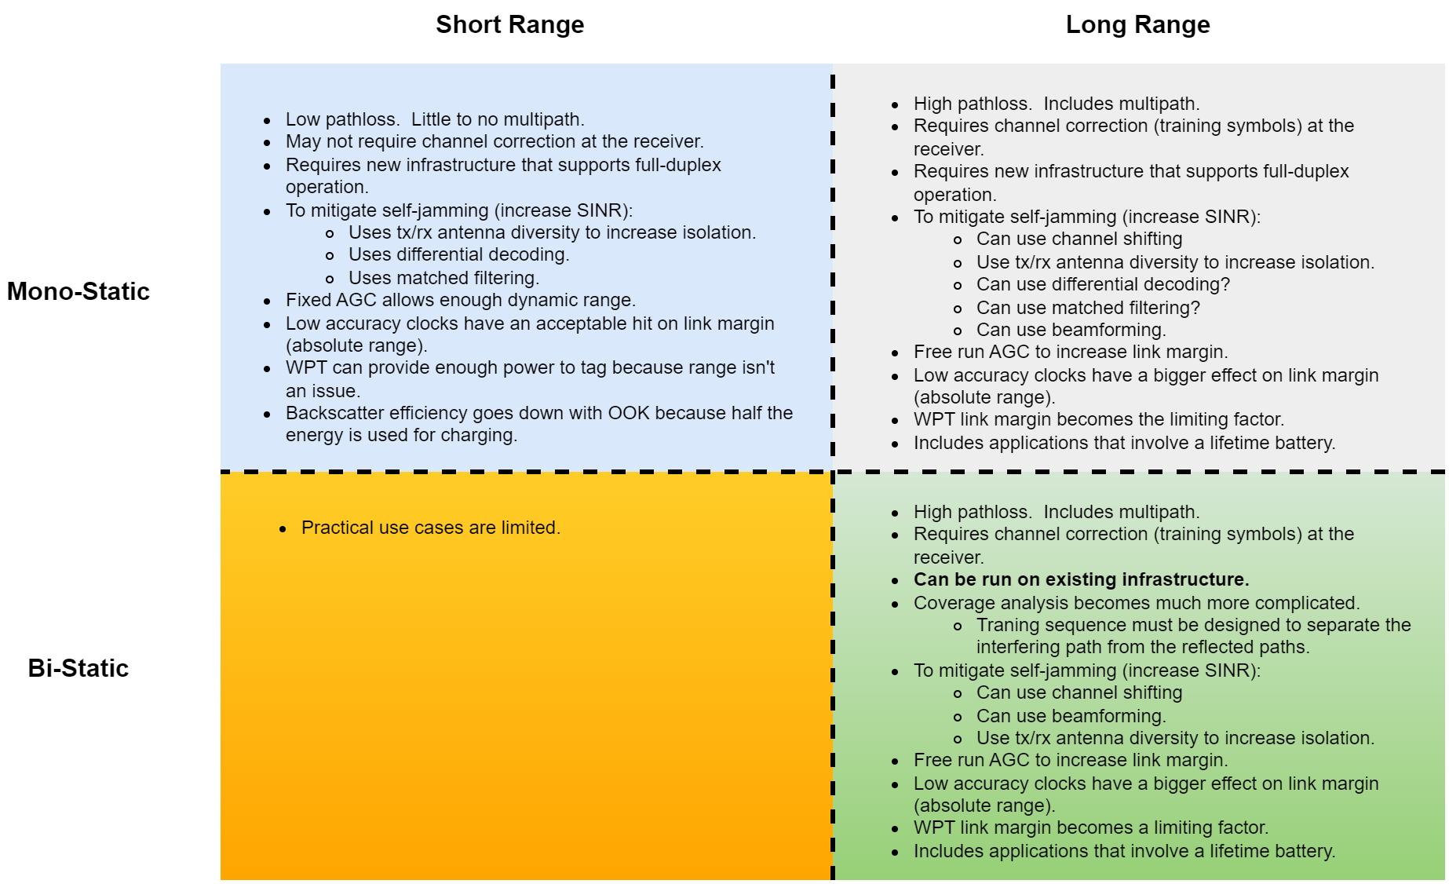
Implementation Differentiators

Slide 8
Long Range Vs. Short Range: Other Trade-offs
Feature | Long Range | Short range
Training sequence | Training required by the receiver to be in the backscatter waveform. Coherent decode increases range. Long range requires better training sequences to mitigate channel and radio impairments. | Can use cancellation techniques in the monostatic case to reduce self-jamming.
Uplink (backscattered) waveform | Emphasis on Range. Difference in energy expenditure on backscatter is minimal between different waveforms. Waveform generated at the Tx, not at the tag. BPSK gets us the longest range. Better backscatter efficiency gets us more range. | Loss in range using OOK, Manchester encoded is acceptable. OOK also allows for energy capture during modulation (backscatter switches to a load instead of short/open).
Battery versus WPT | 10-year battery useful as WPT coverage may be limited in larger areas. This also includes solar (PV cell) based applications. | WPT coverage acceptable.
Clock accuracy | Clock accuracy may be higher because range becomes more important. Clock accuracy affects link margin. | Loss in range due to clock inaccuracies is a percentage of total range; clock accuracy has less effect on absolute range than with longer range applications.
Adoption, backward compatibility, feature reuse | In-market Wi-Fi receivers provide receiver diversity, eases market adoption. Channel shifting provides for more range. Many existing waveforms are compatible with backscatter. | Requires new infrastructure.
Applications | Longer ranges widen the application space. | Shorter ranges restrict the application space.
Cost | Can be higher cost because of energy storage requirements. | Typically, low cost, simpler design.

Slide 9
Conclusion
The requirements for long-range backscatter are significantly different from that of close-range backscatter.
Long-range bistatic backscatter can also be used with existing infrastructure.
The long-range case overlaps with both monostatic and bistatic topologies.
We propose to include a long-range backscattering use case in 11bp AMP.

Slide 10
Straw Polls
SP1:
Do you agree that 11bp should support optional features that enable backscatter communications at ranges beyond those considered for “close range” backscatter.

Slide 11
Straw Polls
SP2:
Do you agree to add the following content to TGbp SFD?
11bp defines a set of features that support long-range backscatter communication in 2.4 GHz.

Slide 12
References
[1] Kezys, 802.11 Feature Re-use, 11-24/1210, July 2024.
[2] Costa et al., Frequency Shifting in Backscatter Operations, 11-24/1687, November 2024.

