Slide 1
Secure E2E Operation for AMP
Date: 2024-12-14
Authors:
Name | Affiliations | Address | Phone | email
Sanket Kalamkar | Qualcomm Technologies Inc. |  |  | sankal@qti.qualcomm.com
George Cherian
Alfred Asterjadhi

Slide 2
Introduction
An AMP client needs to carry out a lightweight authentication and encryption process, which:
Largely follows legacy procedures with enhancements for AMP use cases
Takes into account the limited capabilities of AMP clients, such as
Limited energy availability
Minimal to no persistent memory
This contribution discusses secure end-to-end (E2E) operation for AMP clients

Slide 3
E2E View of AMP Operation
Per Schedule/ On-demand
Once
Once in a while
Once in a while
Offline Onboarding
Initial Info Exchange
AMP Operation Mode Information Exchange
AMP Trigger/ UL Response
Offline Onboarding
Password setting, which establishes the Pairwise Master Key (PMK)
Note: Likely outside IEEE scope
Initial Info Exchange (Discovery)
AP and AMP clients exchange basic information
e.g., MAC addresses and other basic information
AP uses this mode to determine the presence of active AMP clients
AMP Operation Mode Information Exchange
AP requests the client's operation capabilities
The client provides capability and schedule-related information to the AP
E.g., schedule information, power budget, energy harvesting capabilities
AP uses this mode to determine the Tx/Rx parameters to reach AMP clients
AMP Trigger/UL Response
AP triggers the client for uplink (UL) transmissions; client sends UL transmissions
Happens Per Schedule or On-demand manner

Slide 4
Offline Onboarding
Setting up the pairwise master key (PMK) at AP and client
Password acts as pre-shared key (PSK)
PMK is generated from the PSK
In later phases, the PMK is used to generate transient keys, e.g., pairwise transient key (PTK)
For message integrity and encryption

Slide 5
Initial Info Exchange
The AP and the client exchange non-sensitive information
E.g., MAC addresses
No security needed
Since the AP does not know the client's MAC address at this stage, the request will be broadcast, resulting in multiple responses
Collision control should be addressed later
AP
AMP client
Initial Info Req
First time after on-boarding
Initial Info Resp

Slide 6
AMP Operation Mode
Operation Info Request:
AP requests operation capabilities of the client
Schedule information, e.g., how frequently the AP should trigger the client
Power budget of the client, e.g., energy harvesting capabilities
How often the client needs to be asked for operation info request
Required if the schedule changes
Operation Info Response:
Client informs capability and schedule related info to AP
An attacker could use this information to target the client during scheduling
AP
AMP client
Operation Info Req
Repeats once in a while
Operation Info Resp (Schedule, Power Budget)

Slide 7
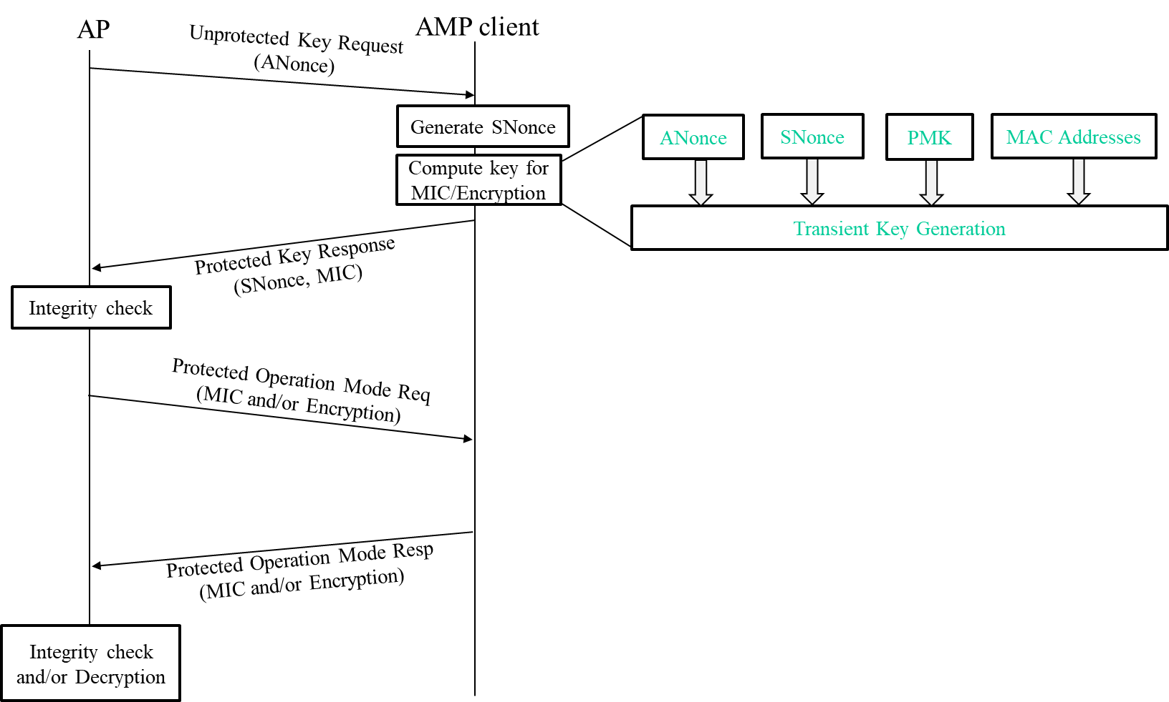
AMP Operation Mode (Contd…)
For secure AMP Operation mode, it can be preceded by a transient key generation process
This step might be required because the AMP client may lack persistent memory to retain the key from previous exchanges with the AP
Key Req is unprotected
One way authentication: The client does not authenticate AP during key generation
Uses PMK obtained during offline on-boarding
The generated key is used to protect:
Operation Info Req
Operation Info Resp

Slide 8
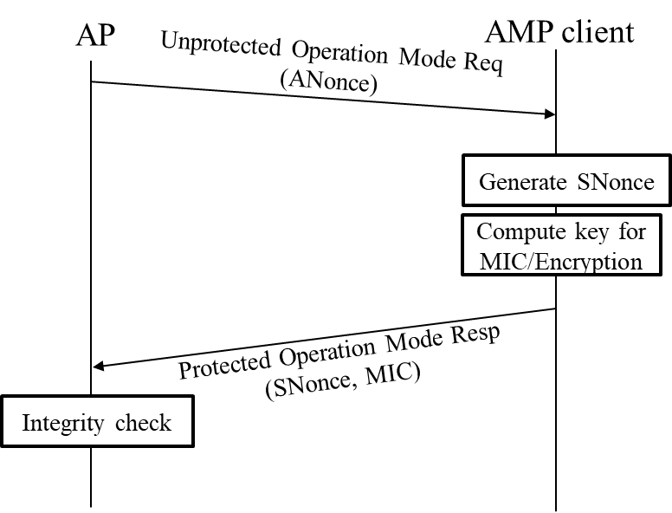
AMP Operation Mode (Contd…)
The Operation Mode Req can be unprotected if:
AP intends to gather responses from multiple clients
The Req does not carry sensitive information
In this case, the Operation Mode Req and Key Req can be merged
Similarly, the Operation Mode Resp and Key Resp can be merged
The Operation Mode Resp can carry MIC
No Encryption

Slide 9
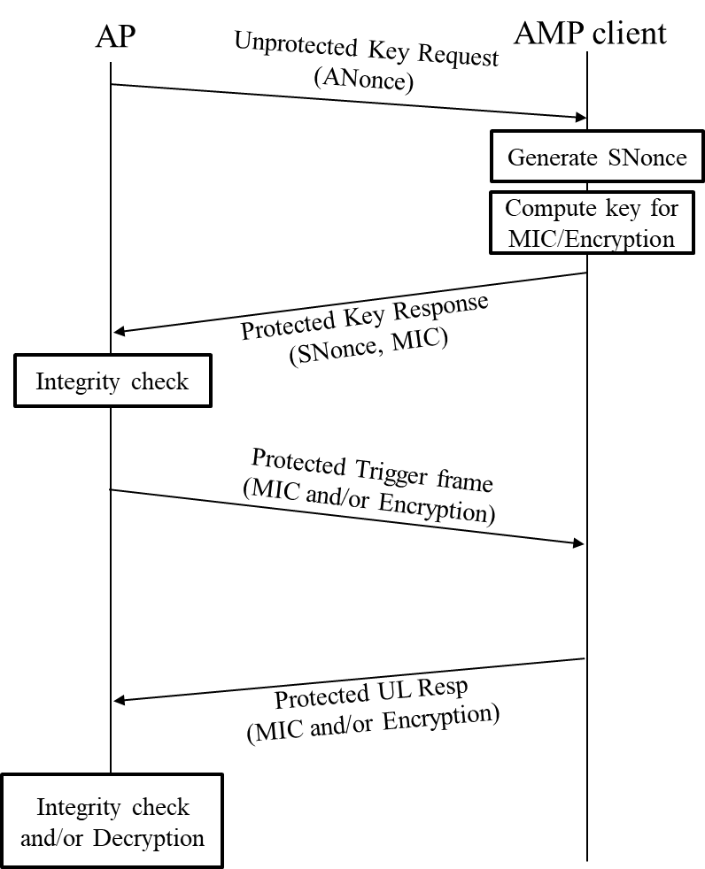
Trigger/UL Transmissions
The AP sends AMP Trigger either as per the schedule or per event basis
If the AMP client can’t retain the transient key, the Trigger process can be preceded by a transient key generation process
E.g., when the AMP Trigger is not sent close to the Operation Mode Req/Resp process
The generated key can be used to protect:
Trigger frame from the AP
UL Response from the client

Slide 10
Trigger/UL Transmissions (Contd…)
The Trigger frame can be unprotected if:
AP intends to gather responses from multiple clients
The frame does not carry sensitive information
In this case, the Trigger frame transmission and Key Req can be merged
Similarly, the UL Resp and Key Resp can be merged
The UL Resp can carry MIC
No Encryption

Slide 11
Summary
Secure end-to-end (E2E) operation for AMP clients, focusing on:
Constraints at AMP Client:
Limited energy availability and minimal persistent memory
Authentication and Encryption:
Lightweight key generation process due to energy constraints
One-way authentication where the client does not authenticate the AP
Key phases of AMP operation:
Offline Onboarding:
Setting up the PMK
Initial Info Exchange:
Exchanging basic information like MAC addresses
AMP Operation Mode:
AP requests and receives operation capabilities and schedule information from the client
AMP Trigger/UL Response:
AP triggers the client for uplink transmissions

Slide 12
SP
Do you agree that TGbp to define a mechanism to support secure communications for 802.11bp clients?

