Slide 1
Impact of hidden nodes on NPCA performance
Date: 01-10-2025

Slide 2
Introduction
802.11bn targets the improvement of packet delivery by reducing the transmission latency and enhancing network reliability [1]
Non-Primary Channel Access (NPCA) mechanism has been adopted to be part of the 802.11bn amendment [2]
  NPCA leverages the secondary channel, while an OBSS is using the primary channel, allowing the BSS of interest to gain additional resources to improve its own network performance

Slide 3
Motivation
A correct operation of NPCA implies that the AP and its associated STAs decide to jump all together to the non-primary channel, as consequence of seeing the same external OBSS events (e.g., RTS-CTS sequence)
Hidden node situations may create different views of those events within the members of the BSS of interest
This contribution analyzes the performance impact on these hidden node situations, covering several deployment setups

Slide 4
NPCA: Recap
Same primary
BSS
OBSS
OBSS
Time
RTS
DL/UL Exchanges
CTS
NPCA BSS
RTS
DL/UL Exchanges
RTS
DL/UL Exchanges
Time
CTS
CTS
BSS jumps to the non-primary channel
BSS returns to the primary channel
The BSS of interest detects the OBSS RTS/CTS sequence, identifies the OBSS TXOP length, and determines if they can trigger NPCA
Proper BSS operation of NCPA requires
  R1: Joint operation for changing to the non-primary channel
  R2: Joint operation for returning to the primary channel, before the OBSS ends the TXOP, and guarantee fairness re-accessing to the primary channel

Slide 5
General Simulation Assumptions
AP and STAs initiate a TXOP using RTS/CTS frames
NPCA is triggered by listening to an OBSS RTS/CTS sequence, using a minimum TXOP length threshold of 2ms to take the decision of enabling NPCA
In the primary channel, the non-AP STAs generate triggered and untriggered UL traffic
In the non-primary channel, the non-AP STAs generate triggered UL traffic
Assume there is no switching delay for changing the channel
EDCA parameters based on 802.11REVme (Table 9-194)
  For primary and non-primary channel access

Slide 6
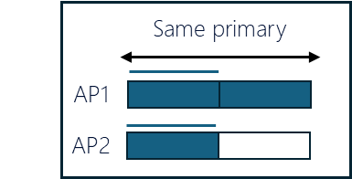


Simulation Setup
Simulations cover OBSS scenarios under different deployment circumstances, mainly focused on hidden node situations
Two independent BSSs, in the same primary channel, each one is composed of one AP and 3 non-AP STAs
  BSS1 is NPCA capable
Data traffic per non-AP STA for both BSSs:
  UDP DL: 150Mps
  UDP UL: 20 Mbps
STA22
STA13
STA11
STA23
BSS1
AP2
80 MHz
AP1
160 MHz
BSS2
STA21
STA12

Slide 7
NPCA Simulation Results
Attending to the requirement R1 (see slide 4) of changing jointly to the non-primary channel, we have defined several scenario deployments:
  No hidden nodes scenario (baseline) – Shown in this slide
  Different hidden node use cases
Under ideal circumstance where all the STAs see each other, the performance gain for the NPCA BSS (BSS1) is clear, while BSS2 has no performance impact, keeping the fairness

Slide 8
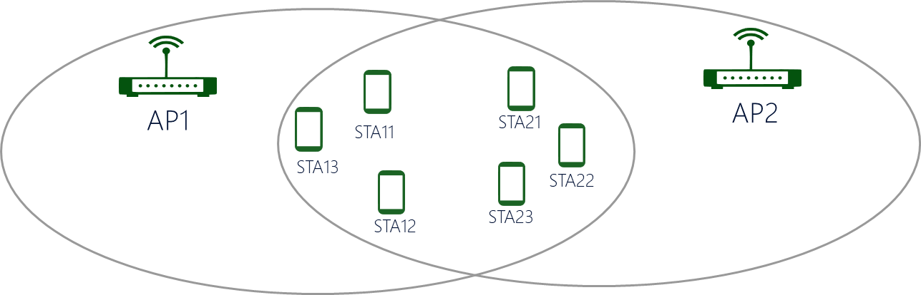
Simulation Results – Hidden nodes A
APs do not see each other
The non-AP STAs see all the OBSS network
NPCA behavior (BSS1):
  Non-AP STAs jump to the non-primary channel
  AP does not see BSS2 RTS/CTS exchange
  NPCA has no impact on the BSS1 performance

Slide 9
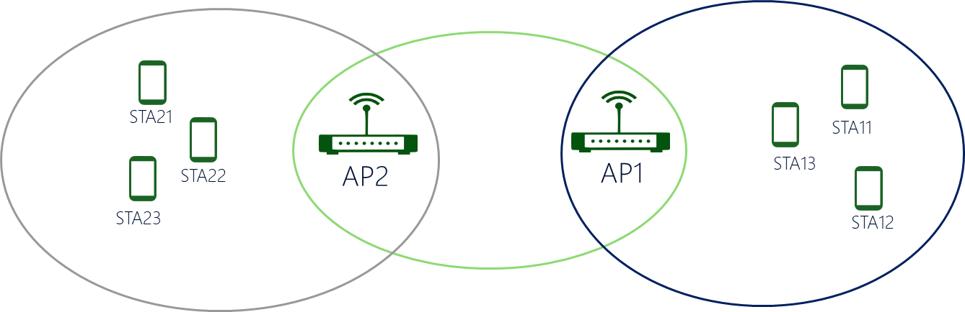
Simulation Results – Hidden nodes B
APs see each other
APs do not see OBSS non-AP STAs
Non-AP STAs do not see OBSS STAs and AP
NPCA behavior (BSS1):
  None of the BSS1 nodes see BSS2 RTS/CTS exchange
  NPCA has no impact on the BSS1 performance

Slide 10
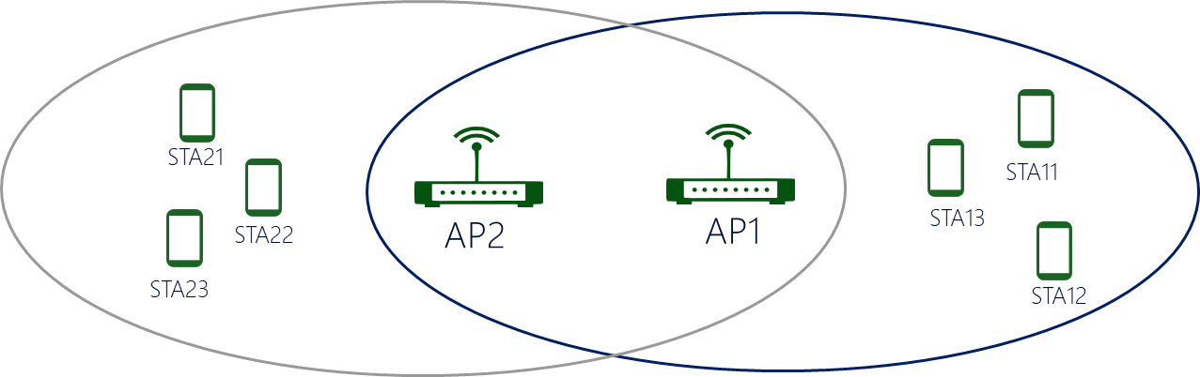
Simulation Results – Hidden nodes C
APs see each other
APs see OBSS non-AP STAs
Non-AP STAs do not see OBSS non-AP STAs
NPCA behavior (BSS1):
  Non-AP STAs do not see BSS2 RTS/CTS exchange
  AP jumps to the non-primary channel
  NPCA has no impact on the BSS1 performance

Slide 11
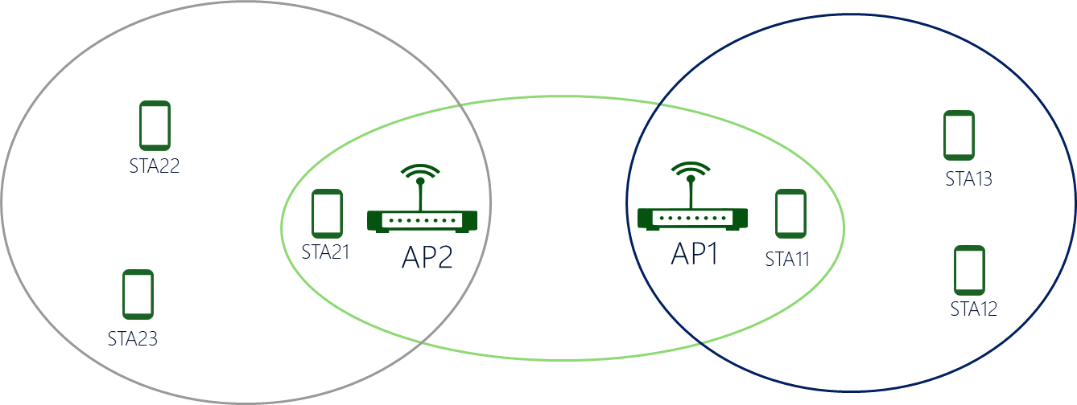
Simulation Results – Hidden nodes D
APs see each other
APs see part of the OBSS non-AP STAs (STAx1)
Part of non-AP STAs do not see OBSS non-AP STAs and AP
NPCA behavior (BSS1):
  Only AP and STA11 jump to the non-primary channel
  For this specific case, NPCA has no impact on the BSS1 performance
  It would help if AP1 knows the non-STAs that have jumped to the non-primary channel
    A mechanism should be included where [3] could be the starting point

Slide 12
Additional Simulation Results
Attending to the requirement R2 (see slide 4) of returning jointly to the primary channel, we introduce the CF-End mechanism in the OBSS network
  The OBSS may end prematurely its TXOP, while the NPCA BSS is not aware of that
The NPCA BSS needs to wait until the primary channel is free again, creating a problem of fairness
OBSS
CF-End
Time
RTS
DL/UL Exchanges
RTS
DL/UL Exchanges
CTS
CTS
BSS does not receive CF-End
NPCA BSS
RTS
DL/UL Exchanges
RTS
Time
CTS
CTS
BSS jumps to the non-primary channel
BSS returns to the busy primary channel
BSS may start contending

Slide 13
Additional Simulation Results
The ideal scenario (no hidden nodes) may experiment a performance loss due to bad medium synchronization at the returning phase
  The performance loss is directly related to the traffic load in the OBSS network and the declared TXOP length at the initial RTS-CTS exchange (i.e., real TXOP versus initial scheduled TXOP)
The hidden node scenario adds uncertainty, creating discoordination within the NPCA BSS (i.e., some STAs receive the CF-End frame, others continue in the non-primary channel)
  Even if there was no impact on the NPCA BSS performance, under the presence of CF-End frames it can be worse

Slide 14
Additional Simulation Results
Hidden node scenario A Hidden node scenario B
Hidden node scenario C Hidden node scenario D

Slide 15
NPCA Simulation Results - Summary
NPCA improves the network performance under an ideal scenario (without hidden nodes)
The introduction of hidden nodes under different scenarios, as expected, shows that NPCA has no impact on performance improvement
However, if the OBSS introduces a mechanism to terminate prematurely the ongoing TXOP, the performance may be worse

Slide 16
Conclusion
We have presented simulation results for NPCA mechanism, focusing on the performance impact for those scenarios with hidden nodes
We need to be aware about the NPCA performance issues under realistic scenarios, such as the ones related to hidden nodes
Even if the performance is not impacted, this is not the case when the OBSS ends prematurely the TXOP, which may occur

Slide 17
References
[1] IEEE 802.11-23/0028r6, UHR PAR discussion
[2] Matthew Fischer et al., “PDT MAC NPCA”, 24/1762r14
[3] Minyoung Park et al., “Non-Primary Channel Access (NPCA)”, 23/2005r1

Slide 18
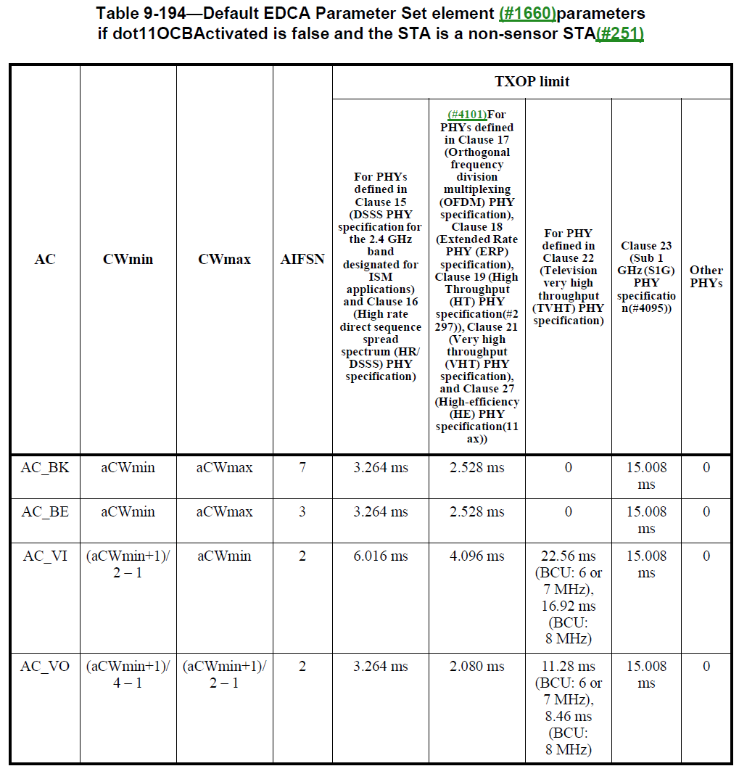
Backup

