Slide 1
Negotiable AMPDU operations for the STA power save
Date: 2024-9-4
Authors:

Slide 2
Introduction
Power save is one important topic that is being discussed in 11bn, and lots of power saving mechanisms have been discussed in the group
For STA power save, the DPS (dynamic power save) has already passed the motion recently in SFD[1],
  The LCM (low capability mode) introduced in the DPS can lower the power consumption of the STA listen mode
For many real use cases of STA, the practical traffic is much more “uni-directional”, in which there are much more DL traffics than UL traffic. For those uses cases, in this contribution, we try propose to enhance the existing AMPDU operations to further lower the STA power consumption

Slide 3
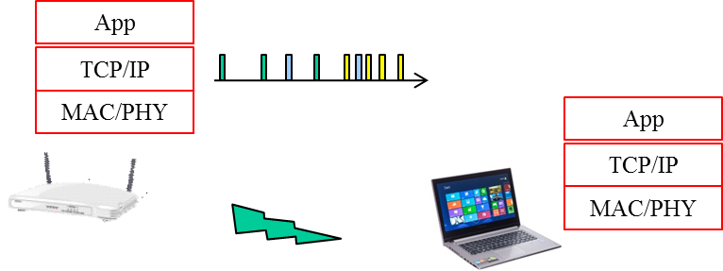
Recap: Unidirectional practical use cases
For STA, e.g. a cell phone, many common practical use cases have many more DL traffic than UL traffic. For example, the web browsing, the online video etc.
In the 11ax traffic model for evaluation [2], some traffic models have been proposed for performance evaluation. Among those traffic models, for STA, two traffic modes are almost purely uni-directional,
  Wireless Display (lightly compressed video) Traffic Model
  Buffered Video Steaming (e.g., YouTube, Netflix) Traffic Model
The buffered video streaming traffic model in [2],

Slide 4
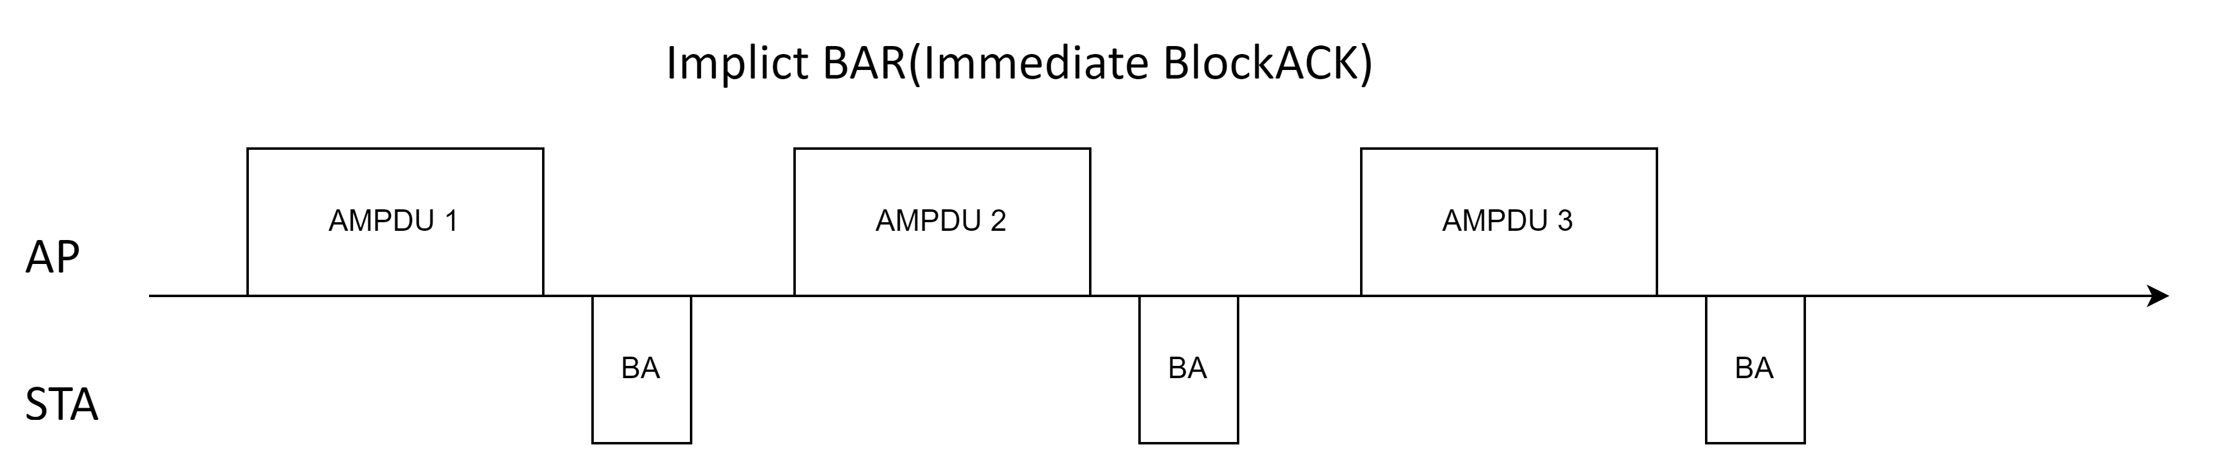
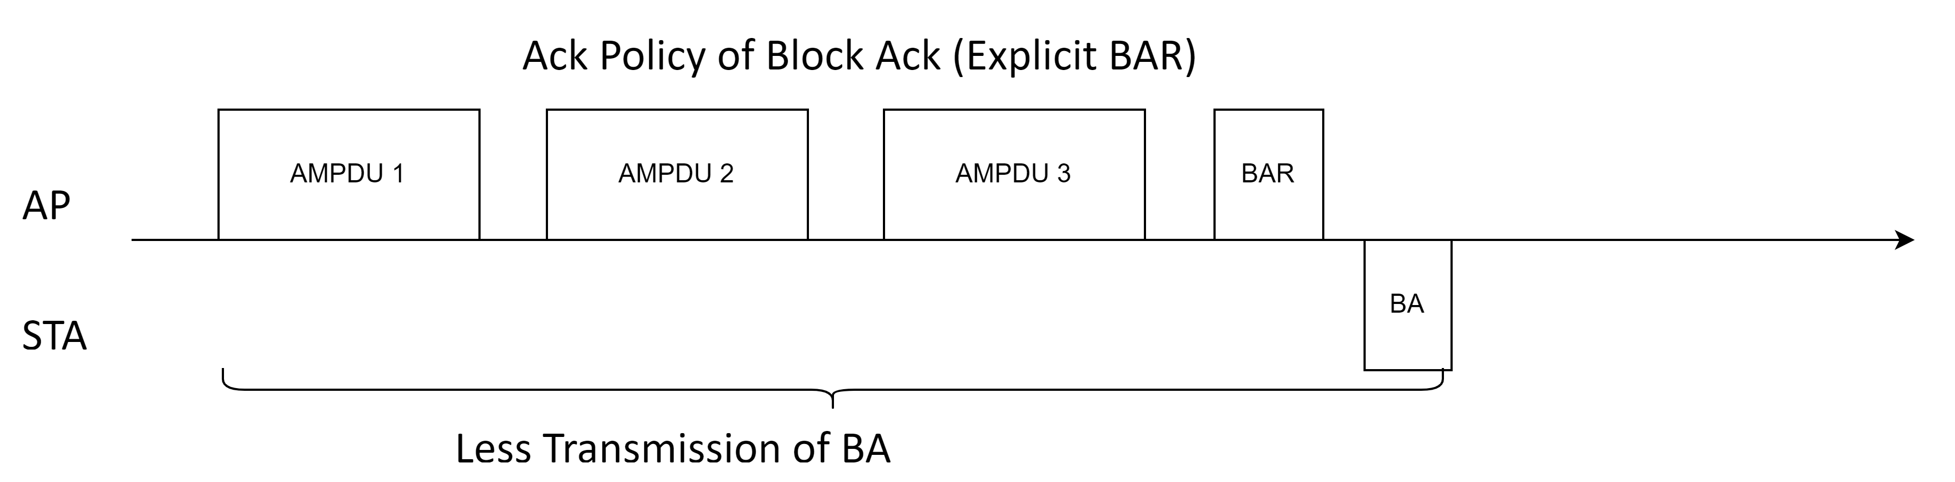
Recap: Common AMPDU operations
For the AMPDU operations, the 802.11 standard now only keeps the HT-immediate block ack procedure. And in practical, for the SU case, almost all the implementations of Originator only use the Ack Policy of Implicit BAR, which requires the Recipient responses a BlockAck immediately.
The Ack Policy of Block ACK (Explicit BAR) is seldom used in the SU case. And the current standard also does not define procedures to explicitly enable the use of the Explicit BAR

Slide 5
Recap: Common AMPDU operations
For the Wi-Fi product, its Transmission power consumption can be quite different (larger) from the Reception power consumption,
  The difference varies hugely per implementation. For same cases, the Tx power consumption (>1000mW) can be 10x larger than that of Rx power consumption (< 100mW)
Here are some public research about the Wi-Fi (Tx/Rx/Idle) power consumption,
  The reference [3] about earlier 11n devices shows that Tx power consumption can be ~1.5x larger than that of Rx for some MCS/BW
  The reference [4] about 11n/11ac devices shows that Tx power consumption can be 4x~5x larger than that of Rx for some MCS/BW
  The reference [5] (11ax simulation scenarios) lists a power table that require the Tx power consumption can be 1.4x~2.8x larger than that of Rx for different BWs
  Although the BA usually uses lower MCS and 1ss, its Tx power consumption can also be very large
    Especially for some cases when the STA is far away from the AP, the STA will increase its Tx power to improve the successful transmission of the BA response

Slide 6
Proposal: Negotiable AMPDU Ack Policy operation
For the DL traffic use case, to lower the total power consumption, we may try to reduce the number of the BA transmission of STA
The STA(as Recipient) can recommend the Originator to use different Tx AMPDU Ack Policy for the corresponding BA agreement
  The conditions that Recipient may recommend to use Explicit BAR may include,
    The reception MPDU PER is not bad
    The corresponding traffic is not very latency sensitive
    The corresponding traffic does not have very low throughput
The AP(as Originator) can accept or deny the recommendation
  Because the Explicit BAR without immediate BA response will require the Originator to have stronger buffer capabilities, as the transmitted MPDUs cannot be released until they are acknowledged (or dropped due to lifetime expiration)

Slide 7
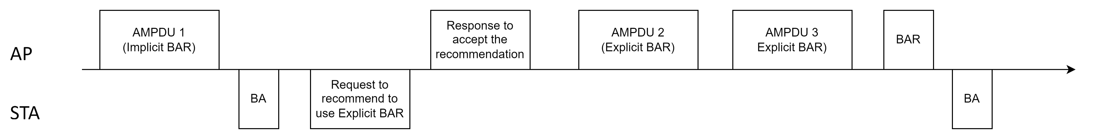
Proposal: Negotiable AMPDU Ack Policy operation
When AP (as Originator) accepts the recommendation of using Explicit BAR Ack Policy, the Originator can try to use Explicit BAR for (some of ) the AMPDUs it transmits
To solicit the BA response, the Originator’s behavior can vary based on actual implementations. For example, the Originator may
  (periodically) transmit AMPDU with Implicit BAR to solicit immediate BA response. Or,
  (periodically) transmit BAR to solicit immediate BA response
The Originator’s behavior may base on the corresponding traffic characters, e.g. the period/delay bound

Slide 8
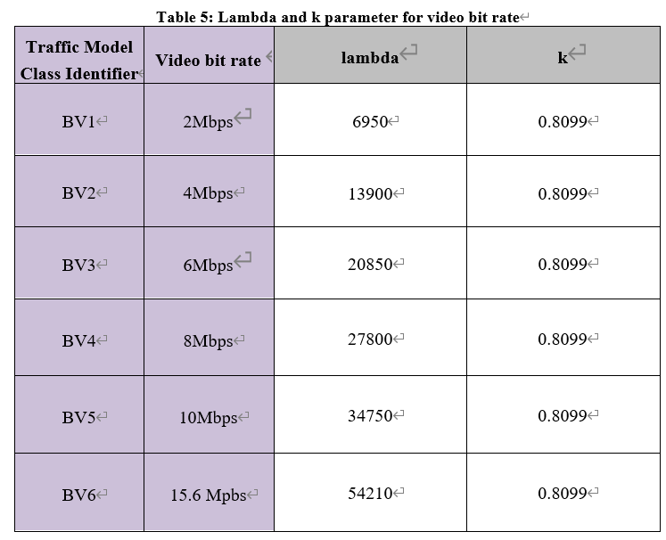
Simulation
Here we use the Buffered Video Streaming (e.g., YouTube, Netflix) Traffic Model in [2] to simulate the power consumption benefit of using Explicit BAR over Implicit BAR
In [2], based on the specification of the video streaming bit rate(e.g. 480p/30fps, 1080p/60fps), there are different parameters to simulate those different video bit rate
  The BV1 may correspond to 480p/30fps
  The BV6 may correspond to 1080p/60fps
As the online video today has much higher quality, we use
another higher video bit rate corresponding to 2K/60fps
  The BV7 that has video bit rate of 25Mbps, lambda of 86875

Slide 9

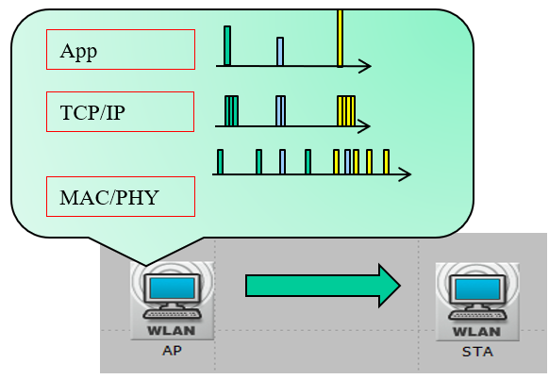

Simulation
The characters of the Buffered Video Streaming traffic model,
  Step 1: The video packet size is generated at constant interval, but with random packet size. At application layer, generate video frame size (bytes) according to Weibull distribution with the following PDF.
  Step 2: AT TCP layer, set TCP segment as 1500 bytes and fragment video packet into TCP segments.
  Step 3: Add network latency to TCP/IP packets when these segments arrive at AP for transmission. The network latency is generated according to Gamma distribution whose PDF is shown below
    Where
    – k=0.2463
    – theta=60.227
So in the view of MAC, the MSDUs are arriving with different/random
sizes and different/random frame interval

Slide 10
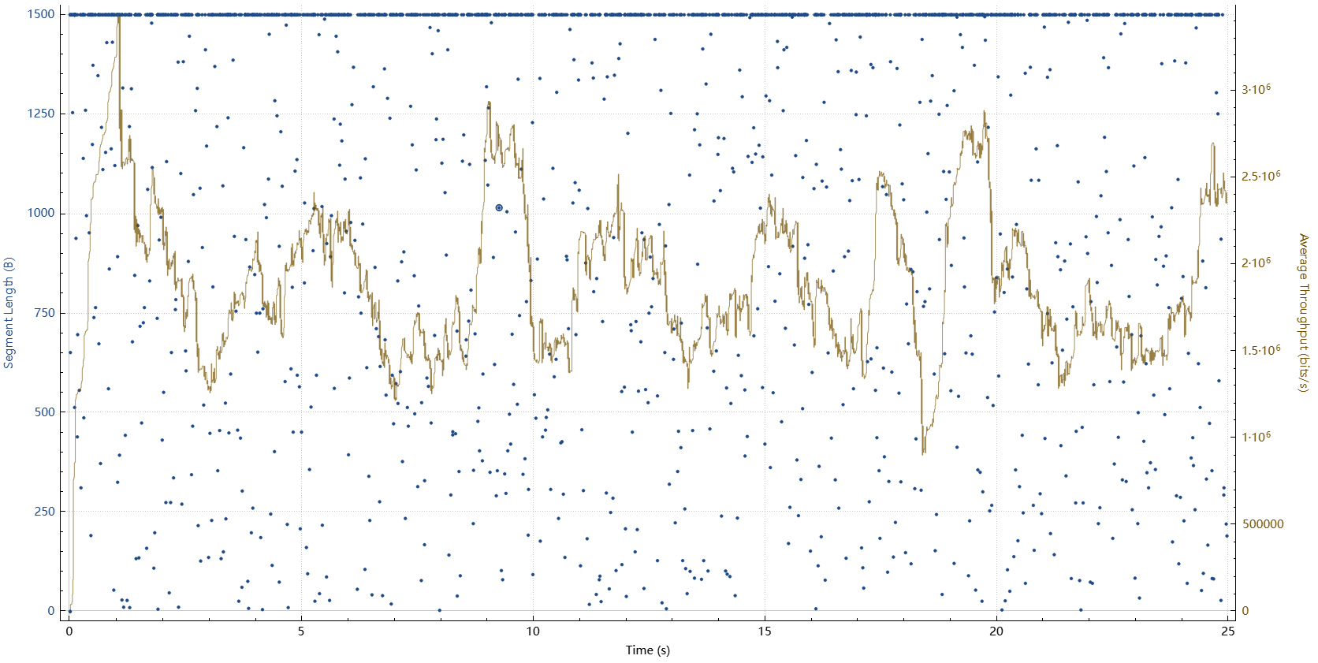
Simulation
The characters of the Buffered Video Streaming traffic model,
  Random size of packet size and random arrival time at the MAC layer
  The below figure shows the MSDU (TCP segment) size and real time throughput for the BV7 (target video bit rate of 25Mbps) simulation
  This shows a BV7 streaming lasting 25 seconds
  The blue dot shows the TCP segment size at each time
    As the video packet size follows Weibull distribution, the TCP segment may have different size at different time
    And the arrival time of each TCP segment is also non-constant
  The yellow line shows the real time TCP throughput
    The real time TCP throughput varies as the size/arrival time of TCP segment varies
    The yellow line shows an average TCP throughput of 23.8Mbps, which is close to the BV7 target video bit rate of 25Mbps

Slide 11
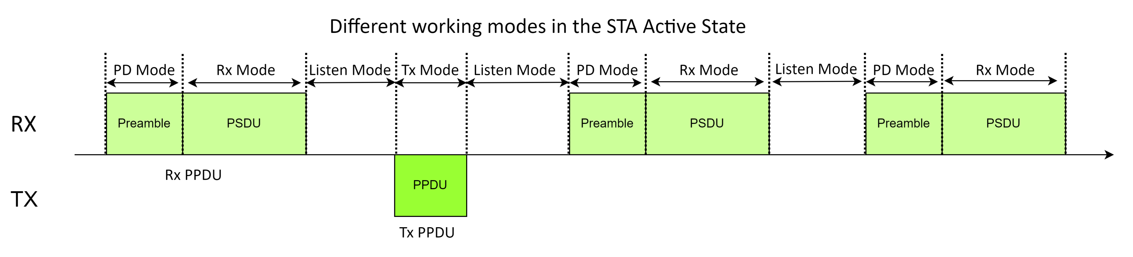
Simulation
Total power consumption calculation
  For the 60fps video streaming, we generate video packet every ~16ms (1/60). Typically, the STA will not enter sleep mode with such a short frame interval
  So during the active time of STA, we divide the STA working mode into 4 states:
    Listen Mode: STA is neither Tx or Rx, and there is not any signal on working channel
    PacketDetect Mode: STA is receiving the preamble of a Rx PPDU. In our simulation, it lasts the duration of pre-HE portion
    Rx Mode: STA is receiving the rest of the Rx PPDU. In our simulation, it begins from the HE portion of the Rx PPDU
    Tx Mode: STA is transmitting
  We will accumulate the time duration for each STA active state during a certain time, and the total power consumption will be the sum of the power consumption of each active state
    P_total = (Duration_PD_Mode x Power_PD_mode) + (Duration_Listen_Mode x Power_Listen_mode)
    (Duration_Rx_Mode x Power_Rx_mode) + (Duration_Tx_Mode x Power_Tx_mode) ;

Slide 12
Simulation
Total power consumption calculation
  As our target is to compare the total power consumption difference between method with Explicit BAR and method with Implicit BAR, the absolute power consumption of each active state is not important. So in our simulation, we
    Set the Power_RX_mode to 1
    Set the Power_PD_mode to (0.9*Power_Rx_mode)
    Set the Power_Listen_mode to (0.6*Power_RX_mode)
      Assuming there is DPS mode that introduces lower power consumption in the Listen mode
    For the Power_TX_mode, we set different levels of Tx power consumption to see the different results caused by different Tx power consumption
      In our simulation, we set Power_TX_mode to be [1.2, 1.5, 2, 2.5, 3, 4, 5] times of Power_RX_mode
  The retransmission is also considered in the simulation. We use 4 different MPDU level PER: 0/0.05/0.1/0.15. The retransmission time and power consumption is also accumulated in the total time/power consumption calculation

Slide 13
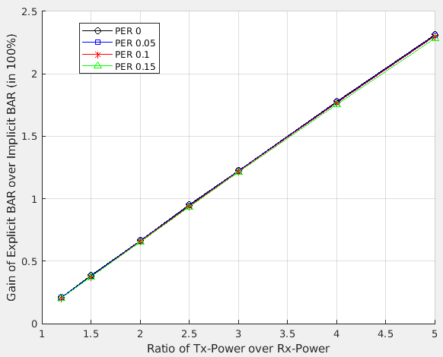
Simulation
Simulation Result 1 for BV1
  Traffic Model: BV1 with target video bit rate of 2Mbps
  Use HE MCS9/BW80/1x1 constant rate
  For Explicit BAR, Originator uses BAR to solicit BA response
  Record the total power consumption during 24 seconds for both Explicit BAR and Implicit BAR
  In the left figure,
    X Axis is the different level of Tx power consumption
    Y Axis shows the gain of the total power consumption with Explicit BAR over that with Implicit BAR (in percentage)
  For the BV1 of 2Mbps, as the traffic throughput is too low compared to the MCS9/BW80/1x1(480Mbps), the gain is more obvious when the Tx power is > 4x of Rx power, in which the gain can be > 2%

Slide 14
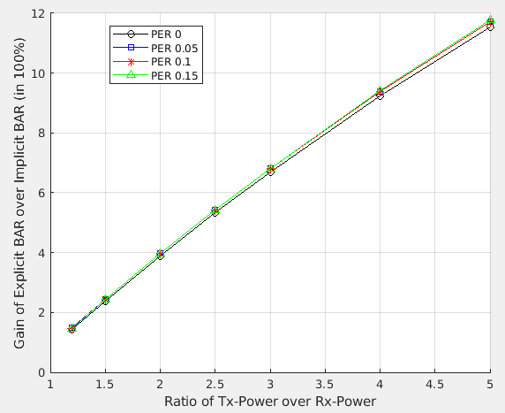
Simulation
Simulation Result 2 for BV6
  Traffic Model: BV6 with target video bit rate of 2Mbps
  Use HE MCS9/BW80/1x1 constant rate
  For Explicit BAR, Originator uses BAR to solicit BA response
  Record the total power consumption during 24 seconds for both Explicit BAR and Implicit BAR
  For the BV6 of 15.6Mbps (actual average throughput is 15.9Mbps), the total power consumption gains of Explicit BAR over Implicit BAR are more obvious. When the Tx Power is > 4x larger than Rx Power, the total power consumption gain can be > 10%

Slide 15
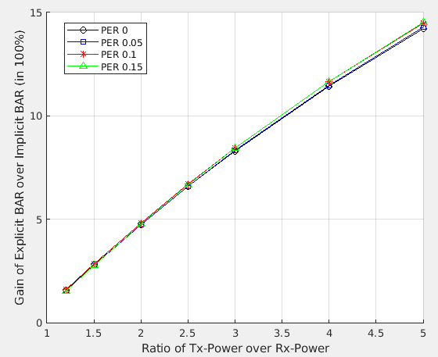
Simulation
Simulation Result 3 for BV7
  Traffic Model: BV7 with target video bit rate of 25Mbps
  Use HE MCS9/BW80/1x1 constant rate
  For Explicit BAR, Originator uses BAR to solicit BA response
  Record the total power consumption during 24 seconds for both Explicit BAR and Implicit BAR
  For the BV7 of 25Mbps (actual average throughput is 23.8Mbps), when the Tx Power is > 3.5x larger than Rx Power, the total power consumption gain can be > 10%

Slide 16
Summary
In this contribution, we provide a proposal to enable STA (as Recipient) to recommend Originator to use a different Ack Policy from that already used in the Originator’s Tx AMPDU.
For some certain use cases, by using the Explicit BAR, it can decrease the number of the BA frames transmitted by STA (as Recipient)
We also provide a simulation with online video use case to show the total power consumption gain of the method with Explicit BAR over that with Implicit BAR

Slide 17
SP
Do you support that an UHR STA as a Recipient of a RX BA agreement can recommend its peer Originator to use a specific Ack Policy in the Originator’s transmitted AMPDUs?
  The recommended Ack Policy can be Implicit BAR or Block Ack (Explicit BAR)
  The Originator can accept or deny the recommendation
  The exact signaling method is TBD

Slide 18
References
[1] 11-24-0209-06-00bn-specification-framework-for-tgbn
[2] 11-15-0590-02-00ax-traffic-model-updates-to-evaluation-methodology
[3] Demystifying 802.11n Power Consumption
[4] Power-Throughput Tradeoffs of 802.11n/ac in Smartphones
[5] 11-14-0980-16-00ax-simulation-scenarios

