Slide 1
UHR TxOP Power Save for the STA low power
Date: 2024-9-4
Authors:

Slide 2
Introduction
Power save is one important topic that is being discussed in 11bn, and lots of power saving mechanisms have been discussed in the group
In [1] (11ax simulation scenario), there was a STA low power mode “Shallow Sleep”
  Shallow sleep power state of a wireless module is defined as a sleep state with baseband and MAC processors turned on, but RF is switched off
  The VHT TxOP Power Save and 802.11ax Intra-PPDU Power Save may make the STA enter the “Shallow Sleep”
For many real use cases of STA, the practical traffic is much more “uni-directional”, in which there are many more DL traffics than UL traffic.
In this contribution, we try to propose the “TxOP level Power Save” for UHR STAs to make UHR STAs have more chances to enter the “shallow sleep” state

Slide 3
Recap: VHT TxOP Power Save
802.11ac has defined a VHT TxOP Power Save procedure, in which the VHT AP allows non-AP VHT STAs to enter doze state during a TXOP, then a non-AP VHT STA that is in TXOP power save mode may enter the doze state until the end of that TXOP
  The VHT AP shall include a nav-set sequence (e.g., RTS/CTS) at the beginning of such a TXOP with the Duration/ID value set to the remainder of the TXOP duration.
  The VHT AP needs send a VHT PPDU with TXOP_PS_NOT_ALLOWED set to 0 in the VHT SIG field
  STA that receives the VHT PPDU containing no MPDUs of interest can enter the doze state until the end of that TxOP
  The VHT AP shall not transmit frames to STAs that have been allowed to enter doze state in that TxOP
The VHT TxOP Power Save is not used widely in implementations. This mechanism has several problems:
  The VHT TxOP Powe Save intends to only apply for Intra-BSS TxOP. But 802.11ac does not define procedures to distinguish the Intra-BSS PPDU and Inter-BSS PPDU
  The VHT PPDU PHY lacks the fields for STA to retrieve the information of TxOP duration, DL/UL, STA AID etc.
    VHT STA can only get those information from the MPDU level, but sometimes VHT STA may not be able to decode the MPDU, such as a VHT MU PPDU not for itself
  The VHT TxOP Power Save is not inherited by HE/EHT, and there is not such a “TXOP_PS_NOT_ALLOWED” field in HE/EHT PPDU

Slide 4
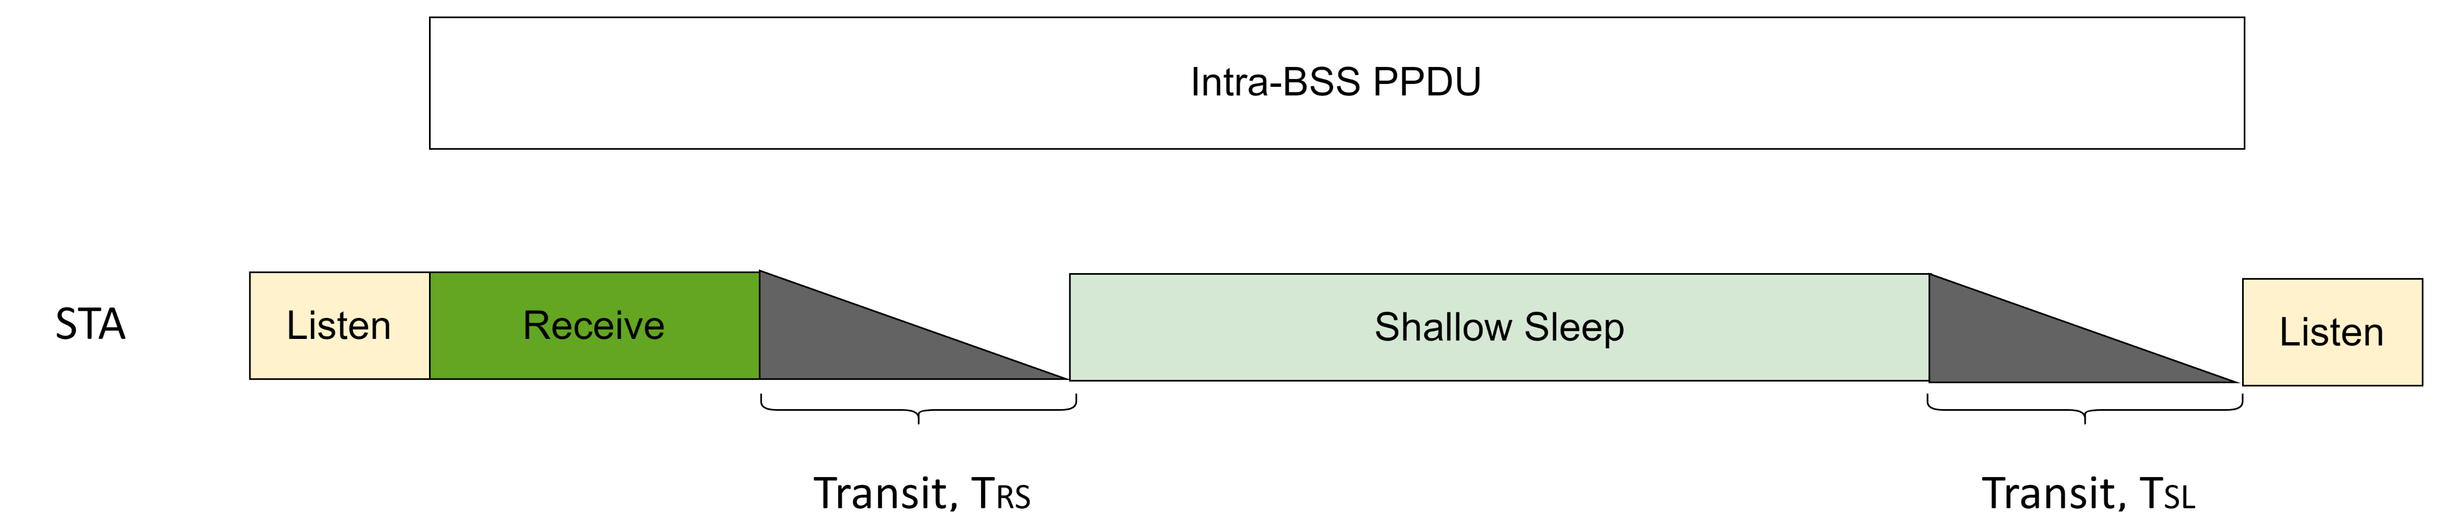
Recap: 802.11ax Intra-PPDU Power Save
802.11ax has defined a PPDU level power save mechanism Intra-PPDU Power Save.
  For a HE STA, a PPDU that is identified as an Intra-BSS PPDU and contains no MPDUs of interest can make this STA enter the doze state until the end of this received PPDU
One of the problems for the Intra-PPDU Power Save is that the PPDU must be long enough (in time) to allow a certain HE STA to enter the doze state
  For a STA, it needs spend some time to enter and exit the doze state. As defined in [1], we assume the STA enters the “shallow sleep” when entering doze state during the Intra-PPDU Power save. So here we call the “doze state” here as “shallow sleep”
  As defined in [1], the time that STA transits from Receiver to Shallow Sleep (doze state) is TRS, and the time from Shallow Sleep to Listen is TSL
    The PPDU length must be bigger than the STA’s reception process and transit time
  And for some pure response frame in pre-HE format (e.g. BA in non-HT), STA needs decode the entire PPDU and has no chance to enter shallow sleep

Slide 5
Analysis: The state transit time
Assuming that the STA enters the shallow sleep during the Intra-BSS PPDU (and the TxOP) Power save, the reference [1] lists some values to show the state transit time,
As highlight, the transit time from Receive to SS is TRS = 200us, while the SS to Listen is TSL = 500us, resulting a total transit time of 700us
  The actual transit time varies hugely depending on the implementation
  For some of current designs, especially considering the DPS mode can use a RF with lower requirements, the transit time in some of implementations can be lower than the above value. For example, the TRS can be < 100us, and the TSL can be <250us, resulting a total transit time of 350us
The larger the transit time is, the longer the corresponding Intra-BSS PPDU should be to make the STA enter the shallow sleep
Power Transition parameters
State Transitions | Transition Time (ms) | Average Power Consumption (mW)
Transmit ⬄ Listen | T_{TL}=0.01ms | 75mW
Receive ⬄ Listen | 0.001ms | 55mW
Listen → Transmit | T_{LT} = 0.01ms | P_{LT} = 100mW
Transmit → Shallow Sleep | T_{TS}=0.01ms | P_{TS} = 15mW
Receive → Shallow Sleep | T_{RS}=0.2ms | PRS = 15mW
Listen ⬄ Shallow Sleep | T_{LS}=0.2ms | PLS = 5mW
Shallow Sleep → Listen | 0.5 ms (T_{SL})
Listen → Deep Sleep | T_{LD}=1ms | P_{DS} = 5mW
Deep Sleep → Listen | T_{SDL} = 10ms

Slide 6
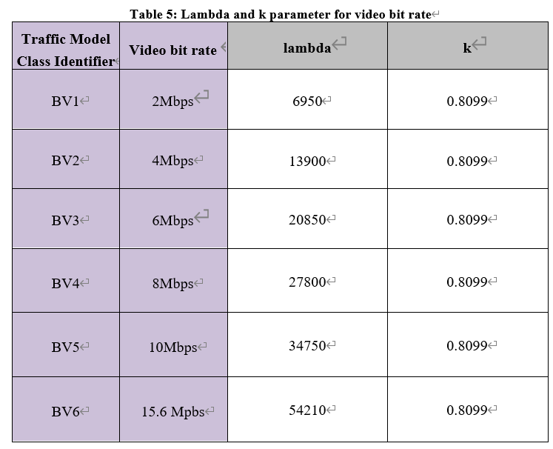
Analysis: Practical use cases
For STA device, e.g. the Phone/Tablet, many of the practical use cases are uni-directional with DL traffic occupying the most time, especially for the long-term use cases. For example, the web browsing, the online video watching etc.
Among those use cases, the MSDUs belonging to the traffic stream can be random in both size and arriving time (arrival at the MAC layer). And each of those use cases usually does not have very high average throughput requirement
The online video use case, referred as Buffered Video Streaming use case in [1], is one of the use cases that have relatively higher throughout requirement. But as shown in the [1], the actual average throughput is still not high, compared with the current 802.11 MAC/PHY capability
  For example, a typical peak MAC/PHY capability of Phone is 2x2 (or 1x1) + BW80 + MCS9/11/13, which can introduce bit rate > 400Mbps
  The BV1 (2Mbps) may correspond to 480p/30fps
  The BV6 (15.6Mbps) may correspond to 1080p/60fps

Slide 7
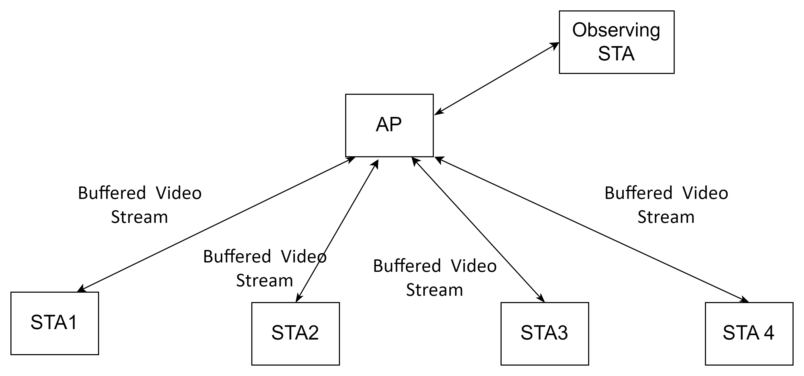
Analysis: Practical use cases
We try to simulate the following use scenarios to find how many PPDUs sent in air can trigger a STA enter the shallow sleep (Intra-BSS PPDU Power Save)
  By contrast, the corresponding TxOP lasting time is recorded as well
The network/BSS under simulation ,
  4 STAs are associated with AP, and are all running the Buffered Video Stream (online video use case) for 24 seconds
    The character of the Buffered Video Stream is illustrated in the following slide
  An observing STA is associated with AP, and record the PPDU/TxOP seen by this Observing STA
    Only the PPDUs that can amke the Observing STA enter Intra-PPDU Power Save are recorded. For example, the Beacon is not recorded
  Some other MAC/PHY configurations,
    Use EHT MCS9/BW80/1x1 constant rate
    Use MPDU level PER (0/0.05/0.1/0.15)
    Use SU frame exchange sequence
    Use AC_BE with default TxOP limit=2528us

Slide 8

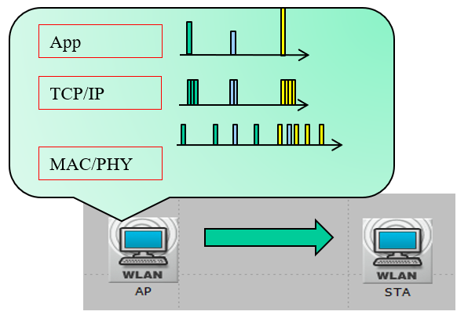

Analysis: Practical use cases
As defined in [2], the characters of the Buffered Video Streaming traffic model,
  Step 1: The video packet size is generated at constant interval, but with random packet size. At application layer, generate video frame size (bytes) according to Weibull distribution with the following PDF.
  Step 2: AT TCP layer, set TCP segment as 1500 bytes and fragment video packet into TCP segments.
  Step 3: Add network latency to TCP/IP packets when these segments arrive at AP for transmission. The network latency is generated according to Gamma distribution whose PDF is shown below
    Where
    – k=0.2463
    – theta=60.227
So in the view of AP MAC, the MSDUs are arriving with different/random
sizes and different/random frame interval

Slide 9
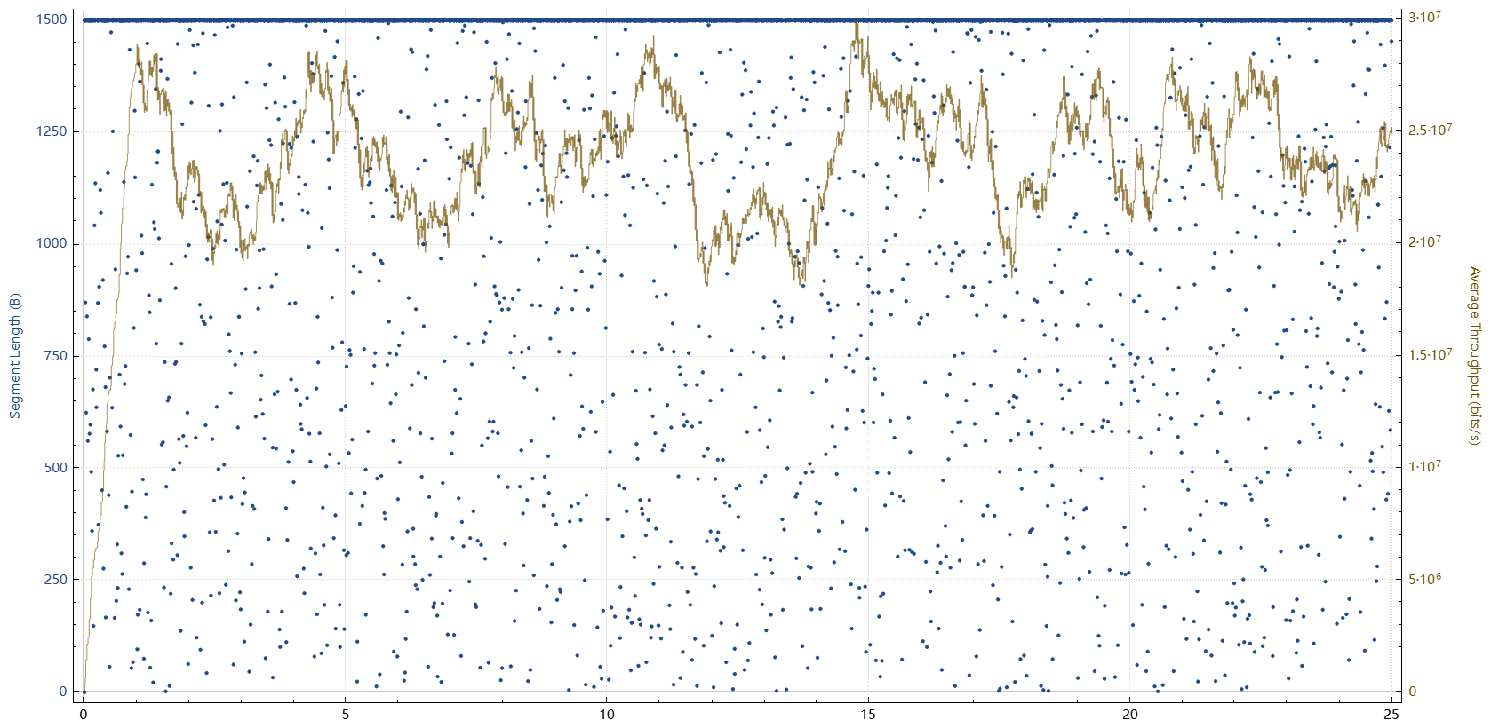
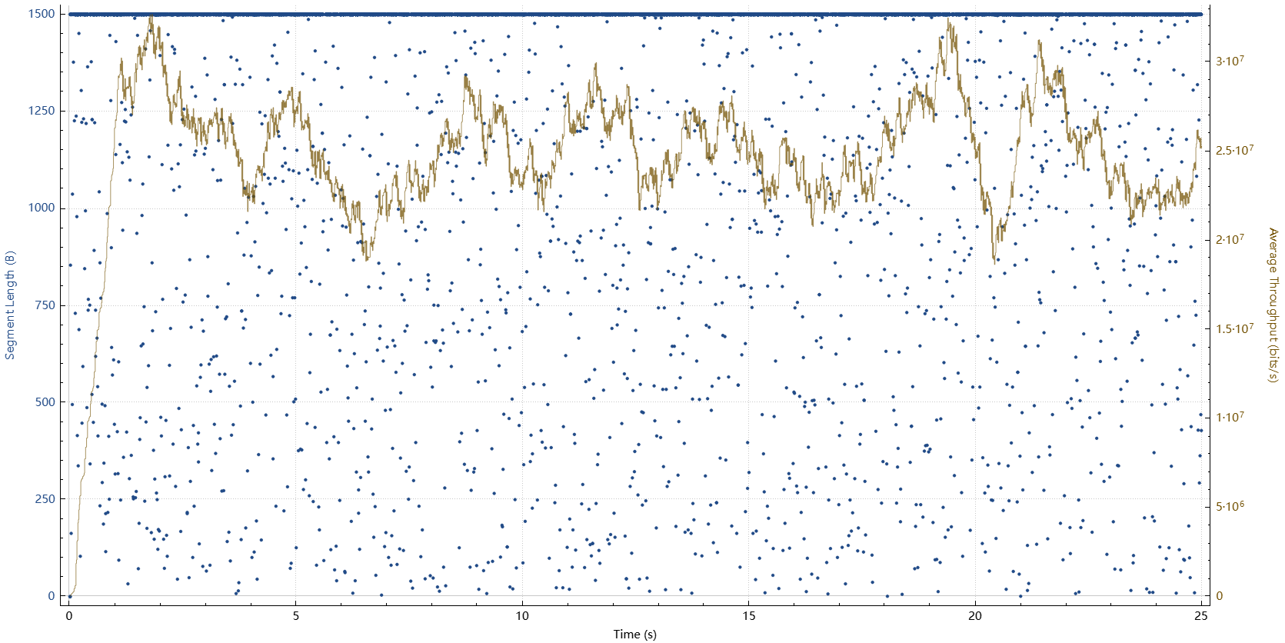
Analysis: Practical use cases
The characters of the Buffered Video Streaming traffic model,
  For two of the STAs, the below figures show the MSDU (TCP segment) size and real time throughput for the BV7 (target video bit rate of 25Mbps) simulation
    The left figure belongs to STA1, and the right figure belong to STA2.
      The X Axis is time in second. The Blue Dot is the MSDU (TCP segment) size and the Yellow Line is the real time throughput at different time
    The figures show the random size of packet size and random arrival time at the AP’s MAC layer for both the STA1 and STA2
      So the AP has random number of MSDUs with random size to form a PPDU at different time

Slide 10
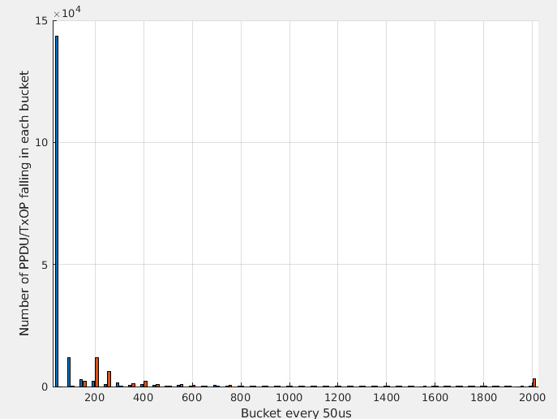
Analysis: Practical use cases
To record the histogram of all the PPDUs/TxOPs lasting time, we use different bucket (with different duration definition) to category the PPDUs/TxOPs, based on the their lasting time
  We use 40 buckets with the time granularity of 50us, and each bucket contains the number of the PPDU/TxOP that has lasting time falling in the bucket. For example,
    Bucket 1 contains the number of PPDU/TxOP with lasting time <= 50us
    Bucket 2 contains the number of PPDU/TxOP with lasting time (50us, 100us]
    Bucket 39 contains the number of PPDU/TxOP with lasting time (1900us, 1950us]
    Bucket 40 contains the number of PPDU/TxOP with lasting time >1950us
  Note: for the PPDU duration, we remove the pre-EHT preamble part as the STA
  needs decode the pre-EHT part to decide if it can enter shallow sleep
  Right figure shows the histogram of each bucket for the PER=0
    As there are a lot of BA and AMPDU with single MPDU, most of the PPDUs have duration < 50us (without pre-EHT part)
    We show the stats in details in the back up slides

Slide 11
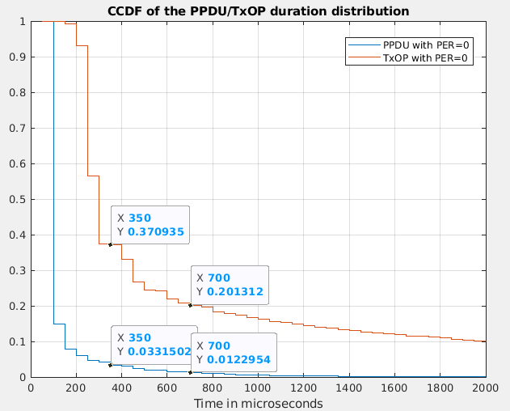
Analysis: Practical use cases
To have a better view of the stats, we use the CCDF (Complementary Cumulative Distribution Function) plot to illustrate the simulation results
  The CCDF for a certain value Y shows the probability of X that F(X)= Probability(X>=Y)
  In this simulation, the CCDF shows the percentage of the PPDU/TxOP with a lasting time that is bigger than a certain duration among all the PPDUs/TxOPs
Right figure shows the CCDF of PPDU/TxOP duration distribution for the case of MPDU PER=0
  For the PPDU duration distribution (in blue line),
    Only 3.3% of all the PPDUs have a lasting time larger than 350us
    Only 1.2% of all the PPDUs have a lasting time larger than 700us
  So, for the Intra-PPDU power save,
    If all the transit time is 700us (TRS 200us + TSL 500us), only 1.2% of all the PPDUs can make the Observing STA enter the shallow sleep
  While, for the TxOP duration distribution (in red line),
    37% of all the TxOPs have a lasting time larger than 350us
    20% of all the TxOPs have a lasting time larger than 700us
  So, for the TxOP level power save,
    If all the transit time is 700us (TRS 200us + TSL 500us), 20% of all the TxOPs can make the Observing STA enter the shallow sleep
    If the transit time is reduced to 350us, then 37% of all the TxOPs can make Observing STA enter the shallow sleep

Slide 12
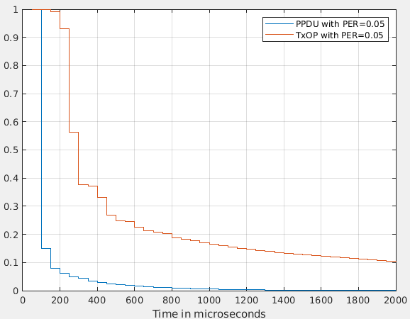
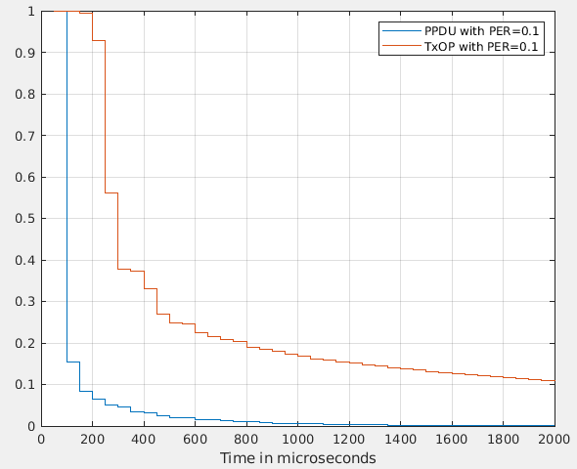
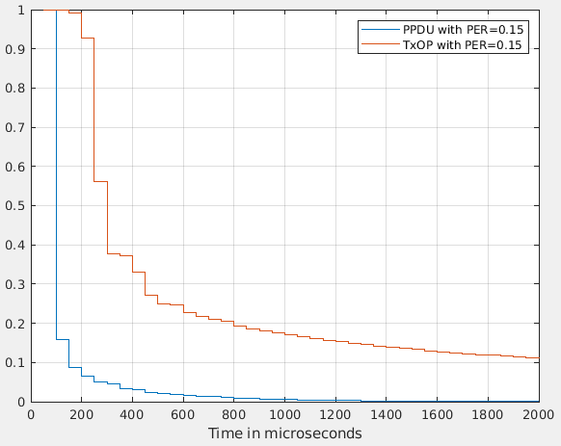
Analysis: Practical use cases
The CCDF plots for the other case with different MPDU PER (0.05/0.1/0.15)
  They all show the almost the same result as the case with MPDU PER=0
A short conclusion of the simulation is that the STA Intra-BSS PPDU Power Save is quite less likely to be triggered in some practical use cases
  Assume the STA enters the shallow sleep for the Intra-BSS PPDU Power Save

Slide 13
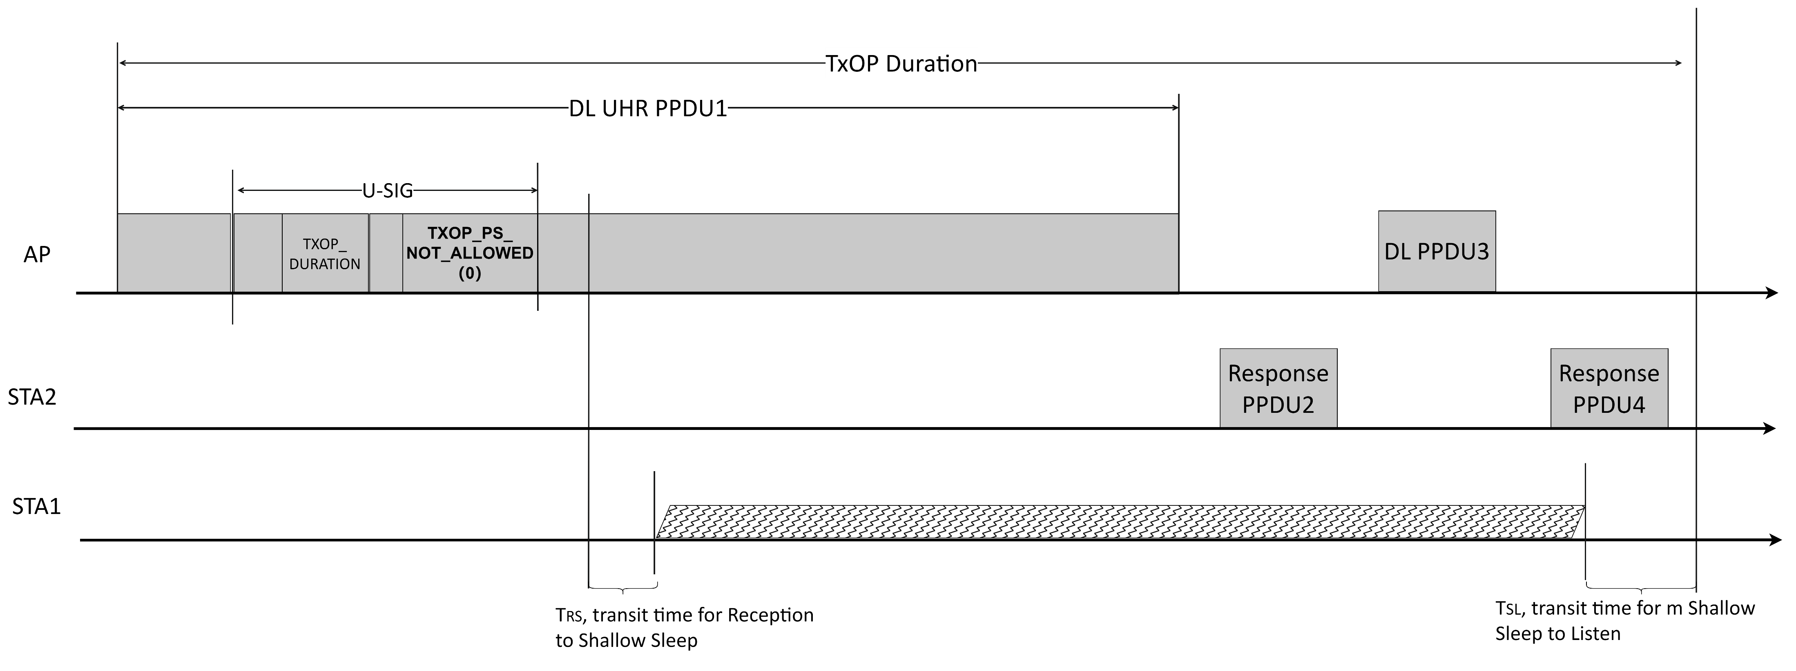
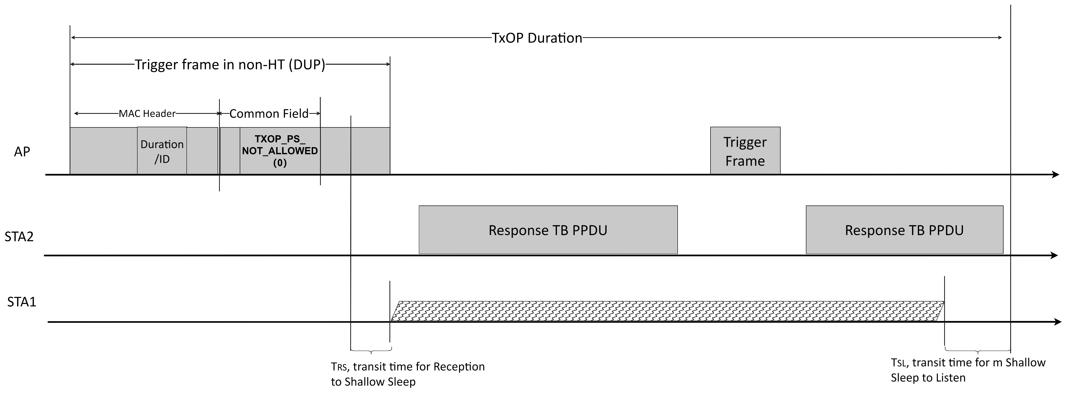
Proposal: Intra-BSS TxOP Power Save for UHR STA
To make UHR STA enter the shallow sleep more often, we propose to apply the Intra-BSS TxOP Level power for the UHR STA, with enhancements based on the existing VHT TxOP Power Save
  Case 1: Allow UHR STA to enter doze state during the AP’s SU/MU downlink TxOP. And the same as VHT TxOP PS, AP uses a bit (e.g. TXOP_PS_NOT_ALLOWED) in the UHR PHY U-SIG to indicate whether the TxOP allows TxOP level power save
  Case 2: Allow UHR STA to enter doze state during the AP’s SU/MU triggered uplink TxOP. AP needs use a bit in the Trigger frame (e.g. in the common field or in the Special User Info field) to have the same indication as the TXOP_PS_NOT_ALLOWED in the PHY U-SIG
    Whether the MU-RTS can trigger the TxOP level power save is TBD

Slide 14
Proposal: Intra-BSS TxOP Power Save for UHR STA
To enable more flexibility,
  The same as VHT TxOP PS, AP can control the UHR TxOP PS procedure per each TxOP by introducing the TXOP_PS_NOT_ALLOWED indication in both the UHR PPDU and Trigger frame in non-UHR PPDU
  Different from VHT TxOP PS, the non-AP UHR STA can dynamically indicate whether it’s in UHR TxOP PS mode or not
    For example, the UHR STA may has the same procedure to enable/disable UHR TxOP PS mode as that of DPS operating mode
    For example, the UHR STA that has lower latency requirement may request to disable the UHR TxOP PS for a while
Coexistence with other power save mechanisms,
  With HE Intra-PPDU Power Save,
    The TxOP PS can coexist with Intra-PPDU PS. And it’s up to STA’s implementation to choose TxOP PS or PPDU PS when a received PPDU satisfies both
  With UHR DPS,
    To better coexist with UHR DPS, there may be some requirements for the DPS,
      Current DPS STA needs to be able to decode upto 24Mbps, and the supported PPDU format is still TBD now.
      To be able to retrieve the TXOP_DURATION and TXOP_PS_NOT_ALLOW information from the UHR PHY U-SIG, the DPS STA shall at least be able to decode upto the UHR PPDU U-SIG (which is BPSK modulation)

Slide 15
Summary
In this contribution, we introduce the 802.11ac VHT TxOP Power Save and the 802.11ax Intra-PPDU Power Save, both of which can provide a chance to make the STA enter the shallow sleep (or doze state)
We try to analyze the limitation of the VHT TxOP Power Save and use a simulation to show the limitation of the 802.11ax Intra-PPDU Power Save
Considering the limitation of the existing 802.11ac/ax mechanisms, we propose to allow an UHR Intra-BSS TxOP level power save for the UHR STA

Slide 16
SP 1
Do you support that the UHR AP and UHR STA can support an UHR Intra-BSS TxOP Power Save operating mode, in which the UHR AP can allow an non-AP UHR STAs to enter doze state during a TXOP, then a non-AP UHR STA that is in TXOP power save mode may enter the doze state until the end of that TXOP under some certain conditions?
  The detailed procedure is TBD
  The detailed conditions are TBD

Slide 17
References
[1] 11-14-0980-16-00ax-simulation-scenarios
[2] 11-15-0590-02-00ax-traffic-model-updates-to-evaluation-methodology

Slide 18
Back Up

Slide 19
The detailed stats for the simulation
PER=0 | Duration (us) | PPDU Count | TxOP Count |  |  | PER=0.05 | Duration (us) | PPDU Count | TxOP Count |  |  | PER=0.1 | Duration (us) | PPDU Count | TxOP Count |  |  | PER=0.15 | Duration (us) | PPDU Count | TxOP Count
Bucket 1 | 50 | 143400 | 0 |  |  | Bucket 1 | 50 | 142589 | 0 |  |  | Bucket 1 | 50 | 141404 | 0 |  |  | Bucket 1 | 50 | 140739 | 0
Bucket 2 | 100 | 11779 | 248 |  |  | Bucket 2 | 100 | 11876 | 247 |  |  | Bucket 2 | 100 | 11903 | 212 |  |  | Bucket 2 | 100 | 11864 | 246
Bucket 3 | 150 | 2891 | 2002 |  |  | Bucket 3 | 150 | 3079 | 2021 |  |  | Bucket 3 | 150 | 3296 | 2045 |  |  | Bucket 3 | 150 | 3560 | 2036
Bucket 4 | 200 | 2305 | 11892 |  |  | Bucket 4 | 200 | 2295 | 11837 |  |  | Bucket 4 | 200 | 2372 | 11733 |  |  | Bucket 4 | 200 | 2450 | 11631
Bucket 5 | 250 | 789 | 6160 |  |  | Bucket 5 | 250 | 798 | 5980 |  |  | Bucket 5 | 250 | 835 | 5918 |  |  | Bucket 5 | 250 | 834 | 5891
Bucket 6 | 300 | 1610 | 125 |  |  | Bucket 6 | 300 | 1704 | 126 |  |  | Bucket 6 | 300 | 1769 | 149 |  |  | Bucket 6 | 300 | 1847 | 113
Bucket 7 | 350 | 595 | 1323 |  |  | Bucket 7 | 350 | 596 | 1370 |  |  | Bucket 7 | 350 | 556 | 1302 |  |  | Bucket 7 | 350 | 597 | 1304
Bucket 8 | 400 | 995 | 2041 |  |  | Bucket 8 | 400 | 1034 | 1953 |  |  | Bucket 8 | 400 | 1089 | 1956 |  |  | Bucket 8 | 400 | 1106 | 1889
Bucket 9 | 450 | 599 | 765 |  |  | Bucket 9 | 450 | 569 | 696 |  |  | Bucket 9 | 450 | 568 | 703 |  |  | Bucket 9 | 450 | 579 | 719
Bucket 10 | 500 | 238 | 90 |  |  | Bucket 10 | 500 | 232 | 96 |  |  | Bucket 10 | 500 | 272 | 83 |  |  | Bucket 10 | 500 | 234 | 75
Bucket 11 | 550 | 587 | 702 |  |  | Bucket 11 | 550 | 584 | 636 |  |  | Bucket 11 | 550 | 615 | 625 |  |  | Bucket 11 | 550 | 566 | 634
Bucket 12 | 600 | 186 | 347 |  |  | Bucket 12 | 600 | 212 | 371 |  |  | Bucket 12 | 600 | 183 | 353 |  |  | Bucket 12 | 600 | 213 | 308
Bucket 13 | 650 | 311 | 240 |  |  | Bucket 13 | 650 | 300 | 222 |  |  | Bucket 13 | 650 | 330 | 242 |  |  | Bucket 13 | 650 | 344 | 242
Bucket 14 | 700 | 388 | 130 |  |  | Bucket 14 | 700 | 369 | 128 |  |  | Bucket 14 | 700 | 396 | 119 |  |  | Bucket 14 | 700 | 405 | 117
Bucket 15 | 750 | 136 | 456 |  |  | Bucket 15 | 750 | 123 | 459 |  |  | Bucket 15 | 750 | 123 | 410 |  |  | Bucket 15 | 750 | 125 | 429
Bucket 16 | 800 | 277 | 176 |  |  | Bucket 16 | 800 | 280 | 172 |  |  | Bucket 16 | 800 | 278 | 184 |  |  | Bucket 16 | 800 | 283 | 182
Bucket 17 | 850 | 182 | 138 |  |  | Bucket 17 | 850 | 182 | 166 |  |  | Bucket 17 | 850 | 181 | 162 |  |  | Bucket 17 | 850 | 177 | 161
Bucket 18 | 900 | 77 | 216 |  |  | Bucket 18 | 900 | 84 | 227 |  |  | Bucket 18 | 900 | 80 | 199 |  |  | Bucket 18 | 900 | 76 | 194
Bucket 19 | 950 | 180 | 173 |  |  | Bucket 19 | 950 | 186 | 196 |  |  | Bucket 19 | 950 | 193 | 193 |  |  | Bucket 19 | 950 | 197 | 165
Bucket 20 | 1000 | 70 | 166 |  |  | Bucket 20 | 1000 | 64 | 184 |  |  | Bucket 20 | 1000 | 60 | 166 |  |  | Bucket 20 | 1000 | 72 | 151
Bucket 21 | 1050 | 103 | 103 |  |  | Bucket 21 | 1050 | 92 | 108 |  |  | Bucket 21 | 1050 | 93 | 104 |  |  | Bucket 21 | 1050 | 90 | 103
Bucket 22 | 1100 | 76 | 178 |  |  | Bucket 22 | 1100 | 87 | 171 |  |  | Bucket 22 | 1100 | 79 | 162 |  |  | Bucket 22 | 1100 | 75 | 160
Bucket 23 | 1150 | 77 | 107 |  |  | Bucket 23 | 1150 | 79 | 116 |  |  | Bucket 23 | 1150 | 68 | 101 |  |  | Bucket 23 | 1150 | 80 | 111
Bucket 24 | 1200 | 95 | 132 |  |  | Bucket 24 | 1200 | 105 | 127 |  |  | Bucket 24 | 1200 | 91 | 132 |  |  | Bucket 24 | 1200 | 93 | 137
Bucket 25 | 1250 | 23 | 99 |  |  | Bucket 25 | 1250 | 39 | 102 |  |  | Bucket 25 | 1250 | 29 | 81 |  |  | Bucket 25 | 1250 | 29 | 92
Bucket 26 | 1300 | 184 | 146 |  |  | Bucket 26 | 1300 | 183 | 145 |  |  | Bucket 26 | 1300 | 208 | 124 |  |  | Bucket 26 | 1300 | 205 | 144
Bucket 27 | 1350 | 30 | 80 |  |  | Bucket 27 | 1350 | 25 | 83 |  |  | Bucket 27 | 1350 | 29 | 73 |  |  | Bucket 27 | 1350 | 30 | 73
Bucket 28 | 1400 | 2 | 116 |  |  | Bucket 28 | 1400 | 5 | 125 |  |  | Bucket 28 | 1400 | 3 | 116 |  |  | Bucket 28 | 1400 | 2 | 109
Bucket 29 | 1450 | 3 | 90 |  |  | Bucket 29 | 1450 | 1 | 82 |  |  | Bucket 29 | 1450 | 5 | 88 |  |  | Bucket 29 | 1450 | 2 | 94
Bucket 30 | 1500 | 23 | 91 |  |  | Bucket 30 | 1500 | 23 | 71 |  |  | Bucket 30 | 1500 | 28 | 86 |  |  | Bucket 30 | 1500 | 24 | 103
Bucket 31 | 1550 | 0 | 100 |  |  | Bucket 31 | 1550 | 3 | 92 |  |  | Bucket 31 | 1550 | 2 | 66 |  |  | Bucket 31 | 1550 | 2 | 95
Bucket 32 | 1600 | 20 | 84 |  |  | Bucket 32 | 1600 | 28 | 85 |  |  | Bucket 32 | 1600 | 29 | 95 |  |  | Bucket 32 | 1600 | 17 | 79
Bucket 33 | 1650 | 1 | 65 |  |  | Bucket 33 | 1650 | 0 | 87 |  |  | Bucket 33 | 1650 | 2 | 80 |  |  | Bucket 33 | 1650 | 2 | 69
Bucket 34 | 1700 | 2 | 63 |  |  | Bucket 34 | 1700 | 1 | 72 |  |  | Bucket 34 | 1700 | 2 | 75 |  |  | Bucket 34 | 1700 | 1 | 73
Bucket 35 | 1750 | 25 | 76 |  |  | Bucket 35 | 1750 | 22 | 67 |  |  | Bucket 35 | 1750 | 21 | 91 |  |  | Bucket 35 | 1750 | 21 | 59
Bucket 36 | 1800 | 1 | 86 |  |  | Bucket 36 | 1800 | 1 | 72 |  |  | Bucket 36 | 1800 | 2 | 83 |  |  | Bucket 36 | 1800 | 1 | 72
Bucket 37 | 1850 | 19 | 78 |  |  | Bucket 37 | 1850 | 11 | 86 |  |  | Bucket 37 | 1850 | 9 | 90 |  |  | Bucket 37 | 1850 | 12 | 85
Bucket 38 | 1900 | 2 | 79 |  |  | Bucket 38 | 1900 | 2 | 61 |  |  | Bucket 38 | 1900 | 0 | 56 |  |  | Bucket 38 | 1900 | 0 | 57
Bucket 39 | 1950 | 0 | 79 |  |  | Bucket 39 | 1950 | 1 | 80 |  |  | Bucket 39 | 1950 | 2 | 76 |  |  | Bucket 39 | 1950 | 2 | 73
Bucket 40 | 2000 | 74 | 3230 |  |  | Bucket 40 | 2000 | 87 | 3298 |  |  | Bucket 40 | 2000 | 88 | 3402 |  |  | Bucket 40 | 2000 | 80 | 3461
 |  | 168355 | 32472 |  |  |  |  | 167951 | 32217 |  |  |  |  | 167293 | 31935 |  |  |  |  | 167036 | 31736

