Slide 1
Low Complexity Backscatter AMP STA
Date: 2024-11-29
Authors:

Slide 2
Abstract
In this contribution, we discuss bit flipping an existing modulated exciter as a means to reduce complexity / energy consumption of a long range backscatter AMP STA. An 802.11 1Mb/s DSSS PPDU excitation will be used as an example.
In addition, the benefits of using an existing PPDU format to allow legacy STA’s to act as receivers for the long range backscattered PPDU will be outlined.

Slide 3
Background
Simplifying AMP STA for reduced complexity and energy consumption is a key goal for Ambient IoT [1]
One strategy to achieve this is to move complexity and energy consuming functions out of the AMP STA and into the infrastructure

Slide 4
Conventional Backscatter
Conventional backscatter devices use an exciter that is not data modulated
  E.g. UHF RFID uses CW [2]
Such devices must construct and modulate the entire backscatter frame
This represents complexity and energy consumption that may not be necessary

Slide 5
Bit flipping pre-constructed frame
Reduce complexity by forming the PPDU (frame) in the infrastructure (preambles, spreading codes, etc)
A field is left with known bits for the backscattering device’s data
Fully formed PPDU is transmitted as an exciter signal by infrastructure [3]
Backscattering device then modifies PPDU data field by selectively flipping appropriate bits

Slide 6
Bit flipping example – 802.11 1Mb/s DSSS
As 802.11 1Mb/s is DBPSK (over Barker sequence), backscatter switch going from open to short will impress 180 phase shift on the reflected bit – i.e. the bit will be flipped.
From either start Legacy Preamble or from AMP sync, backscattering AMP STA determines when to start modifying bits
The scrambling process can be taken into account such that the resulting bits after the receiver’s descrambler represent the AMP STA’s data bits

Slide 7
Backscatter clock accuracy
If the AMP STA does have sufficient timing accuracy (1000 ppm, 100ns bit sync), then bit-level flipping can be done, and the FCS can be made correct
If the AMP STA does not have sufficient timing accuracy to maintain sub-bit accuracy, multiple consecutive bits (e.g. 3) can be flipped to ensure at least one original bit (1usec) is completely flipped
  This does reduce the effective uplink data rate
  The PPDU’s FCS field needs to be corrected

Slide 8
Existing PPDU re-use
The use of existing 802.11 PPDU for long range backscatter uplink has been previously introduced [4]
The key motivation for this approach is to reduce market reluctance in adopting Ambient IoT by leveraging existing deployed infrastructure
1Mb/s DSSS could be used for both backscatter and active transmit

Slide 9
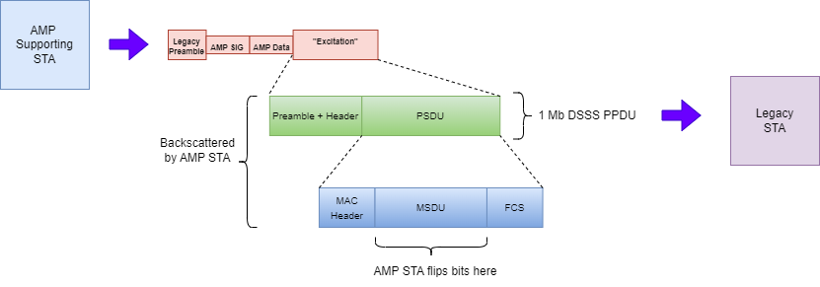
1Mb/s DSSS for Backscatter Uplink

Slide 10
1Mb/s DSSS for Backscatter Uplink
After .11bp downlink sequence, a 1Mb/s DSSS PPDU is transmitted as the excitation signal. This excitation signal is then backscattered with bit-flipping by the AMP STA to provide the uplink PPDU
Advantages:
non-AMP infrastructure (existing STAs) can be used for receiving bistatic backscatter uplink PPDU
of all existing waveforms, 1Mb/s DSSS offers:
  best link-budget / RX sensitivity
  constant envelope hence more power efficient TX – higher TX ZRF power
infrastructure forms PPDU – AMP STA only changes bits on backscatter (low complexity, low power)
Use of DSSS for backscatter does NOT require DSSS data rates to be required for the BSS – i.e. no DSSS beacons / preambles
For shorter PPDU, 802.11b 2Mb/s DSSS (shorter preamble) can be used as an alternative

Slide 11
References
Yinan Qi et. al., “Updated Technical Report on support of AMP IoT devices in WLAN”, IEEE 802.11-24/2203r1, February 2024
Franz Amtmann et. al., “Introduction to passive sub 1GHz RFID systems”, IEEE 802.11-24/0772r0, April 2024
Vytas Kezys, “802.11 compatible backscatter prototype”, IEEE 802.11-23/0056r0, January 2023
Vytas Kezys, “802.11 Feature Re-use”, IEEE 802.11-24/1210r0, July 2024

