Slide 1
On Protected Trigger Frame Design
Date: YYYY-MM-DD

Slide 2
Background and Motivation
The 11bn group is considering protection of Trigger frame [1, 2, 3, 4]
There are many 11bn features (e.g. Coex, DPS, NPCA, DSO, MAP) that rely heavily on Control frames, which are part of the critical data path and can be easily leveraged for DoS attack.
These new Control frame expansions open up more attack surfaces. Lack of protection can enable attacks to hijack WiFi FW/SW or even operating systems, resulting in leaking of host data.
For example, [5] showed that prominent SoCs and operating systems were vulnerable to attacks to unprotected management fames
Control frame protection is a straightforward way to stop attacks

Slide 3
How to Indicate a Protected Trigger Frame
Proposal: Use a reserved bit in Common Info or Special User Info field for the indication
Backwards compatibility is less of a concern and it is risky to redefine the Protected Frame subfield in Frame Control field
Better to place theindication early in the frame to allow receiver start decoding MIC early
Common Info is better than Special User Info:
Allow a decoder to start at least 4 us earlier. Helps to reduce padding size
Protection indication
MAC header
Common Info
Special User Info
User Info for STA1
User Info for STA2
Pre-padding PN, MIC
Padding
FCS
16
8*
0 or ~5
~5
~5
~15, ~20 or ~25
variable
4
At least 4 us saving by having the indication in Common Info, compared to a bit in Special User Info field
MAC header
Common Info
Special User Info
16
8*
0 or ~5
2 OFDM symbols at 24 Mbps

Slide 4
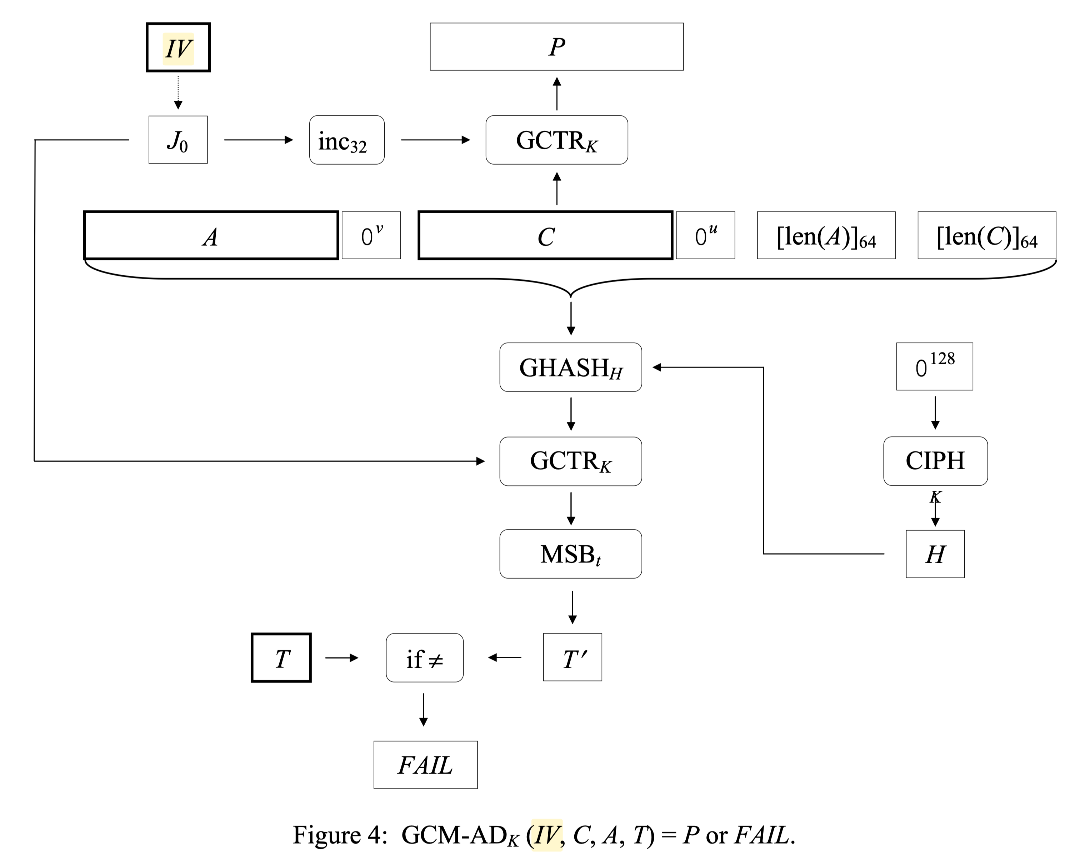
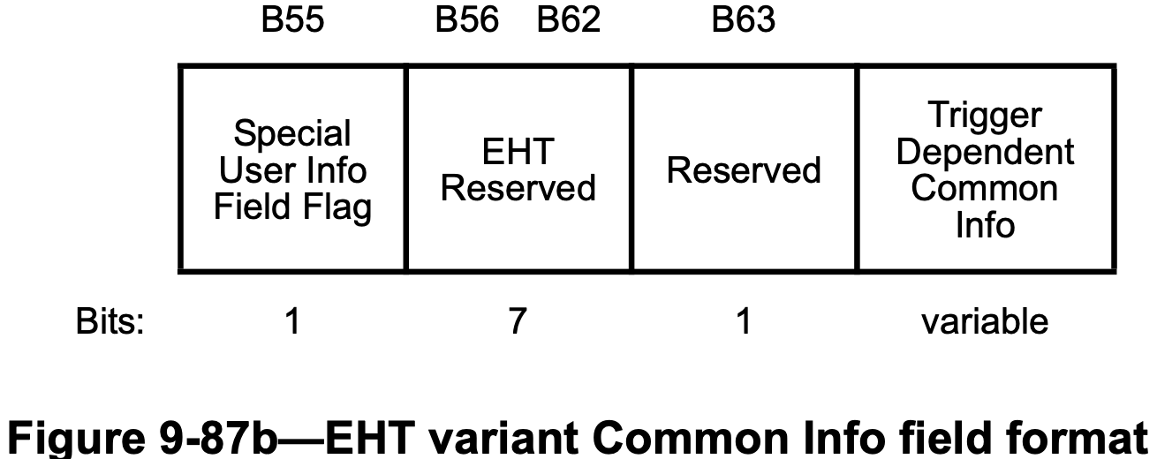
Whether/Where to Have Key ID?
Background: baseline spec uses 2 values (0 and 1) for Key ID for individually address frames, in order to avoid ambiguity (i.e. transmitter and receiver use different keys due to SW delay) during the rekeying process
Proposal: have a Key ID (at least 1 bit) in Common Info or Special User Info field
As early as possible in the frame, as MIC decoding cannot start without the Key ID
Better to have Key ID in Common Info field, similar to rationale on the previous slide
Reference: reserved bits in Common Info field baseline
B56-B63 are reserved for both HE and EHT, better candidate location for Key ID
B22, B26, B53 are only reserved for EHT

Slide 5
Summary
This contribution discussed:
Unprotected Control frames are vulnerable to attacks. This is a concern since many 11bn features will use ICF/ICR
How to indicate a Trigger frame is protected and the corresponding Key ID

Slide 6
SP
Do you agree with the following for UHR-variant trigger frame:
Key ID field: 1 bit field in UHR-variant common info field
TBD for HE/EHT-variant

Slide 7
References
[1] Alfred Asterjadhi and et al, “Thoughts on Secure Control frames”, 23/0321r0
[2] Liwen Chu and et al, “Security enhancement follow up”, 23/1933r0
[3] Po-kai Huang and et al, “Trigger, BA, and BAR Protection”, 23/1995r0
[4] SunHee Baek and et al, “Enhanced Security for Control frame in 11bn”, 23/1915r1
[5] https://googleprojectzero.blogspot.com/2017/09/over-air-vol-2-pt-1-exploiting-wi-fi.html

