Slide 1
Considerations For Sync Sequence Selection
Date: 2024-12-03
Authors:

Slide 2
Abstract
In this contribution we outline few considerations for downlink sync sequence selection, with focus on active transmitter AMP non-AP STA

Slide 3
Basic Metrics to Consider
Miss-detection due to the sync: A device waked up and did not correctly synchronized to the transmitter, which caused modem reception errors
  Too early: side lobe of the sync sequence or over the legacy preambles or
  over the excitation field cause the receiver to demodulate too soon
  Timeout: Missed the transmitter timing, either the receiver started
  to demodulate too late or receiver decided it is a miss-detect and stopped
False alarms – not clear if should be filtered using the sync field or not. Other false alarm filters include:
  The preamble energy rise or duty cycle operation will prevent starting the receiver in the middle of data or frames.
    We think it is not power efficient to wake up using the sync sequence since it is relatively higher power component.
  Invalid SIG or MAC fields within false alarm event can be easily detected, with relatively low energy (even 5 bits are sufficient to get high reliability) and low impact. E.g. CRC/parity, backscatter/active, non-supported rate, non-supported length, non-supported mode.
Timeout
Too early

Slide 4
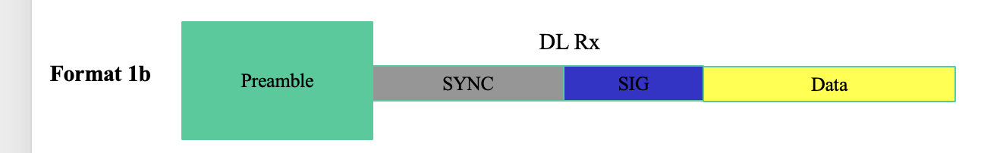

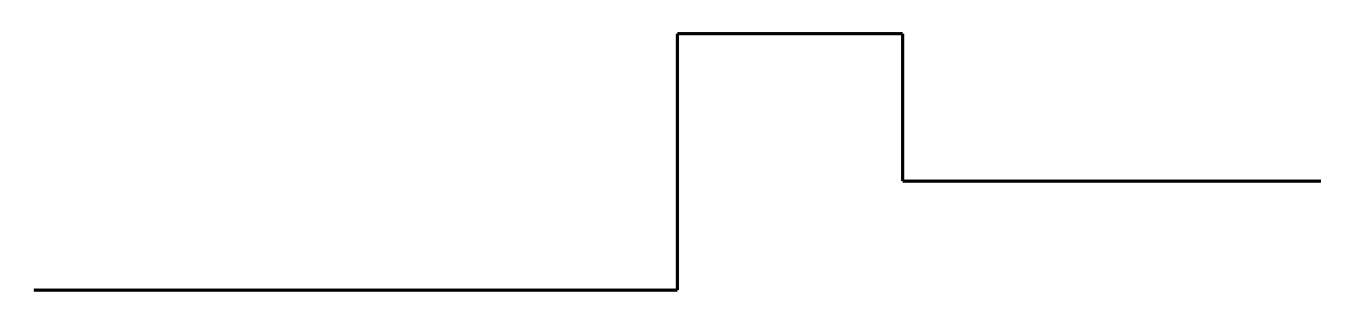
Downlink Sync Usage – Active Devices
From [1], we can use the following PPDU formats as example:
Since RX power consumption is not small, the receiver needs to use the preambles/exitation fields in order to detect energy rise for wakeup and sleep and save energy otherwise.
DL for
active
DL for
backscatter
Active -
RX Power
consumption
Sync
Demode
Sleep

Slide 5
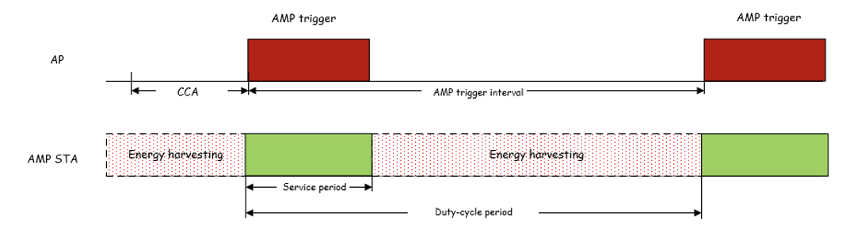
Downlink Sync Usage – Active Devices [Cont.]
In addition, [2] presented duty-cycle operation for AMP non-AP STA.
In order to save energy, it is suggested that the receiver will not operate during the entire time, but just when duty cycle ON.
First trigger will still need to be received with wake-up operation since TSF not synced yet.
RX states:
ON
Sleep

Slide 6

Considerations For Downlink Sync Design [Cont.]
On both scenarios from previous slides, it is not expected that active transmitter AMP non-AP STA needs to detect a sync field in order to startup the receiver.
  For duty-cycle, the receiver is open only when the transmitter is going to transmit
  For non duty cycle it is expected that receiver can use the legacy preamble in order to wakeup
Backscatter receivers can wakeup on sync sequence.
  The sync for backscatter DL can appear after long exitation field, and thus requires also differentiation from data.
  It is expected to be able to detect and sync using very short sequence (e.g. short sequences).

Slide 7
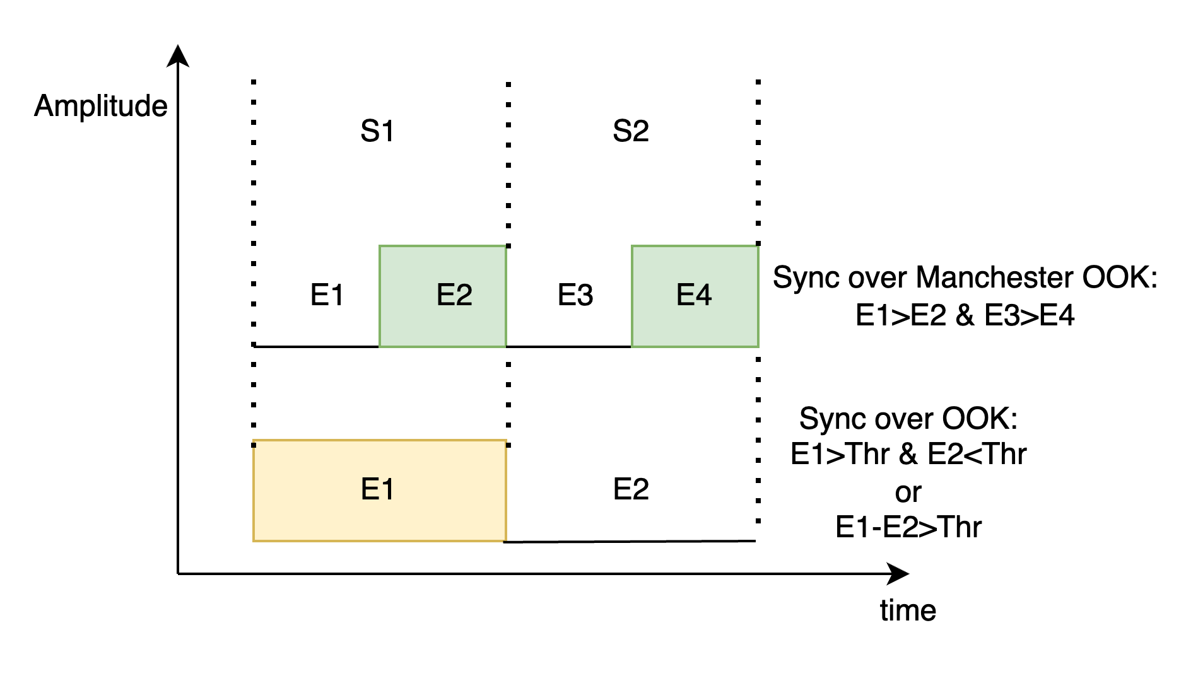
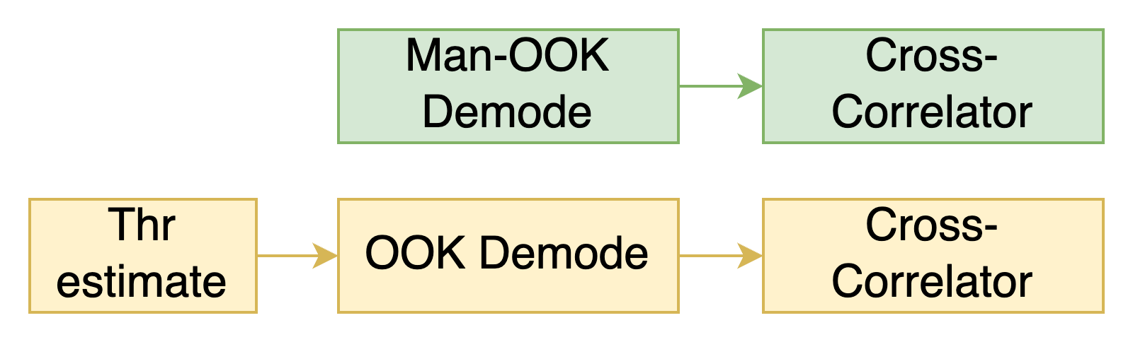
Manchester-OOK sync vs OOK sync for Active Devices
Data part is Manchester-OOK
  It is sufficient statistics to compare estimates
  E1 > E2 and E3 > E4 for optimal reception.
  No need to estimate SNR or Threshold.
Manchester-OOK of the sync will enable reusing the Man-OOK demode for the receiption synchronizer
  Man-OOK demode with Man-OOK sequence has low SLL (same as OOK with OOK demode).
  Adding SNR estimation for online setting of the threshold for OOK can become the bottleneck of the whole reception (e.g. detecting transition)

Slide 8
Example for Man-OOK Sync Performance
Example:
16 b = 64us
for 256kbps
Low SLL is not sufficient for selection criteria
Our analysis assumes timing correction
adds 5dB to FER vs MD performance
Suggestion: Join 16 bits Man-OOK sequence with an OOK sequence
  For example:
Autocorrelation of
16b sequences
1 | 0 | 1 | 0 | 0 | 1 | 0 | 1 | 0 | 1 | 0 | 1 | 1 | 0 | 1 | 0 | 0 | 1 | 1 | 0 | 1 | 0 | 0 | 1 | 1 | 0 | 0 | 1 | 1 | 0 | 1 | 0 | 1 | 1 | 1
Man-OOK
OOK

Slide 9
Summary
We suggest main objective of sync field for active devices is to synchronize the receiver to the timing of the transmitter
  For simplicity, we prefer same sync for 1Mbps/256Kbps active/backscatter and signal the rate in the SIG
  Our analysis indicated 16b Man-OOK sync is sufficient
  We prefer to relegate most of the false alarm detection to SIG stage
Autocorrelation and cross-corrlation with legacy preamble are most relevant for said objective
We suggest second objective to distinguish data and sync fields
  By a transmission of >3 equal consecutive symbols and since Manchester-OOK data can not contain such sequence it is sufficient to differentiate
  This is intended mainly for backscatter devices, like RFID, but can be used by active devices as well

Slide 10
References
Yinan Qi et al, 11-24-1780-01-00bp-further-discussion-on-amp-ppdu-design
Chuanfeng He et al, 11-24-1775-01-00bp-duty-cycle-amp-operation

