Slide 1
ELC support for Positioning
Date: 2024-11-14
Authors:

Slide 2
Abstract
This contribution highlights the potential for positioning using ELC. ELC can offer cm-precision in indoor environments, due to dominant LOS propagation. It is proposed to analyse and specify changes in the positioning algorithm when using fine time measurements from 802.11 by using ELC as the physical layer.

Slide 3
Motivation
ELC has potential in Industrial IoT
IIoT architechture
  Sensor – Wireless Link – Cloud
  Artificial Intelligent (AI) reacts on the scene
  Imaging sensors create video traffic (input)
  Cloud makes intelligent decisions (output)
  Use wireless communication and sensing
Precise position information is valuable for any AI application
  FTM based on sub-7GHz offers precision in the 1 m range, due to NLOS propagation
  When using ELC, propagation is primarily based on LOS
Demonstrate the high potential of ELC for precise indoor positioning

Slide 4

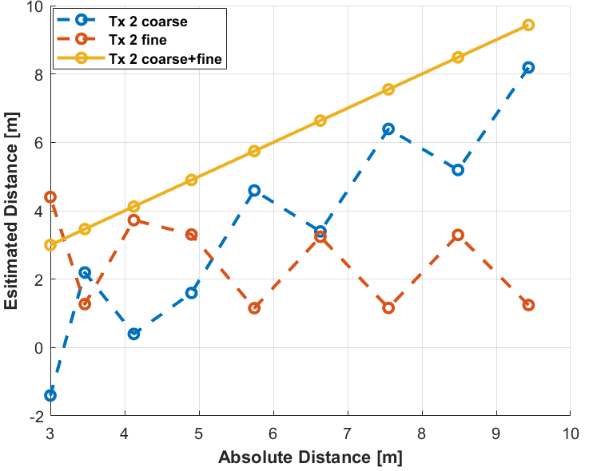
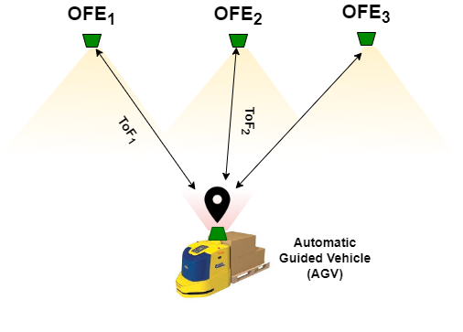
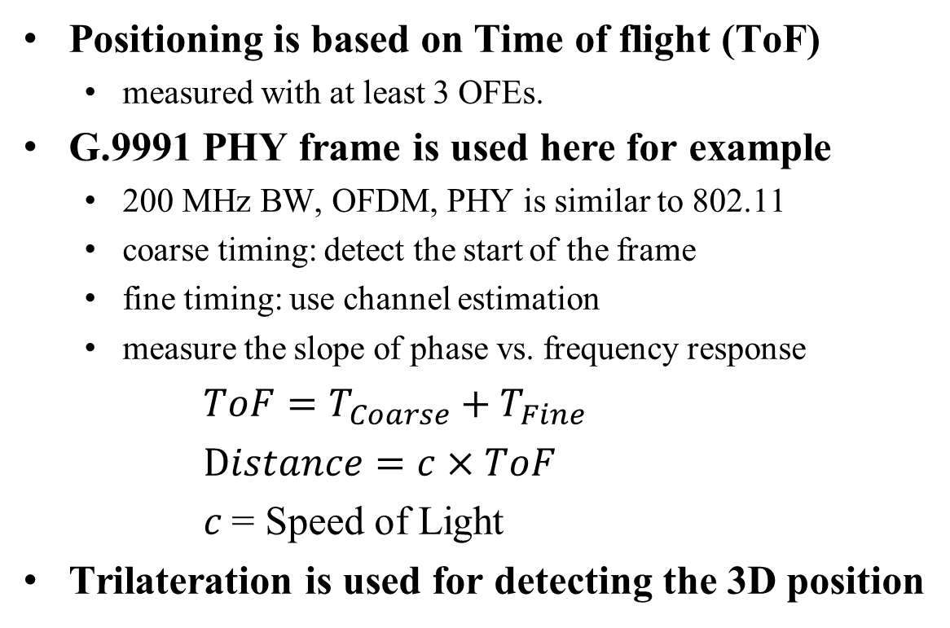
ToF-based Positioning
Positioning is based on Time of flight (ToF)
  measured with at least 3 OFEs.
G.9991 PHY frame is used here for example
  200 MHz BW, OFDM, PHY is similar to 802.11
  coarse timing: detect the start of the frame
  fine timing: use channel estimation
  measure the slope of phase vs. frequency response
$ToF=T_{Coarse}+T_{Fine}$
$Distance=c×ToF$
$c$= Speed of Light
Trilateration is used for detecting the 3D position
Channel estimation
Detect start of the frame
Data

Slide 5
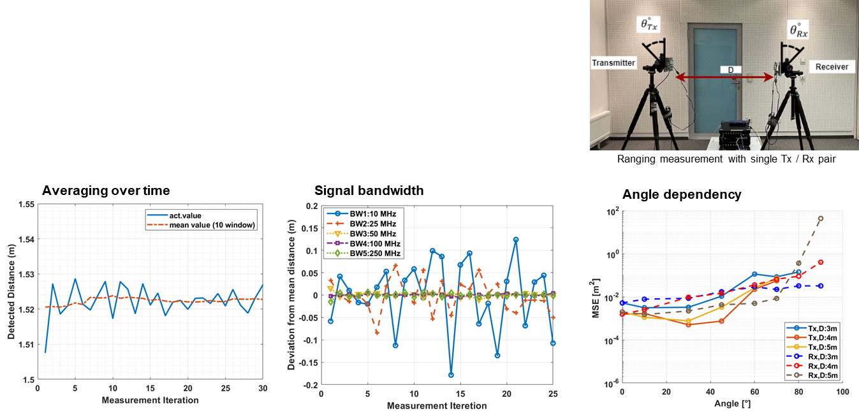
1D ToF measurement
Factors influencing the Precision
  Setup with single transmitter (Tx) and receiver (Rx)
  Precision depends on averaging over time, bandwidth, and angles of Tx and Rx to LOS.

Slide 6
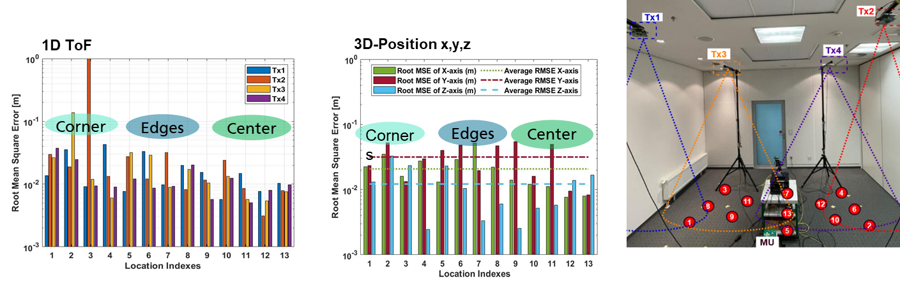
Results in a Conference Room
Multiple TXs at the ceiling, mobile RX
  four ceiling units in 1.5 m grid, and single mobile device
  impact of user position on 1D ToF and 3D positioning accuracy
  select the strongest from three Txs for 3D position evaluation

Slide 7
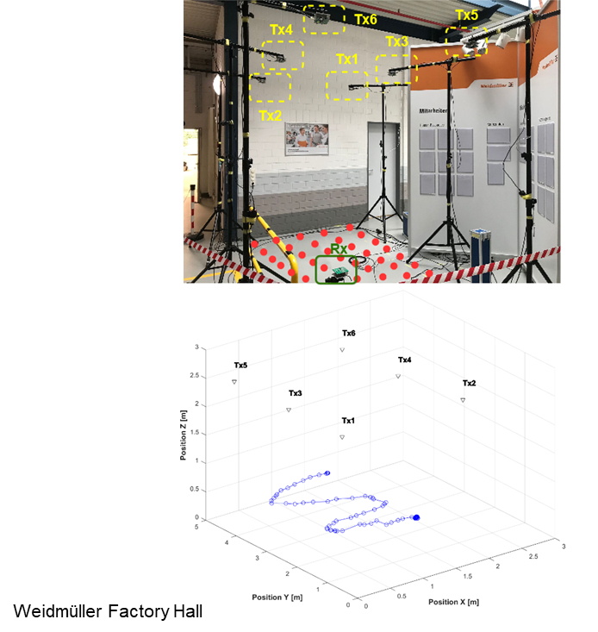
Object Tracking
AGV in a manufacturing hall
  Rx is moved to 35 locations in the cell
  1D – ToF is measured towards each Tx
  3D position of Rx is determined by triangulation
Goal
  Online tracking of slowly moving AGV
Challenges
  Post-optimization to improve precision
  Operation in Realtime

Slide 8
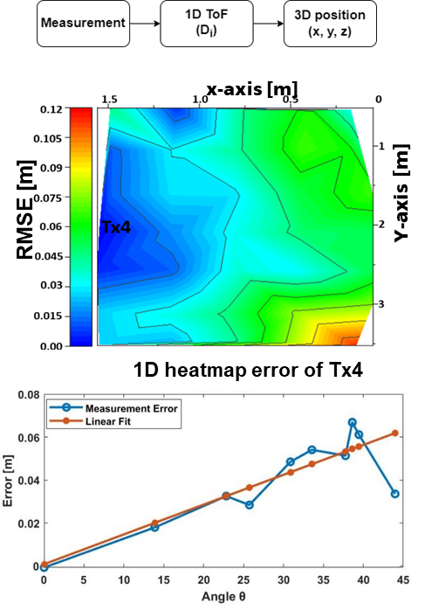
Initial Results
Analysis of the positioning error
  1D ToF error (RMSE) of e.g., Tx4
  has higher RMSEs in far corners
  Lower RMSE close to the Tx4
Error depends on LED radiation angle
  has a systematic and a random part
  systematic part is proportional to angle θ
  Radom part is due to SNR
  SNR reduces in the corners
Idea here: Correct the systematic error

Slide 9
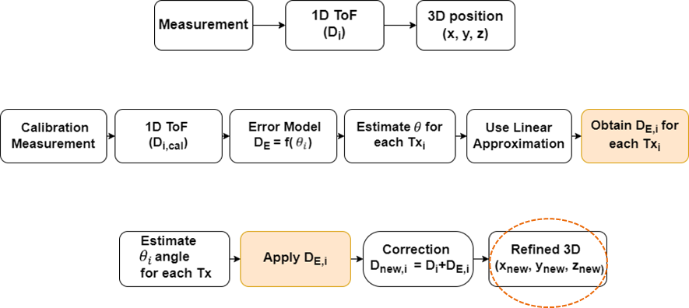
Refined 3D Positioning
Initialization
  Perform regular 1D ToF
  Determine 3D position
Yields raw values for 3D position
Refined positioning
  Estimate angle θ for each Tx
  Perform calibration measurement
Correction
  Refined distance
  Refined 3D position
Significant improvement

Slide 10
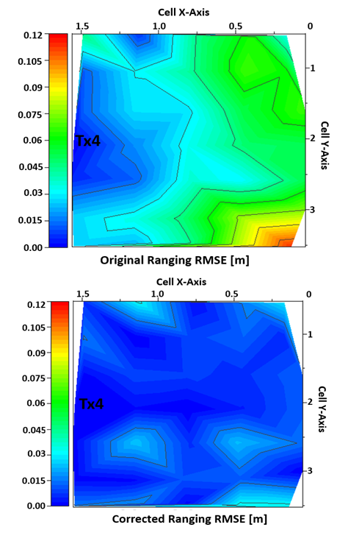
Refined Results
Heatmap for 3D distance error
Original Results
  Lower RMSE close to Tx4
  Increasing RMSE towards the corners
  Max. 3D RMSE: 12 cm
After Refinement:
  Overall 3D RMSE is significantly reduced
  Max. RMSE : 3 cm

Slide 11
Conclusions
Positioning for ELC has high potential for industrial IoT.
Investigated the potential of ToF-based positioning using LC.
  Basis is coarse and fine 1D ToF measurement.
  Then, 3D position is obtained by triangulation.
  Angular characteristics of TX and RX have an impact onto precision.
Refined positioning using LED lights delivers 3 cm positioning error in 3D.
ELC to investigate the use FTMs in 802.11 for precise realtime positiong.

Slide 12
References
[1] S. M. Kouhini et al., “LiFi Positioning for Industry 4.0," in Journal of Selected Topics in Quantum Electronics (JSTQE), in IEEE, 2021. https://ieeexplore.ieee.org/abstract/document/9479791
[2] S. M. Kouhini et al ., "LiFi based Positioning for Indoor Scenarios", ISWCS IEEE 2021. https://ieeexplore.ieee.org/abstract/document/9562207
[3] S. M. Kouhini., et al, “Object Tracking in an Indoor Scenario: Potential for Centimeter Accuracy with LiFi." 2022 13th CSNDSP. IEEE, 2022. https://ieeexplore.ieee.org/stamp/stamp.jsp?arnumber=9908025
[4] Z. Ma et al., "LiFi Positioning and Optimization in an Indoor Factory Environment," IECON 2022, Brussels, Belgium, 2022, https://ieeexplore.ieee.org/abstract/document/9968530
[5] C. Kottke et.al., “In-building optical wireless positioning using time of flight,” OFC 2023, paper M4F.6. https://ieeexplore.ieee.org/stamp/stamp.jsp?arnumber=10117339
Please, refer also to other references on this topic, which are included in these papers.

