Slide 1
802.15 Liaison Report – November 2024
Date: 2024-11-14
Authors:

Slide 2
Abstract
Overview of current activities in WG15.

Slide 3
Working Group 15 November Agenda
https://mentor.ieee.org/802.15/dcn/24/15-24-0545-05-0000-nov-2024-802-15-agenda.xlsx

Slide 4
802.15 Overview
Wireless Specialty Networks Active standards:
802.15.3 - no active projects
802.15.4 - many current projects (see next slide)
802.15.6a Body Area Networks: Revision project, WG ballot comment resolutions
802.15.7a Higher Rate, Longer Range Optical, on December RevCom agenda
802.15.9a KMP Transport, extensions to key management: Techinical proposals
802.16t Extension to 802.16 for specific bands: Initial SA ballot complete, comment resolution and recirculation
Interest Group Access: exploring potential new features to support more efficient spectrum usage via effective shared access
SC THz: discussing future THz communications with Terabit/second data rates (preview: some demonstrations scheduled for January WNG!)

Slide 5
802.15.4 Projects
802.15.4ab Next Generation UWB: First WG Ballot complete, in comment resolution
802.15.4ac Enhanced Privacy: pre-ballot draft in preparation
802.15.4ad Next Generation SUN PHYs: Pre-draft, use case evaluation and Technical Characteristics definition
802.15.4ae ASCON light weight encryption extension for 802.15.4: pre-draft.
802.15.4me Revision E of 802.15.4: In publication process

Slide 6
802.15.4ab Next generation UWB: Amendment to IEEE Std 802.15.4-2024 (rev E)
Initial ballot complete
1471 comments received on draft – 895 technical, 606 editorial
47 comments received on CAD
Meeting objectives: Comment resolution
Closing report: https://mentor.ieee.org/802.15/dcn/24/15-24-0665-01-04ab-tg4ab-closing-report.pptx
 | Current Schedule
First letter ballot | June 2024
Initial LB comment resolution | Start: July 2024
First recirculation | Jan 2024
Recirculation comment resolution | Feb/March 2024
Second recirculation | March 2025
Recirculation comment resolution | March/April 2025
First SA-Ballot | May 2025
SA-Ballot comment resolution | Start July 2025

Slide 7
802.15.4ac Enhanced Privacy
This amendment specifies modifications to the IEEE Std 802.15.4 medium access control (MAC) specification to specify mechanisms that address and improve user privacy. These mechanisms include randomized addresses, and exchanges that support session continuity. This amendment maintains backward compatibility with the base standard.
State: developing initial draft
Opening and closing report: https://mentor.ieee.org/802.15/dcn/24/15-24-0599-01-04ac-november-opening-and-closing.pptx

Slide 8
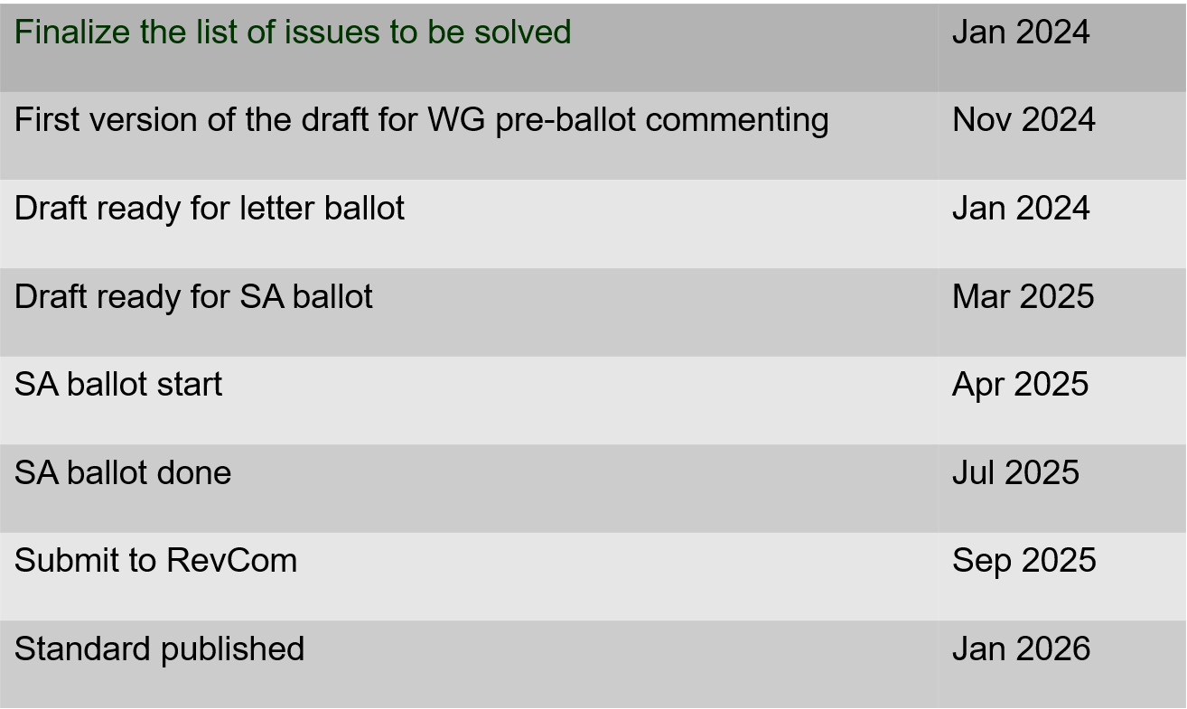
802.15.4ac Enhanced Privacy Timeline

Slide 9
802.15.4ad Next Generation SUN PHYs
Developing enhancements to the 802.15.4 SUN PHYs (FSK, OFDM)
State: pre-draft development
Meeting goals:
Finalize and approve technical guidance document
Finalize call pro proposals
Objectives completed
Closing report: https://mentor.ieee.org/802.15/dcn/24/15-24-0597-01-04ad-tg4ad-agenda-opening-and-closing-report-nov-2024.pptx

Slide 10
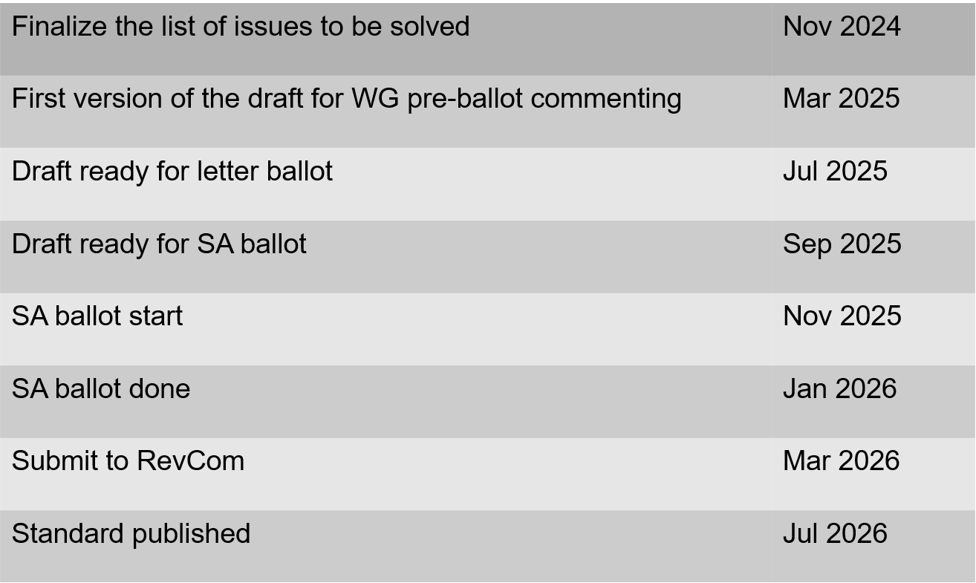
802.15.4ae (ASCON) ASCON light weight encryption extension for 802.15.4
Pre-draft development
Reviewing required changes to 802.15.4 to support ASCON
Prepared comments on the NIST document

Slide 11
802.15.6a
Draft in WG ballot
Initial ballot complete
Comment resolution in progress
Session objectives:
Resolve comments
Closing report: https://mentor.ieee.org/802.15/dcn/24/15-24-0653-01-006a-tg15-6ma-closing-report-for-november-2024.pptx

Slide 12
TG 6ma Timeline(expected)
Tech Req Doc July 2022
Presentation of proposals
May 2023
Comment Resolutionfor LB
Nov. 2024
Comment Resolutionfor LB2
Jan. 2025
EC approval to SB, SB submission
March 2025
SB recirculation
May 2025
WG PreBallot submission for Draft2.5 August 2024
SB recirculation if required
July 2025
Revcom Approve
Sept 2025
^{Draft V1,18 Com}
May. 2024
Recirculation (LB2)
Dec. 2024
RevcomSubmission
August 2025
Comment Resolution fo Draft v2.3 on WG for PreBallot July 2024
1st Letter Ballot(LB)
Sept. 2024
Conditional approval for Sponsor Ballot (SB)
February 2025
TRD,CMD
Call Proposals Sept 2022
Std. Draf V1.9 Proposals
Nov. 2023

Slide 13
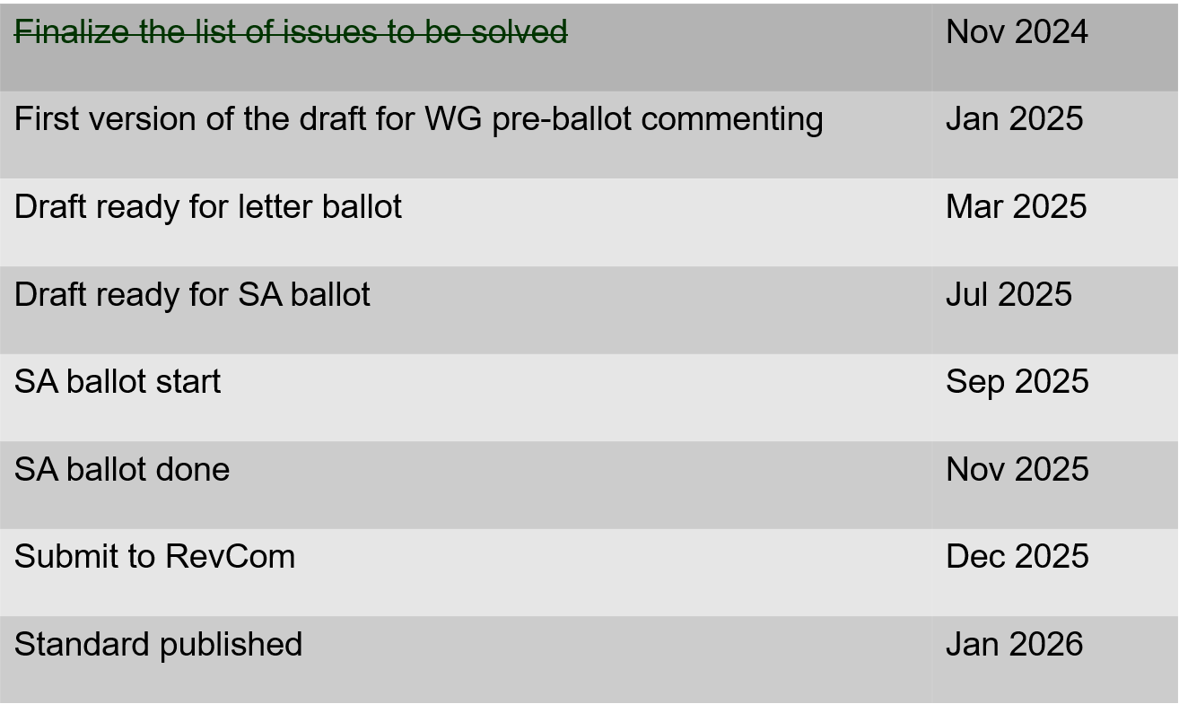
802.15.9a KMP Transport
Extensions to key management: extending to support EDHOC
State: draft development
Session objectives
Update and send out call for participation and call for proposals.
Update list of changes needed to the IEEE Std 802.15.9 for adding EDHOC KMP
Opening and closing report: https://mentor.ieee.org/802.15/dcn/24/15-24-0601-01-009a-november-opening-and-closing.pptx

Slide 14
IG Access
Purpose: to explore potential enhancements to support better spectrum access to support sharing through coexistence
Output: recommendations or information for the Working Group
Short term focus: U-NII 6 GHz band
Consider present occupants (includes UWB)
Consider future growth in occupation and use
Support (Not preempt or disrupt) efforts in other projects
Some goals:
Support for a diversity of uses
Equal access and improved performance for all 802 wireless technologies
Technical contribution and discussion (to continue in January)
Summarize key differences in requirements for various regulatory regions
Participation encouraged!

Slide 15
Licensed Narrowband Amendment TG16t
State: In SA ballot
SA Ballot on P802.16t D4.0 closed October 19th
Comment Resolution Spreadsheet in 802.15-24-0561r0
Session objectives:
Complete comment resolution and initiation recirculation
Closing report: https://mentor.ieee.org/802.15/dcn/24/15-24-0644-02-016t-nov-2024-tg16t-meeting-closing-report.pptx

Slide 16
Terahertz Standing Committee
Plans for January Interim: An extended WG15 WNG meeting to accommodate multiple technical presentations including live demonstrations of THz implementations!

