Slide 1
Introduction to the WAA
Date: 2024-11-12
Authors:

Slide 2
WAA NEW Connectivity -
Chasing the Best WLAN Application Experience
Crane H. Yang
Executive Secretary, WAA
Nov. 13th, 2024, IEEE 802.11 Plenary Meeting

Slide 3
Who we are?
2022年
9月22日
2022年
9月22日
2022年
9月22日
Registered
in China
2022
Formed by Global WLAN Stakeholders
Non-Profit
NGO
and our Vision and Mission is
“To promote the healthy and sustainable development of the world WLAN industry, and build up the best WLAN application experience. ”
We are willing to represent and transfer the Voice of the WLAN industry.
Crane H. Yang, WAA

Slide 4
To achieve better WLAN experience
Application experience
Interaction experience
Connection experience
Technology innovations
Optimal experiences
Everything well connected
Easy to use
Leading in technology innovation
Higher smoothness
Lower frame loss rate
Lower word skipping rate
Lower delay
Lower jitter
Higher throughput
Larger number of connections
Password-free login
Seamless roaming
Fault self-healing
Smart operations
Higher security and intelligence
Faster connection, access, and networking speeds
Stronger WLAN integration
Lower power consumption, delay, and costs
Innovation inputs such as AI
Based on system-level solutions, work with network planners and operators to promote WLAN with better experience to more scenarios and industries.
Crane H. Yang, WAA

Slide 5
About the WLAN & other short range wireless Industry
Our Members are from
telecom operators
equipment vendors
regulation and policy departments
testing facilities
scientific research institute
universities and colleges
end-users from different scenarios such as
Residential
Hotel
Education
Hospital
Manufacturer
Transport and Logistics
Others……
Wi-Fi
Li-Fi
UWB
Zigbee
Blue-tooth
NFC
others
Crane H. Yang, WAA

Slide 6
WAA Members (until Sept. 30, 2024)
4+ Operators
17+ Equipment Manufacturers
14+ Chip Manufacturers
13+ Terminals
14+ Academic Institutions
13+ Testing and Certification Services
84 in total
53 mainland China
31 from other countries and regions
China Mobile Communications Group Co.,Ltd | Council Member
China Telecommunications Group Co.,ltd. | Council Member
China Academy of Information and Communications Technology | Council Member
China Electronics Technology Standardization Research Institute | Council Member
China Quality Certification Center | Council Member
Huawei Technologies Co., Ltd | Council Member
Rheinland Testing and Certification Services (China) Co., Ltd | Council Member
ZTE Corporation Limited | Council Member
NECTARRYOUTH CLOTHING LIMITED | Council Member
China Household Electric Appliance Research Institute | Council Member
Ruisheng Microelectronics(Suzhou)Co.,Ltd. | Council Member
Technology Co.,Ltd of Haier Group | Council Member
Institute of Comprehensive Technology and Economics for Mechanical Industry Instruments and Meters | Council Member
HiSilicon (Shanghai) Technologies Co.,Ltd. | Council Member
Beijing University of Posts and Telecommunications | Council Member
Jingdong Technology Information Technology Co., Ltd. | Council Member
Tencent Technology(Shenzhen)Co.,Ltd. | Council Member
Pengcheng Laboratory | Council Member
Beijing Starpoint Technology Co.,Ltd. | Council Member
Sichuan Ai-link Technology Co.ltd | Council Member
Spirent Communications(Beijing)Co.,Ltd. | Senior member
Hangzhou Yongxie Technology CO., LTD | Senior member
ShenZhen Future Network of Intelligence Institute. All Rights Reserved. | Senior member
Changeself Technology(Shenzhen)Co.,Ltd. | Senior member
Bureau Veritas LCIE China Company Limited | Senior member
GROUP MIDEA STOCK LIMITED | Senior member
Shenzhen Institute of Information and Communications Tec | Senior member
Tel Integration Innovation (Beijing）technology Co., Ltd | Senior member
China Mobile Communication Co.,Ltd. | Senior member
Shenzhen University School of Electronic and Information Engineering | Senior member
Central South University Xiangya Hospital | Senior member
State Grid Corporation of China | Senior member
Macao University | Senior member
Economic and Technological Research Institute ofState Grid Shandong Electric Power Company | Senior member
China United Network Communications Co., Ltd. Research Institute | Ordinary member
FiberHome Telecommunication Technologies Co.,Ltd. | Ordinary member
TÜV SÜD Certification and Testing (China) Co., Ltd. Shenzhen Branch | Ordinary member
Shanghai Tongyao Communication Technology Co.,Ltd. | Ordinary member
Shenzhen Sundray Technologies Company Limited. | Ordinary member
Litepoint Technology (Shanghai) Co.,Ltd. | Ordinary member
Zhoncent Technologies, Inc. | Ordinary member
UNIONMAN TECHNOLOGY CO., LTD | Ordinary member
LinkBroad Technology (Beijing) Co., Limited | Ordinary member
Tongbiao Standard Technical Services (Suzhou) Co., Ltd | Ordinary member
Shenzhen Langli Semiconductor Co., Ltd | Ordinary member
Bowei Technology Co., Ltd. | Ordinary member
Zhejiang Kerui Microelectronics Technology Co., Ltd | Ordinary member
Smartgiant Technology Co.,Ltd | Ordinary member
ShenZhen Arcuchi Technologies Co.,Ltd | Ordinary member
Ruijie Networks Co., Ltd. | Ordinary member
Shenzhen Tefaco Dongzhi Technology Co., Ltd. | Ordinary member
Beijing Xinertel Technology Co., Ltd. | Ordinary member
Shenzhen iTest Technology Co., Ltd. | Ordinary member
DEKRA Testing and Certification China Ltd. | Observation members
Sporton International Inc. | Observation members
OPPO | Observation members
HIP GLOBAL CO.,LTD | Observation members
Aerodyne Middle East FZ-LLC | Observation members
Association De La Jeunesse Internationale | Observation members
FangZi | Observation members
Tohoku-MicroTec Co., Ltd | Observation members
EUE B.V | Observation members
EnE System GmbH | Observation members
Tiwaki Co., Ltd | Observation members
Digilutions | Observation members
TransTec Servce Srl | Observation members
Kuramoto Co., Ltd | Observation members
Allion Labs | Observation members
Anritsu Communication Technology (Shanghai) Co., Ltd. | Observation members
RS Technologies Co.,Ltd | Observation members
Cctech Japan Co, Ltd | Observation members
YCommunication | Observation members
Ambition photonices Inc. | Observation members
Veerlow Media LLC | Observation members
Datum Consultants FzCO | Observation members
Redefinition of Eco System and Value Chain | Observation members
Shinteco Intemational | Observation members
Eurmaxi GmbH | Observation members
NIE Consulting | Observation members
Nanjing Ruima Millimeter Wave Terahertz Technology | Observation members
BLUEUNI | Observation members
Kostanay Engineering and Economic University | Observation members
Contact Sensor Company | Observation members
Yoshinaga Shoji Co., Ltd | Observation members
Crane H. Yang, WAA

Slide 7
WAA Structure Governance
General Assembly
Council
ZHANG Ping Academician
Chairman
Expert Committee
Strategy Advisory Committee
Secretariat
Technical Committee on Standardization (TCS)
YANG Tao
Secretary-General
Industrial Requirement
Standards
Testing & Certification
Marketing
Industry Development
Crane H. Yang, WAA

Slide 8
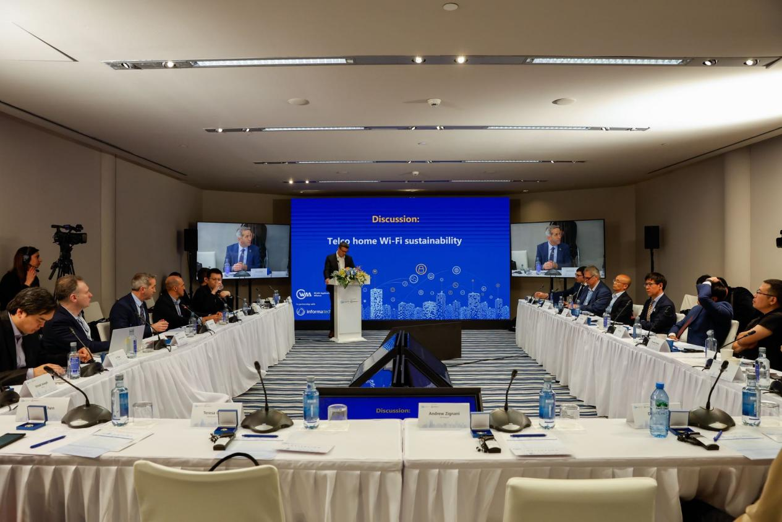
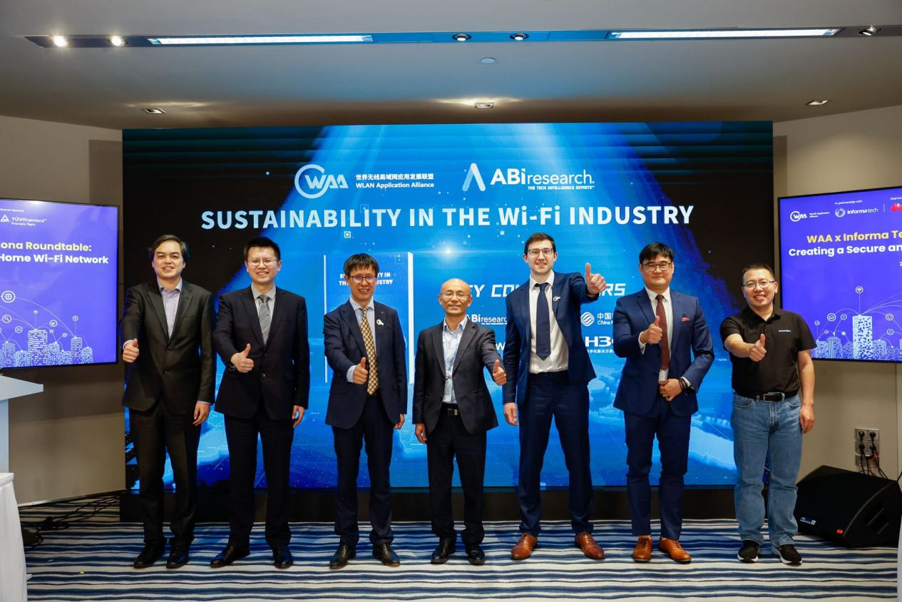
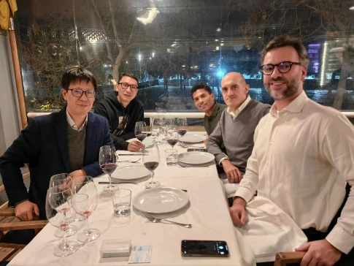
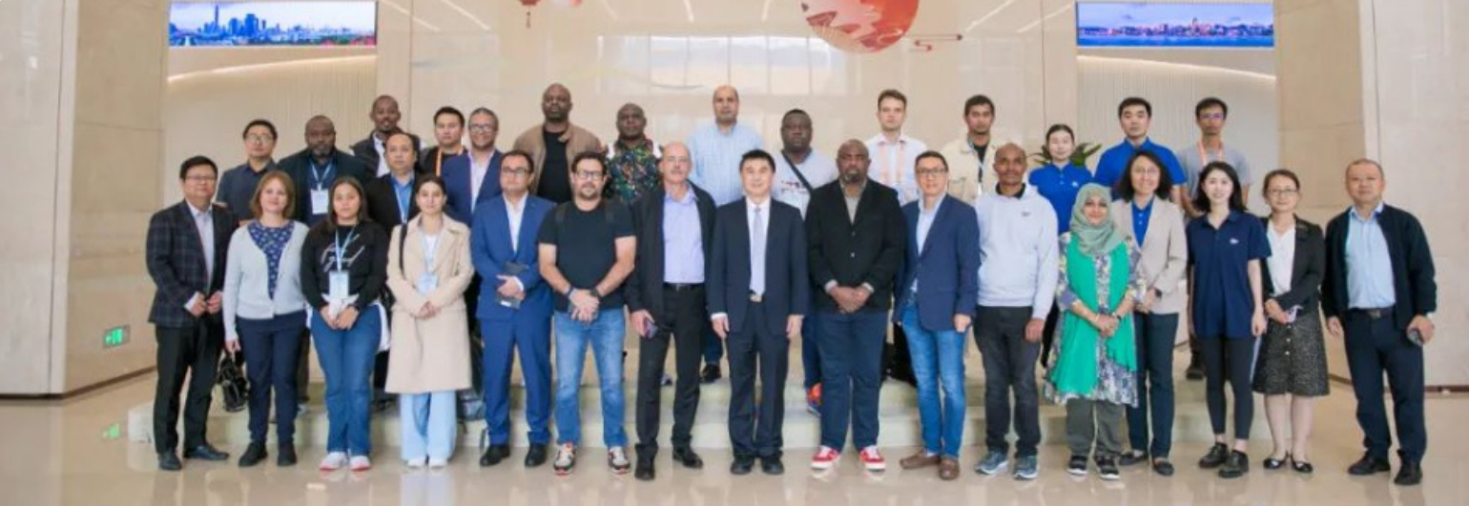
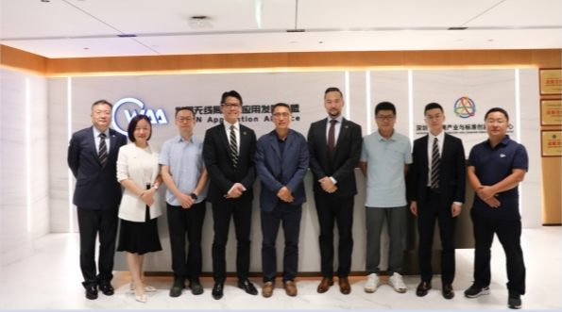
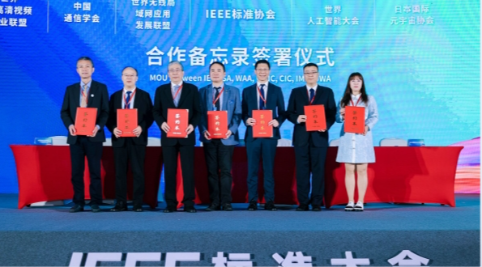
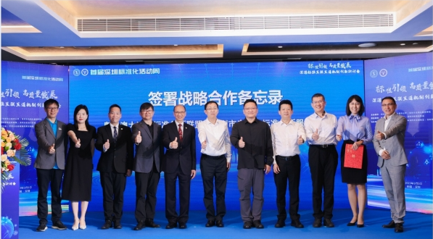
WAA Global Partners
IEEE SA
WBA
Wi-Fi NOW
BSI
HKQAA
SAMENA
Crane H. Yang, WAA

Slide 9
01
02
03
04
05
Standardization
Test & Certification
Forums & Events
Industry Research
Demonstration & Pilot Project
Our Business
Scope
Crane H. Yang, WAA

Slide 10
Technical Committee on Standardization (TCS)
WAA Technical Committee on Standardization (TCS) was established in Jan. 2024. TCS Meetings Twice per year.
The purpose of the WAA TCS is to influence and accelerate the development of regional and global WLAN standards on application experience and system requirements, to make recommendations and cooperate with other worldwide standards organizations (ISO, IEC, ITU, IEEE, etc.), and other national/regional standardization departments to promote their adoption.
Principles for WAA TCS Topic Selection
TCS
Meaningful – should be required by the industry development, to enhance the WLAN application experience;
Not redundant – should leverage work and standards of other global SDOs;
Doable – should have basement with mature technologies and massive practices.
WG1
WGn
TF-1
TF-2
TF-3
TF-n
Crane H. Yang, WAA

Slide 11
TCS Working procedure
Project Stage | Activity | Deliverable
Proposal Stage | new idea was raised by TCS member and discuss with other members, write the new work item proposal | Approved NP Form and TF Leader was nominated by TCS chair
Draft Stage | finish the draft and start WG review process | Working Draft
WG Review Stage | WG finish the draft, start TCS external review | Committee Draft
External review Stage | WG finish the draft TCS external review and start voting process | Final Draft
Approval Stage | finish TCS voting process | Publish Standard
Council Member, Senior member can do voting and should designate one individual from their organization to be the Voting Representative for that organization;
All items put up for a vote of the membership shall be communicated by the Chair, Vice-Chair and the TCS Secretariat with a minimum of three weeks advance notice;
Voting will be in the meeting or by email, and tabulated by the TCS Secretariat;
At least quorum of 2/3 of members must vote on a given item for the vote to be binding; failing a quorum of 2/3 of votes cast the ballot will fail;
TCS Secretariat will publish the outcome of any vote within one week of the closing of the vote.
Crane H. Yang, WAA

Slide 12
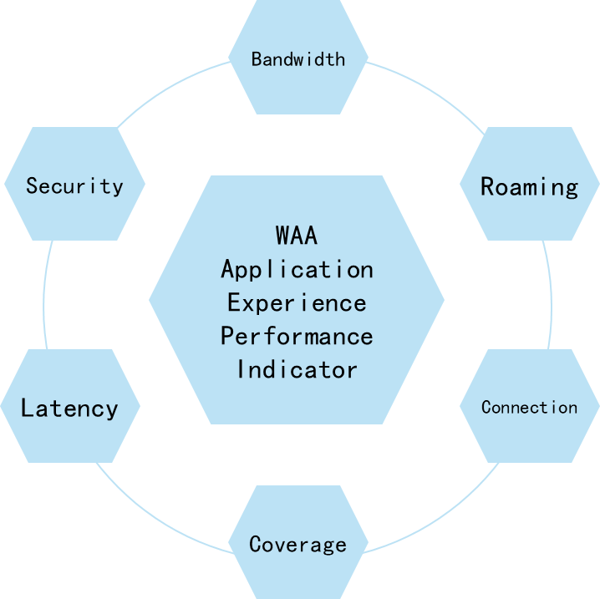
WAA TCS scope and relationship with IEEE 802.11
Application Experience Performance
Scene Model & Test Case
Multi-User Concurrent Office Service 30 Meeting Conference + 3 FTP Download
Mobile Office Service 2 AP with same spectrum, Each AP with 15 Meeting Conference + 1 Roaming FTP Download
Concurrent Access of Video Services Live Video Service Access Capacity Test
Equipment & System Requirements
Networking Scenario Definition
Network Performance for different scenario
Equipment & System Requirements
WAA
Promote WLAN
PHY/MAC optimize
suggestion
Project Status
Standard guidance
Green WLAN System Requirements
STA
AP
AC
Controller
Protocol &
Interoperation
IEEE
802.11
Define standard protocol(MAC/PYH) of WLAN
Future technical discussion (Interest Topic)
SDN-Controller
Tidal traffic and energy-saving networks can save 25% network energy consumption, even * 10 in environment
Energy-saving requirements based on the tidal characteristics of network nodes should be defined
WAA has already launched one IEEE Industry Connection (IC) project “User Experience in WLAN Network”
Crane H. Yang, WAA

Slide 13
WAA Standards Publications and On-going Projects
No. | Published Recommendations
1 | Technical specifications for campus office wireless local area network (WLAN) performance
2 | Test method for campus office wireless local area network (WLAN) performance
3 | Technical specifications for home scenario wireless local area network (WLAN) single device performance and experience
4 | Test method for home scenario wireless local area network (WLAN) single device performance and experience
5 | Technical specifications for home scenario wireless local area network (WLAN) devices networking performance and experience
6 | Test methods for home scenario wireless local area network (WLAN)device networking performance and experience
Standards Features
……
No. | Published White Paper
1 | High-Quality WLANs in Typical Enterprise Scenarios White Paper
2 | Sustainability in the WLAN Industry
3 | Smart Campus Development and Application of WLAN Sensing Integration
4 | WAA Green Campus WLAN Technical White Paper
Serviceability
Green Energy Saving
Security
Performance
Standards Scenarios
Family
Campus Office
Industrial
Medical
Education
Commercial
……
Network Device
No. | On-going | WG | Status
1 | TF 1 : Manufacture scenario WLAN performance | WG 1 : Campus WLAN | Working Draft (exp 2024)
2 | TF 2 : Enhanced of campus office WLAN performance （Base on IEEE 802.11BE） | WG 1 : Campus WLAN | Working Draft (exp 2024)
3 | TF 3 : Enhanced of home scenario WLAN performance （Base on IEEE 802.11BE） | WG 2 : Home WLAN | Working Draft (exp 2024)
4 | TF 4 : Green WLAN System for campus scenario | WG 1 : Campus WLAN | Working Draft (exp 2025)
5 | TF 5 : Green WLAN System for home scenario | WG 2 : Home WLAN | Working Draft (exp 2025)
Terminal Device
Standards
Target
System Network
……
Crane H. Yang, WAA

Slide 14
01
02
03
04
05
Standardization
Test & Certification
Forums & Events
Industry Research
Demonstration & Pilot Project
Our Business
Scope
Crane H. Yang, WAA

Slide 15
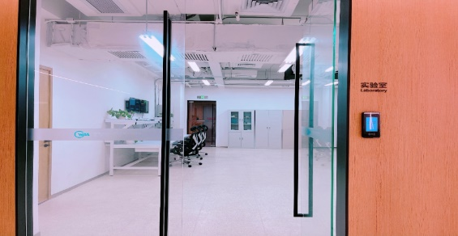
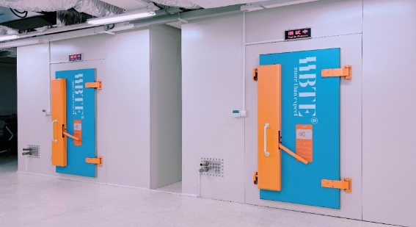
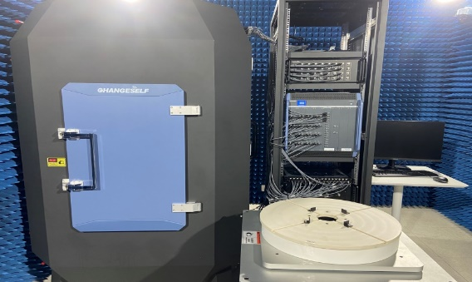
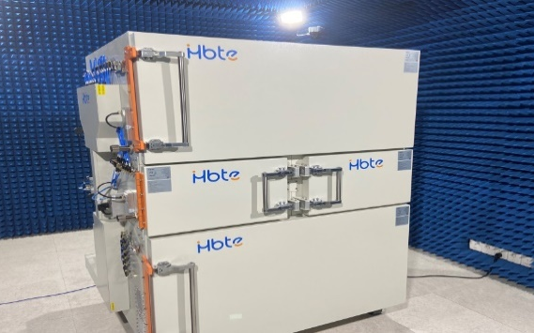
WAA Test and Certification
What is WAA Certification?
WAA certification is based on the WLAN for home wireless broadband, enterprise campus, whole house intelligence, smart healthcare, industrial intelligent manufacturing, smart cars and other scenarios of wireless access latency, reliability, anti-interference, roaming switching and other application-aware performance related to the certification system of the standard certification system.
Current on-going Certification Program
1. WLAN single-device network performance and experience verification in home scenarios
2. WLAN performance certification in campus office scenarios
Crane H. Yang, WAA

Slide 16
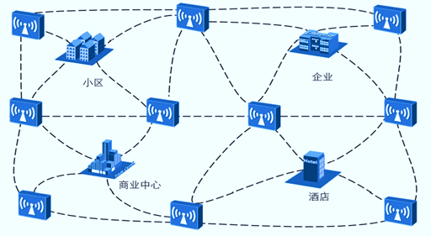
WAA WLAN Certification: Core Testing Elements
Field-Based Certification
Operator accreditation
Commercial project accreditation
Experience Performance
Green Serviceability
Cybersecurity
………...
Other accreditation
WAA Certification
Scenario-Based Certification
1. CAICT
2. China Mobile
Product certification of member companies
1. CQC
2. TUV
House
Campus
Medical
WAA
Test & Certification
Education
Industry
Product-Based Certification
Network Device
Terminal Device
Cooperation and management of certificate issuance authorities
Test platform incubation
(Joint labs...)
Cooperation and management of authorized labs
System Network
……
Crane H. Yang, WAA

Slide 17
November 2024
01
02
03
04
05
Standardization
Test & Certification
Forums & Events
Industry Research
Demonstration & Pilot Project
Our Business
Scope
Slide 17
Crane H. Yang, WAA

Slide 18
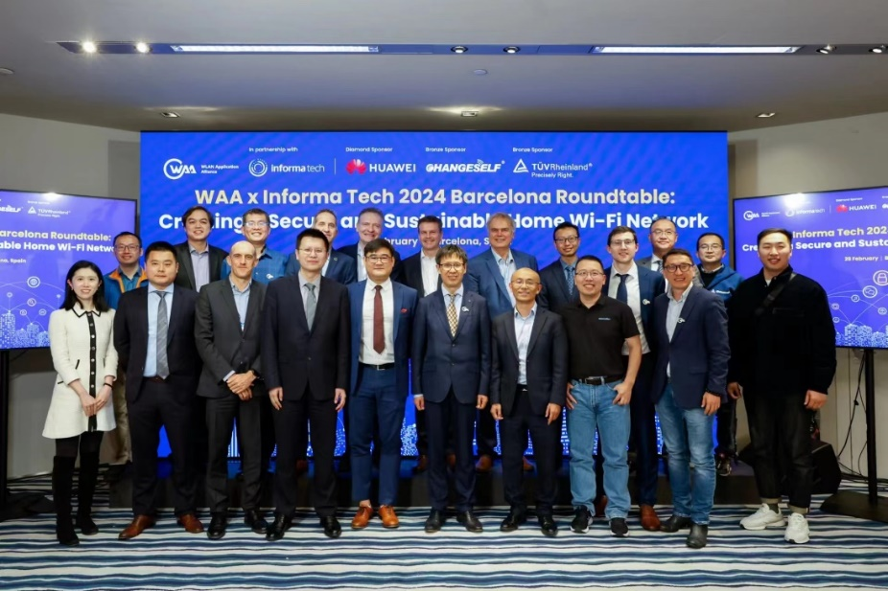
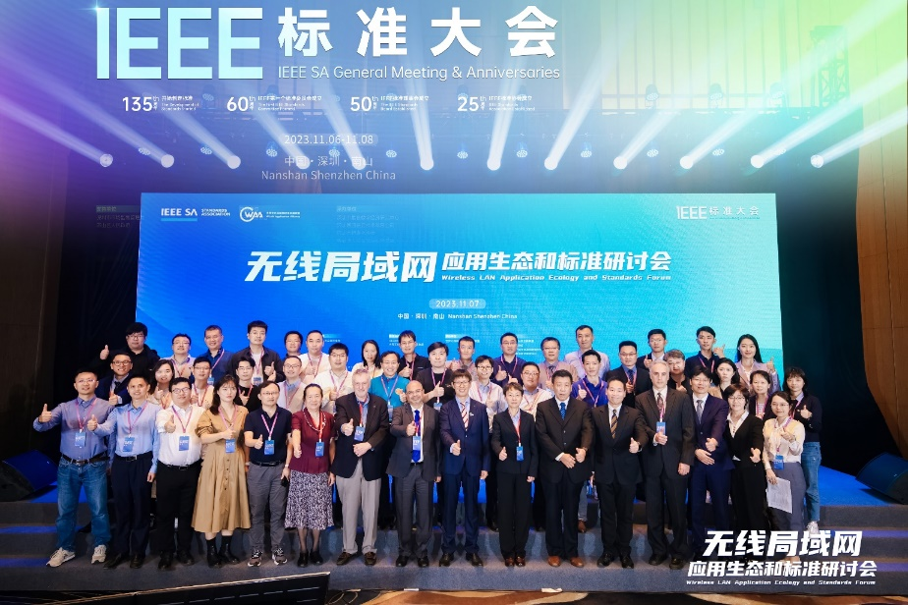
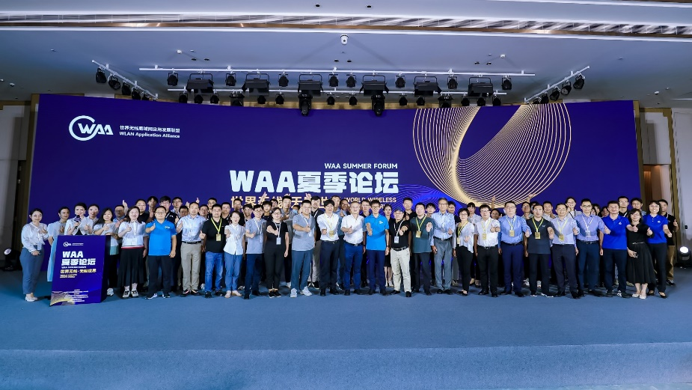
WAA Global Forums and Events
General Assembly
WAA Forum of Four Seasons
WAA International Forums
……
WAA x Informa Tech 2024 Barcelona Roundtable
WLAN Application Ecology and Standards Forum, by WAA & IEEE SA
WAA Summer Forum 2023
Crane H. Yang, WAA

Slide 19
November 2024
01
02
03
04
05
Standardization
Test & Certification
Forums & Events
Industry Research
Demonstration & Pilot Project
Our Business
Scope
Slide 19
Crane H. Yang, WAA

Slide 20
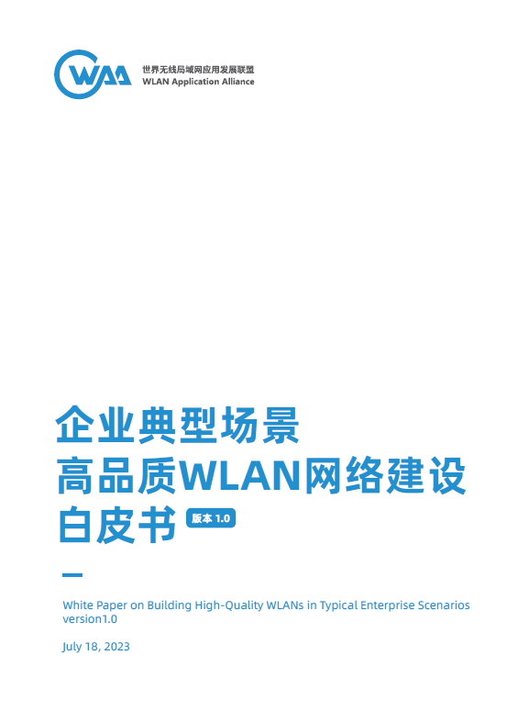
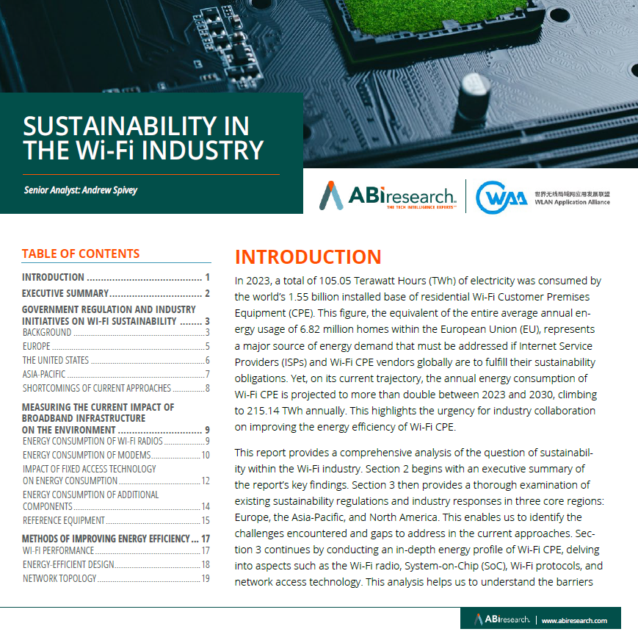
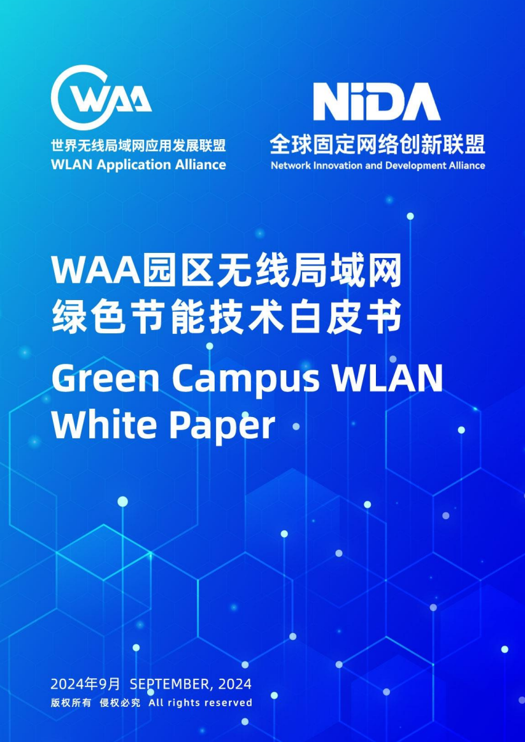
WAA Industry Research—Status
2023.7.18
2024.2.28
2024.9.10
2024.9.28
2024.11.28
White Paper on
Building High-Quality WLANs in Typical Enterprise Scenarios
White Paper on
Sustainability in the Wi-Fi Industry
White paper on Green energy-saving WLAN
(To WLAN operator)
(In Developing)
White Paper on the Development and Application of Integrated WLAN Sensing and Communication in Smart Campus
White Paper on advanced WLAN technologies
Coming Soon
Crane H. Yang, WAA

Slide 21
November 2024
01
02
03
04
05
Standardization
Test & Certification
Forums & Events
Industry Research
Demonstration & Pilot Project
Our Business
Scope
Slide 21
Crane H. Yang, WAA

Slide 22
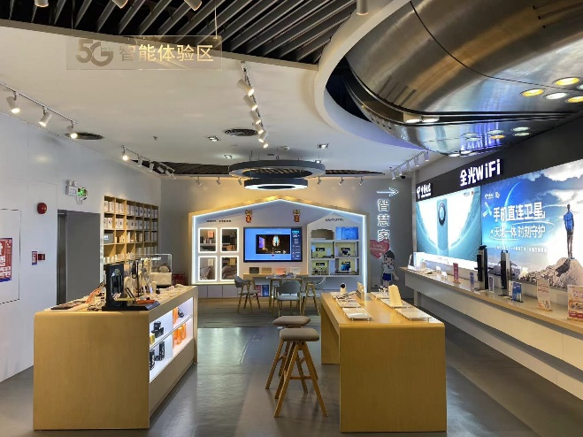
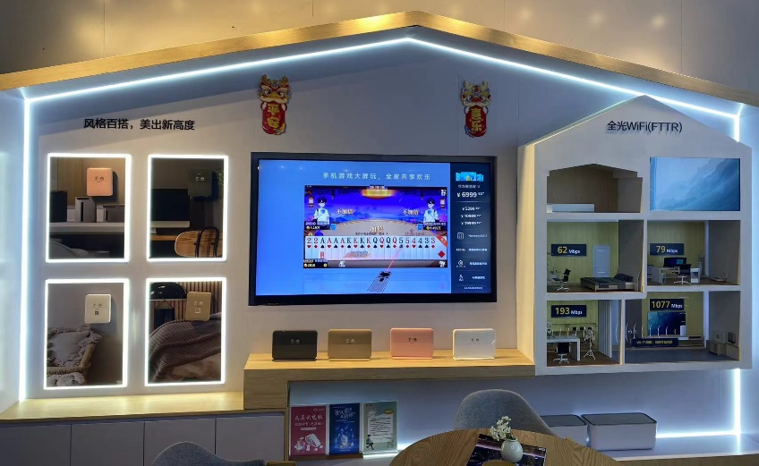
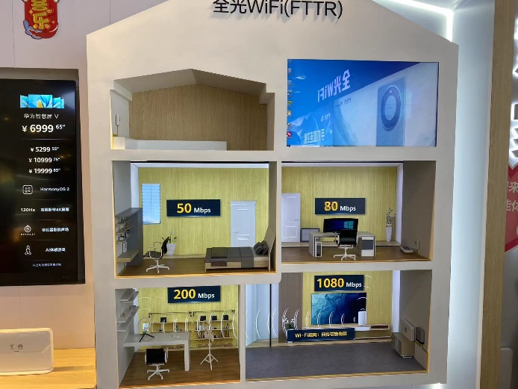
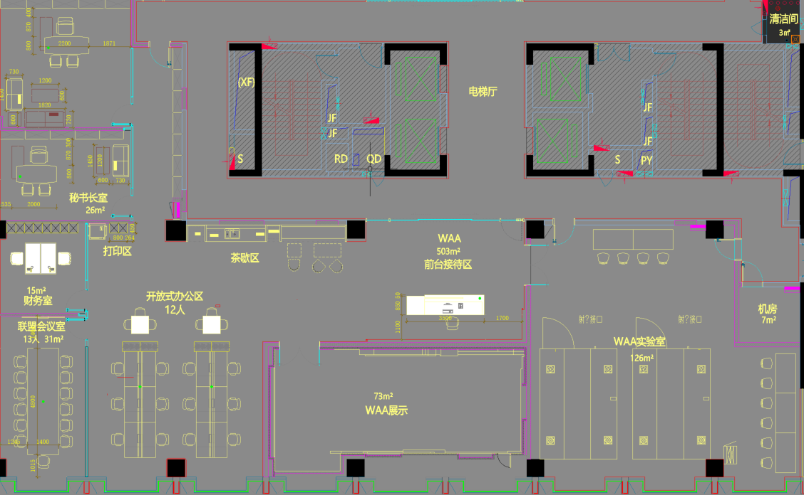
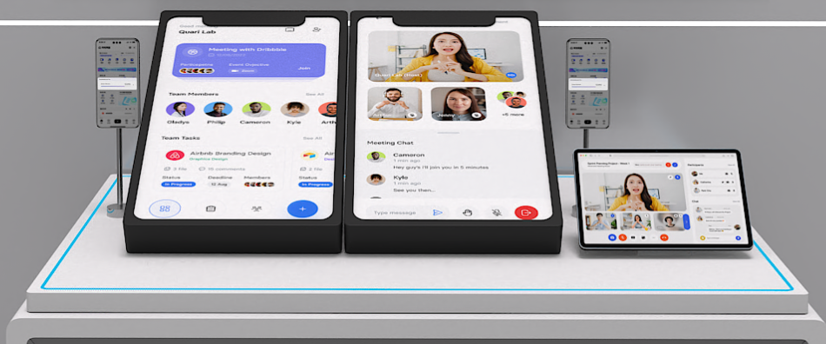
WAA Demonstration & Pilot Project
Pilot Project at China Telecom
Demonstration Functions
Large-scale demonstration application in
Shenzhen
Xiamen
Macao
……
Implementing Plan
Experience Platform
Crane H. Yang, WAA

Slide 23
Global Challenges,
Global Opportunities,
Global Collaboration!
THANK YOU！
Welcome to contact us!
yanghe@waa-alliance.org
www.waa-alliance.org
WAA is willing to establish the liaison relationship with IEEE 802.11 WG
Crane H. Yang, WAA

