Slide 1
Low-Power Enhanced-Range PHY Mode for ELC
Date: 2024-11-11
Authors:

Slide 2
Abstract
This contribution introduces On-Off-Keying (OOK) with Frequency-Domain Equalization (FDE) to reduce power and enhance range for ELC. It can be realized with minor changes of the LC PHY.

Slide 3
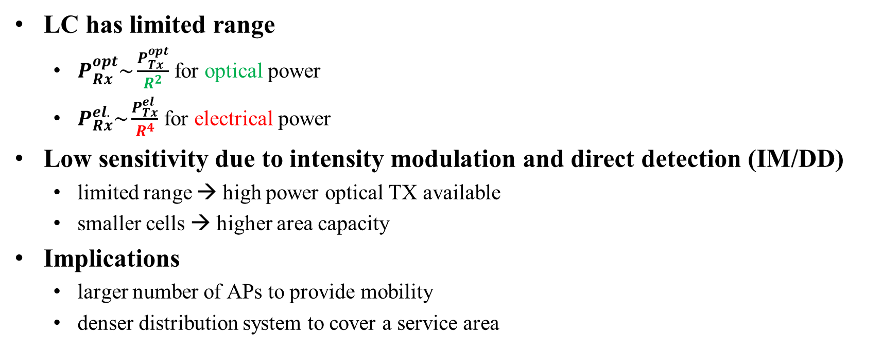
Motivation
LC has limited range
  $P_{Rx}^{opt}\sim \frac{P_{Tx}^{opt}}{R^{2}}$for optical power
  $P_{Rx}^{el.}\sim \frac{P_{Tx}^{el}}{R^{4}}$ for electrical power
Low sensitivity due to intensity modulation and direct detection (IM/DD)
  limited range → high power optical TX available
  smaller cells → higher area capacity
Implications
  larger number of APs to provide mobility
  denser distribution system to cover a service area

Slide 4
Higher Reliability
Industrial scenarios need wider beams
Overcome blockages by multiple optical APs
  overlapping coverage is useful, i.e., if one link fails there is another one
  this concept needs wider beams
Correspondingly reduced RX power
  many use cases ask for better power efficiency and longer range for LC
  overcome limitations due to the DC-biased OFDM waveform in LC PHY [1, 2]

Slide 5
On-Off Keying (OOK)
Simplified LED driver circuit [3-6]
  LC IF signals typically need 50Ω
  LED has only few Ω → use FET to match impedances
DC-biased OFDM vs. OOK
  OFDM needs bias (blind power) and reduces modulated light amplitude (≈ 0.3x) to avoid clipping
  OOK switches the light on/off → zero bias and higher modulated light amplitude w/o clipping
OOK is promising to reduce power and increase range

Slide 6
Highpass Filtering
11bb model for LC optical frontend (OFE)
  combination of high-pass (for bias) and low-pass (LED/PD) [7]
Power spectral density of OOK
  PRBS includes DC components, line codes try to reduce them
  high-pass in the LC OFE removes low frequency components
Statistical effects
  long runs of consecutive ones and zeros are forced to zero
  classical line codes instead of PRBS avoid such long runs
PRBS

Slide 7
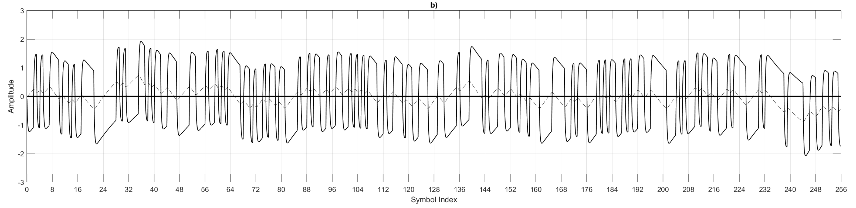
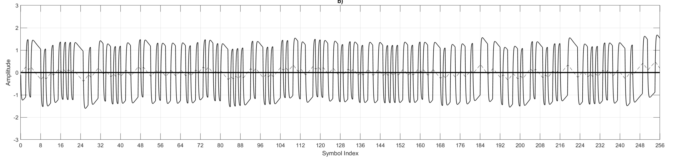
Baseline Wander
Baseline Wander Effect
  random walk depending on the run length in data sequence [8]
  BLW is stronger for 64B66B
  8B10B can reduce BLW somewhat
Overhead
  64B67B (guided scrambler) has 4.5% at max. run length of 12
  8B10B has 25% overhead (OH) at max. run length of 6
More overhead for better performance
25 MBd with OFE model
64b66b
8b10b

Slide 8
Overcome Baseline Wander
12.5 MBd
Low-overhead linecode alone is not very effective
  PM-PHY in IEEE Std 802.15.13-2023
  supports 12.5, 25, 50, 100 and 200 MBd
  8B10B is always the best choice
  64B67B and PRBS would cause error floors
Use equalization to reduce baseline wander [9]
  frequency-domain equalizer (FDE) removes the error floor
  works similarly with time-domain equalizer
  2-3 dB penalty with PRBS compared to 8B10B
Does OOK/FDE need another PHY?
  YES: PM-PHY vs. HB-PHY in IEEE Std 802.15.13-2023
  NO: OOK/FDE needs only minor changes to existing OFDM PHYs
200 MBd
PRBS
PRBS w. FDE

Slide 9
Comparison of OOK/FDE and OFDM
OOK/FDE shares most DSP blocks with OFDM
  move IFFT from TX to RX
  disable frequency up- and down-shift
Further changes
  new binary sequences for
    synchronization, channel estimation
    for both header and payload
  works at very high data rates [10-13]
Backwards-compatibility
  needs second RX in lower PHY
    switch btw. OFDM and OOK/FDE modes
    after CRC for the header
OOK/FDE only
OFDM only

Slide 10
Conclusions
ELC should consider an optimized LC waveform for low power and enhanced range. This is useful for both, mobile devices and in the infrastructure.
OOK/FDE is a modern concept to reduce the classical baseline wander effect of serial modulation. It works also w/o line coding overhead.
Implementation reuses almost all DSP blocks from existing OFDM PHYs.
ELC should define minimal PHY changes to save power and enhance range by reducing the peak-to-average power ratio.

Slide 11
References
[1] IEEE Std 802.11bb-2023, https://standards.ieee.org/ieee/802.11bb/10823/
[2] Tutorial on Light Communication Stds: https://mentor.ieee.org/802.11/dcn/23/11-23-0277-01-0000-ieee-802-standards-on-light-communication.pdf
[3] M. Hinrichs et al., “Pulsed modulation PHY for power efficient optical wireless communication,” in IEEE ICC May 2019. https://ieeexplore.ieee.org/document/8761150
[4] M. Hinrichs et al. “Advanced physical layer design for Li-Fi in the industrial internet of things,” in OSA APC Jul. 2019, pp. SpTh3E–4. https://www.researchgate.net/publication/336709570_Advanced_Physical_Layer_Design_for_Li-Fi_in_the_Industrial_Internet_of_Things
[5] M. Hinrichs et al., “Demonstration of optical wireless communications using the pulsed modulation PHY in IEEE 802.15.13,” in IEEE ICTON, July 2020, https://ieeexplore.ieee.org/document/9203161
[6] M. Hinrichs et al. “A physical layer for low power optical wireless communications,” IEEE Trans. Green Commun. Netw, vol. 5, no. 1, pp. 4–17, 2021. https://ieeexplore.ieee.org/document/9261607
[7] L. Bober et al.”Optical frontend model for PHY simulation,” https://mentor.ieee.org/802.11/dcn/19/11-19-0087-01-00bb-optical-frontend-model-for-phy-simulation.docx
[8] M. Hinrichs et al. “Efficient line coding for low-power optical wireless communications,” in VTC-Fall, IEEE, Sep. 2021, iSSN: 2577-2465. https://ieeexplore.ieee.org/document/9625557
[9] M. Hinrichs et al., “Reducing overhead for low-power optical wireless communications,” in IECON, IEEE, Oct. 2022, iSSN: 2577-1647. https://ieeexplore.ieee.org/document/9968414
[10] M. Hinrichs et al. “Demonstration of 1.75 Gbit/s VCSEL-based non-directed optical wireless communications with OOK and FDE,” in ECOC, Optica Publishing Group, Sept. 2022, paper We5.52. https://ieeexplore.ieee.org/document/9979263
[11] M. Hinrichs et al., “4 Gbit/s optical wireless communication with high-power transmitter,” in ECOC, Optica Publishing Group, Oct. 2023, p. We.A.2.5. https://ieeexplore.ieee.org/document/10484554
[12] M. Hinrichs et al. “7.75 Gbit/s LiFi transmitter using high-power VCSEL arrays,” in ECOC, Sep. 2024.
[13] M. Hinrichs et al., “A performance comparison of OFDM and pulsed PHY modulations in optical wireless communications,” SACVLC, Nov. 2023, pp. 124–129. https://ieeexplore.ieee.org/document/10347540 .

