Slide 1
UHR SCS Enhancements
Date: 2024-11
Authors:

Slide 2
Abstract
11bn is considering enhancements for Triggered UL access for a better QoS Support
In these slides, we provide additional thoughts on potential enhancements during an SCS agreement

Slide 3
Problem Statement
11be introduced the SCS+QoS Char. protocol to enable a client to request the AP to trigger the client for UL based on min./max. service interval and min. data rate
Requesting a large data rate on a long term in the SCS agreement leads to unnecessary padding and power consumption
However, due to dynamic change in the application data size when using variable bit rate encoding, allocated UL resources may not be sufficient and may lead to a buffer build up
Temporary buffer build up requires more UL resources to be allocated by the AP to meet delay bound
It is observed that although a client reports the BSR, an AP may not trigger a client sufficiently and in such cases a client may have to disable UL Triggered Access through OM Control

Slide 4
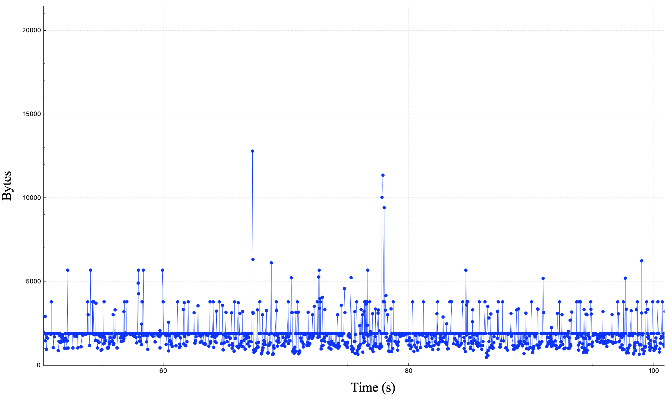
Video Call UL Traffic Profile During QoS Session
Application Data rate varies due to real-time user interactions and the data rate in the SCS Request may not be sufficient to describe the STA requirements

Slide 5
SCS Enhancements To Meet Delay Bound (1/2)
Thus, we propose the following under an SCS agreement:
Client requests in the SCS agreement a commitment from the AP for more triggering (beyond min. data rate) during an SCS agreement based on the reported BSR
The goal is to meet the delay bound if the client reports more data in the queue size for the TID of the SCS agreement
An AP that accepts such request, promise to trigger the client sufficiently until the AP depletes the reported queue size for the TID of the SCS agreement
The AP will trigger the client more for the unacknowledged data that is reported in the BSR

Slide 6
SCS Enhancements To Meet Delay Bound (2/2)
For the signaling, we propose to add a field in the QoS Characteristics element:

Slide 7
Flow Separation Using Additional TID(s) During an SCS Agreement
It is helpful to allow additional TID(s) for an AC (AC_VO and AC_VI) during an SCS agreement
This helps the AP to isolate other traffic from the SCS flows and be able to trigger the client to deplete the buffers for the TID(s) of an SCS agreement
Also, the additional TID(s) can also help to streamline the reception of those QoS flows and reduce reorder buffer delays
STA requests in the SCS Request frame the additional TID(s), one or more TID(s) may be dynamically assigned to a particular AC
If the AP accept the additional TID(s) in the UL or DL, separate BA agreement(s) may be setup for the additional TID(s)
The same additional TID can be used for bidirectional flows to help the AP isolate other traffic from the traffic of the SCS flows and enhance the delivery of the DL traffic for the TID(s) of an SCS agreement

Slide 8
Summary
In these slides, we discuss the issue where a client may have a temporary surge in the buffer size for QoS flows during an SCS agreement due to real-time interactions and variable bit rate encoding
For QoS flows with tight delay bounds (<= 10 ms), a client may start failing the delay bound due to insufficient UL triggering by the AP
We propose a mechanism to enhance the QoS by enabling the client to be triggered sufficiently during an SCS agreement to meet the delay bound of the QoS flow

