Slide 1
Low Latency Roaming Flow
Date: 2024 – 11 – 09
Authors:
Name | Affiliations | Address | Phone | Email
Pooya Monajemi | Apple Inc. |  |  | P_Monajemi@apple.com
Jarkko Kneckt
Yong Liu
Anuj Batra

Slide 2
Introduction
In this submission, we advocate for maintaining quality of experience in low latency applications during a roam event, with the following goals:
  Minimizing latency including pause periods
  Minimizing/eliminating packet loss
A request/response flow has been discussed in recent contributions
  We analyze potential cases that may introduce latency in data flow
Main ideas
  Early semi-static context transfer in the background
  Reducing last-stage roaming latency by optionally eliminating sync requirements
    SN reset, to avoid last-SN sync between APs

Slide 3
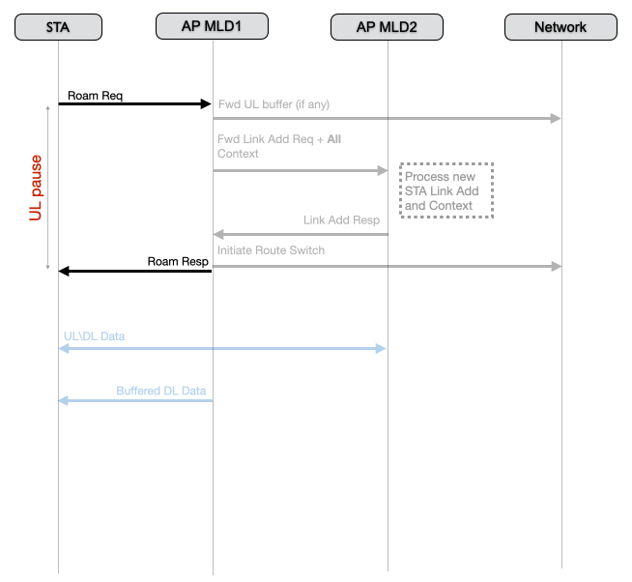
A Single Exchange Flow
Sequence
  Roam initiated by STA
  AP MLD1 (origin) triggers DL route switch
  AP MLD1 also initiates a context transfer to AP MLD2 (target)
  Once above steps are done AP MLD1 sends a Roam Ready signal to STA
  AP MLD1 meanwhile sends any buffered DL data to the STA
  STA needs to pause all UL traffic until the roam ready signal is received, then start UL with target AP MLD
Concerns:
  UL pause can be prohibitively long for a low latency application
    AP-to-AP communication may be slow depending on architecture, medium, etc.
  A rejected or an undesirable Roam Ready response may cause an unnecessary delay in data while STA looks for another roaming target

Slide 4
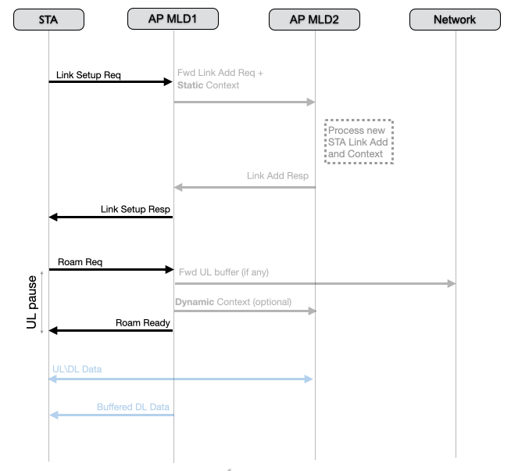
Minimizing Roaming Latency
Goal: Push as much of the process as possible to the background
  While data Rx/Tx continues with the origin AP MLD
Links can be set up in the background
Static context transfer can be performed in the background
  Static context is the set of parameters that do not change frequently
  Static context transfer may be combined with link setup process
Dynamic context transfer can be optional
  UL likely still needs to be paused during the last roam request/response exchange
  STA can opt to eliminate the need for last-stage dynamic context transfer to shorten this duration
  SN values can be reset to 0 at the target AP (other BA parameters may be transferred)
  The need for PN sync can be also eliminated (details to be discussed in future)

Slide 5
Summary
Presenting a flow for data path switch during roaming that can reduce latency caused by AP-to-AP sync
Moving the AP-to-AP sync to background while DL/UL continue with origin AP
Avoiding last-stage SN state sync by restarting the sequence numbers

Slide 6
Straw Poll 1
Do you support that in the roaming request, non-AP MLD can request not to transfer from the current AP MLD to the target AP MLD the following as part of the context transfer?
- the next SN for existing DL BA agreement (TBD on whether it is per TID)
- the latest SN that has been passed up for existing UL BA agreement (TBD on whether it is per TID)
- The AP MLD shall accept the request

