Slide 1
Power Save Operation and AP Behaviour for Coex Unavailability
Date: 2024 – 10 – 16
Authors:
Name | Affiliations | Address | Phone | Email
Qi Wang | Apple Inc. |  |  | qi_wang2@apple.com
Neel Nurani Krishnan
Yong Liu
Abdel Ajami
Yanjun Sun
Anuj Batra

Slide 2
Introduction
We presented the methods of solicited (PBT) and unsolicited (UUA) unavailability announcement for in-device co-existence management in 11bn submission 24/0094r0, etc. [1] [2] [3].
In this submission, we specify the following aspects of the PBT and UUA operations:
  AP behaviors during Coex unavailability (Slide 3)
  Interaction with power management mode, and TWT mechanisms (slide 4 - 5);
  AP behavior for Coex unavailability inside TXOP (slide 6 - 7).

Slide 3
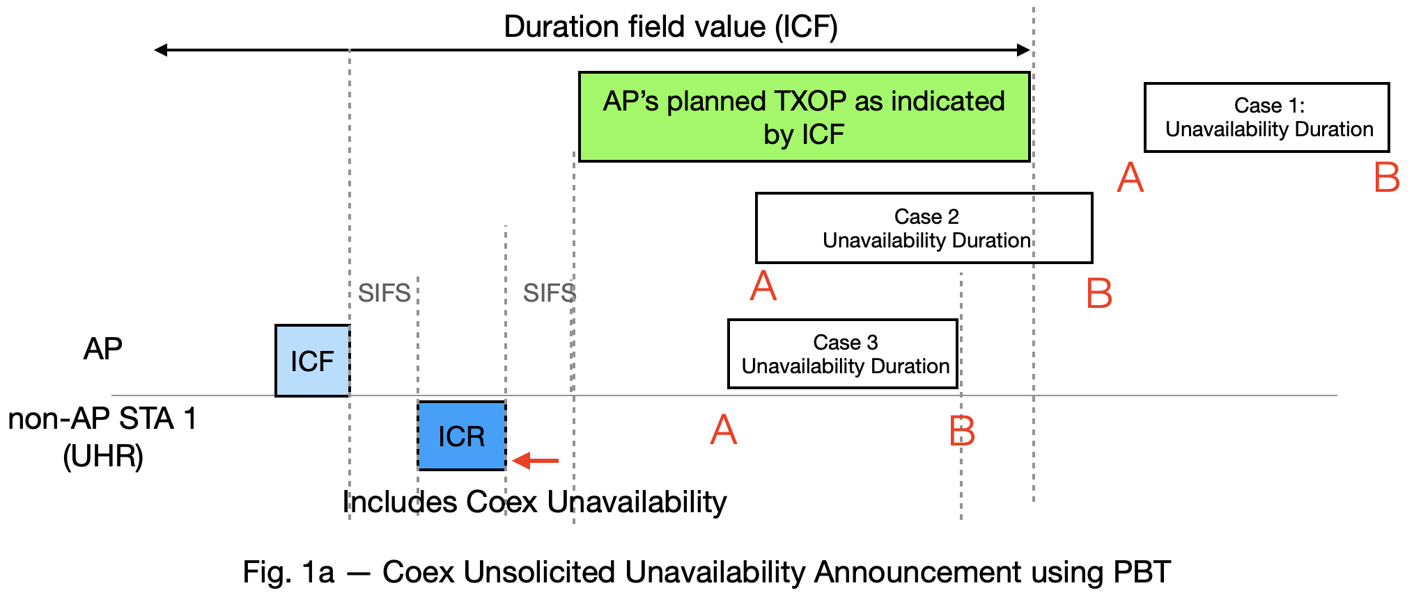
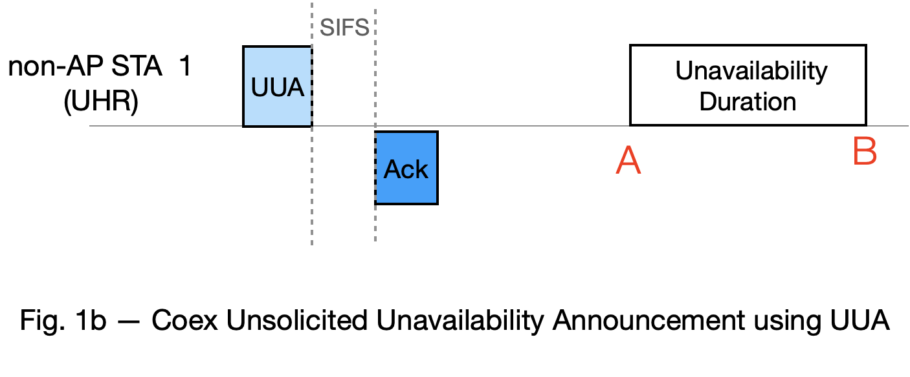
AP Behavior During Coex Unavailability
For solicitated Coex unavailability Case 1, 2 and 3:
During the “Unavailability Duration”, the AP shall buffer the individually addressed BUs addressed to STA 1, if the AP MLD is unable to deliver the BU(s) to an available STA affiliated with the same non-AP MLD on another link.
  11.2.3.1 Power management in non-DMG infrastructure network / General ([4], page 2496, line 4-5)
    “The AP shall buffer individually addressed BUs addressed to STAs operating in a PS mode. These buffered BUs shall be transmitted only at designated times.”
For unsolicited Coex Unavailability announced by UUA, AP’s behavior is the same as unavailability announced by PBT ICR - case 1.

Slide 4
Coex Unavailability Interaction with Power Management Mode
For all three PBT scenarios (Fig.1a) and UUA (Fig. 1b):
  STA may be in either Active mode or Power Save mode (both allowed) at the beginning of the Unavailability Duration (i.e., point A)
  During the announced unavailability duration, STA may transmit a frame and change its PM setting at any point.

Slide 5
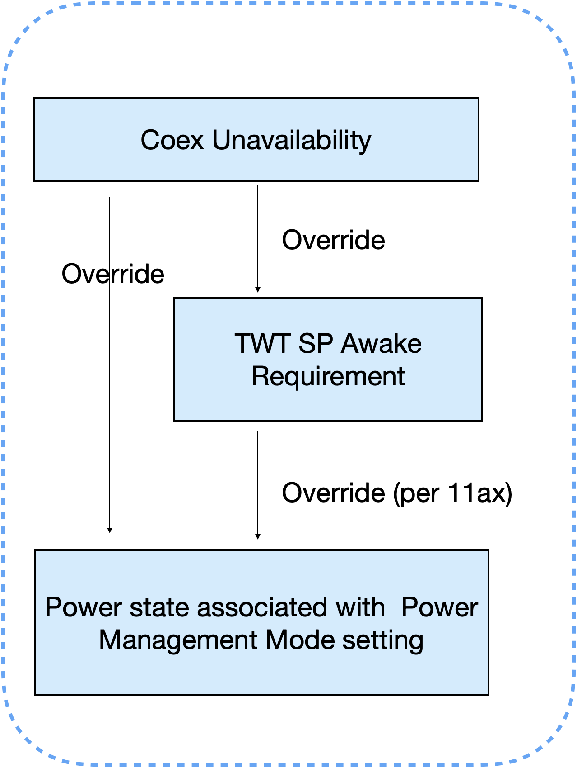
Coex Unavailability Interaction with TWT
If the Unavailability Duration partially or entirely overlaps with a TWT SP, the STA’s unavailability overrides the TWT requirement and the STA is unavailable, that is, the STA’s unavailability takes precedence over an TWT agreement.

Slide 6
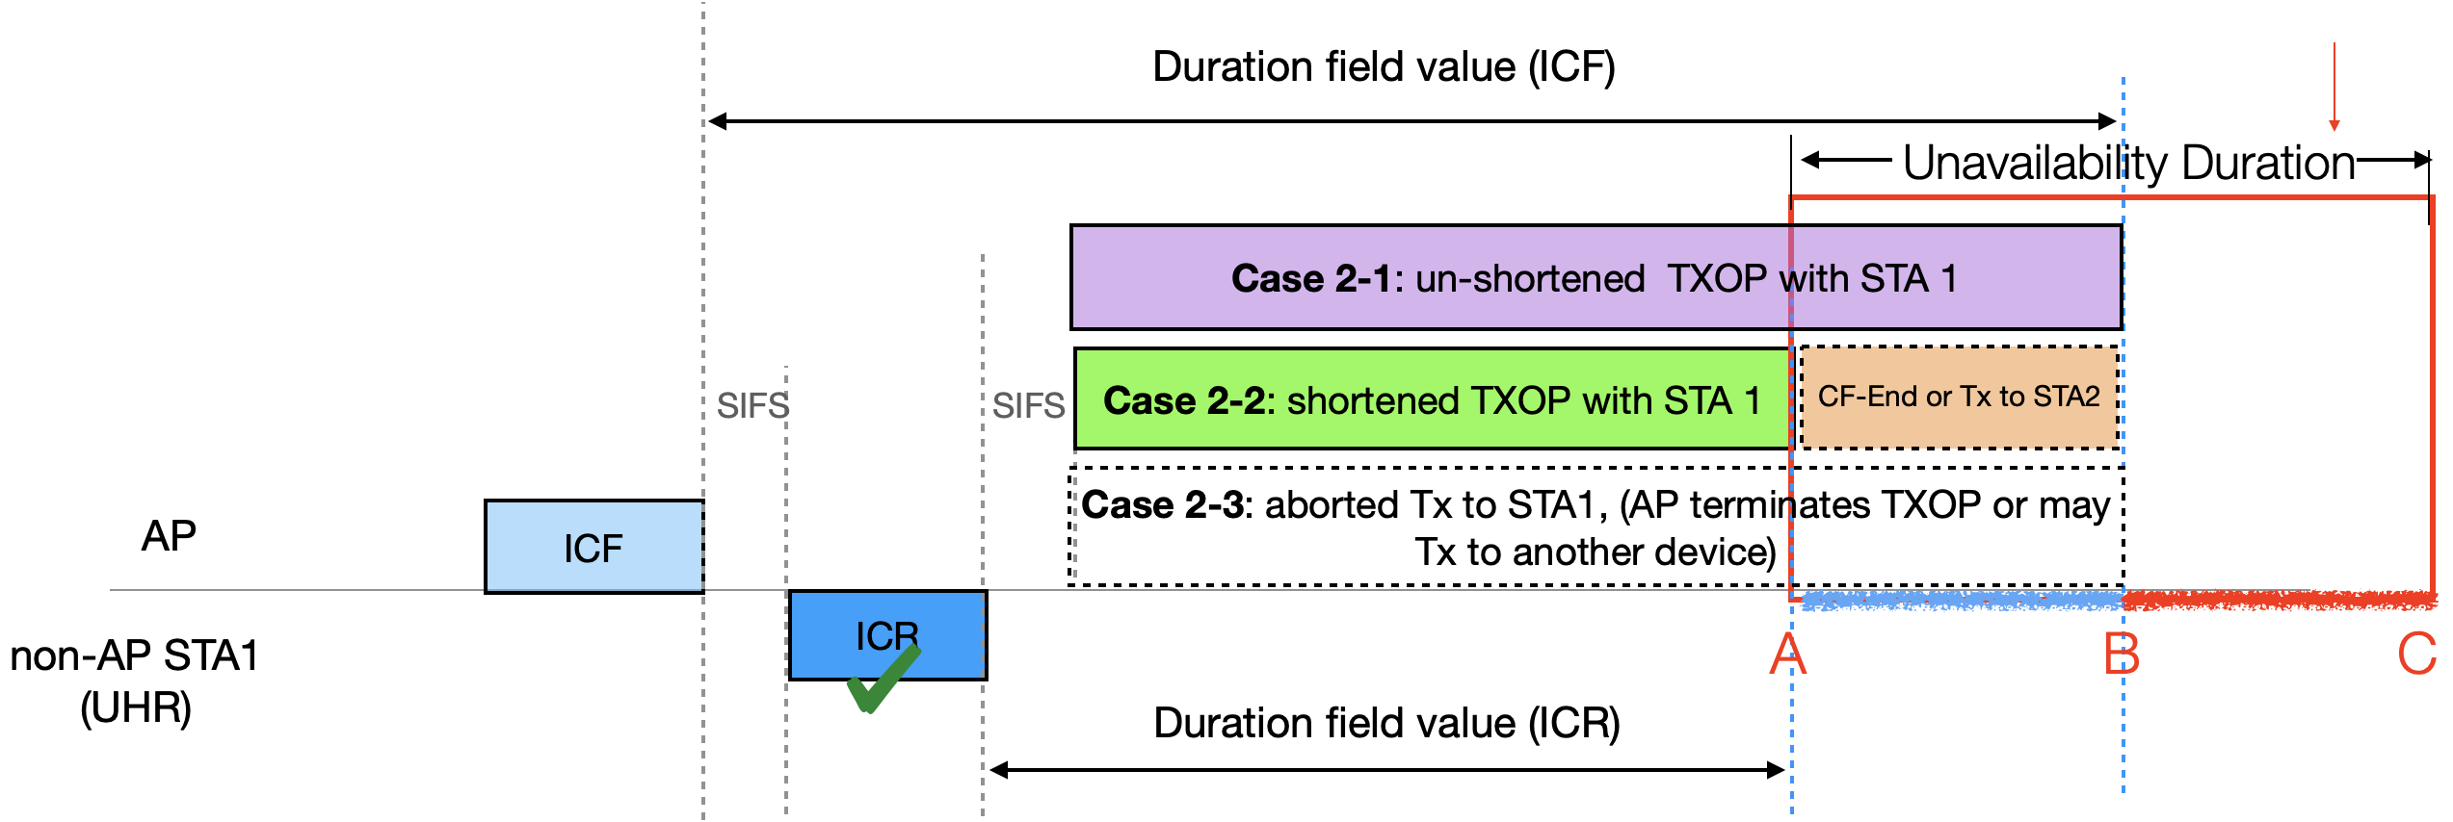
AP Behavior For Unavailability Inside TXOP, Case 2
During the time period B to C: AP behaves per slide 3.
STA2: a 3rd party STA
 | AP’s CW behavior | AP’s retry behavior | AP’s rate adaptation behavior
Case 2-1 | CW[AC] shall be left unchanged. | If AP learns from ICR the Coex Unavailability, the AP should avoid retrying STA1 during an indicated coex unavailability. | AP shall not drop data rate for STA1 due to packet failure during unavailability.
Case 2-2 | Baseline behavior.
Case 2-3

Slide 7
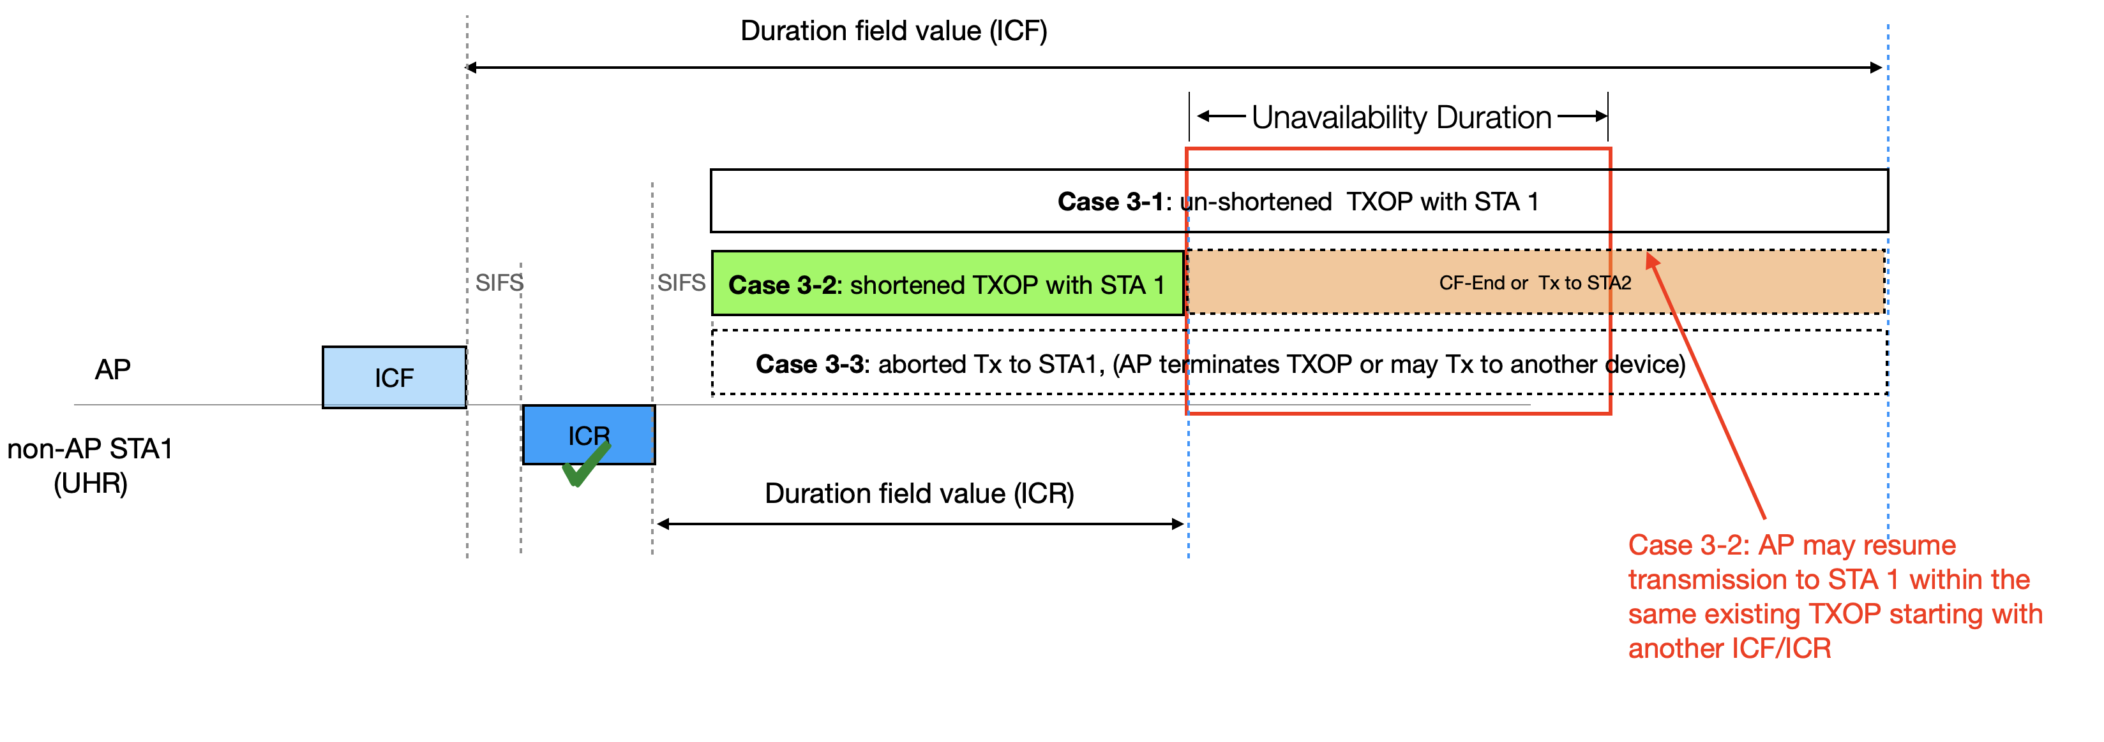
AP Behavior For Unavailability Inside TXOP, Case 3
AP’s behavior for 3-1 and 3-3 is the same for case 2-1 and 2-3, respectively, as shown on slide 6.
For Case 3-2: after the end of the Unavailability, AP may resume transmission to STA 1 within the same TXOP.
  The AP shall resume transmission to STA 1 by transmitting an ICF first.

Slide 8
Summary
In this submission, we have proposed additional aspects of the PBT and UUA operations.

Slide 9
References
[1] IEEE 802.11bn - 24/0094r0, “Probe-Before-Talk and Unsolicited Unavailability Announcement for Co-ex Management”
[2] IEEE 802.11bn– 24/1550r0, “In-device coexistence follow up”
[3] IEEE 802.11bn – 24/1247r0, “ICF ICR Design for Coex”
[4] Draft P802.11REVme_D7.0, Draft Standard for Information Technology — Telecommunications and Information Exchange between Systems Local and Metropolitan Area Network — Specific Requirements, Part 11: Wireless LAN Medium Access Control (MAC) and Physical Layer (PHY) Specification

Slide 10
Straw Poll 1
Do you support:
During the unavailability duration that is announced by a non-AP STA (as either a TXOP holder or a TXOP responder), an AP shall buffer the individually addressed BUs to the non-AP STA, if the AP MLD is unable to deliver the BU(s) to an available non-AP STA affiliated with the same non-AP MLD on another link?

Slide 11
Straw Poll 2
Do you support:
  A non-AP STA may be in either Active mode or Power Save mode at the beginning of the unavailability duration that is announced by the non-AP STA as either a TXOP holder or a TXOP responder.
  During the announced unavailability duration, a non-AP STA may transmit a frame and change its PM setting at any point using the same baseline behavior specified in 11.2.3.2.

Slide 12
Straw Poll 3
Do you support:
After the recipient of an ICR including unavailability information provided by a non-AP STA, if the AP is unable to modify its TXOP duration according to the STA’s unavailability and results in a transmission failure, then the AP:
Does not drop data rate for the STA;
Leaves the CW[AC] unchanged;
Should avoid retrying the STA during the unavailability duration indicated in the ICR.

Slide 13
Appendix

Slide 14
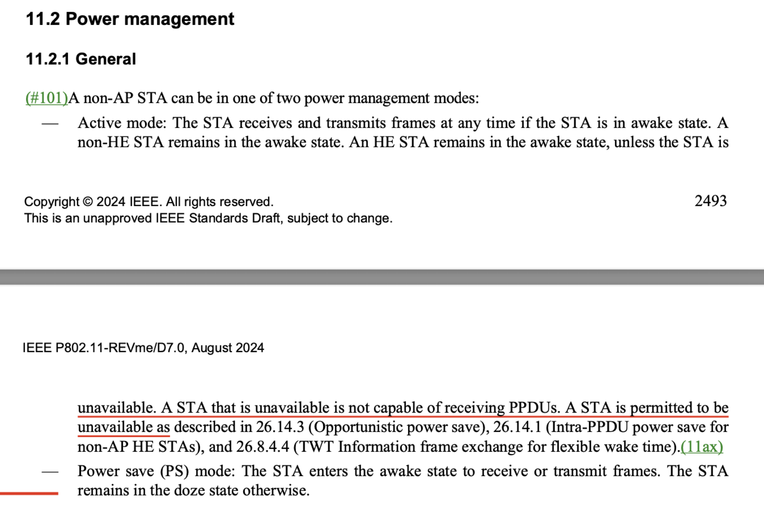
Spec Reference [4] of Being “Unavailable” During Active Mode

