Slide 1
802.11bn Architecture and Key Hierarchy
Date: 2024-11-08
Authors:

Slide 2
Abstract
This submission defines architecture when an AP MLD supports Seamless Roaming (SR) and 802.11r fast transition (FT).
The proposed architecture minimizes changes to the 802.11r key hierarchy.

Slide 3
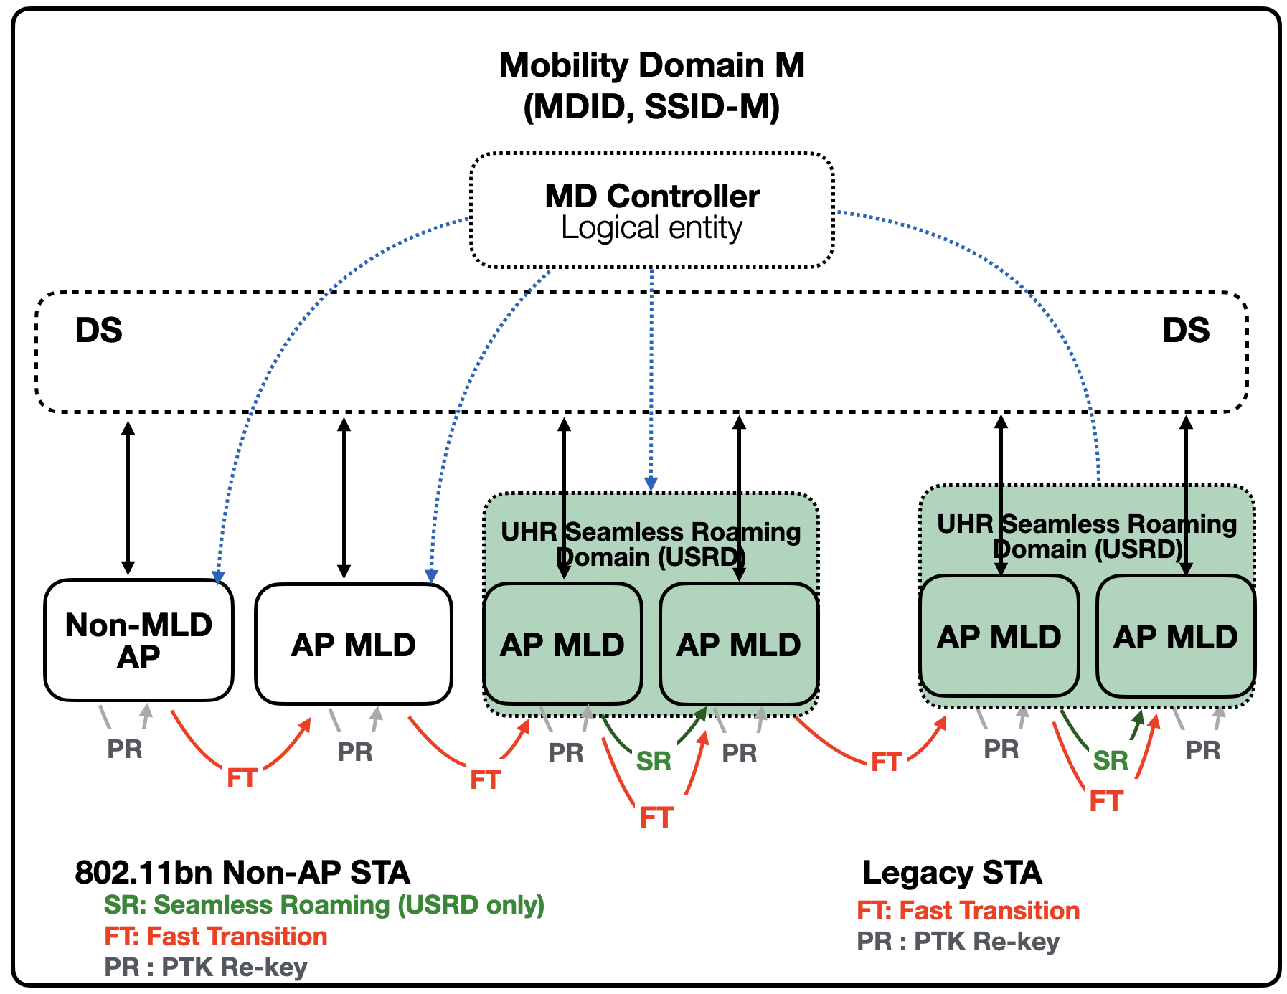
The Main Roaming Concepts
FT: FT is possible within a Mobility Domain (MD)
FT requires a STA to re-associate
SR: SR is possible within an UHR Seamless Roaming Domain (USRD)
When an UHR STA roams, it stays associated (state 4) with USRD
USRD may be within a MD
PR: A STA may rekey its PTK at any time
Note: AP MLDs in USRD do not support FT, if the USRD is not within a MD

Slide 4
Proposal, FT Support for Legacy STAs
All APs and AP MLDs in a Mobility Domain have FT parameters to support legacy STAs
Legacy STAs do not see any differences on FT use
Within a mobility domain an UHR non-AP STA:
Should do SR between AP MLDs of the same USRD
Should do FT otherwise
802.11bn key hierarchy needs to support both SR and FT protocols

Slide 5
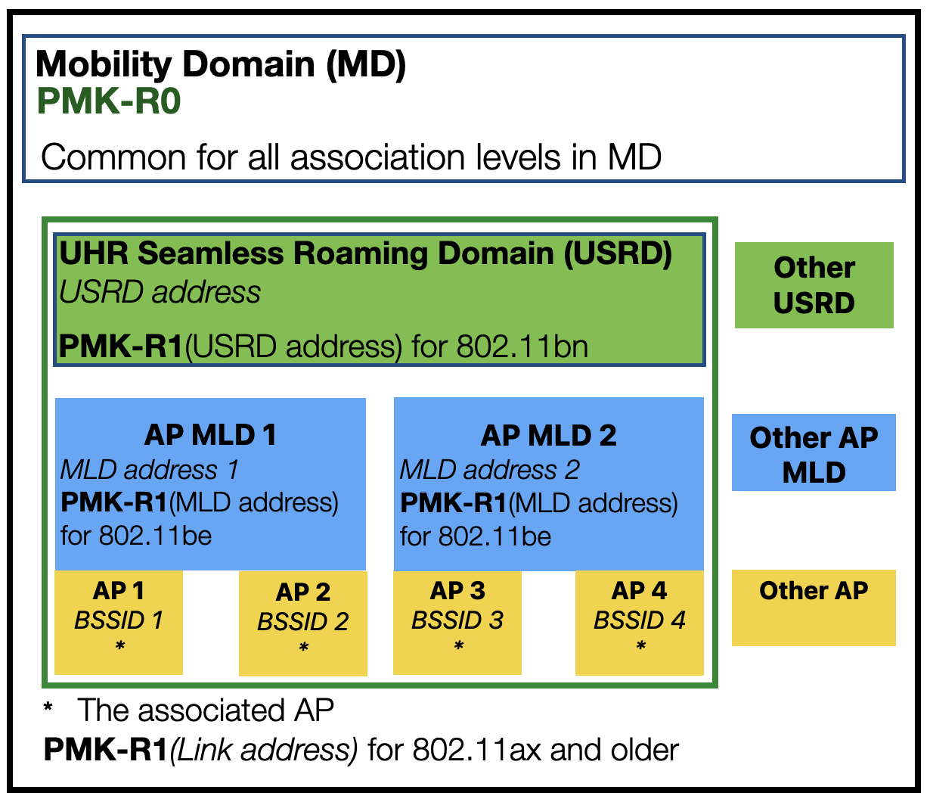
Proposal: FT Compliant Key Hierarchy
Background: FT has 2 level PMK hierarchy
PMK-R0 is stored at the mobility domain
PMK-R1 is created at the association level
FT and SR use PMK-R1 to create PTK
USRD has common PMK-R1 for affiliated AP MLDs
Changes to the key hierarchy are minimized
A non-AP device selects its association level (Link, MLD, or USRD)

Slide 6
Summary
Seamless roaming (SR) is possible between AP MLDs in UHR Seamless Roaming Domain
Fast Transition (FT) is possible between APs and AP MLDs in Mobility Domain
The PMK-R0 is maintained in Mobility Domain
The PMK-R1 is created at association level (Link, MLD, or USRD)
FT and SR use PMK-R1 to create PTK

Slide 7
Straw Poll
Do you support to use PMK-R0 and PMK-R1 as shared PMK in an UHR SR domain, if the UHR SR domain is part of a (FT) mobility domain?
- The PMK-R0 and PMK-R1 are compatible with FT key hierarchy

Slide 8
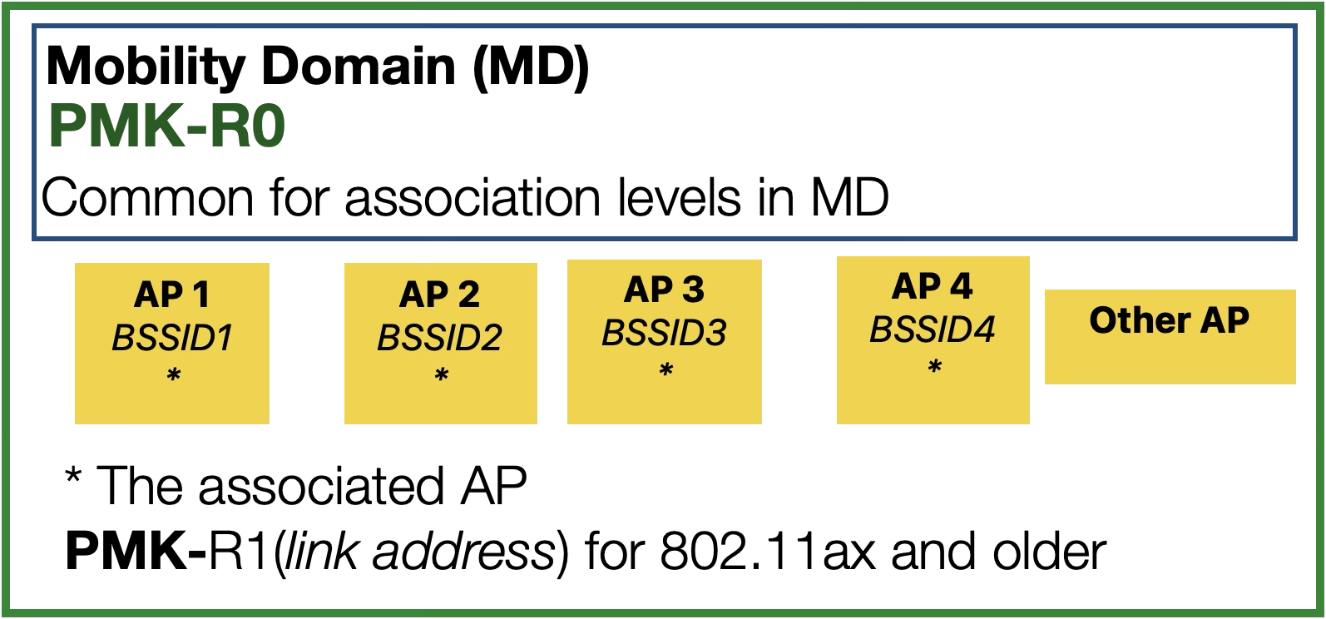
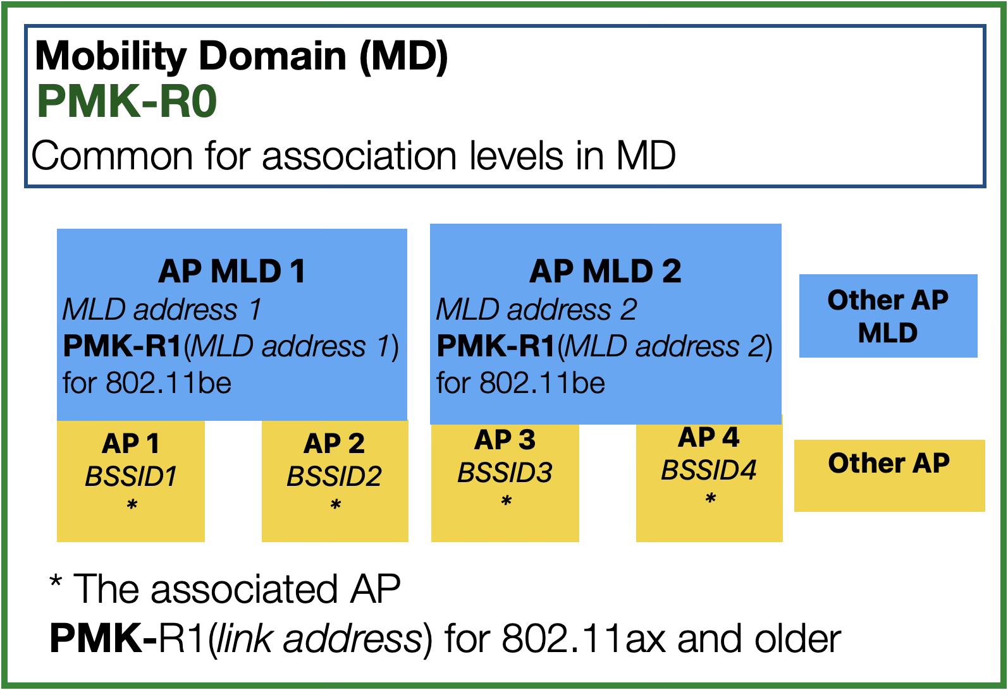
Annex: Different Views of Wi-Fi Architecture
802.11ax and older STAs view
802.11bn STAs view
802.11be STAs view

