Slide 1
ERD: Enhanced Reverse Direction Protocol to
Support TXOP Sharing and Low-Latency Traffic Exchange
Date: November 8th, 2024
Authors:

Slide 2
Problem Statement
If AP is the TXOP holder
  It can send DL traffic to one or more STAs during its acquired TXOP
  To send UL traffic, a non-AP STA can use BSR to request resources
    802.11ax uses Trigger-based resource allocations to enable non-AP STAs to send UL traffic
    802.11be TXS Mode 1 enables non-AP STA to send SU UL
    802.11be TXS Mode 2 enables non-AP STA to perform Peer-to-Peer (P2P) transmissions with other non-AP STAs
  Shortcomings: (1) These sharing methods require sending control frames, and (2) if a non-AP STA needs to send peer-to-peer traffic, it cannot request for resources from the AP (e.g., when relaying operation is required)
If a non-AP STA is the TXOP holder
  Solutions have been proposed to share TXOP with AP using control frames
  Shortcomings: (1) These sharing methods require sending control frames, (2) the current proposals do not allow the AP to request TXOP sharing from non-AP STAs, and (3) partial TXOP sharing is not possible
In this contribution, we propose enhancements to the Reverse Direction (RD) protocol to address the above shortcomings

Slide 3
Related Contributions
The Reverse Direction (RD) protocol is specified in Section 10.29 of 802.11-2020 standard
Some contributions show the effectiveness of using RD for interactive and Low-Latency (LL) traffic exchanges [11-23/1387r0] [11-23/1874r0] [11-24/0668r1] (please see Appendix A)
The RD protocol utilizes two bits
  Reverse Direction Grant (RDG)/More PPDU
  AC Constraint
Both fields are located in the Command and Status (CAS) subfield, which is in the A-control subfield

Slide 4
Overview of the existing Reverse Direction (RD) Protocol (Section 10.29 of 802.11-2020 standard)
The Reverse Direction (RD) protocol allows for bidirectional frame exchange during TXOPs
The TXOP Holder exchanges bidirectional traffic with the TXOP Responder
TXOP Duration
PPDU
AC_VO
RDG/More PPDU = 0
AC Constraint = 0
PPDU
AC_VO
RDG/More PPDU = 1
AC Constraint = 1
PPDU
RDG/More PPDU = 0
BA
RDG/More PPDU = 0
Non-AP STA: TXOP Holder
PPDU
AC_VO
RDG/More PPDU = 1
PPDU
AC_VO
RDG/More PPDU = 0
BA
BA
RDG/More PPDU = 1
BA
AP: TXOP
Responder
One burst of PPDUs from TXOP Responder
(no ACK between these PPDUs)

Slide 5
Shortcomings of RD
RD does not allow the Responder to ‘request’ for TXOP sharing
  If the Responder has LL traffic, it cannot notify the Holder
RD does not allow the Responder to communicate with any STA other than the Holder
  LL traffic from Responder to other STAs (not the Holder) cannot be sent
RD is unable to specify the TXOP sharing duration
  There is no guarantee on the return time of shared TXOP; the Responder may use the entire remaining TXOP duration
RD is unable to specify the permissible traffic types that can be sent during a shared TXOP
  Simply relying on the Access Category (AC) of the last PPDU may prevent the transmission of LL traffic
Further enhancement of throughput and reduction of tail latency can be achieved by overcoming the above shortcomings

Slide 6
TXOP Holder switches to sending AC_VO frames
(higher-priority traffic)
TXOP Holder offers TXOP sharing to the TXOP Responder, where the permissible traffic type is AC_VO
Last AC_VI frame sent by the TXOP Holder
PPDU
AC_VI
RDG/More PPDU = 0
AC Constraint = 0
PPDU
AC_VI
RDG/More PPDU = 0
AC Constraint = 0
PPDU
AC_VO
RDG/More PPDU = 0
AC Constraint = 0
PPDU
AC_VO
RDG/More PPDU = 1
AC Constraint = 1
TXOP
Holder
BA
RDG/More PPDU = 0
AC Constraint = 0
BA
RDG/More PPDU = 0
AC Constraint = 0
TXOP
Responder
TXOP Responder declines the offer because it only has high-priority AC_VI traffic to send

Slide 7
Enhanced Reverse Direction (ERD)
We propose using an extended encoding of RD’s two bits to support additional operational modes
  A TXOP Responder (AP or non-AP) can request for TXOP sharing
  A TXOP Responder (AP or non-AP) can request for TXOP sharing to communicate with 3rd party STAs (i.e., STAs other than the TXOP Holder)
ERD does not require exchanging additional control frames to enable these additional operational modes
Also, the reserved bits in the CAS subfield and the remaining bits in the A-Control subfield can be leveraged to enhance RD and convey additional information such as the following:
    TXOP Holder can announce the permissible traffic types during the shared TXOP
    TXOP Holder can enforce the duration of the shared TXOP duration
    TXOP Responder can convey the type, amount and destination of traffic in its buffer
    TXOP Responder can request for a certain/minimum TXOP sharing duration

Slide 8
Items marked with * are the newly proposed features
Frames sent by TXOP Holder | RDG/More PPDU | AC Constraint | Unused bits in CAS and A-Control subfields
None | 0 | 0 | Additional information TBD (sample encoding in Appendix C)
*TXOP Sharing Offer (TSO): Sharing for communication with 3rd party STAs | *0 | *1
TXOP Sharing Offer (TSO): Sharing without AC constraint | 1 | 0
TXOP Sharing Offer (TSO): Sharing with AC constraint | 1 | 1
Frames sent by TXOP Responder | RDG/More PPDU | AC Constraint | Unused bits in CAS and A-Control subfields
None/Offer Rejection | 0 | 0 | Additional information TBD (sample encoding in Appendix C)
*Requesting sharing for communication with 3rd party STAs (communication with the TXOP Holder is allowed) | *0 | *1
Accepting TXOP sharing offer | 1 | 0
*Requesting sharing for communication with the TXOP Holder | *1 | *1

Slide 9
TXOP Duration
TXOP sharing offer for communication with 3rd party STAs (STAs other than the TXOP Holder) and/or the TXOP Holder
PPDU
PPDU
RDG/More PPDU = 0
AC Constraint = 1
PPDU
RDG/More PPDU = 0
AC Constraint = 0
TXOP Sharing Duration
TXOP Holder (non-AP STA)
BA
RDG/More PPDU = 0
AC Constraint = 1
BA
RDG/More PPDU = 1
AC Constraint = 0
PPDU
RDG/More PPDU = 0
AC Constraint = 0
The AP may communicate with
3rd party STAs and/or
the TXOP Holder
TXOP Responder (AP)
Accepting offer
A TXOP sharing request for communication with 3rd party STAs
3rd Party STA

Slide 10
TXOP Duration
PPDU
PPDU
RDG/More PPDU = 0
AC Constraint = 1
TXOP sharing offer for peer-to-peer communication
PPDU
RDG/More PPDU = 0
AC Constraint = 0
TXOP Sharing Duration
TXOP Holder (AP)
BA
RDG/More PPDU = 0
AC Constraint = 1
BA
RDG/More PPDU = 1
AC Constraint = 0
PPDU
RDG/More PPDU = 0
AC Constraint = 0
The non-AP STA performs peer-to-peer communication
TXOP Responder (non-AP STA)
Accepting offer
P2P
communication
3rd Party STA
Make a TXOP sharing request
Indicate its peer-to-peer traffic type/size
Indicate the requested sharing duration

Slide 11
Summary
The RD protocol is an efficient way to allow a TXOP Holder to share its TXOP with the TXOP Responder
Using RD, no control frames are required to perform sharing (i.e., minimal overhead of TXOP sharing)
This contribution proposed enhancements to the RD protocol:
  A TXOP Responder (AP or non-AP STA) can request TXOP sharing from the Holder
  A TXOP Responder (AP or non-AP STA) can request for TXOP sharing to perform communication with a 3rd party STA
  TXOP Holder and Responder can negotiate via exchanging information such as the TXOP sharing duration and traffic types that are allowed/need to be exchanged
  None of these negotiations require the exchange of additional control frames

Slide 12
Straw Polls
Do you support to add the following to UHR SFD: 11bn should enhance the RD protocol to allow a TXOP Responder to request TXOP sharing from the TXOP Holder to perform communication with the Holder or another STA?
YES/NO/ABSTAIN
Do you support to add the following to UHR SFD: 11bn standard should enhance the RD protocol to enable a TXOP Holder and a TXOP Responder to enforce or negotiate TXOP sharing parameters?
YES/NO/ABSTAIN

Slide 13
APPENDIX A
Related Contributions and Straw Polls

Slide 14
Related Contributions
The benefits of enabling non-AP STAs to share their TXOP with the AP have been demonstrated in various works and several solutions have been proposed [11-24/1224r2] [11-24/068r0] [11-23/1886r3] [11-24/0168r0] [11-24/0389r0] [11-23/581r0]
  Some of these works, however, only allow a non-AP STA to share the unused portion of its TXOP with the AP [11-23/1874r0] [US9655136B2]
    ERD allows sharing any part of the TXOP at any time
    ERD is a fully in-band method that does not require the exchange of any additional control frames for sharing
Some of these works present their contribution within the context of facilitating low-latency traffic exchange [11-23/1886r3] [11-24/0168r0] [11-24/1207r0] [11-24/0389r0]
  There exist contributions related to the priority of channel access during TXOPs [11-24/1257r0] [11-24/416r1]
Another category of works show how TXOP sharing can be leveraged to enhance relaying performance
  This is particularly useful for XR applications [11-24/0105r0] [11-24/0668r1]
  There exist contributions related to the negotiation process of such communication [11-23/1958r0] [11-24/0073r0] [11-24/1885r1]
    ERD can also be used with SCS to inform the AP to whom the packet must be forwarded

Slide 15
Related Straw Polls
Allow non-AP STAs to share their TXOPs with the associated AP
[11-24/068r0] [11-23/581r0 and 11-23/1847r0] [11-23/1387r0] [11-23/1874r0] [11-24/1224r2] [11-24/0668r1] [11-23/1886r3] [11-24/0168r0] [11-24/1207r0] [11-24/0389r0]
Do you support allowing a non-AP STA initiate downlink transmissions with its associated AP in TGbn?
[11-24/1224r2] [11-24/0168r0] [11-23/1886r3] [11-24/0389r0]
Do you support allowing a non-AP STA initiate downlink/uplink transmissions with its associated AP and P2P transmissions with its peer STA(s) in the same TXOP in TGbn?
[11-24/1224r2] [11-24/0668r1]
Do you support enhancing relaying operation for AP-STA1-STA2 communication?
[11-24/0105r0] [11-24/0668r1] [11-23/1958r0] [11-24/1885r1]

Slide 16
APPENDIX B
Shortcoming of RD with Specifying Reverse Direction Traffic

Slide 17
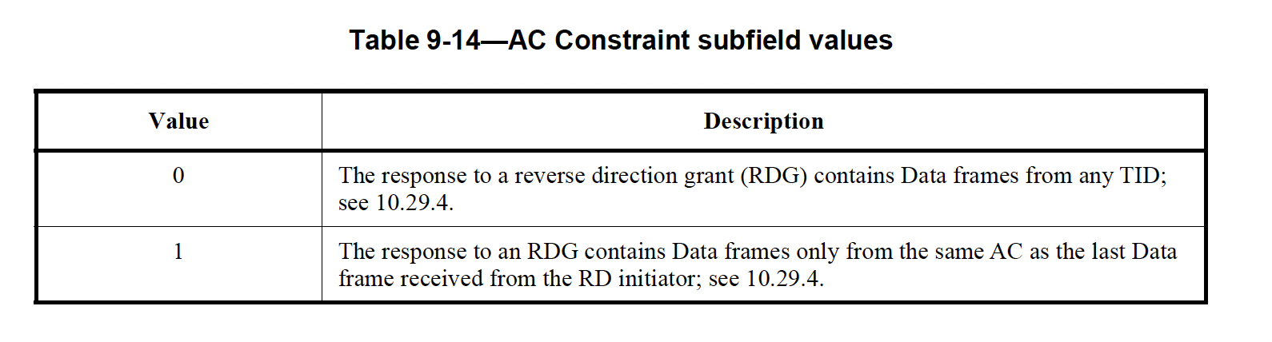
The existing method used by RD (Section 10.29 of 802.11-2020) for constraining the traffic types that can be sent during the shared TXOPs may impose some limitations

Slide 18
For instance, consider the following case
  The TXOP Holder acquires the TXOP and sends frames belonging to AC_VI
  The TXOP Holder then sends its high-priority traffic belonging to AC_VO
  Since the AC of the PPDU is AC_VO, the AC Constraint field of the frame sent by the TXOP Holder informs the TXOP Responder that only traffic belonging to AC_VO can be sent
  The TXOP Responder declines the offer because its buffered traffic type is AC_VI
  However, the TXOP Holder wanted to allow both AC_VO and AC_VI to be sent by the TXOP Responder
    This is especially important when the TXOP Responder needs to reply back to the Holder with frames that belong to the same traffic stream (e.g., same TCP/UDP connection)
Therefore, simply relying on the AC Constraint field sent by the TXOP Holder may not provide the specific granularity needed to control permissible traffic types during shared TXOPs
An enhanced and flexible method proposed by ERD
  We propose a new subfield, called TXOP Sharing-Traffic Characteristics Indication (TXS-TCI)
  We propose to use the 5 reserved bits of CAS subfield to encode permissible traffic types
  An alternative approach is to use the 5 bits of CAS plus the 14 remaining bits of A-Control subfield

Slide 19
APPENDIX C
More Details about ERD Features and Operation

Slide 20
Items marked with * are the newly introduced subfields
A-Control (30 bits total)
 | CAS (8 bits total)
4 bits | 1 bit | 1 bit | 1 bit | 5 bits (reserved) | 4 bits | 14 bits
CAS Control ID value: 6 | AC Constraint (*extended encoding) | RDG/More PPDU (*extended encoding) | PSRT PPDU | *TXS-TCI TXOP Holder: Permissible traffic types TXOP Responder: Buffer report | *A new Control ID value (between 10 to 14) | *TXS-DU TXOP Holder: TXOP sharing duration TXOP Responder: Requested TXOP sharing duration
TXS-TCI: TXOP Sharing-Traffic Characteristics Indication
TXS-DU: TXOP Sharing-Duration
For the AC Constraint and RDG/More PPDU fields, we propose extended bit encodings, in addition to those available in the existing RD protocol (in 802.11ax/be)

Slide 21
Items marked with * are the newly proposed features
Frames sent by TXOP Holder | RDG/More PPDU | AC Constraint | *TXS-TCI | *TXS-DU
None *Time until next TXOP sharing | 0 | 0 |  | *The minimum/exact amount of time before next TXOP sharing instance
*TXOP Sharing Offer (TSO): Sharing for communication with 3rd party STAs | *0 | *1 | *Permissible traffic types during the TXOP sharing period | *TXOP sharing duration
TXOP Sharing Offer (TSO): Sharing without AC constraint | 1 | 0 |  | *TXOP sharing duration
TXOP Sharing Offer (TSO): Sharing with AC constraint | 1 | 1 | *Permissible traffic types during the TXOP sharing period | *TXOP sharing duration
Frames sent by TXOP Responder | RDG/More PPDU | AC Constraint | *TXS-TCI | *TXS-DU
None/Offer Rejection | 0 | 0
*Offer Rejection *Requesting sharing for communication with 3rd party (communication with the TXOP Holder is allowed) | *0 | *1 | *Traffic type/amount report | *Requested TXOP sharing duration
Accepting TXOP sharing offer While Responder is sending frames to the Holder | 1 | 0
*Offer Rejection *Requesting sharing for communication with TXOP Holder | *1 | *1 | *Traffic type/amount report | *Requested TXOP sharing duration

Slide 22
The TXOP Holder may announce in its PPDUs the minimum amount of time before the next TXOP sharing instance
This time difference (next TXOP sharing – current time) can be announced via the TXS-DU field
TXOP Sharing Offer (TSO) frame
TXS-DU = D₁
Time until next TXOP sharing = I₂
Time until next TXOP sharing = I₁
TXOP Sharing Offer (TSO) frame
TXS-DU field = D₂
STA_{X}: TXOP Holder
…
…
I₁
I₂
D₁
D₂
TXOP Sharing Duration
TXOP Sharing
Duration
STA_{Y}: TXOP Responder
Sleep
Sleep
STA_{Z}: 3rd Party STA

Slide 23
TXOP Duration
D₁
Initial TXOP Sharing Duration
Updated TXOP sharing duration
TXS-DU field = D₂
D₂
TXOP Sharing Offer (TSO)
TXS-DU field = D₁
Updated TXOP
Sharing Duration
Early termination of TXOP sharing period
PPDU
AC_VI
RDG/More PPDU = 0
AC Constraint = 0
PPDU
AC_VI
RDG/More PPDU = 1
AC Constraint = 1
TXS-DU
PPDU
AC_VI
RDG/More PPDU = 0
AC Constraint = 0
BA
RDG/More PPDU = 1
AC Constraint = 1
TXS-DU
BA
RDG/More PPDU = 0
AC Constraint = 0
TXOP
Holder
PPDU
AC_VO
RDG/More PPDU = 1
AC Constraint = 0
BA
RDG/More PPDU = 0
AC Constraint = 0
BA
RDG/More PPDU = 1
AC Constraint = 0
PPDU
RDG/More PPDU = 0
AC Constraint = 0
TXOP
Responder
This PPDU is ACK/BA soliciting
The Responder does not return the TXOP to the Holder as long as RDG/More PPDU = 1 and AC Constraint = 0
Responder returns the TXOP to the Holder

Slide 24
TXOP Holder offers TXOP sharing to the TXOP Responder, where the permissible traffic types are AC_VO and AC_VI
The TXS-TCI field is included to convey the permissible traffic types
TXOP Holder switches to sending AC_VO frames
Last AC_VI frame sent by the TXOP Holder
PPDU
AC_VI
RDG/More PPDU = 0
AC Constraint = 0
PPDU
AC_VI
RDG/More PPDU = 0
AC Constraint = 0
PPDU
AC_VO
RDG/More PPDU = 0
AC Constraint = 0
PPDU
AC_VO
RDG/More PPDU = 1
AC Constraint = 1
TXS-TCI and TXS-DU
TXOP Sharing Duration
TXOP
Holder
PPDU
AC_VI
RDG/More PPDU = 1
AC Constraint = 0
BA
RDG/More PPDU = 0
AC Constraint = 0
BA
RDG/More PPDU = 1
AC Constraint = 0
TXOP
Responder
TXOP Responder accepts the offer because it has AC_VI traffic to send

Slide 25
Requesting for TXOP Sharing
The TXOP Responder may request the Holder to share its TXOP
A Responder can send a request frame to the Holder if the Holder is currently expecting to receive at least one frame (e.g., ACK/BA, data frame) from the Responder
The Responder can send two types of requests:
  Request for sharing TXOP to communicate with the Holder
  Request for sharing TXOP to communicate with 3rd party STAs and potentially the Holder too
When sending a TXOP sharing request, the Responder can use the proposed TXS-TCI field to indicate the type and/or the amount of its buffered data
The Responder can use use the following two types of requests
  To request for TXOP sharing to communicate with 3rd party STAs:
    RDG/More PPDU = 0 and AC Constraint = 1
    The TXS-DU field of this frame conveys the minimum requested duration of sharing
  To request for TXOP sharing to communicate with the TXOP Holder
    RDG/More PPDU = 1 and AC Constraint = 1
    The TXS-DU field of this frame conveys the minimum requested duration of sharing

Slide 26
Case 1: No ongoing sharing period
Whenever the Holder is expecting an ACK/BA from the Responder, the Responder can use the ACK/BA frame to make the request
Note: Any frame, such as BA, using the Control Wrapper can include the A-Control subfield
See the next slide
Note: A Responder cannot use random-access for sending such request frames; the Responder can only send such requests when allowed by the Holder

Slide 27
TXOP Duration
PPDU
RDG/More PPDU = 0
AC Constraint = 0
PPDU
RDG/More PPDU = 0
AC Constraint = 1
TXS-TCI and TXS-DU
TXOP sharing offer for communication with 3rd party STAs
PPDU
RDG/More PPDU = 0
AC Constraint = 0
TXOP Sharing Duration
TXOP Holder (AP)
BA
RDG/More PPDU = 0
AC Constraint = 1
TXS-TCI and TXS-DU
BA
RDG/More PPDU = 1
AC Constraint = 0
PPDU
RDG/More PPDU = 0
AC Constraint = 0
The STA may communicate with 3rd party STAs and the AP
TXOP Responder (non-AP STA)
Accepting offer
P2P
communication
3rd Party STA
Request for TXOP sharing for communication with 3rd party STAs
Uses TXS-TCI to indicate its traffic type/size
Used TXS-DU to indicate its requested sharing duration

Slide 28
Case 2: An ongoing sharing period where:
  The TXOP has already been shared with the TXOP Responder to communicate with the Holder, and
  The Responder needs to communicate with 3rd party STAs
The Responder must use combination RDG/More PPDU = 1 and AC Constraint = 0 in all of its frames, except the last one
Therefore, to request a new type of sharing, the Responder needs to end the current sharing while also making a new request
This can be achieved by using either of the frame types used for requesting TXOP Sharing
See next slide

Slide 29
TXOP Duration
TXOP sharing offer for communication with TXOP Holder
TXOP sharing offer for communication with 3rd party STAs
PPDU
RDG/More PPDU = 1
AC Constraint = 1
TXS-TCI and TXS-DU
BA
RDG/More PPDU = 0
AC Constraint = 1
TXS-TCI and TXS-DU
TXOP Sharing Duration
TXOP Sharing Duration
TXOP Holder (AP)
PPDU
RDG/More PPDU = 1
AC Constraint = 0
PPDU
RDG/More PPDU = 0
AC Constraint = 1
TXS-TCI and TXS-DU
BA
RDG/More PPDU = 1
AC Constraint = 0
PPDU (e.g., NDP)
RDG/More PPDU = 1
AC Constraint = 0
PPDU (e.g., NDP)
RDG/More PPDU = 0
AC Constraint = 0
The STA may communicate with
3rd party STAs and the AP
TXOP Responder (non-AP STA)
P2P
communication
3rd Party STA
Request for TXOP sharing for communication with 3rd party STAs
Uses TXS-TCI to indicate its traffic type/size
Used TXS-DU to indicate its requested sharing duration

Slide 30
Case 3 (not required):
  The TXOP has already been shared with the TXOP Responder to communicate 3rd party STAs
  The Responder needs to communicate with the Holder
The Responder is allowed to communicate with the Holder
Therefore, this case does not require any additional request for sharing

Slide 31
When a Responder receives an offer, if the offer does not align with its needs, it can send another request using the same frame that is used to decline the previous offer
The counteroffer may be sent via BA or other types of PPDUs

Slide 32
TXOP Duration
PPDU
RDG/More PPDU = 0
AC Constraint = 1
TXS-TCI and TXS-DU
PPDU
RDG/More PPDU = 0
AC Constraint = 1
TXS-TCI and TXS-DU
PPDU
RDG/More PPDU = 0
AC Constraint = 0
TXOP Sharing Duration
TXOP Holder (AP)
BA
RDG/More PPDU = 0
AC Constraint = 1
TXS-TCI and TXS-DU
BA
RDAC Constraint = 1
G/More PPDU = 0
PPDU
RDG/More PPDU = 0
AC Constraint = 0
The STA may communicate with
3rd party STAs and
the AP
TXOP Responder (non-AP STA)
Accepting offer
P2P
communication
3rd Party STA
Decline the offer and make a new request
Uses TXS-TCI to indicate its traffic type/size
Used TXS-DU to indicate its requested sharing duration

Slide 33
APPENDIX D
RD Encoding within the HT Control Field
Reference: 802.11ax-2021 standard

Slide 34
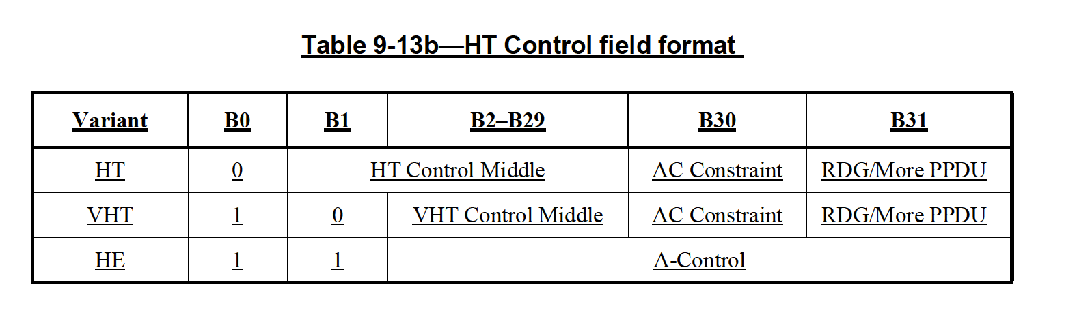
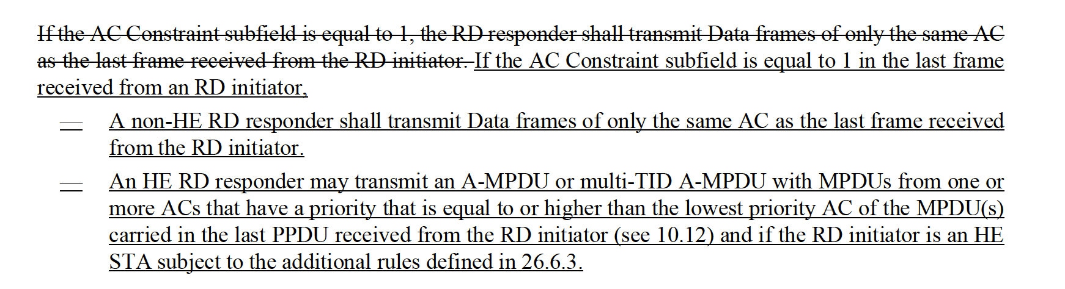
RD Encoding within the HT Control Field

Slide 35
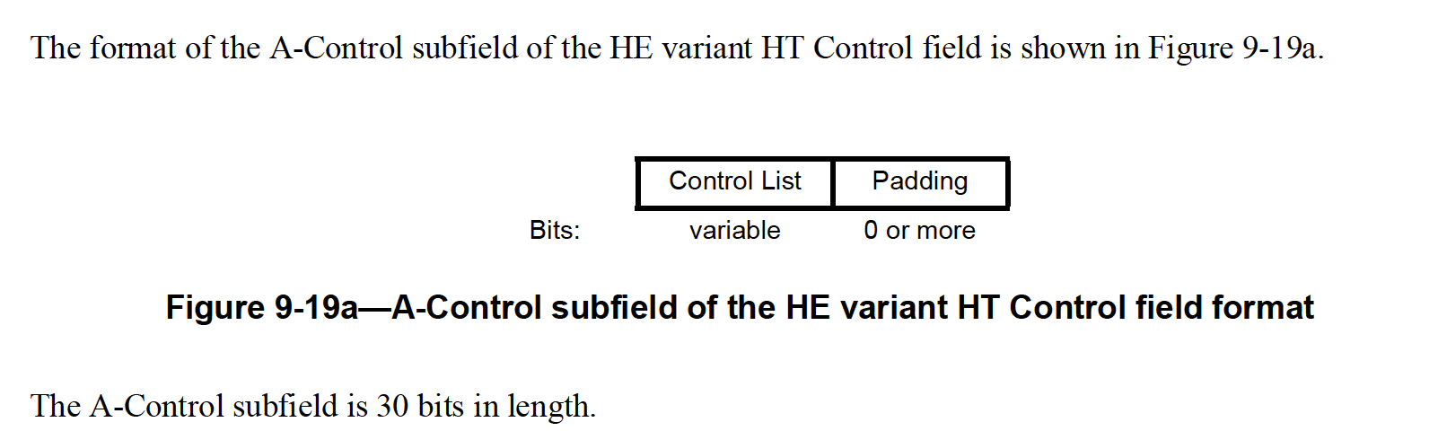
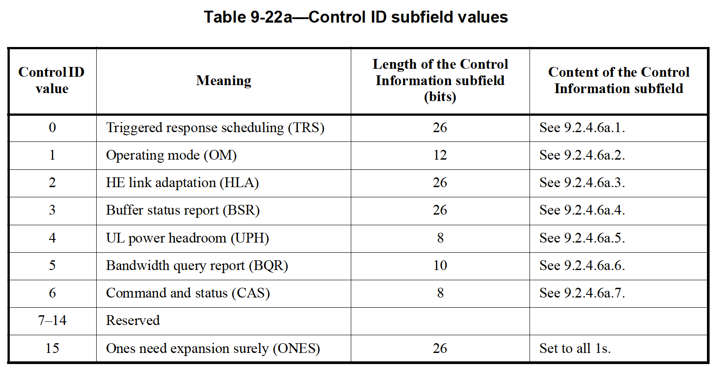
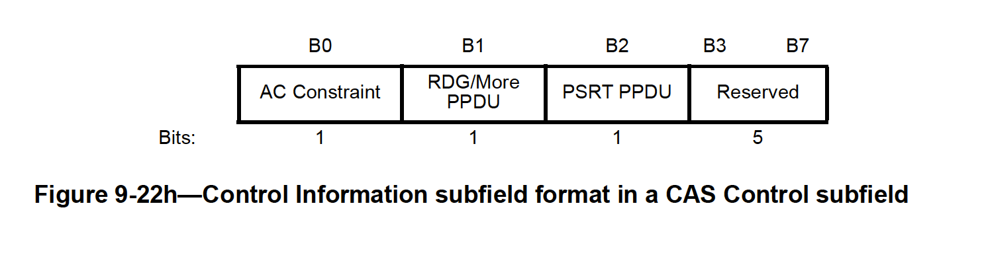
RD Encoding within the HT Control Field

