Slide 1
On the Scalability and Overhead of Utilizing Polling for Soliciting
STA’s Needs for Uplink Low-Latency Transmission
Date: November 8th, 2024
Authors:

Slide 2
Introduction
UHR aims to provide more predictable delays and reduce tail latency
For aperiodic low-latency (LL) traffic, the AP must have up-to-date information regarding the current needs of STAs to effectively allocate communication resources
The AP can utilize polling mechanisms to actively request Buffer Status Reports (BSRs) from STAs
In this contribution, we study the overhead of polling STAs based on BSRP and BSR frames
We show the impact of the number of STAs, available bandwidth and MCS on polling overhead

Slide 3
Introduction
A sample application of using polling is during TXOPs
  If the TXOP holder is the AP, it can use a portion of its acquired TXOP to poll non-AP STAs about their needs to send UL LL traffic
  If the TXOP holder is a non-AP STA, it may share a portion of its TXOP with the AP to send DL LL traffic or poll non-AP STAs about their needs for sending UL LL traffic
Sample methods have been proposed in [11-24/0390r0] [11-24/0870r0] [11-24/629r0] [11-23/1886r3] [11-24/0168r0] [11-23/1874r0]

Slide 4
An Example Method of LL Traffic Exchange during TXOPs
In the above figure:
  Transmission Period refers to the durations where the TXOP holder oversees the TXOP and communicates with the responder(s) (e.g., a non-AP STA transmits frames to the AP)
  LL Traffic Exchange refers to a period during which the AP can use the TXOP to perform LL traffic exchange with non-AP STAs
Polling Process
  To assess the need for UL traffic exchange, the AP can poll STAs
  The AP sends BSRP, and in response, the STAs respond with BSR frames
TXOP Duration
Transmission Period
LL Traffic Exchange
Transmission Period
Non-AP STA_{X} is the TXOP holder and communicates with the AP
TXOP shared with the AP to perform LL traffic exchange
Non-AP STA_{X} is the TXOP holder and communicates with the AP

Slide 5
The AP polls three STAs, two of which report LL traffic
The AP schedules UL traffic from these two STAs
The main purpose of this contribution is to study the overhead (duration) of the polling process
Polling Duration
AP polls STAs
AP sends a TF to schedule UL traffic from STA 3 and STA 4
BSRP
TF
AP
STA 1
TXOP Holder
Transmission Period
LL Traffic Exchange
STA 2
BSR
STA 3
BSR
DATA
These two STAs have LL data to send
STA 4
BSR
DATA

Slide 6
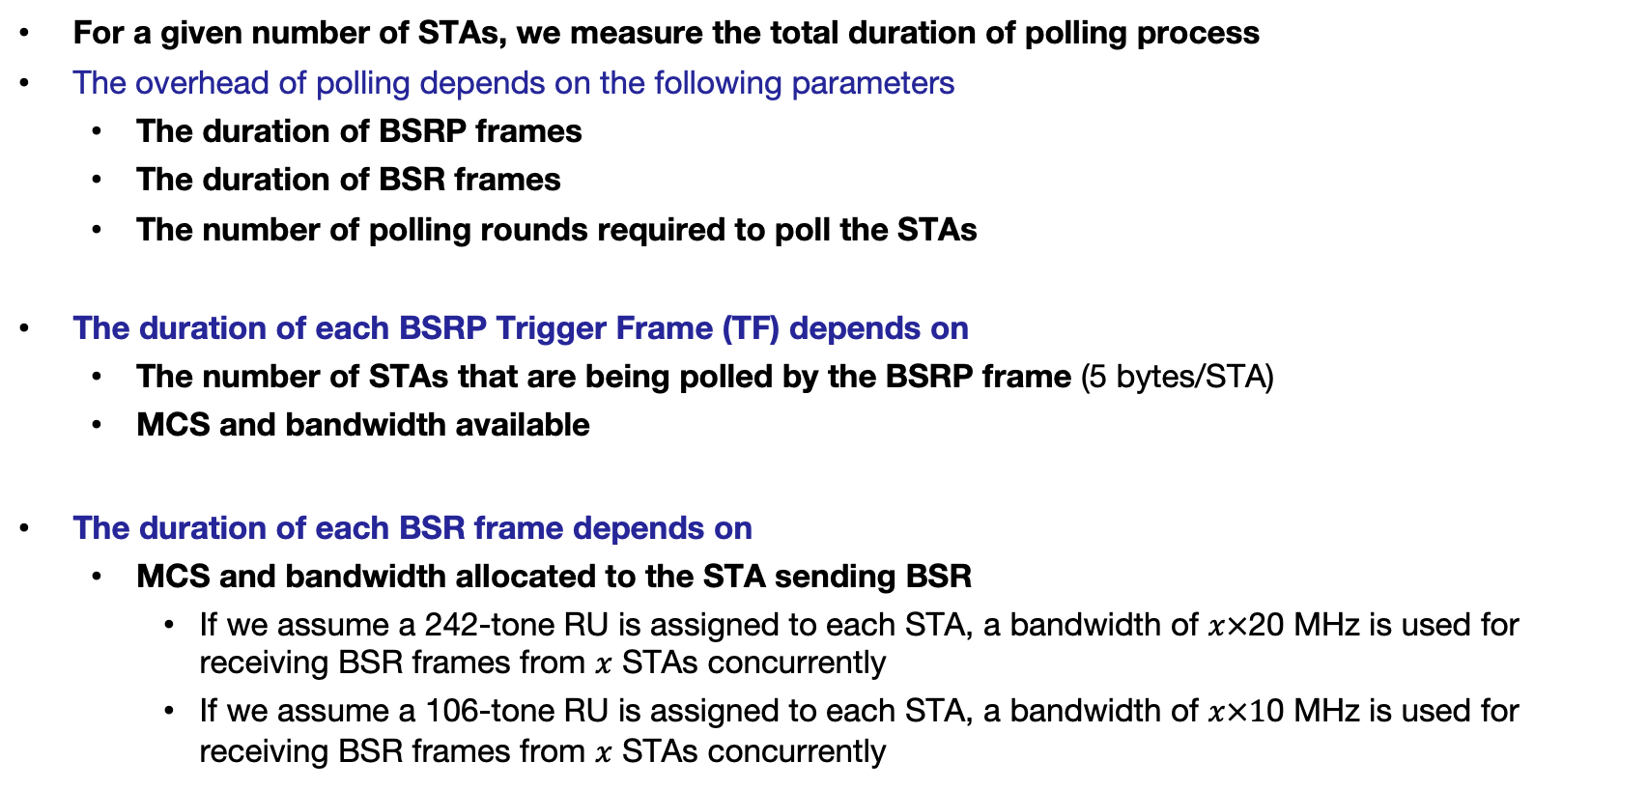
Polling Duration
For a given number of STAs, we measure the total duration of polling process
The overhead of polling depends on the following parameters
  The duration of BSRP frames
  The duration of BSR frames
  The number of polling rounds required to poll the STAs
The duration of each BSRP Trigger Frame (TF) depends on
  The number of STAs that are being polled by the BSRP frame (5 bytes/STA)
  MCS and bandwidth available
The duration of each BSR frame depends on
  MCS and bandwidth allocated to the STA sending BSR
    If we assume a 242-tone RU is assigned to each STA, a bandwidth of $x×$20 MHz is used for receiving BSR frames from $x$ STAs concurrently
    If we assume a 106-tone RU is assigned to each STA, a bandwidth of $x×1$0 MHz is used for receiving BSR frames from $x$ STAs concurrently

Slide 7
In the following example, the TXOP holder is not the AP
  During the LL Traffic Exchange duration, the TXOP holder allows the AP to perform STA polling
Assume up to four STAs can be polled concurrently by each BSRP frame
  One polling round is enough to poll the four STAs
The BSRP frame allocates resources to STAs 2, 3, 4, and 5 to reply back
Polling Duration
One polling round
AP
BSRP
TF
LL Traffic Exchange
STA 1
TXOP Holder
Transmission Period
STA 2
BSR
STA 3
BSR
DATA
STA 4
BSR
DATA
STA 5
BSR
DATA

Slide 8
Six STAs are polled by the AP, where four STAs can be polled concurrently by each BSRP frame
Two polling rounds are required to poll the six STAs
Note: since the second BSRP allocates resources to a lesser number of STAs than the first one, the size of the second one is smaller
This BSRP frame allocates resources to STAs 6 and 7 to reply back
Second polling round
This BSRP frame allocates resources to STAs 2, 3, 4, and 5 to reply back
First polling round
AP
BSRP
BSRP
TF
LL Traffic Exchange
STA 1
TXOP Holder
Transmission Period
Transmission Period
STA 2
BSR
STA 3
BSR
DATA
STA 4
BSR
DATA
STA 5
BSR
DATA
STA 6
BSR
DATA
STA 7
BSR
DATA
Polling Duration

Slide 9

Evaluation: How long it takes to poll a certain number of STAs?
When presenting results, we show two horizontal lines
  Red line: 300 $μs$ (10% of a 3 $ms$ TXOP)
  Blue line: 800 $μs$ (10% of an 8 $ms$ TXOP)
If the available bandwidth is 40 MHz, STAs cannot be polled within a reasonable time frame
If the available bandwidth is 160 MHz, polling 20 STAs takes about 200 us and up to 35 STAs can be polled in under 300 μs
Using smaller RUs, more STAs can be polled concurrently and the overhead BSRP frames drops

Slide 10
Summary
For aperiodic and LL traffic, the AP needs to have up-to-date information about the demands of STAs
  The AP may rely on polling to solicit BSRs
The number of STAs that can be polled concurrently depends on the available bandwidth
When smaller RUs are assigned to STAs to report their BSR, a greater number of STAs can be polled concurrently, but the duration of each BSR frame increases
The overhead of polling may be unacceptable, especially when the available bandwidth for polling is less than 80 MHz
Therefore, to identify STAs that need to transmit UL LL traffic, depending on the number of STAs and available bandwidth, more efficient polling and/or random-access methods may be required

Slide 11
Straw Poll
Do you agree that 11bn should introduce new mechanisms to enhance the efficiency of polling STAs or identifying LL STAs?
Yes/No/Abstain

Slide 12
Appendix A
BSRP and BSR Frames

Slide 13
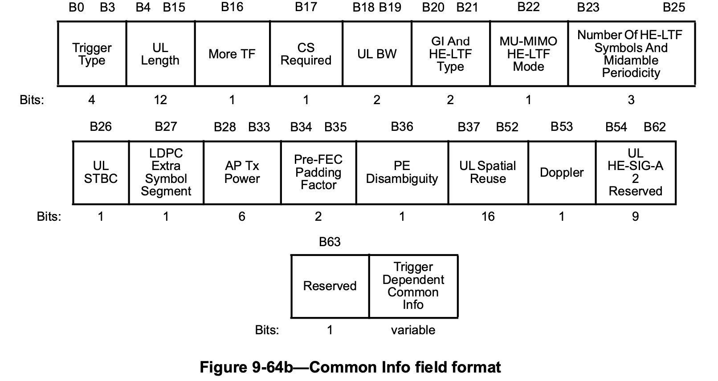
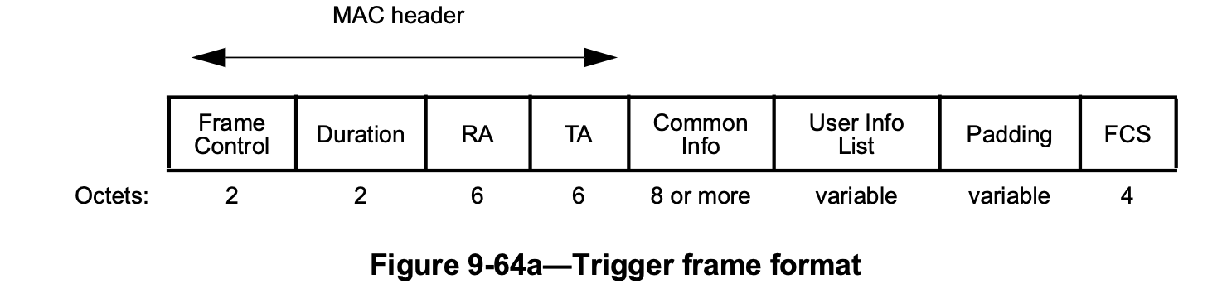
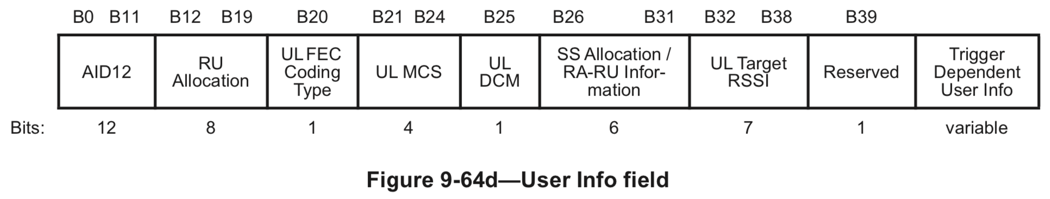
Overhead of Buffer Status Report Poll (BSRP) Frame
Buffer Status Report Poll (BSRP): This Trigger Frame (TF) allows the AP to poll STAs
  The minimum size of the ‘Common Info’ field is 8 bytes
  The ‘User Info List’ size depends on the number of users being polled: 5 bytes per user

Slide 14

Overhead of Buffer Status Report Poll (BSRP) Frame
Total BSRP Frame = PHY Header + MAC Header + Common Info + User Info List + FCS
= PHY header + 16 bytes + 8 bytes + 5 bytes x (#users) + 4 bytes
The duration of BSRP frame when polling $N$ STAs: PHY duration $+ \frac{(16+8+5×N+4)×8}{R}$
Assuming R = 8.6 Mbps, the total airtime for polling one STA is
  PHY Header Duration + MPDU = 40 µs + 30.69 µs ≈ 70.69 µs
  Additional assumption
    A single PHY stream
    The PHY header includes legacy fields

Slide 15
Overhead of Buffer Status Report (BSR) Frame
Buffer Status Report (BSR): Included in QoS Data frames, QoS Null frames, and/or Management frames
For BSR frames, we assume
  MAC header carries two addresses
  BSR is included in the A-Control subfield (A-Control is included in the HT-Control field)
    QoS Control field is not needed
Total NDP/BSR Frame Size = PHY Header + MAC Header + HT Control Field + FCS
= PHY header + 18 bytes + 4 bytes + 4 bytes
= PHY header + 26 bytes
Assuming a data rate of R = 8.6 Mbps (802.11ax, MCS 0, BPSK ½, 20 MHz, 0.8 us GI)
Total airtime of one BSR frame:
  PHY Header Duration + MPDU= 40 µs + 24.18 µs ≈ 64.18 µs
  Additional assumption
    A single PHY stream
    The PHY header includes legacy fields

Slide 16
Appendix B
Additional Results

Slide 17
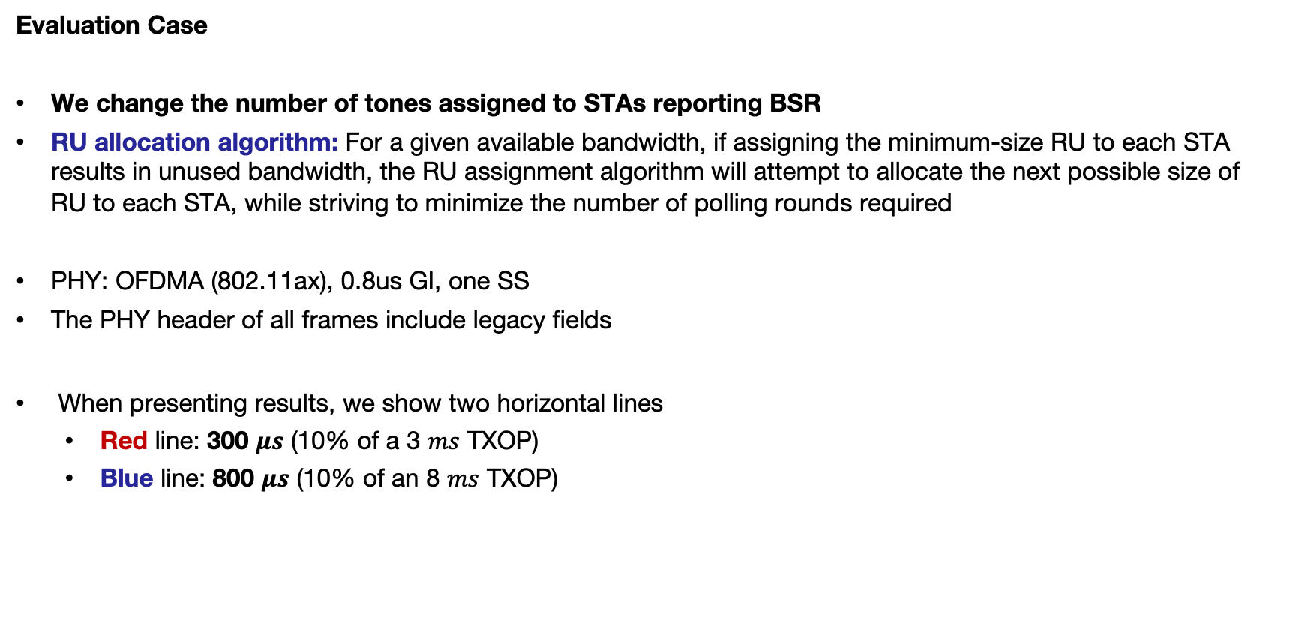
Evaluation Case
We change the number of tones assigned to STAs reporting BSR
RU allocation algorithm: For a given available bandwidth, if assigning the minimum-size RU to each STA results in unused bandwidth, the RU assignment algorithm will attempt to allocate the next possible size of RU to each STA, while striving to minimize the number of polling rounds required
PHY: OFDMA (802.11ax), 0.8us GI, one SS
The PHY header of all frames include legacy fields
When presenting results, we show two horizontal lines
  Red line: 300 $μs$ (10% of a 3 $ms$ TXOP)
  Blue line: 800 $μs$ (10% of an 8 $ms$ TXOP)

