Slide 1
Performance Benefits of DSO
Date: 2024-11-10
Authors:
Name | Affiliations | Address | Email
Kerstin Johnsson | Nokia Tech | 520 Almanor Ave, Sunnyvale, CA 94085 | Kerstin.Johnsson@nokia.com
Klaus Doppler
Salvatore Talrico
Behnam Dezfouli
Juhyung Lee
Prabodh Varshney
Okan Mutgan
Mikhail Liubogoshchev
Mika Kasslin
Mario Costa
Eda Genc
Notes:
November 2012

Slide 2
Overview
Problem statement
DSO definition
DSO and NPCA synergy
DSO performance benefits
Straw poll

Slide 3
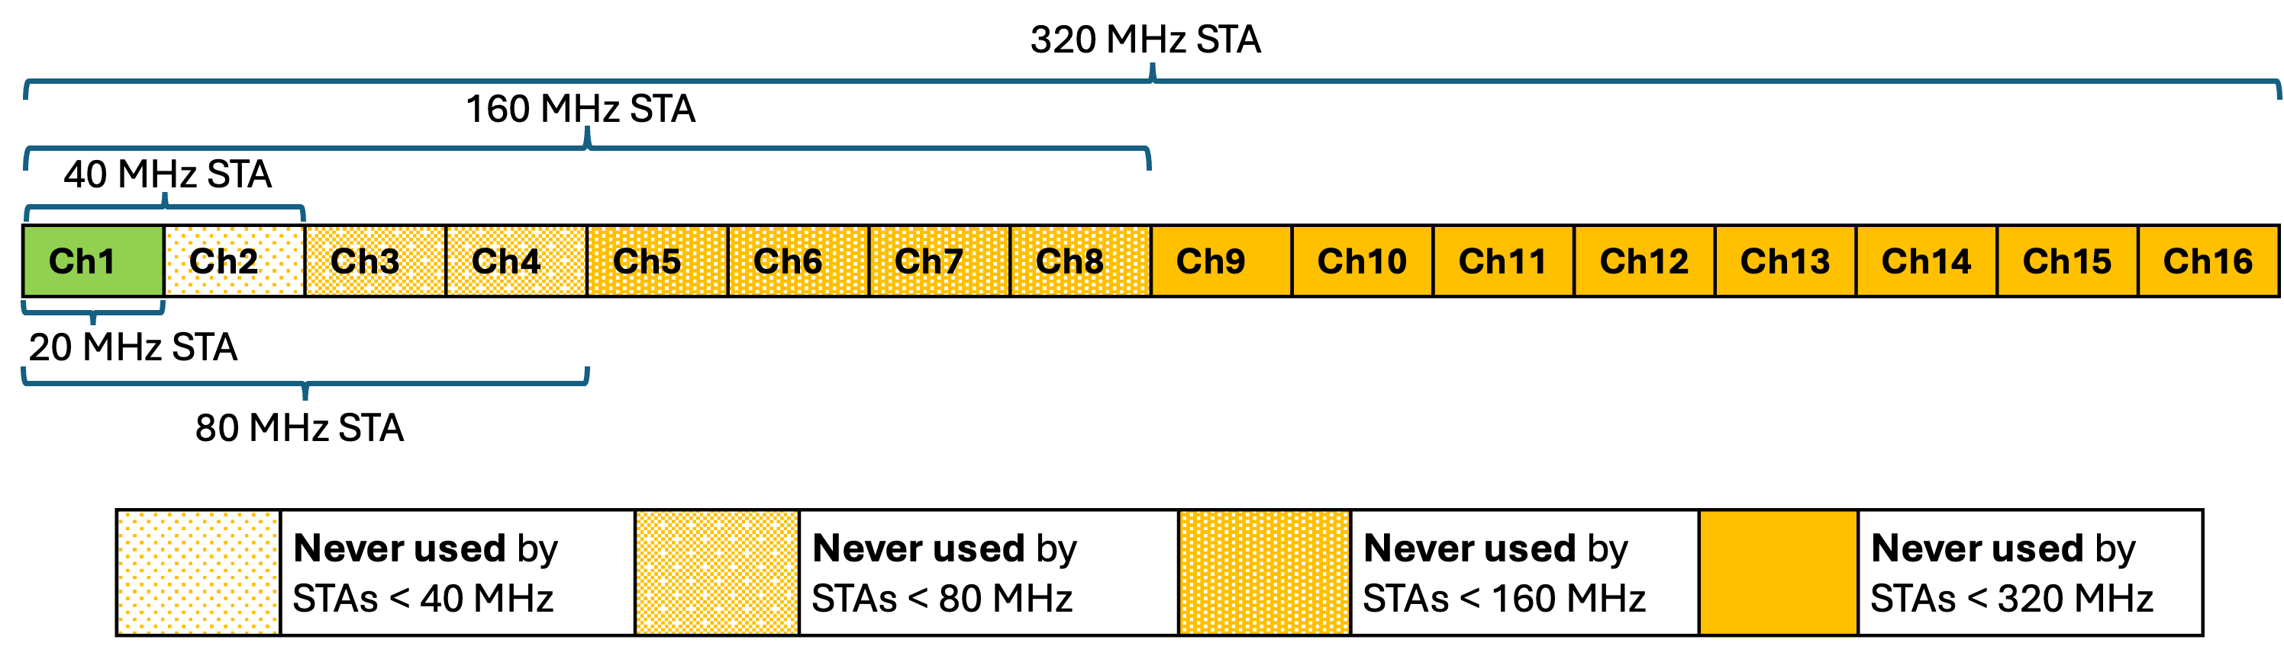
Problem Statement
802.11be supports up to 320MHz operating bandwidth
However, some non-AP STAs may only support operating bandwidths < 320 MHz (e.g., 160 MHz, 80 MHz, 20 MHz)
Since STA’s operating BW must include primary channel, BW mismatch between AP and associated non-AP STAs can result in large parts of BSS operating BW going unused in BSS (see figure)

Slide 4
Dynamic Sub-band Operation (DSO)
DSO enables an AP to allocate any available part of its operating bandwidth to associated non-AP STAs
DSO has already been proposed in many contributions:
  2204 and 0843r1 from SG
  1496, 2027r2, 2141r3, 0517, 0783r1, 0949r1, 1244, 1474, 1553, 1564r2, 1587r1, and 1588r1 from TG
Contributions generally cover one/both of the following:
  Pre-negotiation between AP and its associated non-AP STAs of DSO capabilities (turn on/off DSO, sub-bands available for DSO, switching time per sub-band, etc.)
  DSO trigger (either in a standalone control frame or enabled via existing control frames like MU-RTS/BSRP) along w/ required contents/changes to said frames
Proposed spec impacts are minimal, while perf gains can be substantial (see slide 6)

Slide 5
Synergy with NPCA
Non-primary channel access (NPCA) has already been adopted in SFD
DSO and NPCA are similar in that they enable AP/non-AP STAs to use other parts of BSS operating BW
Together, they address two major limitations on Wi-Fi performance:
  Inability to use BSS operating BW when primary channel is busy
  Inability to use BSS operating BW when non-AP STAs have limited operating BW
NPCA allows AP/non-AP STAs to temporarily move their primary channel to a different location in the BSS’s operating BW when the primary channel is busy
DSO is simpler (as primary channel still available to manage procedure) and requires far fewer changes to standard
Both are needed to maximize Wi-Fi throughput and minimize latencies

Slide 6
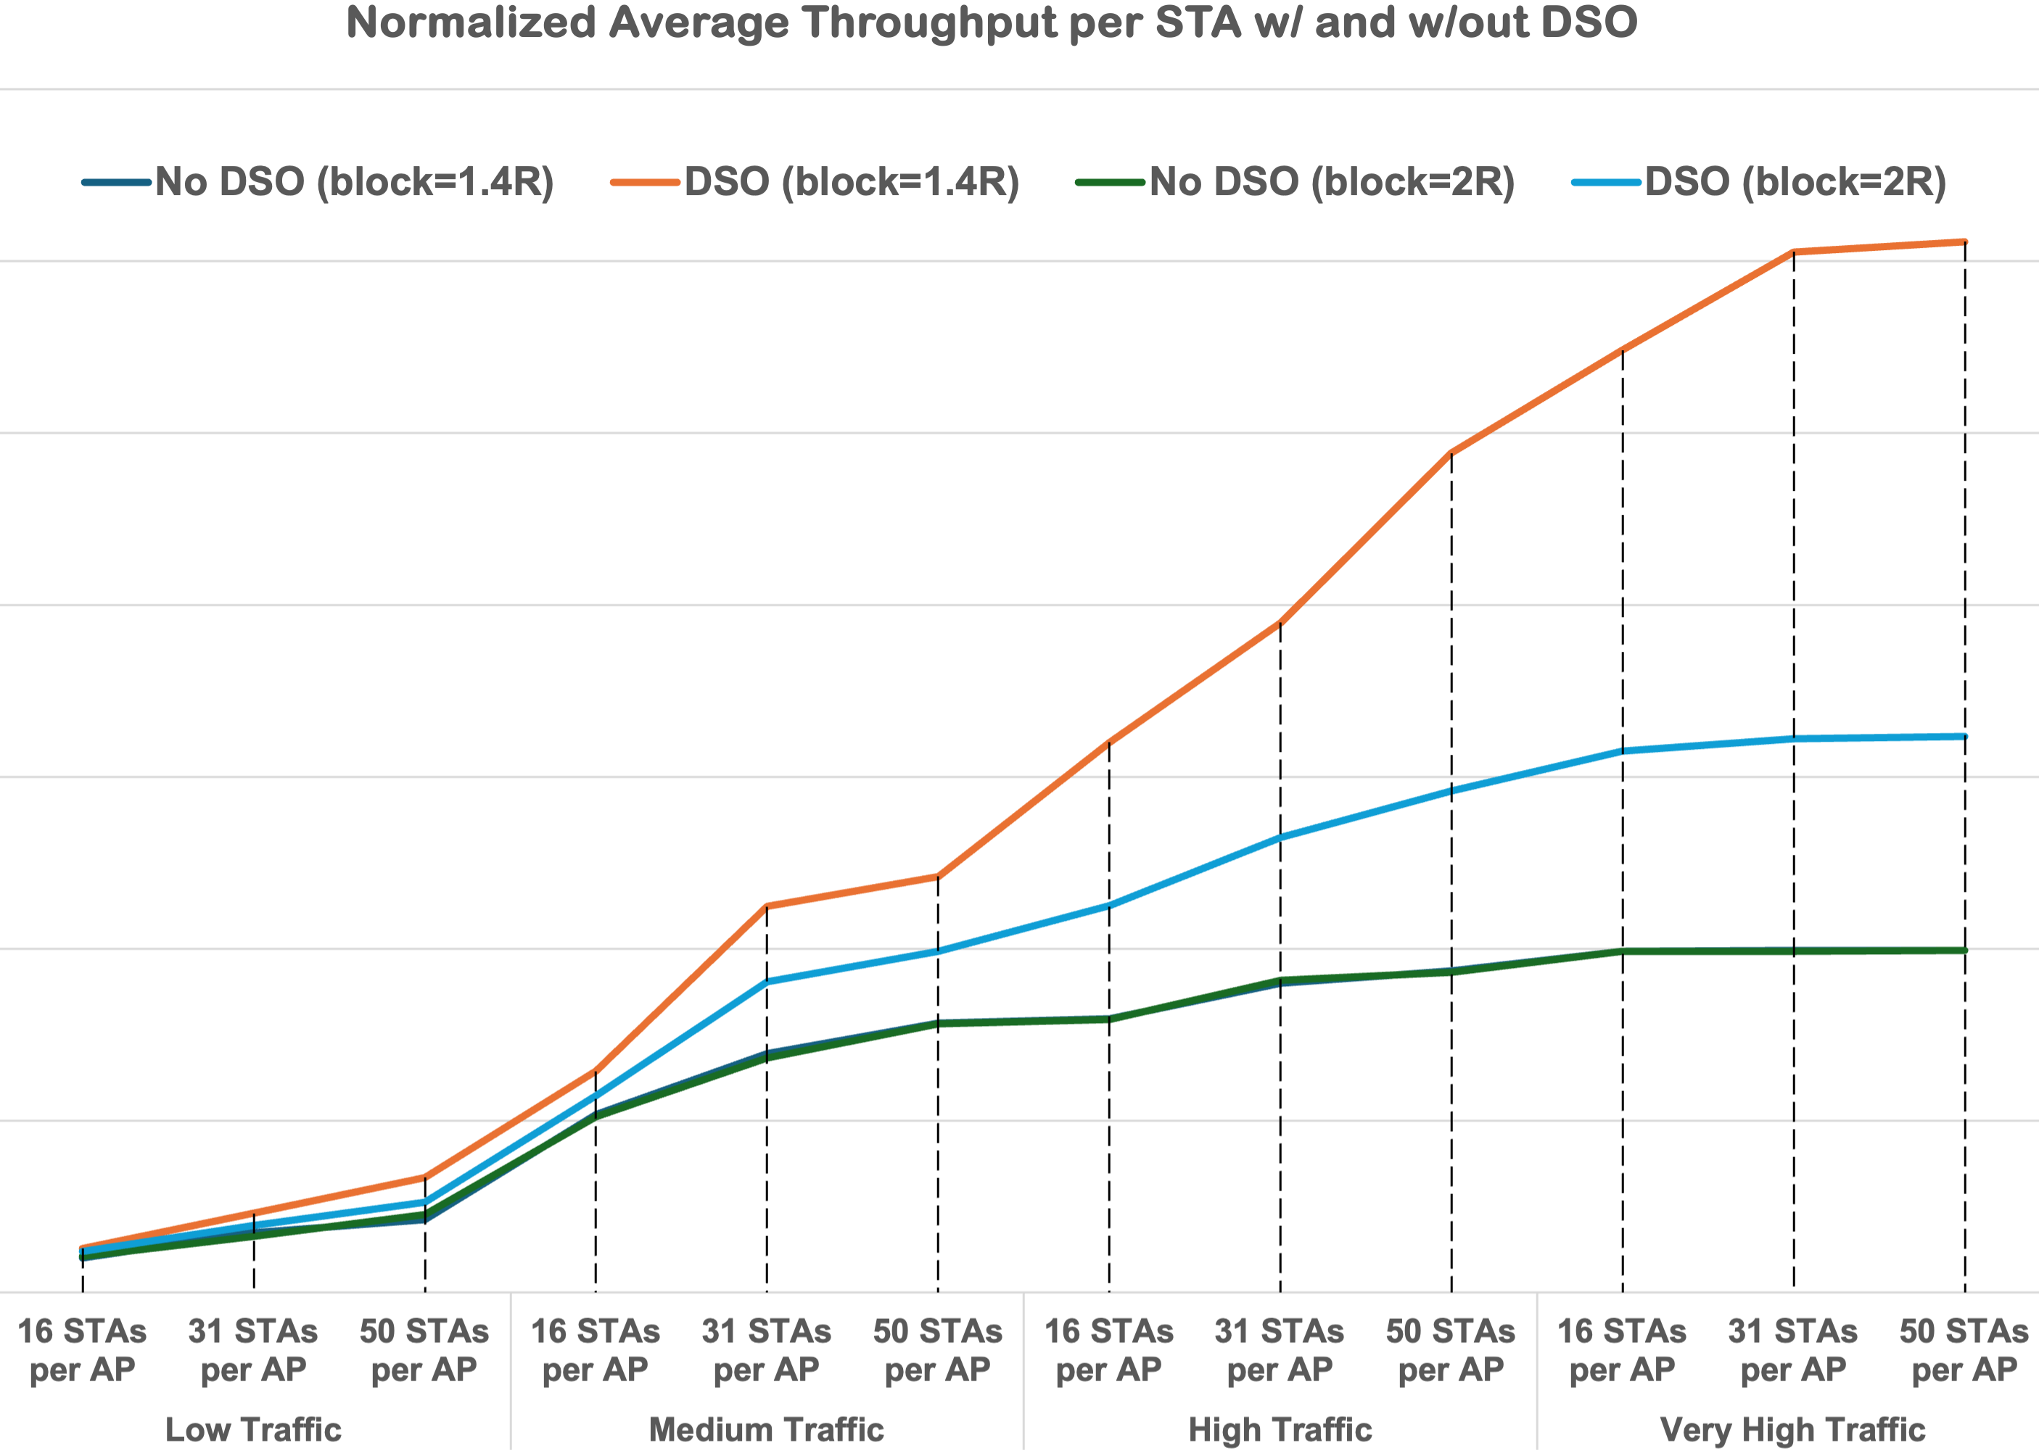
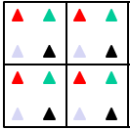
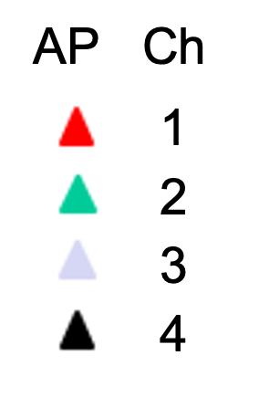
DSO performance benefits
Statistical model of Wi-Fi
4x4 BSS Wi-Fi deployment
160 MHz APs, 40 MHz STAs
Reuse 4, i.e., in cluster of 4 APs, each is assigned diff 40 MHz from 160 MHz BW
Without DSO, AP/STA must use assigned 40 MHz if/when available
With DSO, AP/STA can use any available part of 160 MHz; when non-primary 40MHz used, TXOP reduced by 1/5 to account for switch time
STAs per AP = [16, 31, 50]
Avg UL/DL traffic per STA = [low, med, high, very high]
Blocking range = [1.4R, 2R], where APs are 2R distance apart
3x
1.6x
➢ DSO gains increase w/traffic load, reaching ~1.5x-3x throughput gain over baseline depending on blocking range

Slide 7
Straw Poll 1
As part of 802.11bn, do you agree that it would be beneficial to enable an AP to dynamically assign any part of its operating bandwidth to its associated non-AP STAs regardless of their operating bandwidths?
Y/N/A

Slide 8
Appendix

Slide 9
Related Straw Polls (1 of 3)
2204r0 (Sindhu Verna, Broadcom)
Do you agree to define Dynamic Subband Operation (DSO) in UHR where narrower bandwidth capable non-APs can dynamically on a per-TXOP basis, be allocated resources outside of their current operating bandwidth within the larger bandwidth of an AP?
0843r1 (Liuming Lu, OPPO)
Do you support to specify dynamic subband/subchannel operation(DSO) as a mode of operation and a mechanism for the flexible management of DSO mode in UHR?
2027r2 (Vishnu Ratnam, Samsung)
Do you agree to allow DSO Sub-band Switch initial control frame to address DSO STAs that are served much later in a TXOP without soliciting ACK/CTS from them?
Do you agree to allow an AP to use a follow-up frame to the DSO Sub-band Switch initial control frame to reserve the medium for the time required for the DSO Sub-band switch?
2141r3 (Sindhu Verma, Broadcom)
Do you agree to define a mechanism where narrower bandwidth non-APs can dynamically, on a per-TXOP basis, be allocated resources outside of their current operating bandwidth within the larger bandwidth of an AP?
517r0 (Vishnu Ratnam, Samsung)
Do you agree to allow DSO Sub-band Switch initial control frame to provide sub-band indication for any DSO STA scheduled to be served within the TXOP?
Do you agree to allow DSO Sub-band Switch initial control frame to indicate to an addressed DSO STA, if a response is solicited from the STA?
0783r1 (Chaoming Luo, OPPO)
Do you agree that an UHR non-AP STA may solicit dynamic sub-band transmission during the associated AP’s TXOP?
Do you agree that an UHR non-AP STA may indicate dynamic sub-band transmission during its TXOP?
0949r1 (Seongho Byeon, Samsung)
Do you support to define a mechanism in 11bn, enabling resource allocations to non-AP STAs beyond their current operational bandwidth and within the associated AP's BSS bandwidth on a per Broadcast TWT Service Period basis?

Slide 10
Related Straw Polls (2 of 3)
1244r0 (Ross Jian Yu, Huawei)
Do you agree to include the following into the 11bn SFD? 11bn supports subchannel selective transmission for secondary 160 MHz channel.
Do you agree to include the following into the 11bn SFD? 11bn supports subchannel selective transmission when there exists static preamble puncturing. Dynamic preamble puncturing case is TBD
Do you agree to include the following into the 11bn SFD? 11bn defines frequency domain aggregation of a 160 MHz HE PPDU and 160 MHz UHR PPDU.
Do you agree to include the following into the 11bn SFD? 11bn defines frequency domain aggregation of an 80 MHz HE PPDU, 80 MHz HE PPDU and 160 MHz UHR PPDU.
1553r0 (Gaurang Naik, Qualcomm)
Do you support that in the DSO ICF, the AP indicates to a DSO STA to switch to a DSO sub-band
  Upon reception of the DSO ICF, the DSO STA shall
Transition to the DSO sub-band,
Transmit the response in the DSO sub-band a SIFS after the end of the DSO ICF
And receive frames or be triggered to transmit frames, subject to its spatial stream capabilities and operation mode, in the DSO sub-band (derived from the DSO ICF), a SIFS after the end of the response frame
Note: how the STA performs CS check before responding to DSO ICF is TBD
Do you agree that if no non-AP STA that is assigned resources in the primary 20 MHz responds to the initial Control frame and there is at least one response on other channels, the AP shall do one of the following:
Terminate the frame exchange sequence with all non-AP STAs, or
Continue the frame exchange sequence by ensuring that the primary 20 MHz is occupied
Whether there are other options is TBD
1564r2 (Liwen Chu, NXP)
Do you agree that to allocate resources to a DSO STA in a DSO sub-band, the AP shall initiate the frame exchange sequence with a DSO initial Control frame (ICF)?
The BSRP Trigger frame shall be a DSO ICF
Whether MU-RTS TF is a DSO ICF or not is TBD
the DSO sub-band is indicated with the RU allocation field and whether we have additional signaling indicating that it is DSO TxOP or not is TBD

Slide 11
Related Straw Polls (3 of 3)
1244r0 (Ross Jian Yu, Huawei)
Do you support that
  DSO STAs shall have operating bandwidth of 80MHz or above
  Secondary 80MHz in 160MHz BSS can be a DSO subband
  Secondary 160MHz in 320MHz BSS can be a DSO subband
  one default 80MHz subband in 320MHz BSS can be a DSO subband
  Whether allow one or more 80MHz subband in 320MHz BSS is TBD
  Only UHR STAs are involved in DSO ICF/ICR frame exchange and PPDU transmissions that follows it.
Do you agree that an AP shall initiate a DSO initial Control frame (ICF) to allocate resources to a DSO STA in a DSO subband?
BSRP trigger frame shall be a DSO ICF for DL/UL DSO TXOP.
Whether MU-RTS trigger frame is a DSO ICF is TBD
RU allocation field in ICF indicates the resource allocation for ICR within the DSO subband
Whether an explicit indication to a DSO STA to determine DSO operation is TBD
Do you agree that an AP, that supports transmitting intermediate FCS, shall include an intermediate FCS in initial control frame to initiate a DSO TXOP, if needed by at least one scheduled DSO STA?
Whether mandatory or optional support for transmitting intermediate FCS is TBD.
Note: intermediate FCS may not be needed, if no DSO STAs scheduled in the DSO TXOP requires padding. It is TBD whether an intermediate FCS can be avoided if a MIC is present
1588r0 (Sindhu Verma, Broadcom)
Do you agree that:
Only 80MHz UHR STAs and 160MHz UHR STAs can be DSO STAs
The DSO ICF-ICR exchange and the PPDUs that follows it shall only be between UHR STAs
One 80MHz subband in 320MHz BSS can be a DSO subband
Whether more than one 80MHz subband can be a DSO subband in 320MHz BSS is TBD
Secondary 80MHz in 160MHz BSS can be a DSO subband
Secondary 160MHz in 320MHz BSS can be a DSO subband

