Slide 1
Discussion on Link Adaptation Aspects of ELR Transmissions
Date: 2025-01-13
Authors:

Slide 2
Abstract
Enhanced Long Range PPDU is one of the new features in 802.11bn [1-5].
An ELR PPDU will be helpful in reducing the downlink/uplink range asymmetry problem in current Wi-Fi.
Several contributions have shown +6 dB link improvements due to combinations of time and frequency domain duplications and power boosting.
However, as ELR PPDU have very low data rate, network throughput may suffer when ELR PPDUs are not used efficiently.

Slide 3
ELR PPDU
ELR Transmissions have a much farther range compared to non-ELR transmissions. However, this may impact the performance of the network. Ideally, STAs should only use ELR PPDUs when needed to not prevent OBSS STAs that detects the ELR PPDUs to transmit.
ELR PPDU range
Non-ELR PPDU range
STA 1
AP 1
STA 2

Slide 4
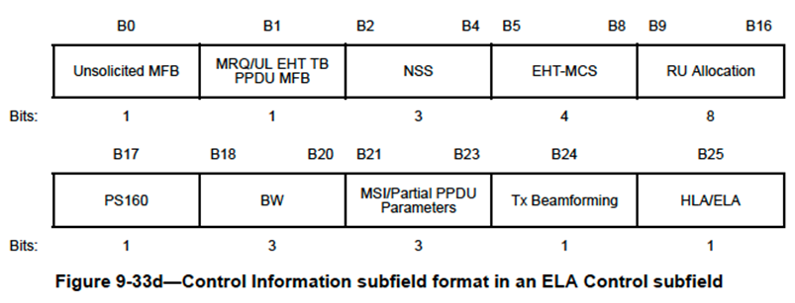
ELR MCS Recommendation using UHR Link Adaptation
In baseline operation, it is up to the transmitter what PPDU format or MCS it uses based on the capability of the receiver.
Some guidance from the receiver is helpful for the transmitter to know whether ELR PPDU is recommended or not. For example, an ELR STA receiving an MCS feedback indicating a data rate of >= 6 Mbps can interpret it as a signal to use non-ELR PPDUs. Another way is to have an explicit indication whether ELR or non-ELR PPDUs is recommended.

Slide 5
ELR PPDU Disable
A non-AP STA may use ELR PPDU even when it is not necessary (or no longer necessary). For example
  The STA was previously out of range of non-ELR PPDU but has moved within range of non-ELR PPDU.
  Link adaptation algorithm of the STA uses ELR PPDUs after a series of failed transmissions (e.g. due to interference)
Hence, a way to disable transmission of an ELR PPDU for specific STAs may be necessary.
Note: In 802.11ax, an AP can disable its reception of an HE ER SU PPDU using the HE Operation element. We can employ a similar mechanism to disable ELR PPDU for a specific STA.

Slide 6
Conclusion
In this contribution, we discussed aspects of ELR transmissions related to link adaptation.
By providing receiver feedback whether ELR PPDUs are recommended or not, we can prevent a STA from occupying the channel for a long time.
Feedback whether to use ELR PPDU or not may be provided via the UHR link adaptation mechanism. Alternatively, the AP may disable use of ELR PPDU for specific STAs.

Slide 7
Strawpoll
Do you support adding in the SFD,
11bn defines a mechanism for an AP STA to provide feedback to a non-AP STA when to use or not to use an ELR PPDU.
Y
N
A

Slide 8
References
https://mentor.ieee.org/802.11/dcn/24/11-24-0921-00-00bn-an-enhanced-long-range-ppdu.pptx
https://mentor.ieee.org/802.11/dcn/24/11-24-0873-00-00bn-design-targets-and-considerations-for-enhanced-long-range.pptx
https://mentor.ieee.org/802.11/dcn/24/11-24-0875-01-00bn-uhr-enhanced-long-range-support.pptx
https://mentor.ieee.org/802.11/dcn/24/11-24-1478-02-00bn-elr-ppdu-design.pptx
https://mentor.ieee.org/802.11/dcn/24/11-24-1573-00-00bn-an-elr-ppdu-follow-up.pptx
https://mentor.ieee.org/802.11/dcn/24/11-24-1488-00-00bn-elr-ppdu-transmission-design.pptx

