Slide 1
Passpoint & OpenRoamingTM for Automotive Connectivity
IEEE 802 Plenary, November 2024
Date: 2024-11-11
Author:

Slide 2
Abstract
Passpoint and OpenRoaming for Automotive Connectivity
It overviews the current issues and solutions for public Wi-Fi connectivity and provides details on how Passpoint and OpenRoaming can help with automotive connectivity.

Slide 3
Outline
Opportunities with public Wi-Fi networks
Challenges with public Wi-Fi connection
Standards work
Passpoint
  what it is,
  how it works
  how it helps with automotive connectivity
OpenRoaming –
  what it is,
  how it work and
  how it helps with automotive connectivity Federation
Q&A

Slide 4
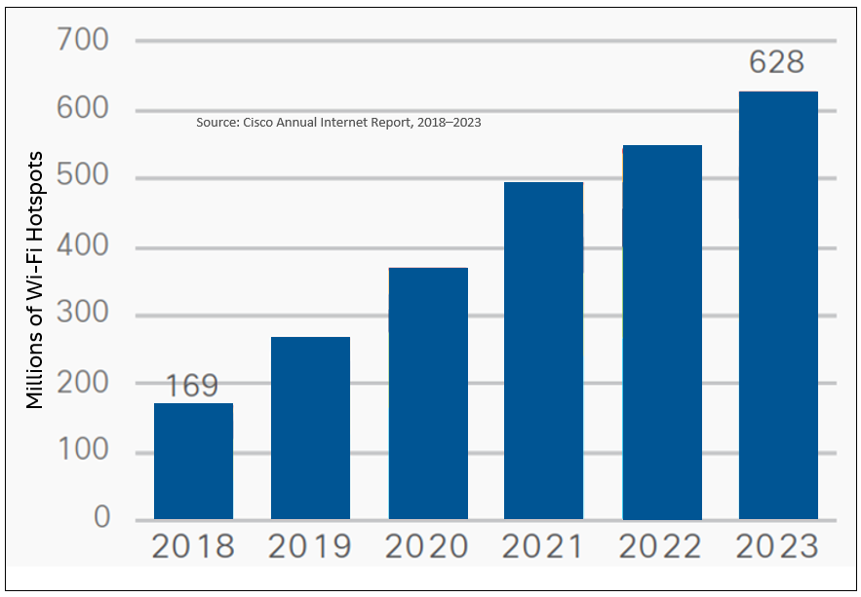
Opportunity: Global Wi-Fi Hotspots
Hundreds of millions of public Wi-Fi networks to connect to around the world
Notes:
Public Wi-Fi Networks are everywhere coffee shops, hotels, trains….. Wi-Fi use is growing fast.

Slide 5
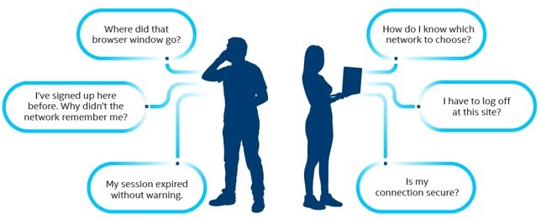
Friction at Public Wi-Fi Connections
Click on Wi-Fi icon
Figure out the SSID
Launch a web browser
Accepts terms and conditions
Enter credentials - if any
How will my email to be used?
Security!!!!
Not connecting!

Slide 6
Standards Work
IEEE 802.11u – Interworking with External Networks (2004-2011)
Defined pre-associated network discovery capabilities
Generic Advertisement Service (GAS)frames
Access Network Query Protocol (ANQP)
Roaming Consortium (RCOI)element
NAI Realm
Venue type
Access Network type
Others…
Wi-Fi Alliance® (WFA)
Hotspot 2.0/Passpoint – based on IEEE 802.11u – started the work in 2010
Launched in 2012
Wireless Broadband Alliance (WBA)
Next Generation Hotspots with Passpoint + Wireless Roaming Intermediary eXchange (WRIX) framework
OpenRoaming

Slide 7
Passpoint®

Slide 8
Wi-Fi CERTIFIED Passpoint®
Developed by Wi-Fi Alliance - based on IEEE 802.11u. Also known as Hotspot 2.0 technology
Enables seamless, secure and automatic public Wi-Fi networks connection
Network advertises its support for Passpoint and what credentials it accepts
Mobile devices discover the network support and match their credentials and connect to the Passpoint networks automatically and securely - irrespective of the SSID.
Eliminates the need for users to find and authenticate a network each time they visit
More than 5 thousand Wi-Fi CERTIFIED Passpoint® devices and supported by all major OSes

Slide 9
Passpoint Releases and Key Features
Makes use of IEEE 802.11u, 802.1x, 802.11i and WPA2/WPA3™ and WFA defined mechanisms
Release 1 (2012):
  Network discovery and selection – 802.11u + Hotspot 2.0 ANQPs
  Roaming – decoupled service advertisement from the SSID and discover roaming partnership
  Enterprise level security 802.1x authentication and encryption
Release 2 (2016):
  Added Online Sign Up (OSU) – Deprecated in 2023
  Per Provider Subscription Managed Object (PPS MO) – supports operators to implement policies on STAs
Release 3 (2019):
  Single SSID for onboarding and actual connection
  Venue URL Information - Allows networks operators and venues to provide additional information to the user, such as venue maps, directories, promotions, and coupons.
  T&C acceptance is legally required in some locations and venues to provide network access

Slide 10
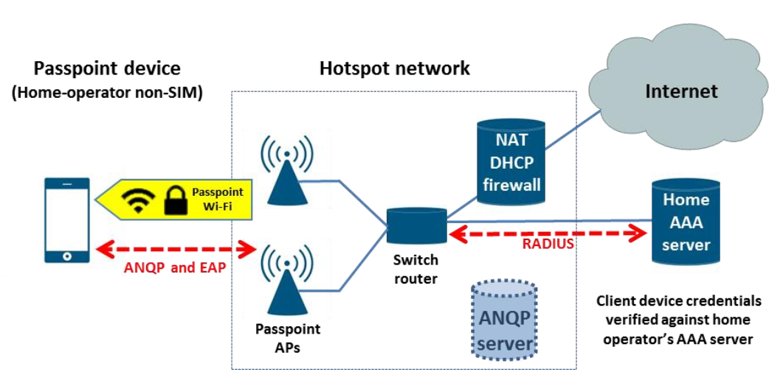
Passpoint Network Architecture with Home SP

Slide 11
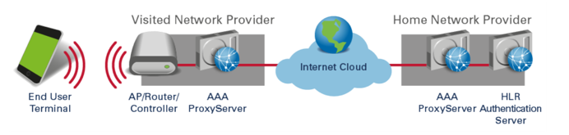
Passpoint with Visited Network and Roaming

Slide 12
Network Discovery & Selection
AP advertises Hotspot 2.0 support in beacons and probe responses
STA scans for Passpoint enabled networks and identifies them based on the AP support
STA discovers the network capabilities using ANQP in pre-associated state
STA matches the NAI realms or OIs received against its list of provisioned credentials or Per Provider Subscription Managed Object (PPS MO) to determine if it can access the network
If STA has credentials to connect to the network, it initiates association and secure 802.1x authentication process with AAA server automatically
Upon completion of authentication, STA connects the network securely

Slide 13
Access Network Query Protocol (ANQP) Elements
ANQP Elements | Description
NAI Realm ANQP-element | Identifies accessible NAI realms and their authentication methods.
Roaming Consortium ANQP-element | Identifies networks and service providers for roaming
Venue Name ANQP-element | Defines the venue group and venue type
NAI Home Realm | Discovers if network provides access for the STA specified NAI home realm
Network Authentication Type ANQP-element | Describes the authentication type used by the network
IP Address Type Availability ANQP-element | Informs clients about IP address versions and types available after association
3GPP Cellular Network ANQP-element: | Provides information for hotspots with cellular operator roaming relationships
Domain Name ANQP-element | Specifies the AP’s domain name
Venue URL ANQP-element | Provides venue URL for additional information about the network provider
HS Capability list | Provides list of identifiers of HS2.0 ANQP-elements supported by the network
Operator Friendly Name | Allows free-form text to identify the operator and location
Operating Class Indication | Lists the channels on which the hotspot can operate
Note: Some of these are defined in IEEE 802.11u, others were added by the Wi-Fi Alliance in Passpoint specification

Slide 14
Passpoint Supported Credential Types
Credential Type | EAP Method
Certificate | EAP TLS
SIM/USIM | EAP-SIM, EAP-AKA, EAP-AKA’
Username & Password with server-side certificates | EAP-TTLS with MS-CHAPv2

Slide 15
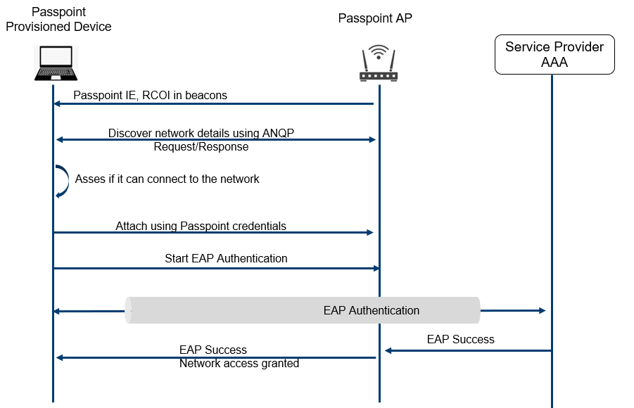
Passpoint Flow

Slide 16
Passpoint vs Legacy Networks
Features | Passpoint | Legacy
Automatic Connection | Yes – seamless, secure and automatic connection | No
Network Discovery | Yes – GAS/ANQP | No
Network Selection | Yes, NAI realm/Policy – decoupled from SSID | SSID based
Authentication | 802.1x – STA & network perform mutual authentication via EAP methods | Web-Auth/Pre-shared keys/Open
Encryption | WPA2/WPA3 | PSK/clear
Operator Policy | Yes – PPS MO | No
Roaming | Yes | No
Security Risks | No – Enterprise grade security | Honey pot/Evil Twins, Man In the Middle attack

Slide 17
OpenRoamingTM

Slide 18
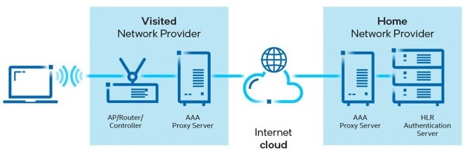
Why OpenRoaming
  Challenges with enabling global Wi-Fi roaming
    Bilateral roaming agreements are long and tedious process involving:
    Technical
    Business
    Financial
    Legal steps
    Millions of Wi-Fi hotspots available globally
    by different providers - operators, venues,
    public spaces, enterprises, cities and others
    Unlike cellular world, it is not easy to establish global Wi-Fi roaming
    network because of the fragmentation.

Slide 19

One Global Wi-Fi Network
An extension of Passpoint, takes the connected experience a step further
OpenRoamingTM is a federation of identity & access network providers to enable seamless roaming & onboarding
WBA OpenRoaming creates the framework to connect billions of users and things to millions of Wi-Fi networks globally

Slide 20

OpenRoaming: Creates a ubiquitous blanket of Wi-Fi coverage around the globe!
        Framework to interconnect Wi-Fi networks globally
        Addresses roaming issues
        Enables seamless and secure public Wi-Fi network connection
Slide 20
Necati Canpolat (Intel)

Slide 21
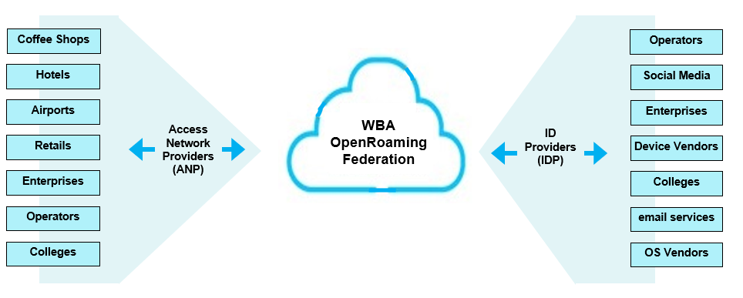
OpenRoaming Federation
WBA is acting as a centralized policy authority
many-to-many relationships
Slide 21
Notes:
OpenRoaming brings together a federation of networks and identity providers, allowing users to join any network managed by a federation member.

Slide 22
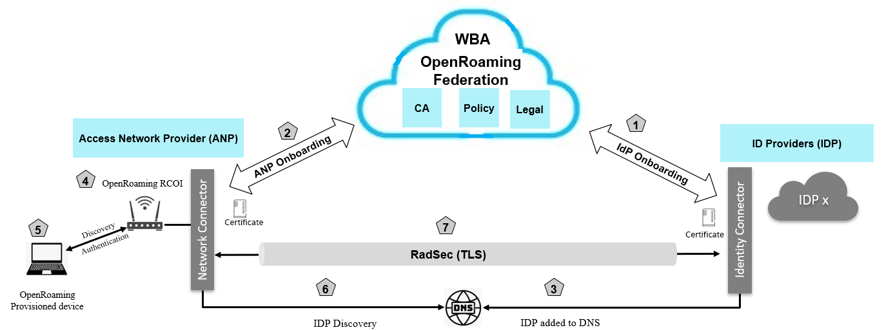
OpenRoaming – How it works?
Network Access:
  Device is provisioned with OpenRoaming profile
  ANP AP advertises “Federated Roaming RCOI in the beacon.
  Device discovers OpenRoaming network
  Device attaches ANP AP using OpenRoaming profile.
  ANP finds IDP in DNS
  Secure and authenticated tunnel establishment
Onboarding ANPs and IDPs:
  ANPs and IDPs registers with OpenRoaming Federation
  OpenRoaming Federation verifies them and issues certificates and WBAID
  IDPs are added to OpenRoaming DNS
Slide 22
Necati Canpolat (Intel)
Notes:
RadSec provides a means of securing the communication between two RADIUS peers.

Slide 23
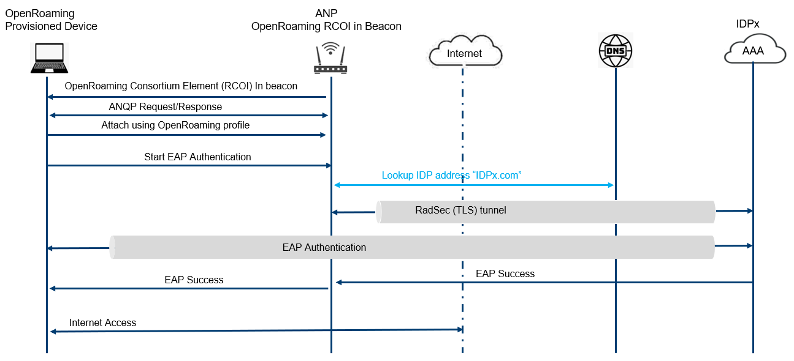
OpenRoaming Flow

Slide 24
OpenRoaming vs Passpoint
Features | OpenRoaming | Passpoint
Network configuration | Only one code needs to be configured on WLC or AP - the alphanumerical code of the federation – Roaming Consortium Organization Identifier (RCOI). | Each roaming partner (realms) needs to be configured at the WLC/APs. Each time there a change on the partners realm, it needs to be updated on all infrastructure. Not easy to scale.
SSID discovery & authentication | Fast network discovery and association using RCOI, fast ANQP “handshake”. | As the number of realms grow the latency to attach & re-attach to the network and authentication increases substantially.
End-to-end roaming | Easily connect to other networks, including airports, hotels, coffeeshops, cities, etc. At the commercial level, joining the federation to partner with all with the possibility of “blacklist” and at technical level interconnection interoperability is done automatically via RadSec dynamic tunnels. | Each roaming partner needs to have an individual negotiation for roaming agreement contracts and a specific technical implementation of interconnection-interoperability (IPsec VPN tunnels).
Future-proof deployment | If extending deployment to other IDPs, OR enables scalability at a marginal cost, compared with performing another 1 to 1 Passpoint deployment (operational cost saving) | Need to negotiate bilateral roaming agreements with hundreds or thousands of partners.
Policy for QoS & QoE | Policy implementation based on RCOIs, either for QoS or QoE, always having a fast handshake. | Policy can be done at realm level, meaning more realms configuration and latency for handshake will grow.
User Experience | Automatic Network Discovery and Selection | Automatic Network Discovery and Selection
Scalability | Highly scalable – single registration with many networks | Not scalable due roaming relationships challenges
Onboarding | Provision the device once for the OpenRoaming network in advance and use it globally for the global OpenRoaming network | Need to go thru provisioning process many times due to limited roaming coverages and not knowing the network in advance

Slide 25
IoT Devices Onboarding for OpenRoaming
Joint work between WBA and the FIDO Alliance to enable onboarding of IoT devices to OpenRoaming using FIDO Device Onboard (FDO) and OpenRoamingTM technologies
Aims to create a zero-touch seamless and secure onboarding process for IoT Wi-Fi devices
Developed a new framework for integrating FIDO Device Onboard (FDO) and WBA OpenRoaming technologies
Addresses critical challenges of large-scale IoT deployments by providing a secure, scalable, and automated solution
Devices can be provisioned during the manufacturing that would be quite relevant for auto industry.
Auto manufacturers can get put the OpenRoaming certificates during the production and manage the ownership thru FIDO

Slide 26
Federated Onboarding Service for OpenRoaming
Passpoint Online Sign-Up (OSU) was removed due to a lack of implementation on major devices and deployments of operators
Federated Onboarding Service is a WBA solution addressing the market needs
Offering easy implementation for device/OS vendors on a global scale, simplified deployment for operators with reduced complexity and cost, and a user-friendly experience in a consistent manner
Leveraging OpenRoaming framework

Slide 27
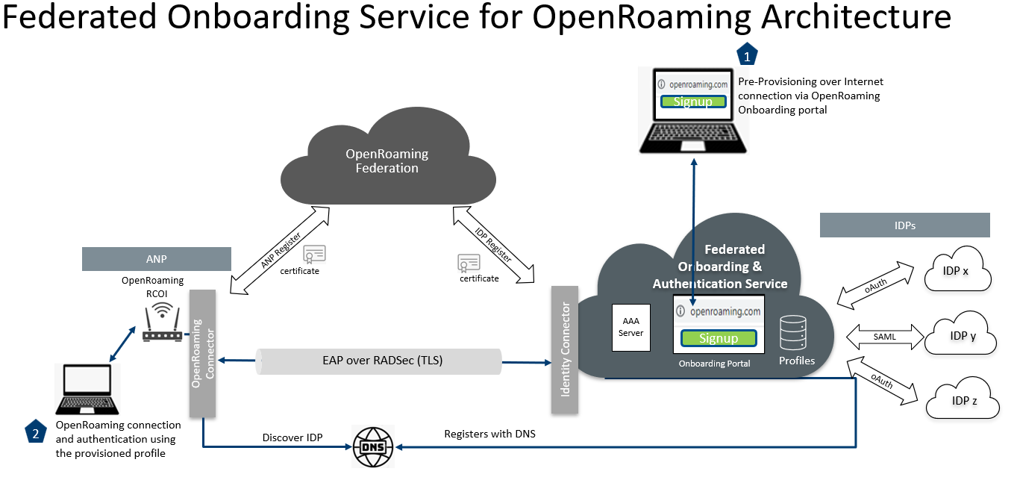

Slide 28
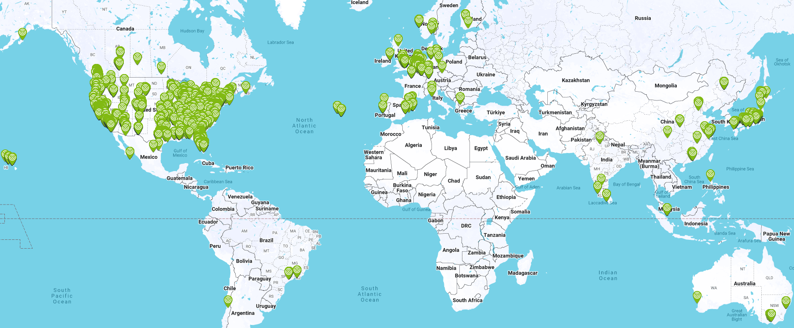
OpenRoaming Deployments Map
https://wballiance.com/openroamingmaps/

Slide 29
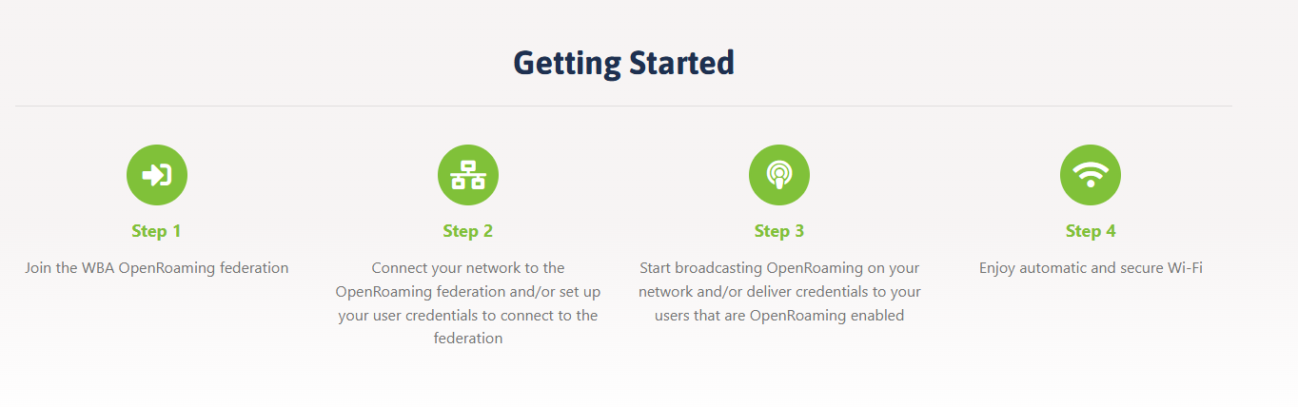
Getting Started with OpenRoaming

Slide 30
Simple, Seamless and Secure public Wi-Fi connectivity with global scale!
No Searching for networks, no sharing passwords, secure, privacy protected and standards based!
Just Connect to “One Global Wi-Fi Network”
Slide 30
Necati Canpolat (Intel)
Notes:
Connect to public Wi-Fi networks seamlessly and securely – globally!
Trains, hotels, cafes, airport, colleges….
No searching for networks
No sharing passwords
No multi steps manual process for registration to get onto network
No open unsecure public Wi-Fi networks - Fully secure – privacy protected
Just connect!
Based on the industry approved standards!
- Passpoint, secure PKI based framework and cloud based federation, identity management for ANPs and IDPs with unique WBAID to guarantee security, OR Privacy policy restricts the usage of personal information

Slide 31
Call to Action
We have the necessary solutions available for the seamless, secure and scalable connections to public Wi-Fi networks
We should put them in use for ““Automotive Connectivity”

Slide 32
References
https://www.cisco.com/annual-internet-report/index.html
Wi-Fi CERTIFIED Passpoint® Deployment Guidelines
https://www.wi-fi.org/file/passpoint-specification-package
Wi-Fi CERTIFIED Passpoint® Technology Overview (2019)
https://wballiance.com/openroaming/
OpenRoaming: One Global Network of Wi-Fi Networks
WBA Wi-Fi Opportunities for Connected Vehicles (2020)
https://www.wballiance.com/wp-content/uploads/2019/05/The-Connected-Vehicle.pdf
https://wballiance.com/federated-onboarding-service-openroaming/
https://wballiance.com/resource/openroaming-for-iot-fido-device-onboarding-framework/
https://wballiance.com//2024/09/WBA-Wi-Fi-Exp-for-Moving-Networks

Slide 33
Thank You!

