Slide 1
Tone Distribution in DRU with Puncturing - Follow up
Date: 2024-11-09
Authors:
Name | Affiliation | Address | Phone | Email
Yan Xin | Huawei Technologies Canada |  |  | yan.xin@huawei.com
Junghoon Suh
Sara Norouzi
Mahmoud Hasabelnaby
Osama Aboul-Magd

Slide 2
Introduction
When one 20 MHz subchannel is unavailable for tone distribution across 20 MHz subchannels in an 80 MHz subblock, it implies that subcarriers can be distributed over a maximum 60 MHz spectrum.
This contribution summarizes the proposal in [1] and proposes a mode for tone distribution in DRU with DRU distribution BW to be 60 MHz, in which only one 20 MHz subchannel with a fixed location is punctured in a 80 MHz subblock.

Slide 3
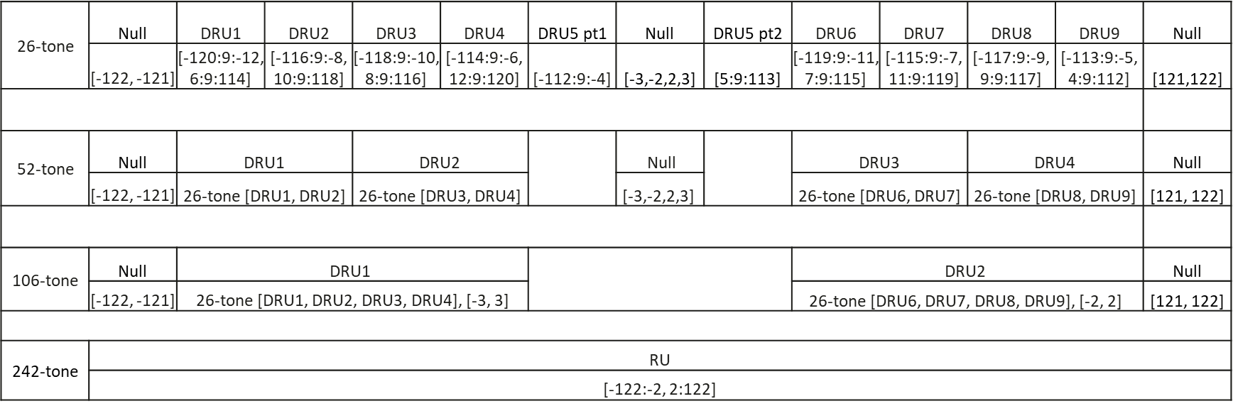
26-, 52- and 106-tone DRU tone indices in a 20 MHz PPDU [2]

Slide 4
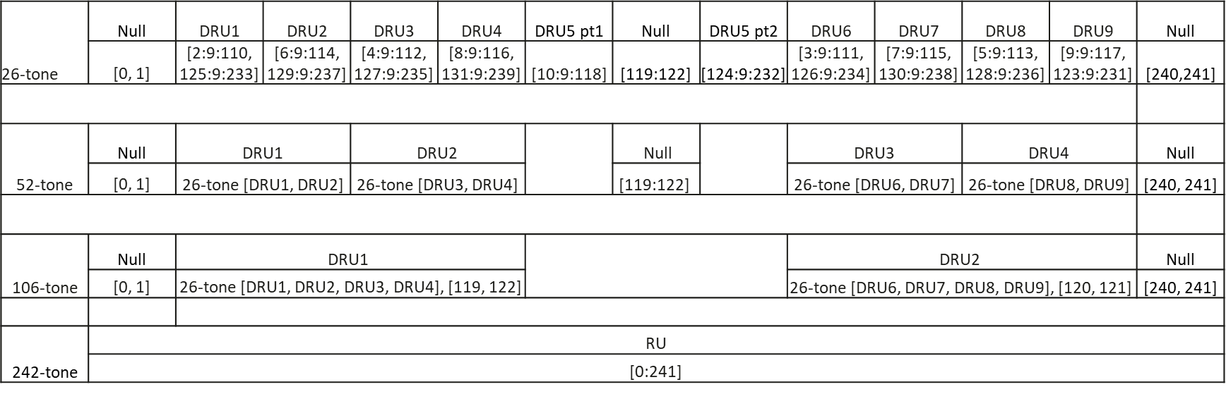
Tone distribution per 20 MHz
Universal one-to-one mappings between 26-, 52- and 106-tone distribution indices and 242-tone indices per 20 MHz, which are derived from DRU tone indices in a 20 MHz PPDU proposed in [2].

Slide 5
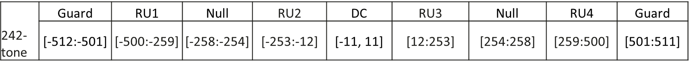
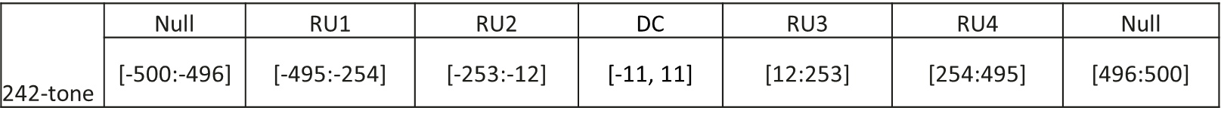
242-tone RU locations in an 80 MHz PPDU
RU locations in an 80 MHz EHT PPDU
Rearrangement of EHT data, pilot and null subcarrier indices of 242-tone RUs in 80 MHz PPDU (23 DC subcarriers located [-11:11] unchanged)
Note: Tone rearrangement is for the design of DRU tone distribution in an intermediate step only. Final DRU tone distributions are based on the locations of RUs, and DC, null and guard tones specified in EHT.

Slide 6
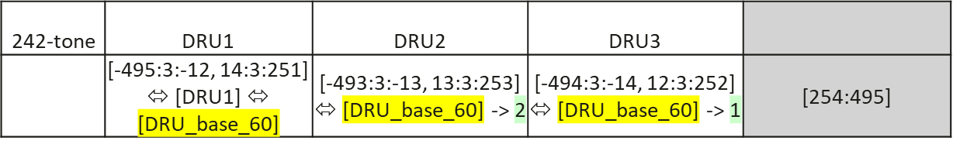
242-tone DRU tone indices with DRU BW 60 MHz in an 80 MHz PPDU
The highest 20 MHz subchannel is unavailable for tone distribution across subchannels
Based on the rearrangement of EHT data, intermediate 242-tone DRU tone indices, idx, with DRU BW 60 MHz are defined as:

Slide 7
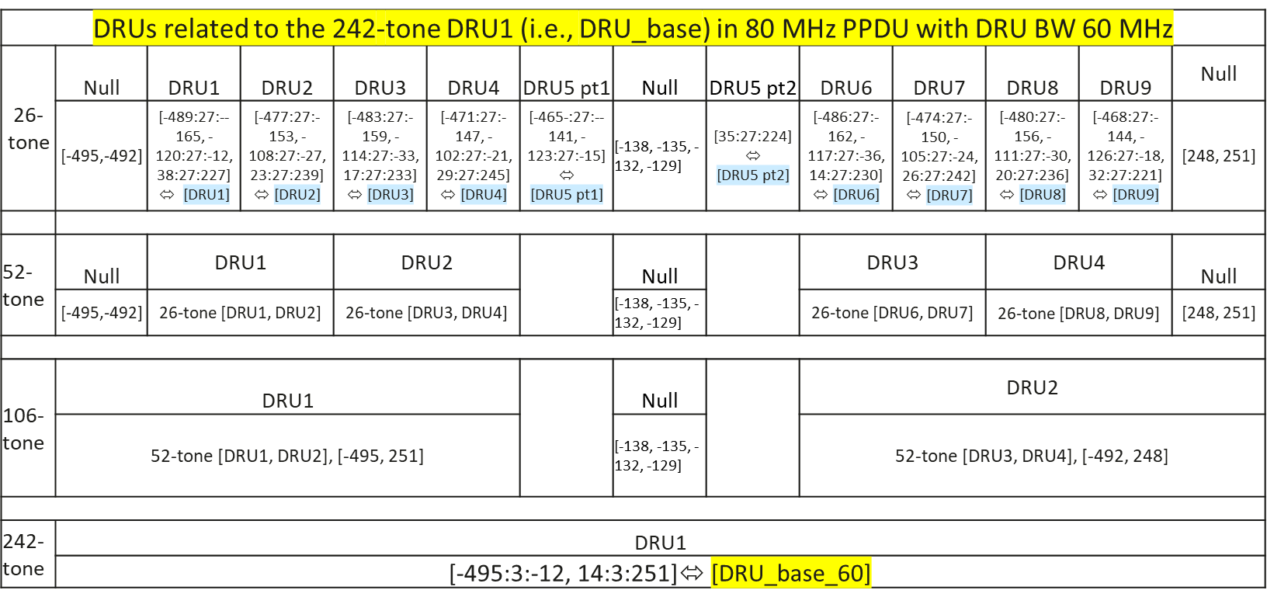
26-, 52-, 106-and 242-tone DRU tone indices in an 80 MHz PPDU with DRU BW 60 MHz
Intermediate 26-, 52- and 106-tone DRU tone indices, idx, corresponding to 242-tone DRU1

Slide 8
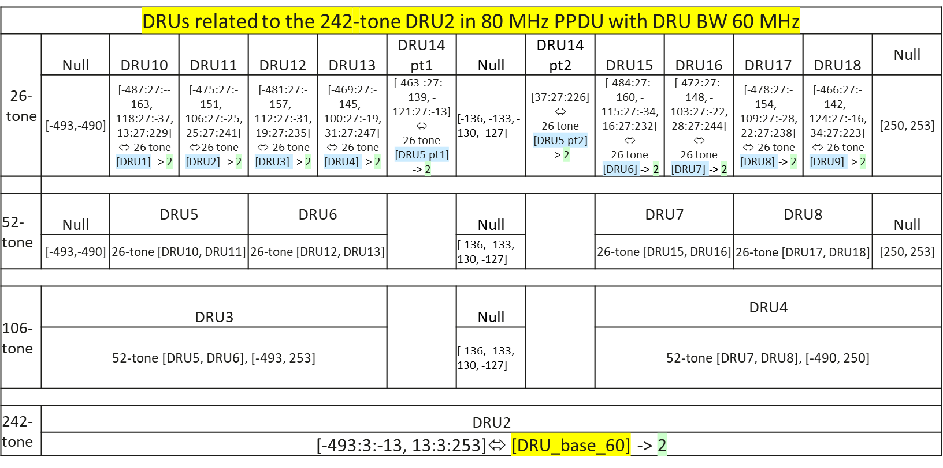
26-, 52-, 106-and 242-tone DRU tone indices in an 80 MHz PPDU with DRU BW 60 MHz
Intermediate 26-, 52- and 106-tone DRU tone indices, idx, corresponding to 242-tone DRU2

Slide 9

26-, 52-, 106-and 242-tone DRU tone indices in an 80 MHz PPDU with DRU BW 60 MHz
Intermediate 26-, 52- and 106-tone DRU tone indices, idx, corresponding to 242-tone DRU3

Slide 10
26-, 52-, 106-and 242-tone DRU tone indices in an 80 MHz PPDU with DRU BW 60 MHz
26-, 52-, 106- and 242-tone DRU tone indices, IDX, to be allocated based on 80 MHz EHT PPDU RU allocation
- 26-, 52-, 106- and 242-tone DRU tone indices, IDX, with DRU BW 60 MHz can be derived from the intermediate 242-tone DRU indices, idx, by shifting those tone indices as follows based on the EHT tone plan specified in an 80 MHz EHT PPDU.
if idx ≤ -254,
IDX = idx <- 5
else if -254 < idx < 254,
IDX = idx

Slide 11
Summary
This contribution further proposes a mode of tone distribution in DRU with distribution BW of 60 MHz, in which only the highest 20 MHz subchannel is punctured in a 80 MHz subblock.

Slide 12
References
[1] 802.11-24-1541r0, Tone distribution in DRU - follow up, September 2024.
[2] 802.11-24/0468r2, DRU tone plan for 11bn, May 2024.

Slide 13
Straw Poll
Do you support to define the DRU distribution bandwidth of 60 MHz in an 80 MHz frequency subblock (with the highest 20 MHz subchannel unallocated) in a UHR TB PPDU?
No allocation is made in the highest 20 MHz subchannel
Yes
No
Abstain

