Slide 1
Wireless Broadband Alliance (WBA) Liaison Report – November 2024
Date: 2024-11-13
Authors:
Name | Company | Address | Phone | Email
Necati Canpolat | Intel |  |  | necati.canpolat@intel.com

Slide 2
Wireless Broadband Alliance (WBA)
Drives enabling seamless & interoperable Wi-Fi services
Addresses business and technical issues, as well as opportunities in the industry
IEEE 802.11 (std dev) WFA (cert) WBA (enablement)

Slide 3
Wireless Global Congress & Members Meeting
WBA has three events per year
The last event was on October 7-10 in Paris co-located with Network X
https://www.wirelessglobalcongress.com/2024-Post-Event-Report
The presentations will be made public in December 2024

Slide 4
WBA Annual Industry Report 2024
Producing the Annual Wireless Industry Report
It will be publicly available in December 2024

Slide 5
TECHNICAL ACTIVITIES ROADMAP FOR 2024 WBA WORK GROUPS & PROJECTS
5G
Work Group
IoT
Work Group
NextGen
Work Group
Roaming
Work Group
OpenRoaming
Work Group
Testing & Interop
Work Group
Private & 5G Wi-Fi Convergence
IoT & Smart Home
Wi-Fi 7
RADIUS Accounting Assurance
Federated Onboarding Service for OpenRoaming
Access Network Metrics
Mission Critical & Emergency Services
Wi-Fi HaLow for IoT Applications
Wi-Fi Experience for Moving Networks
Wi-Fi Security Guidelines
OpenRoaming for Private LTE/5G
E2E Wi-Fi QoS & L4S
Enterprise Security for Private 5G Networks
Wi-Fi Sensing
Operator Managed Wi-Fi
OpenRoaming for IoT & FIDO Device Onboarding
Wi-Fi User & Device Identification
AIML for Wi-Fi
WBA Tools & Testing Platforms
Policy & Regulatory Affairs
Work Group
Market
Work Group
OpenRoaming Certification
Innovation Forum
- Led by CTO Group
Connected
Communities Forum
Enterprise Connectivity Forum
https://wballiance.com/wba-program-overview-2024/
https://wballiancec.com/proejcts-details
See the updates in the following slides

Slide 6
Wi-Fi 7 Field Trials
Ongoing with several operators covering different deployments and geographies.
The trial results will be made public in December 2024

Slide 7
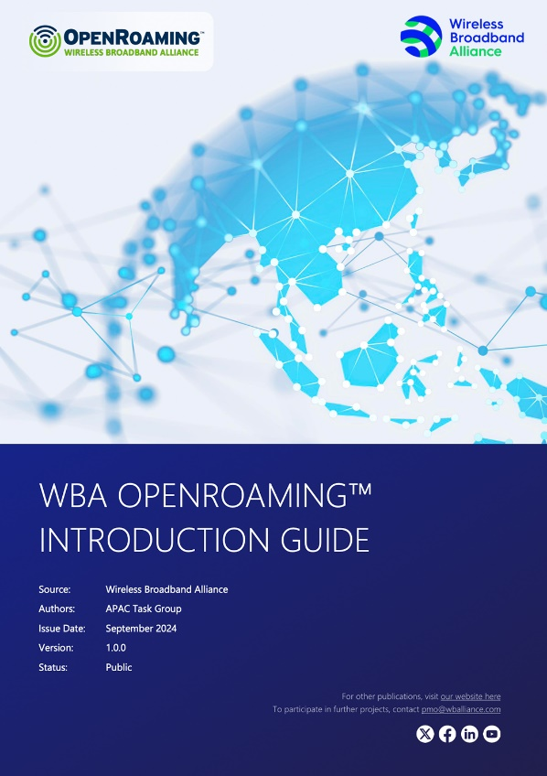
WBA OpenRoaming Introduction Guide
Published the WBA OpenRoaming™ Introduction Guide
OpenRoaming simplifies connectivity for users, enhancing user experiences while maintaining robust security standards.
Covers the technicalities, benefits, and strategic implementation of OpenRoaming to revolutionize public, guest, and enterprise Wi-Fi networks.
https://wballiance.com/wp-content/uploads/2024/10/WBA-OpenRoaming-Guide-APAC-TG_v1.0.0-FINALPublic.pdf

Slide 8
WBA Access Network Metrics – Phase 1
Addresses the challenges present in current Wi-Fi networks, reaffirms the value of explicit QoE evidence, and demonstrates the advantages for users and providers.
Specifies essential metrics and introduces a framework for assessing and sharing Wi-Fi network quality, aiming to foster a more dependable and efficient Wi-Fi future.
The working group is now embarking on Phase 2, focusing on industry alignment.
https://wballiance.com/wp-content/uploads/2024/08/Access-Network-Metrics-Whitepaper-Outline-v1.0.0-Public.pdf

Slide 9
Zero Touch Onboarding of IoT Devices
New framework to enable a ‘zero-touch’ onboarding process for Internet of Things (IoT) Wi-Fi devices
Integrates the simplicity and security of WBA OpenRoaming with FIDO Device Onboard
Ensures device security through ownership vouchers and cryptographic mechanisms
Details how these technologies work together to simplify and secure the onboarding process for IoT devices.
https://wballiance.com/openroaming-for-iot-fido-device-onboard-framework/
Download

Slide 10
Wi-Fi Experience for Moving Networks
Highlights solutions for seamless connectivity in moving networks like trains, ships, airplanes, public buses etc.
Details how today’s Wi-Fi standards can be used to enhance commutes, travel & daily errands with reliable & secure Wi-Fi networks covering:
Challenges in Moving Networks
Innovative Solutions
Practical Use Cases
Industry Benefits
https://wballiance.com/wi-fi-experience-for-moving-network/
Download

Slide 11
Further information
WBA information at https://wballiance.com/
Current work areas https://wballiance.com/wba-program-overview-2024/
WBA resource center https://wballiance.com/resource/
WBA events https://wballiance.com/events-awards/
WBA memberships: https://wballiance.com/membership/

Slide 12
Backup

Slide 13
WBA ORGANIZATION
WBA IS A NONPROFIT ASSOCIATION WITH THE VISION TO ACCELERATE THE DEVELOPMENT OF
“SEAMLESS AND INTEROPERABLE WI-FI SERVICES”
Seamless, Secure and Interoperable Wi-Fi
Convergence and Coexistence of Wireless Technologies
Accelerate Next Generation Wi-Fi Networks
Established
in 2003
+200 MEMBERSHIP
COMMUNITY
PROJECTS &
PROGRAMS
3 ANNUAL
EVENTS
PROMOTION AND
GO-TO-MARKET
THOUGHT LEADERSHIP &
MARKET RESEARCH

Slide 14
WBA Focus Areas
WBA MEMBERS SOLVE
REAL BUSINESS ISSUES
Fosters success for its members
WBA’s mission is to enable collaboration between service providers, technology companies and organizations to drive positive change and enable opportunities for growth.
Standards & Specifications - Setting the scene, requirements and creating specifications
Testing & Interoperability - Creating test plans to showcase the technology capabilities
End-to-End Trials - Running field trials/ proof of concept on real-world environment
Guidelines & Best Practices – Accelerate deployments of services and technologies
Certification & Plug Fests - Addressing gaps and helping the industry to maximizing biz opportunities
Think Thank & Advocacy – Industry leaders roundtables and targeted verticals analysis

